Slide 1

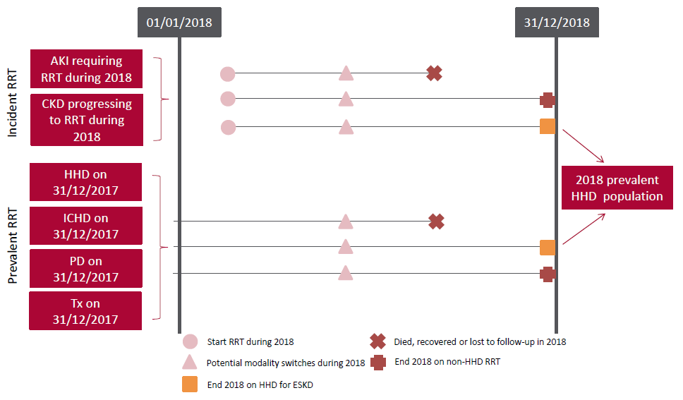
UK Renal Registry 22nd Annual Report
Data to 31/12/2018
Figure 6.1 Pathways adult patients could follow to be included in the UK 2018 prevalent HHD population
Note that patients receiving dialysis for acute kidney injury (AKI) are only included in this chapter if they had a timeline or RRT modality code for chronic HHD
at the end of 2018 or if they had been on RRT for ≥90 days and were on HHD at the end of 2018
CKD – chronic kidney disease

Slide 2
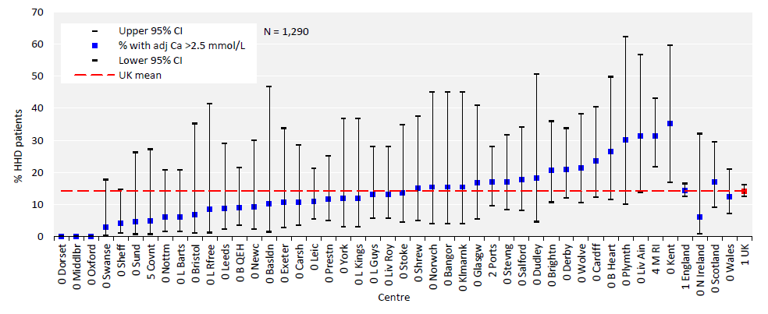
UK Renal Registry 22nd Annual Report
Data to 31/12/2018
Figure 6.2 Percentage of adult patients prevalent to HHD on 31/12/2018 with adjusted calcium (Ca) above the target range (>2.5 mmol/L) by centre
CI – confidence interval

Slide 3
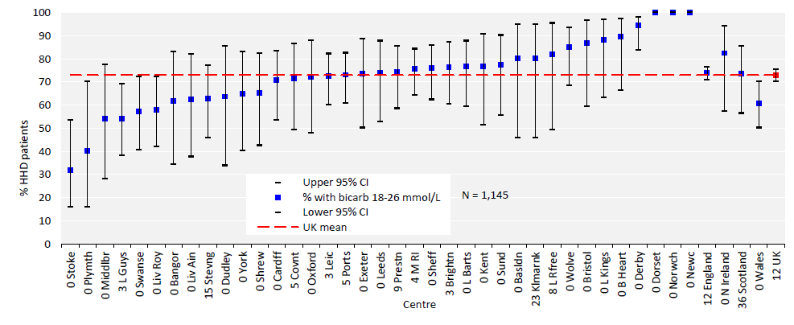
UK Renal Registry 22nd Annual Report
Data to 31/12/2018
Figure 6.3 Percentage of adult patients prevalent to HHD on 31/12/2018 with pre-dialysis bicarbonate (bicarb) within the
target range (18–26 mmol/L) by centre
CI – confidence interval

Slide 4
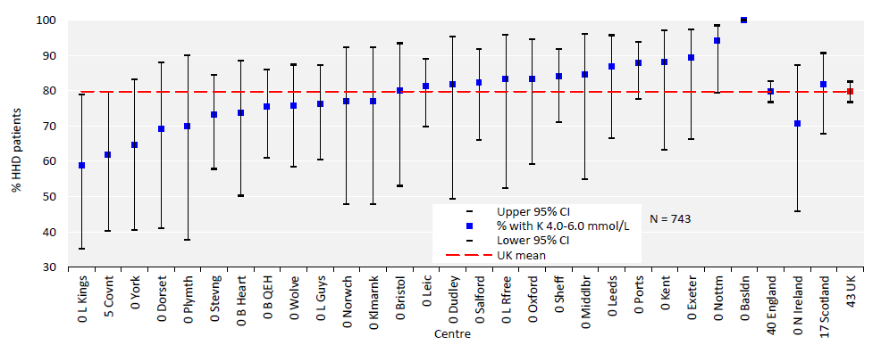
UK Renal Registry 22nd Annual Report
Data to 31/12/2018
Figure 6.4 Percentage of adult patients prevalent to HHD on 31/12/2018 with pre-dialysis potassium (K) within the target range
(4.0–6.0 mmol/L) by centre
CI – confidence interval

Slide 5
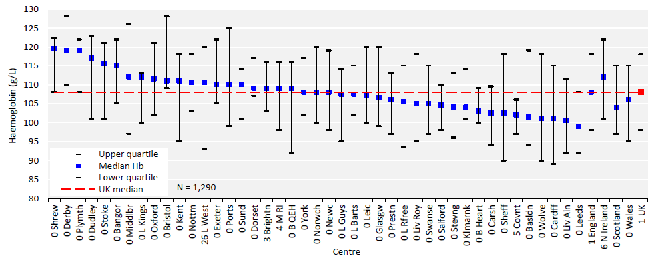
UK Renal Registry 22nd Annual Report
Data to 31/12/2018
Figure 6.5 Median haemoglobin (Hb) in adult patients prevalent to HHD on 31/12/2018 by centre

Slide 6
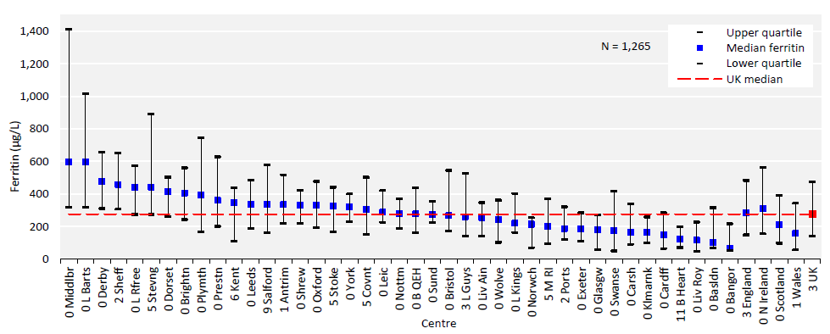
UK Renal Registry 22nd Annual Report
Data to 31/12/2018
Figure 6.6 Median ferritin in adult patients prevalent to HHD on 31/12/2018 by centre

Slide 7
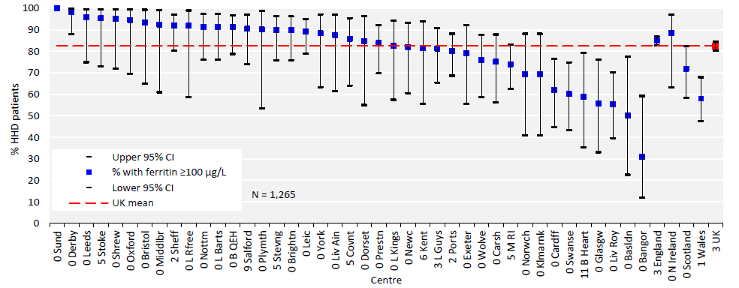
UK Renal Registry 22nd Annual Report
Data to 31/12/2018
Figure 6.7 Percentage of adult patients prevalent to HHD on 31/12/2018 with ferritin ≥100 μg/L by centre
CI – confidence interval

Slide 8
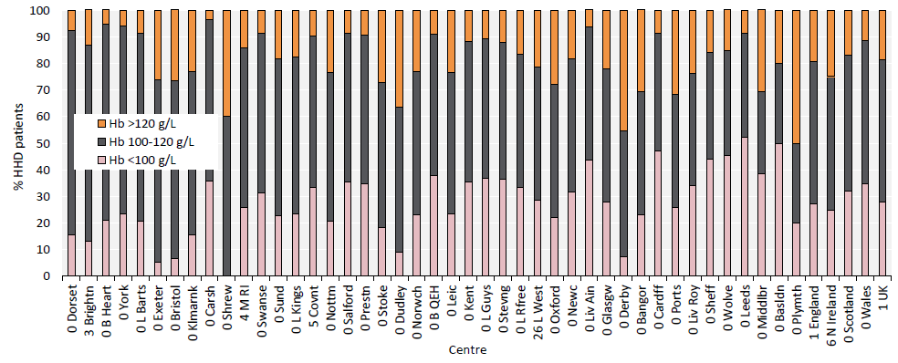
UK Renal Registry 22nd Annual Report
Data to 31/12/2018
Figure 6.8 Distribution of haemoglobin (Hb) in adult patients prevalent to HHD on 31/12/2018 by centre

Slide 9
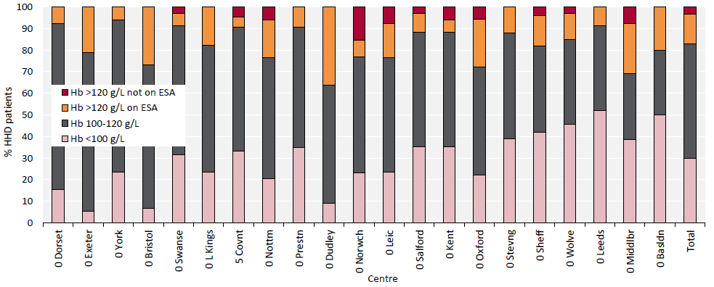
UK Renal Registry 22nd Annual Report
Data to 31/12/2018
Figure 6.9 Distribution of haemoglobin (Hb) in adult patients prevalent to HHD on 31/12/2018 and the proportion with
haemoglobin >120 g/L receiving erythropoiesis stimulating agent (ESA) by centre
Figure (including total) does not include centres with <70% data completeness (or <70% ESA use).

Slide 10
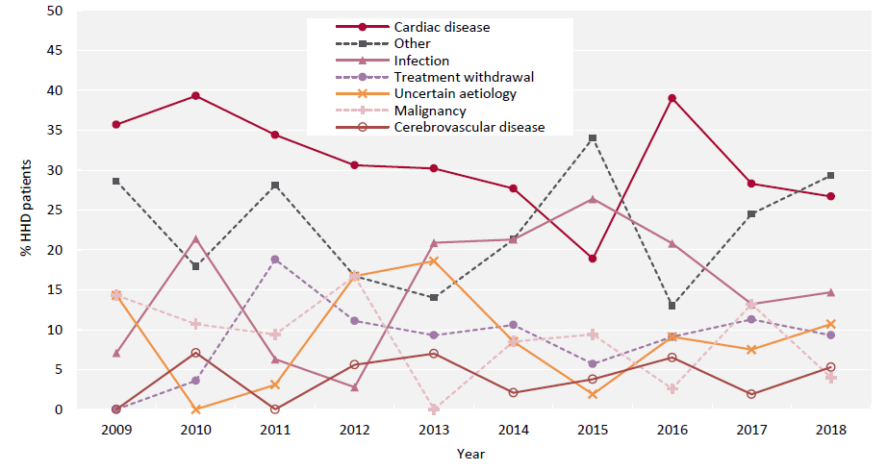
UK Renal Registry 22nd Annual Report
Data to 31/12/2018
Figure 6.10 Cause of death between 2009 and 2018 for adult patients prevalent to HHD at the beginning of the year

