Slide 1

UK Renal Registry 22nd Annual Report
Data to 31/12/2018
RRT initiation during 2018
Day 90
Dialysis for AKI
Patient A
Patient B
2018 incident RRT population
Patient C
Dialysis or pre-emptive Tx for ESKD
Patient D
Patient E
Acute dialysis code
Acute dialysis
Code indicating ESKD
RRT for ESKD
Died, withdrew or lost to follow-up in 2018
Figure 1.1 Example histories for patients starting RRT, illustrating the use of timeline codes to define dialysis as being ‘acute’ or for ESKD
Note that patients who recovered renal function before 90 days on dialysis are not included in this chapter, whether they were coded as AKI or ESKD.
Note that patients who followed patterns B–E received RRT for ESKD and are counted as ‘incident to RRT’ throughout this report.
Patients who followed pattern A are not counted as ‘incident to RRT’ and do not feature in this chapter.

Slide 2
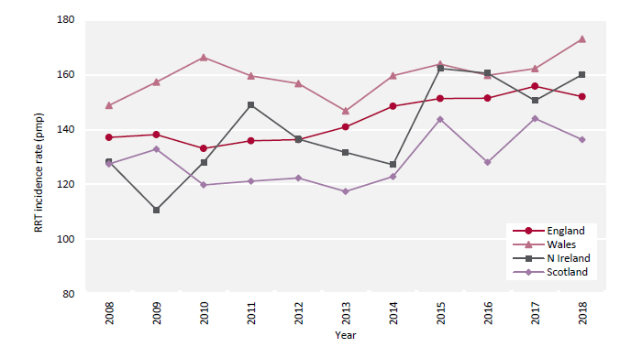
UK Renal Registry 22nd Annual Report
Data to 31/12/2018
Figure 1.2 Adult RRT incidence rates by country between 2008 and 2018
Country was determined by patient postcode. Rates appear higher than in previous reports, because from this year those <18 years were excluded from
estimated populations.
pmp – per million population

Slide 3
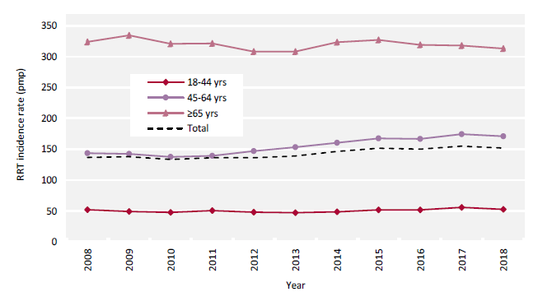
UK Renal Registry 22nd Annual Report
Data to 31/12/2018
Figure 1.3 Adult RRT incidence rates by age group between 2008 and 2018
pmp – per million population

Slide 4
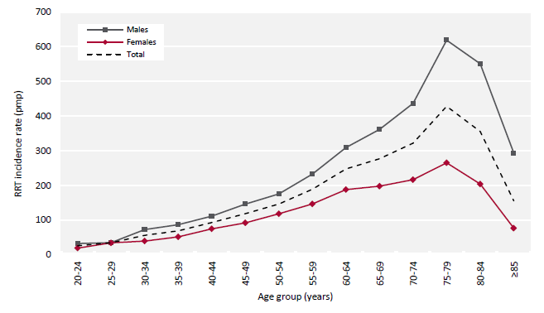
UK Renal Registry 22nd Annual Report
Data to 31/12/2018
Figure 1.4 Incidence rates for adult patients starting RRT in 2018 by age group and sex
pmp – per million population

Slide 5
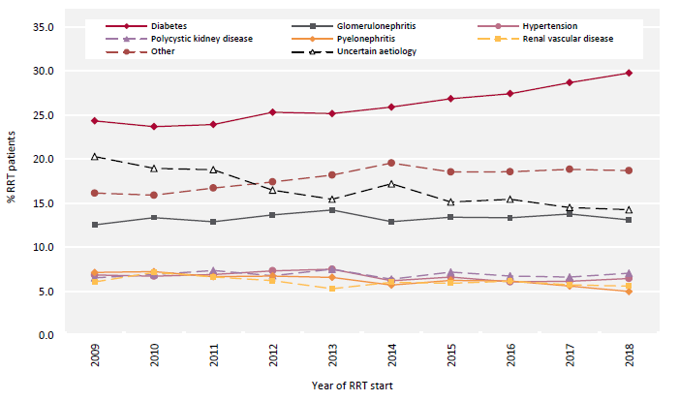
UK Renal Registry 22nd Annual Report
Data to 31/12/2018
Figure 1.5 Change in primary renal disease (PRD) of adult patients incident to RRT from 2009 to 2018

Slide 6
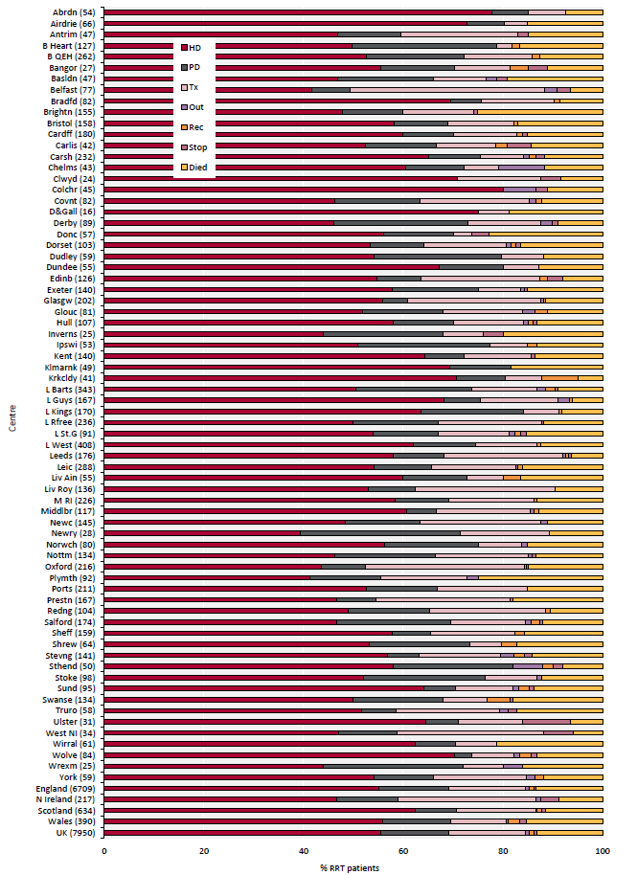
UK Renal Registry 22nd Annual Report
Data to 31/12/2018
Figure 1.6 RRT modality at 1 year for incident adult RRT patients who started RRT in 2017 by centre
Number of patients in a centre in brackets.
Out – moved out of a centre but did not reappear in another centre; Rec – recovered kidney function; Stop – treatment withdrawal

Slide 7
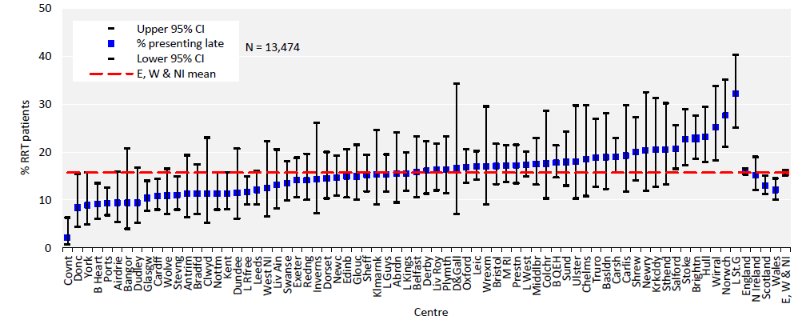
UK Renal Registry 22nd Annual Report
Data to 31/12/2018
Figure 1.7 Percentage of incident adult RRT patients presenting late (<90 days) to a nephrologist (2017–2018 2 year cohort)
Scottish data on referral were not used to calculate the UK mean because of a different definition (see appendix A).
CI – confidence interval

Slide 8
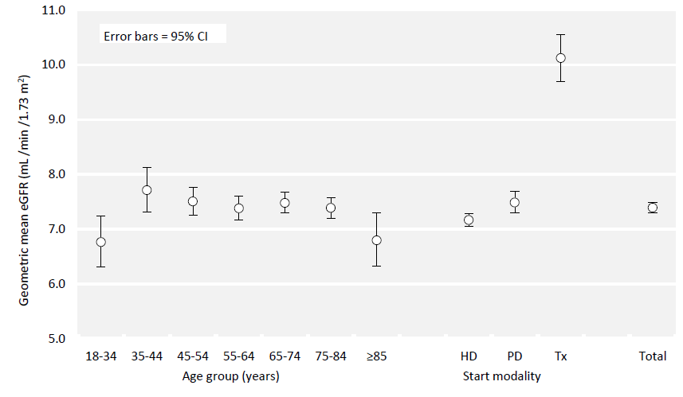
UK Renal Registry 22nd Annual Report
Data to 31/12/2018
Figure 1.8 Geometric mean estimated glomerular filtration rates (eGFR) for adult patients incident to RRT in 2018 by age group
and start modality
CI – confidence interval

Slide 9
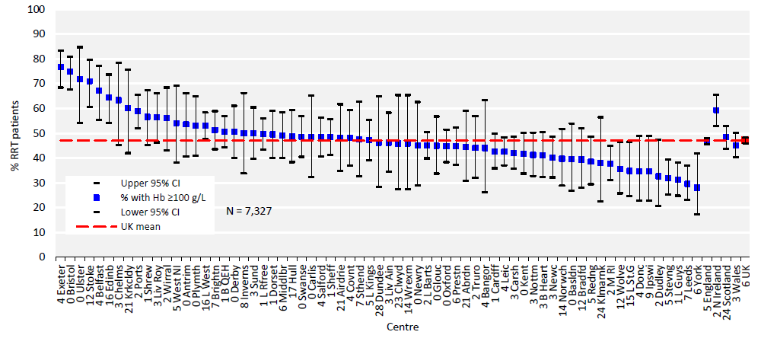
UK Renal Registry 22nd Annual Report
Data to 31/12/2018
Figure 1.9 Percentage of adult patients incident to RRT in 2018 with haemoglobin (Hb) ≥100 g/L at start of RRT treatment
by centre.
CI – confidence interval

Slide 10
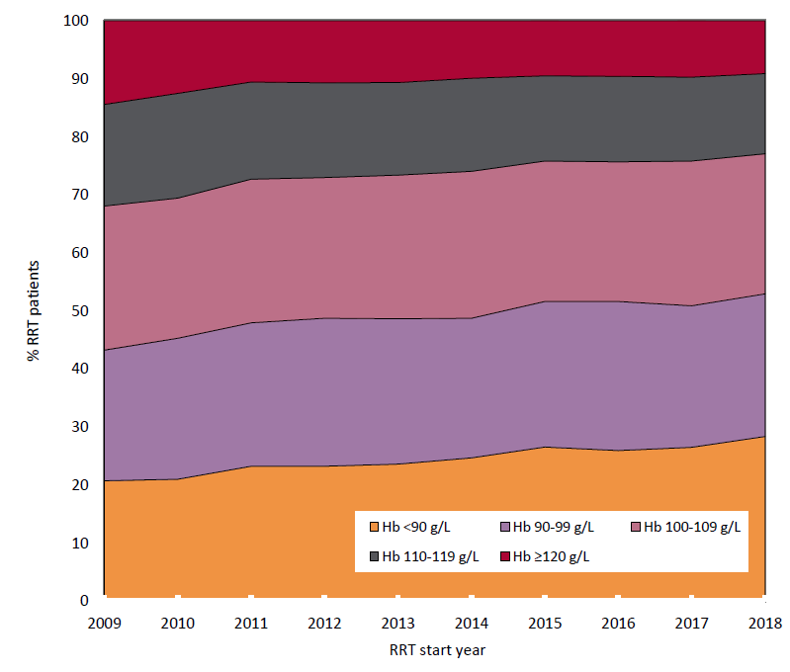
UK Renal Registry 22nd Annual Report
Data to 31/12/2018
Figure 1.10 Distribution of haemoglobin (Hb) in incident adult RRT patients by year of start between 2009 and 2018

Slide 11
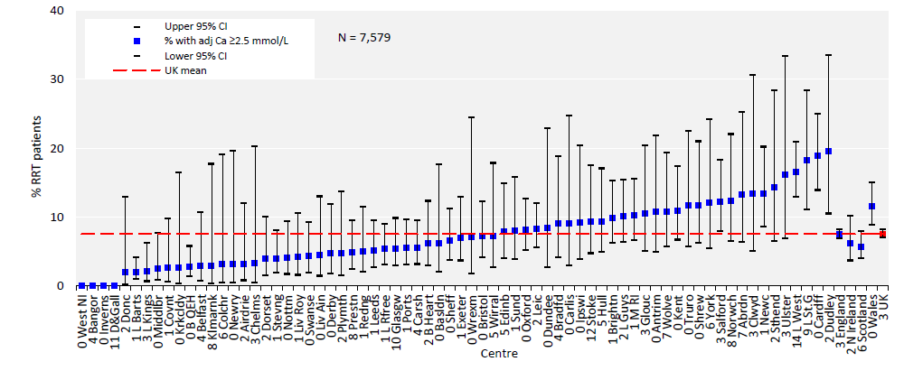
UK Renal Registry 22nd Annual Report
Data to 31/12/2018
Figure 1.11 Percentage of adult patients incident to RRT in 2018 with adjusted calcium (Ca) above the normal range (>2.5
mmol/L) by centre
CI – confidence interval

Slide 12
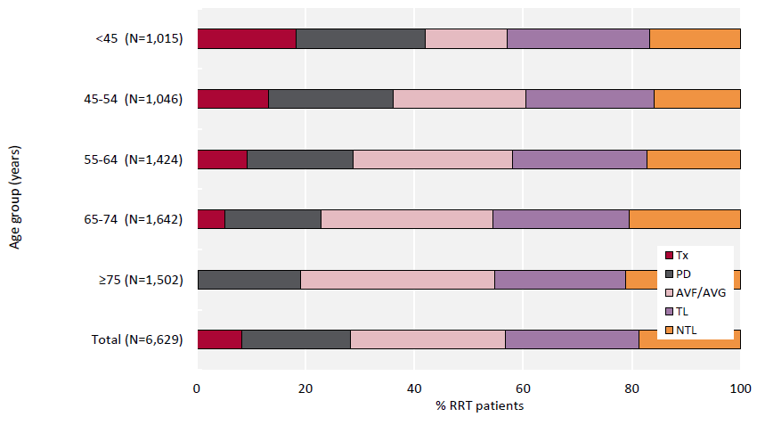
UK Renal Registry 22nd Annual Report
Data to 31/12/2018
Figure 1.12 Dialysis access used for adult patients incident to RRT in 2018 by age group (2018 Multisite Dialysis Access
Audit)
AVF – arteriovenous fistula; AVG – arteriovenous graft; NTL – non-tunnelled line; TL – tunnelled line

Slide 13
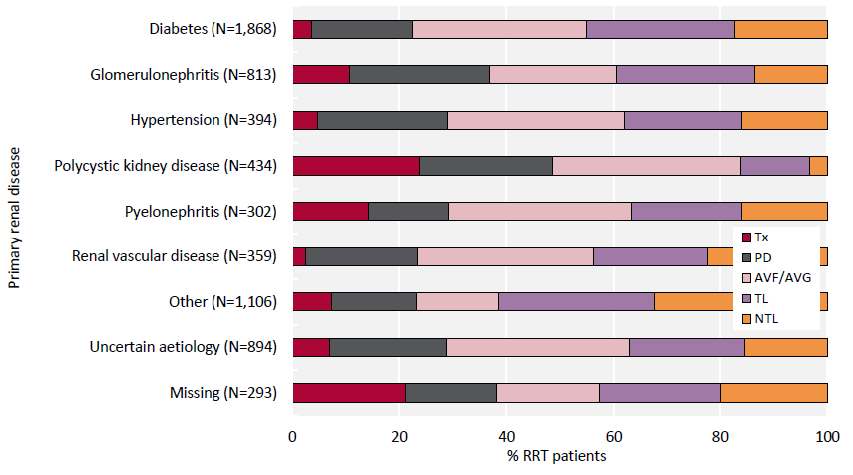
UK Renal Registry 22nd Annual Report
Data to 31/12/2018
Figure 1.13 Dialysis access used for adult patients incident to RRT in 2018 by primary renal disease (2018 Multisite
Dialysis Access Audit)
AVF – arteriovenous fistula; AVG – arteriovenous graft; NTL – non-tunnelled line; TL – tunnelled line

Slide 14
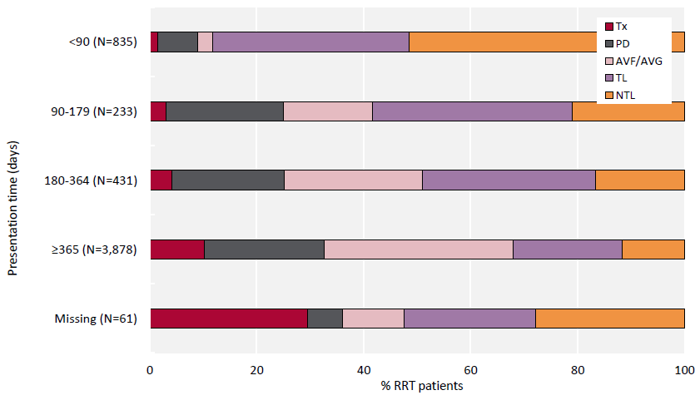
UK Renal Registry 22nd Annual Report
Data to 31/12/2018
Figure 1.14 Dialysis access used for adult patients incident to RRT in 2018 by presentation time (2018 Multisite Dialysis
Access Audit)
AVF – arteriovenous fistula; AVG – arteriovenous graft; NTL – non-tunnelled line; TL – tunnelled line

Slide 15
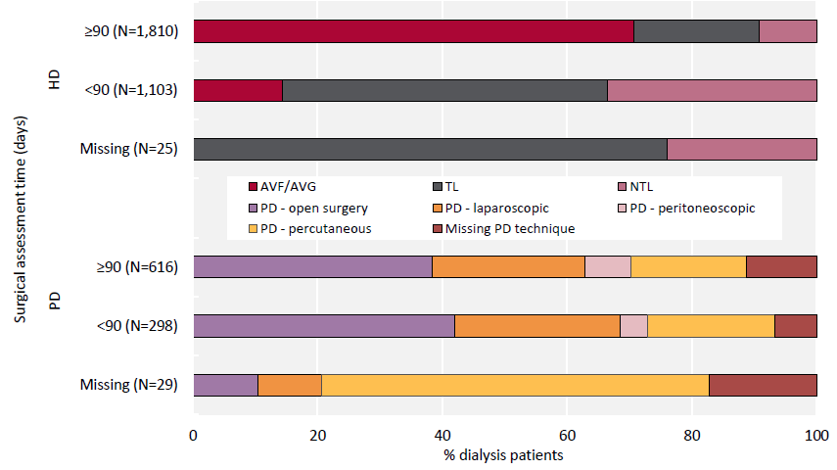
UK Renal Registry 22nd Annual Report
Data to 31/12/2018
Figure 1.15 Dialysis access used for adult patients incident to dialysis in 2018 by surgical assessment time (2018 Multisite
Dialysis Access Audit)
AVF – arteriovenous fistula; AVG – arteriovenous graft; NTL – non-tunnelled line; TL – tunnelled line

Slide 16
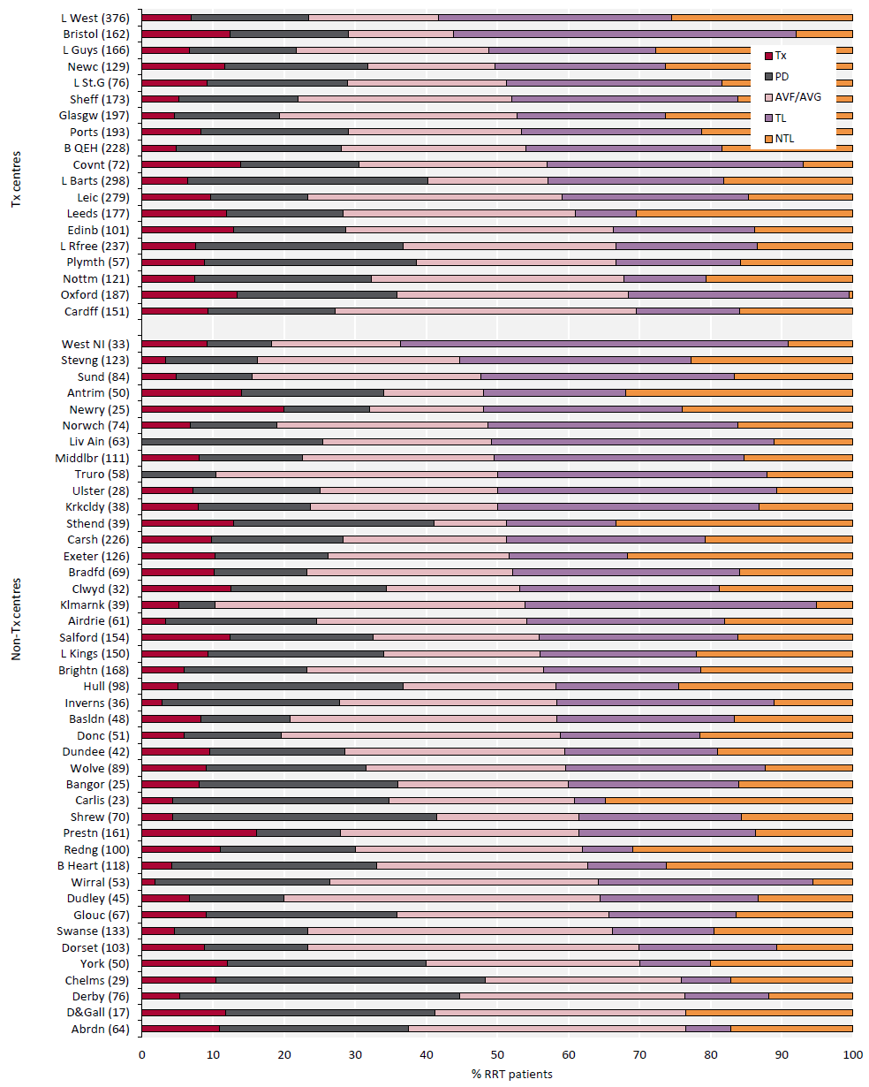
UK Renal Registry 22nd Annual Report
Data to 31/12/2018
Figure 1.16 First dialysis access used for adult patients incident to RRT in 2018 by centre (2018 Multisite Dialysis Access Audit)
Number of incident patients on RRT in a centre in brackets (centres with <70% access data for the incident RRT population were
excluded). Centres are ordered by decreasing use of lines.
AVF – arteriovenous fistula; AVG – arteriovenous graft; NTL – non-tunnelled line; TL – tunnelled line

Slide 17
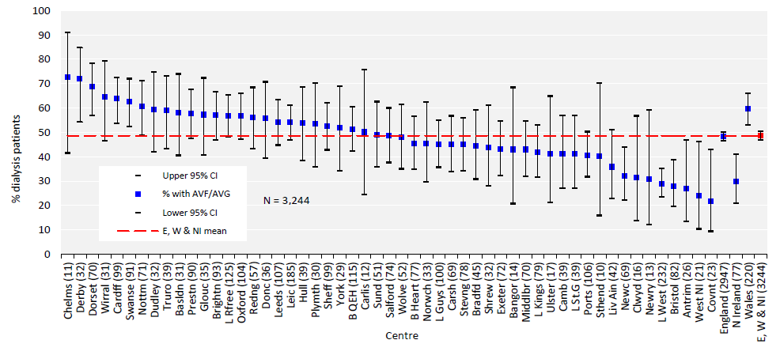
UK Renal Registry 22nd Annual Report
Data to 31/12/2018
Figure 1.17 Percentage of adult patients incident to dialysis in 2018 who started dialysis using either an arteriovenous fistula (AVF)
or an arteriovenous graft (AVG) by centre (2018 Multisite Dialysis Access Audit)
Numbers in brackets represent the number of patients with data in each centre rather than missing data.
CI – confidence interval

Slide 18
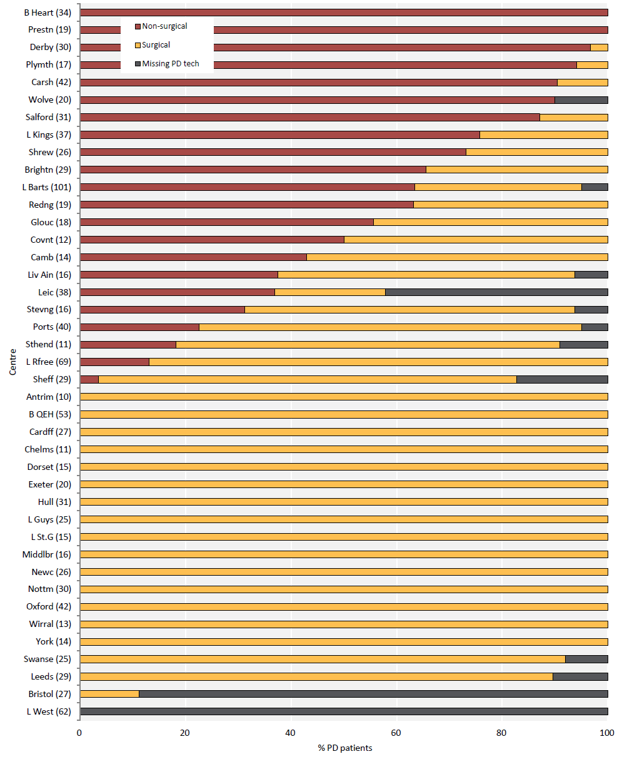
UK Renal Registry 22nd Annual Report
Data to 31/12/2018
Figure 1.18 PD catheter insertion technique for adult patients incident to PD in 2018 by centre (2018 Multisite Dialysis Access Audit)
Centres with <10 incident PD patients were excluded. Number of incident patients on PD in a centre in brackets.
Centres are ordered by decreasing use of non-surgical PD insertion technique.

Slide 19
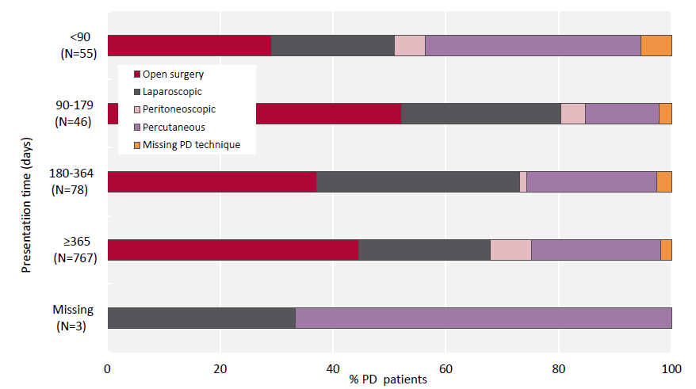
UK Renal Registry 22nd Annual Report
Data to 31/12/2018
Figure 1.19 PD catheter insertion technique for adult patients incident to PD in 2018 by presentation time
(2018 Multisite Dialysis Access Audit)

Slide 20
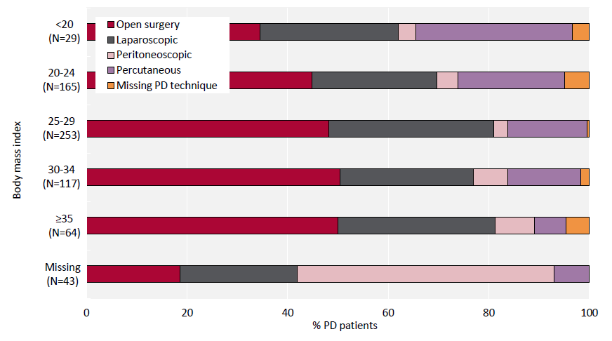
UK Renal Registry 22nd Annual Report
Data to 31/12/2018
Figure 1.20 PD catheter insertion technique for adult patients incident to PD in 2018 by body mass index
(2018 Multisite Dialysis Access Audit)

Slide 21
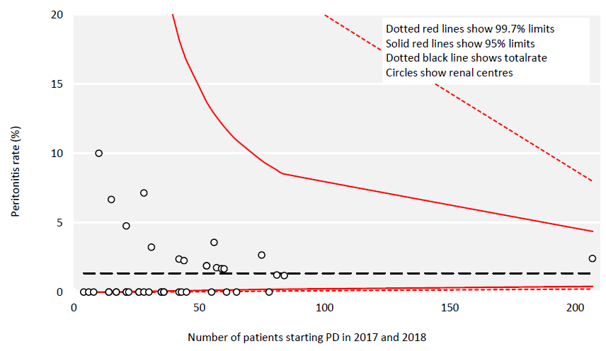
UK Renal Registry 22nd Annual Report
Data to 31/12/2018
Figure 1.21 Peritonitis within 2 weeks of catheter insertion for adult patients incident to PD in 2017 and 2018 (2017 and 2018
Multisite Dialysis Access Audits)

Slide 22
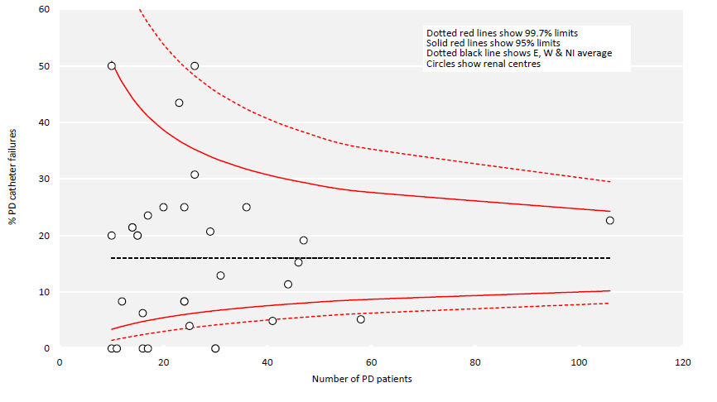
UK Renal Registry 22nd Annual Report
Data to 31/12/2018
Figure 1.22 Percentage of PD catheter failures within 1 year of first ever PD session for adult patients incident to PD in 2017
(2018 Multisite Dialysis Access Audit)
Centres with follow-up data for <10 PD patients were excluded.

Slide 23
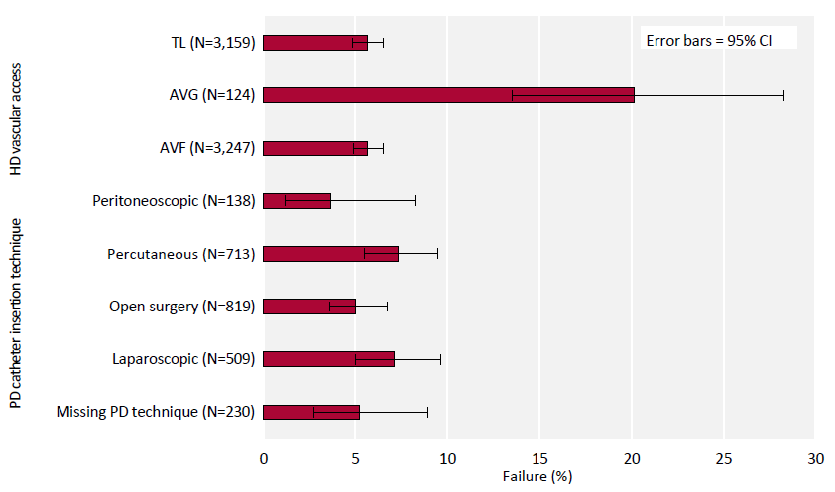
UK Renal Registry 22nd Annual Report
Data to 31/12/2018
Figure 1.23 Percentage of incident adult dialysis patients experiencing failure of first access within 3 months by type of first access
(2017 and 2018 Multisite Dialysis Access Audits)
AVF – arteriovenous fistula; AVG – arteriovenous graft; CI – confidence interval; TL – tunnelled line

Slide 24
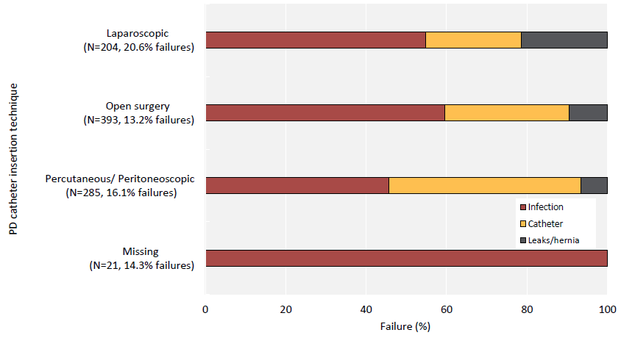
UK Renal Registry 22nd Annual Report
Data to 31/12/2018
Figure 1.24 Cause of PD catheter access failure within 1 year of first ever PD session for adult patients incident to PD in 2017
(2018 Multisite Dialysis Access Audit)

Slide 25
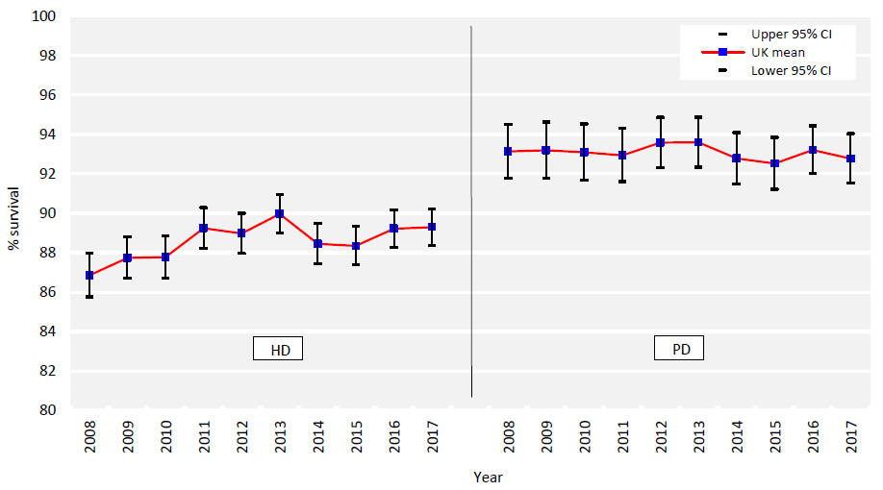
UK Renal Registry 22nd Annual Report
Data to 31/12/2018
Figure 1.25 1 year after 90 days survival (adjusted to age 60 years) of incident adult RRT patients by start modality between
2008 and 2017
CI – confidence interval

Slide 26
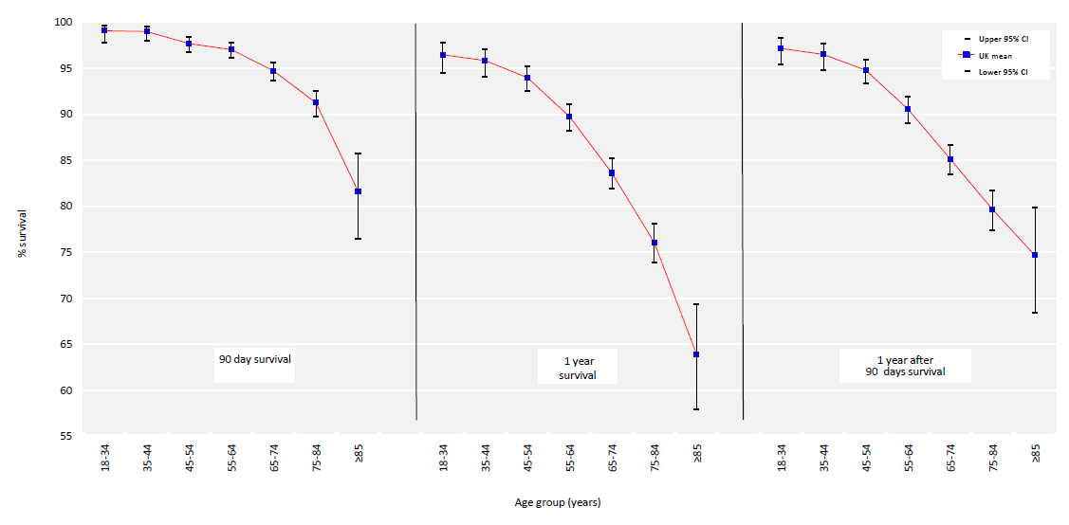
UK Renal Registry 22nd Annual Report
Data to 31/12/2018
Figure 1.26 90 days, 1 year and 1 year after 90 days survival of incident adult RRT patients by age group (2017 cohort)
CI – confidence interval

Slide 27
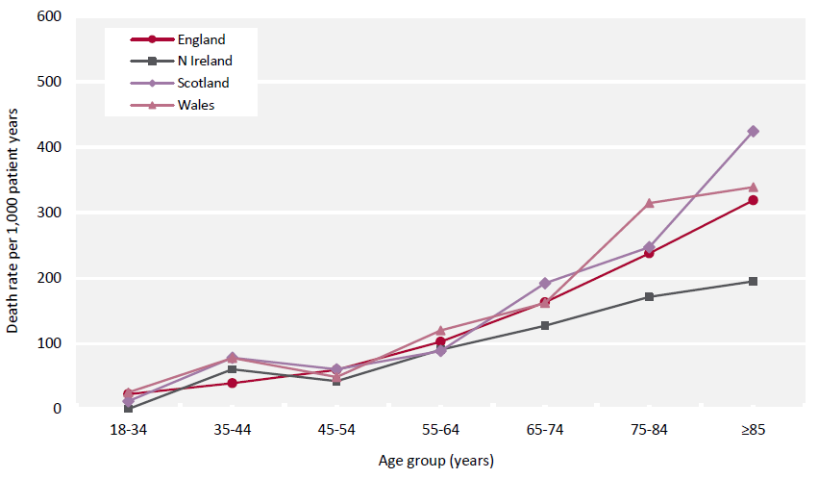
UK Renal Registry 22nd Annual Report
Data to 31/12/2018
Figure 1.27 1 year after 90 days death rate per 1,000 incident RRT adult patient years by age group and country
(2014– 2017 4 year cohort)

Slide 28
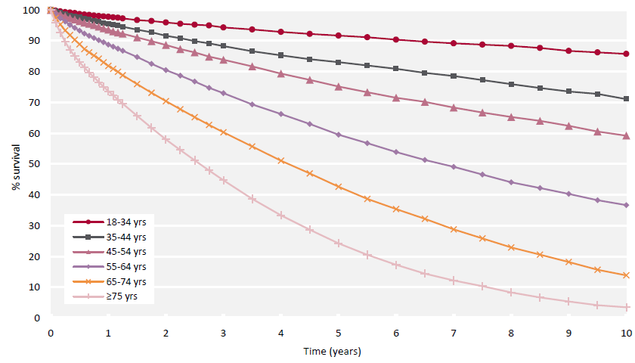
UK Renal Registry 22nd Annual Report
Data to 31/12/2018
Figure 1.28 Survival (unadjusted) of incident adult RRT patients from day 0 by age group (2008–2017 10 year cohort)

Slide 29
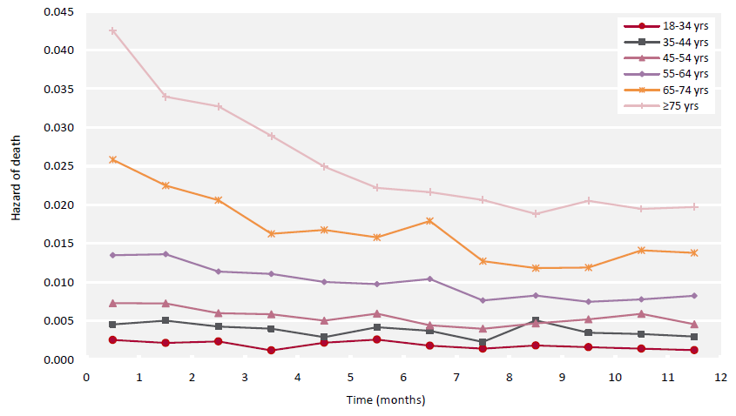
UK Renal Registry 22nd Annual Report
Data to 31/12/2018
Figure 1.29 Monthly hazard of death (unadjusted) of incident adult RRT patients from day 0 to 1 year by age group
(2008– 2017 10 year cohort)

Slide 30
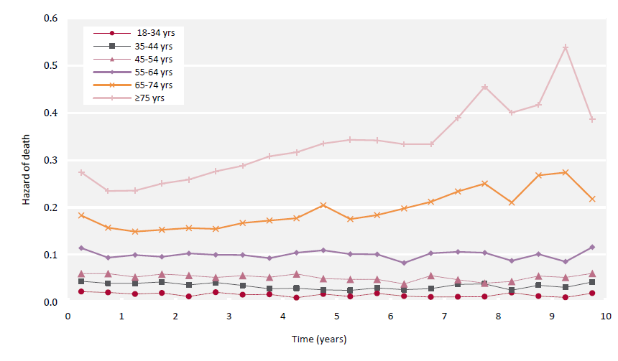
UK Renal Registry 22nd Annual Report
Data to 31/12/2018
Figure 1.30 6 monthly hazard of death (unadjusted) of incident adult RRT patients from day 0 to 10 years by age group
(2008–2017 10 year cohort)

Slide 31
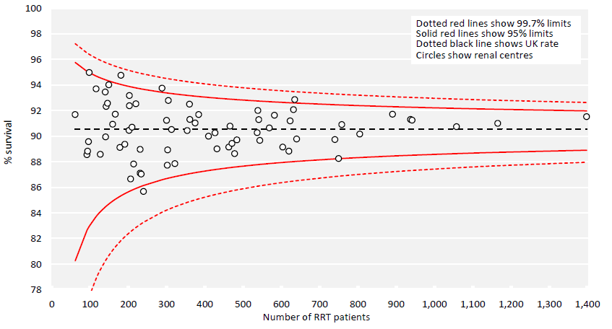
UK Renal Registry 22nd Annual Report
Data to 31/12/2018
Figure 1.31 1 year after 90 days survival (adjusted to age 60 years) of incident adult RRT patients by centre (2014–2017 4 year cohort)

Slide 32
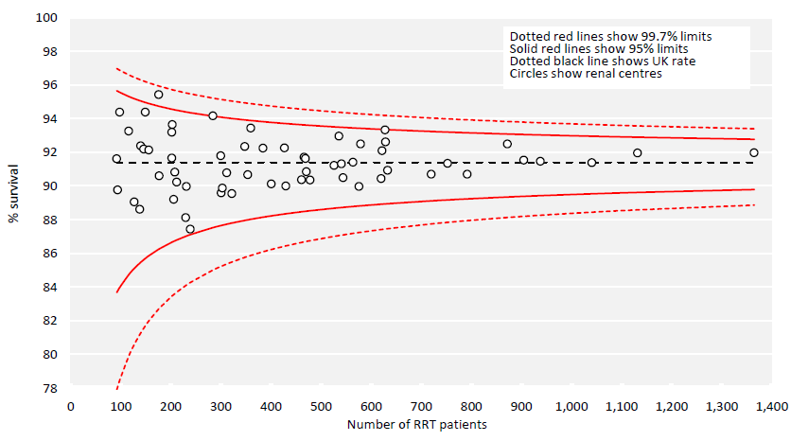
UK Renal Registry 22nd Annual Report
Data to 31/12/2018
Figure 1.32 1 year after 90 days survival (adjusted to age 60 years, male and median comorbidity score) of incident adult RRT
patients by centre (2014–2017 4 year cohort)

