Slide 1

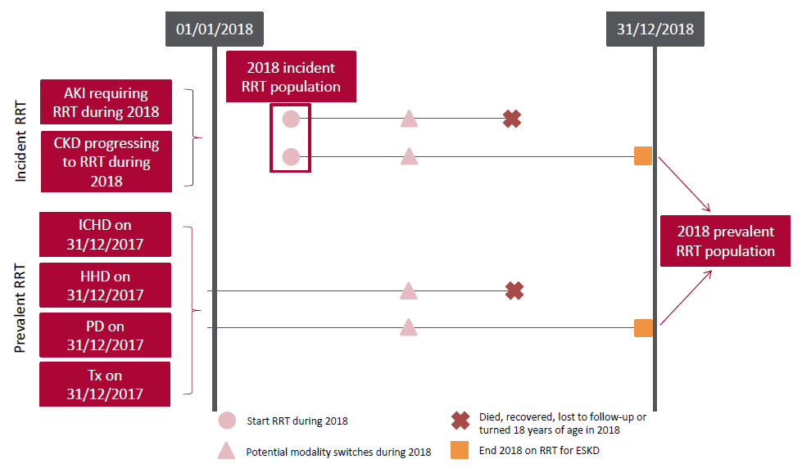
UK Renal Registry 22nd Annual Report
Data to 31/12/2018
Figure 7.1 Pathways children and young people could follow to be included in the UK 2018 incident and/or prevalent RRT populations
Note that patients starting RRT in 2018 are only included in this chapter if they remained on RRT for ≥90 days.
CKD – chronic kidney disease

Slide 2
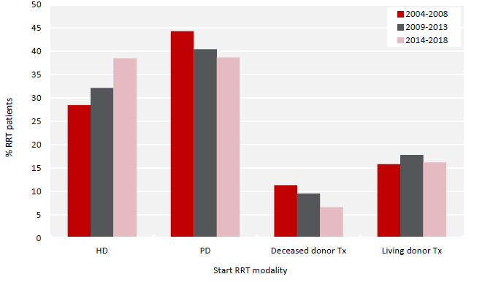
UK Renal Registry 22nd Annual Report
Data to 31/12/2018
Figure 7.2 Start RRT modality for paediatric patients (<16 years old) incident to RRT by 5 year time period

Slide 3
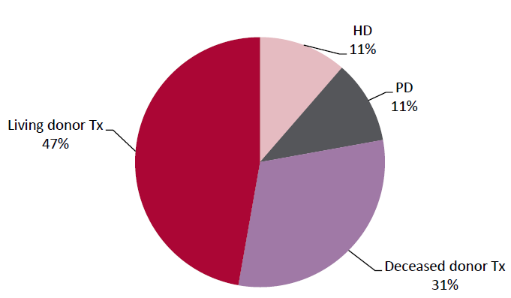
UK Renal Registry 22nd Annual Report
Data to 31/12/2018
Figure 7.3 RRT modality used by paediatric patients (<16 years old) prevalent to RRT on 31/12/2018

Slide 4
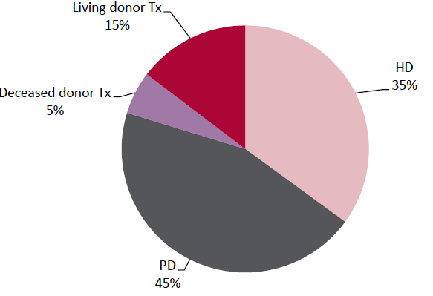
UK Renal Registry 22nd Annual Report
Data to 31/12/2018
Figure 7.4 RRT modality used at the start of RRT by paediatric patients (<16 years old) prevalent to RRT on 31/12/2018

Slide 5
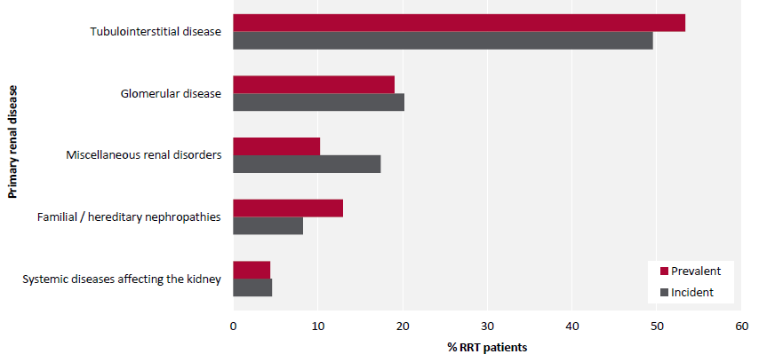
UK Renal Registry 22nd Annual Report
Data to 31/12/2018
Figure 7.5 Comparison of primary renal diseases for paediatric patients (<16 years old) incident and prevalent to RRT in 2018
with no missing data

Slide 6
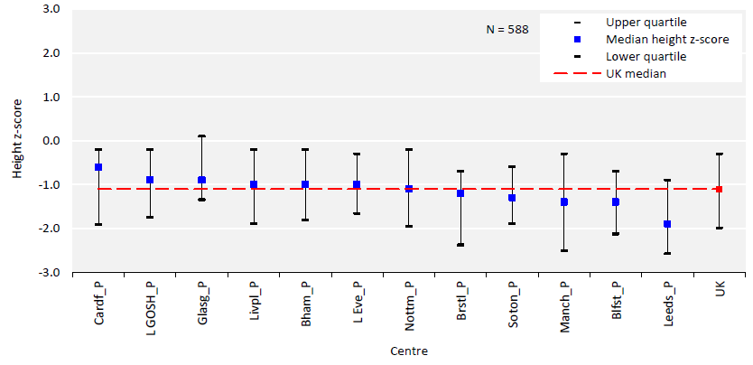
UK Renal Registry 22nd Annual Report
Data to 31/12/2018
Figure 7.6 Median height z-scores for paediatric patients (<16 years old) prevalent to Tx on 31/12/2018 by centre

Slide 7
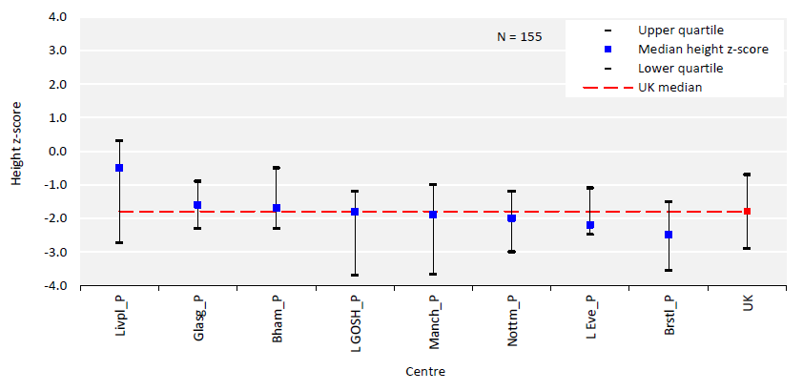
UK Renal Registry 22nd Annual Report
Data to 31/12/2018
Figure 7.7 Median height z-scores for paediatric patients (<16 years old) prevalent to dialysis on 31/12/2018 by centre

Slide 8
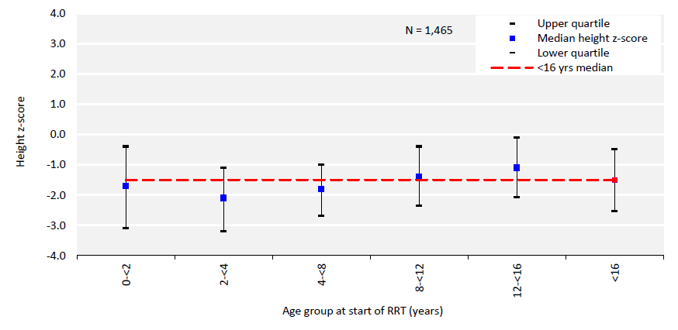
UK Renal Registry 22nd Annual Report
Data to 31/12/2018
Figure 7.8 Median height z-scores at start of RRT for incident paediatric RRT patients (<16 years old) between 2004 and 2018
by age group at start of RRT

Slide 9
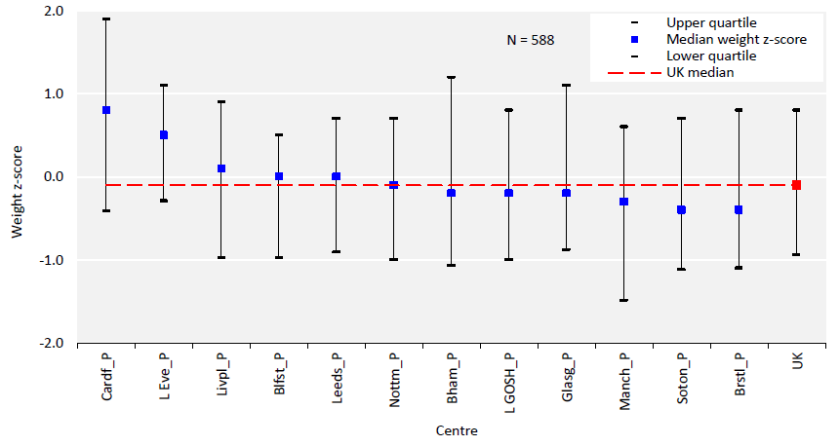
UK Renal Registry 22nd Annual Report
Data to 31/12/2018
Figure 7.9 Median weight z-scores for paediatric patients (<16 years old) prevalent to Tx on 31/12/2018 by centre

Slide 10
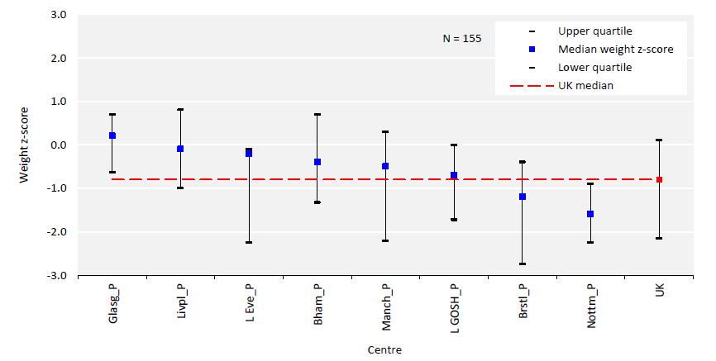
UK Renal Registry 22nd Annual Report
Data to 31/12/2018
Figure 7.10 Median weight z-scores for paediatric patients (<16 years old) prevalent to dialysis on 31/12/2018 by centre

Slide 11
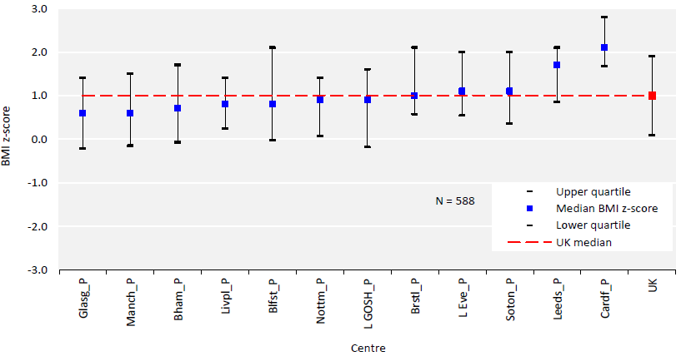
UK Renal Registry 22nd Annual Report
Data to 31/12/2018
Figure 7.11 Median body mass index (BMI) z-scores for paediatric patients (<16 years old) prevalent to Tx on 31/12/2018 by centre

Slide 12
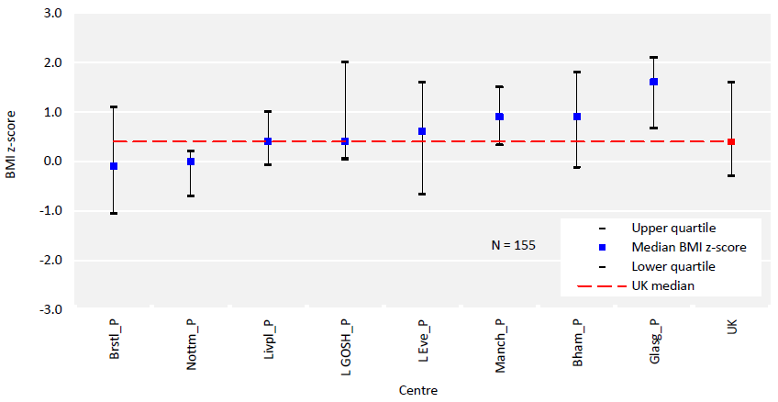
UK Renal Registry 22nd Annual Report
Data to 31/12/2018
Figure 7.12 Median body mass index (BMI) z-scores for paediatric patients (<16 years old) prevalent to dialysis on 31/12/2018 by centre

Slide 13
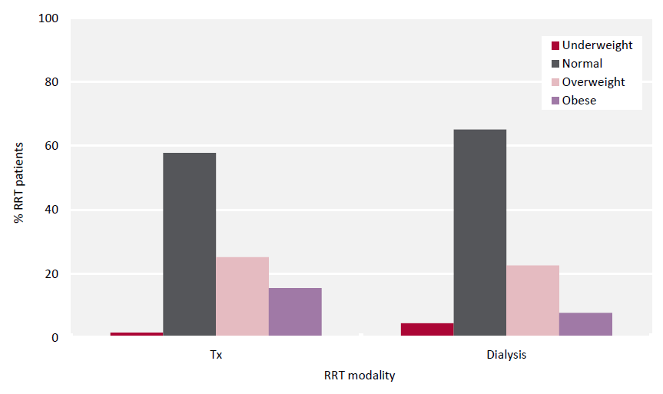
UK Renal Registry 22nd Annual Report
Data to 31/12/2018
Figure 7.13 Body mass index categorisation of paediatric patients (<16 years old) prevalent to RRT on 31/12/2018 by RRT modality

Slide 14
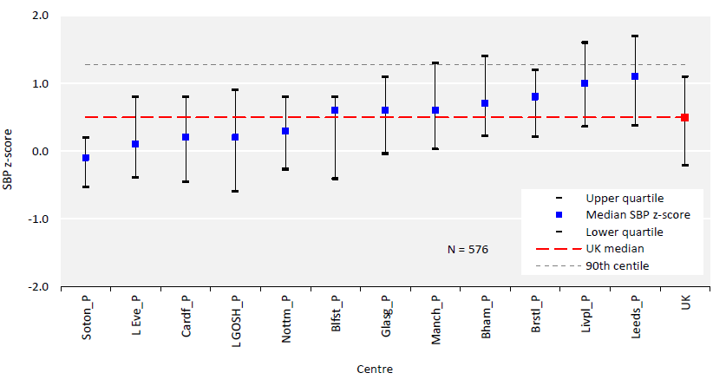
UK Renal Registry 22nd Annual Report
Data to 31/12/2018
Figure 7.14 Median systolic blood pressure (SBP) z-scores for paediatric patients (<16 years old) prevalent to Tx
on 31/12/2018 by centre

Slide 15
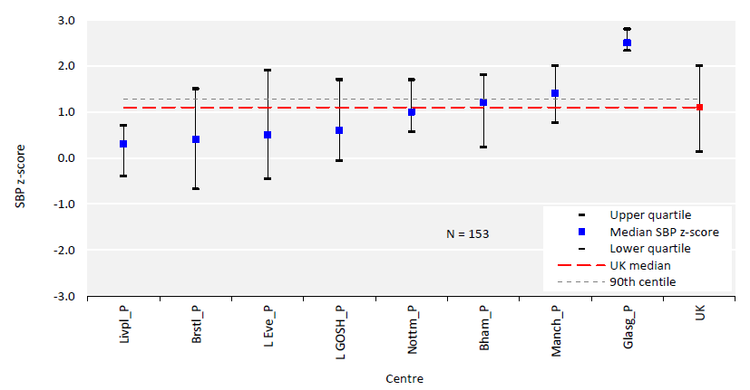
UK Renal Registry 22nd Annual Report
Data to 31/12/2018
Figure 7.15 Median systolic blood pressure (SBP) z-scores for paediatric patients (<16 years old) prevalent to dialysis on
31/12/2018 by centre

Slide 16
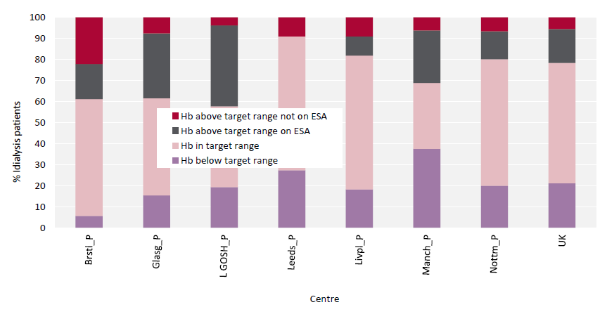
UK Renal Registry 22nd Annual Report
Data to 31/12/2018
Figure 7.16 Proportion of paediatric patients (<16 years old) prevalent to dialysis on 31/12/2018 with haemoglobin (Hb) below,
within and above target by centre; for those above target the proportion on erythropoiesis stimulating agent (ESA) therapy is shown

Slide 17
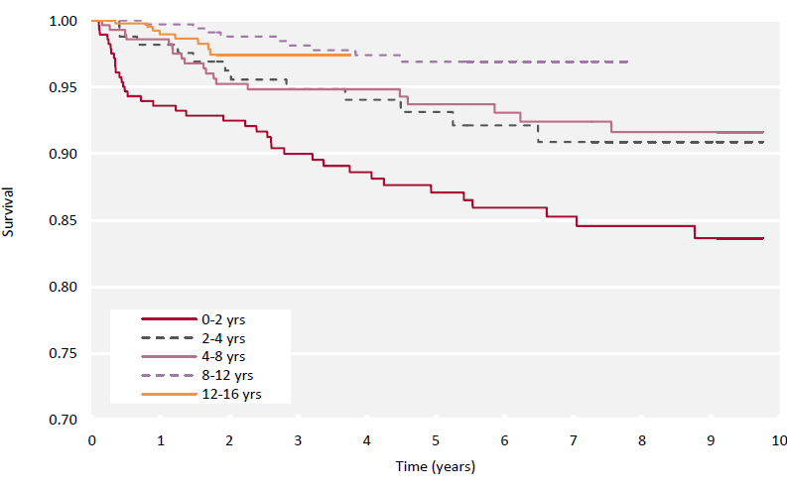
UK Renal Registry 22nd Annual Report
Data to 31/12/2018
Figure 7.17 Unadjusted Kaplan-Meier survival (from day 90) of incident paediatric RRT patients (<16 years old) between
2004 and 2017 by age group at start of RRT

