Slide 1

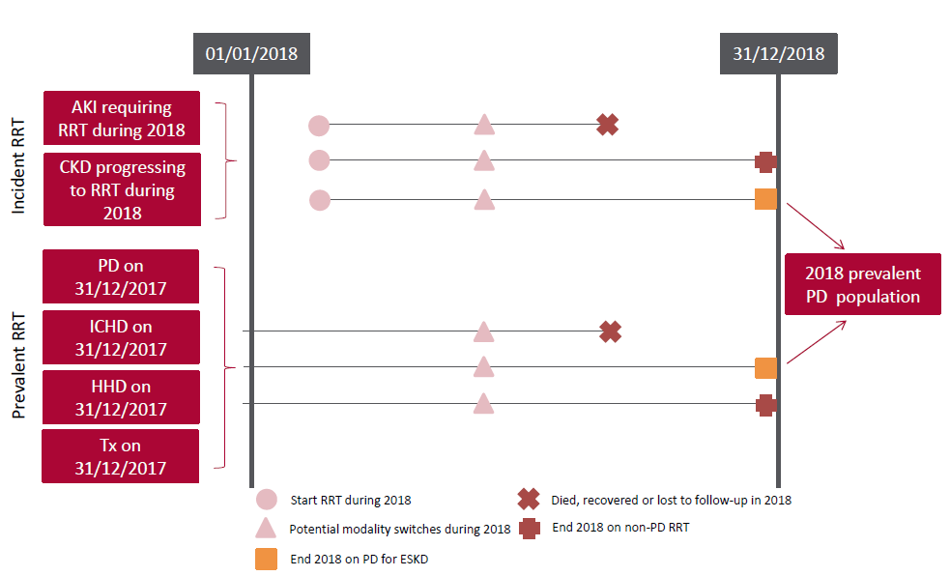
UK Renal Registry 22nd Annual Report
Data to 31/12/2018
Figure 5.1 Pathways adult patients could follow to be included in the UK 2018 prevalent PD population
Note that patients receiving dialysis for acute kidney injury (AKI) are only included in this chapter if they had a timeline or RRT modality
code for chronic PD at the end of 2018 or if they had been on RRT for ≥90 days and were on PD at the end of 2018.
CKD – chronic kidney disease

Slide 2
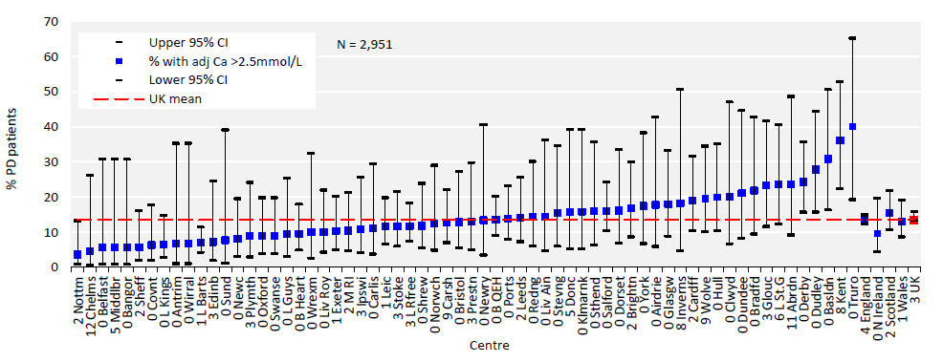
UK Renal Registry 22nd Annual Report
Data to 31/12/2018
Figure 5.2 Percentage of adult patients prevalent to PD on 31/12/2018 with adjusted calcium (Ca) above the target range
(>2.5 mmol/L) by centre
CI – confidence interval

Slide 3
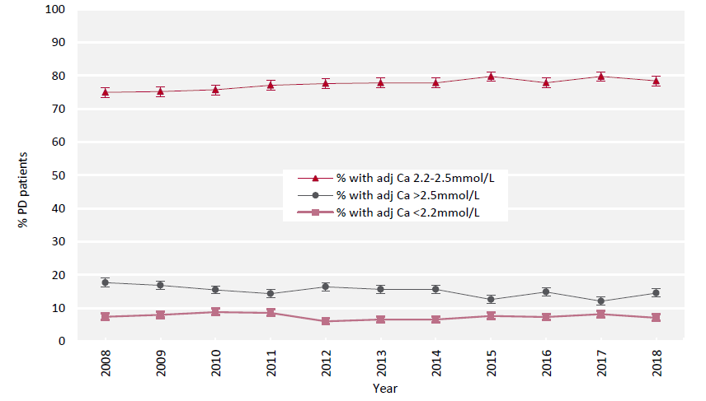
UK Renal Registry 22nd Annual Report
Data to 31/12/2018
Figure 5.3 Change in percentage of prevalent adult PD patients within, above and below the target range for adjusted
calcium (Ca 2.2–2.5 mmol/L) between 2008 and 2018

Slide 4
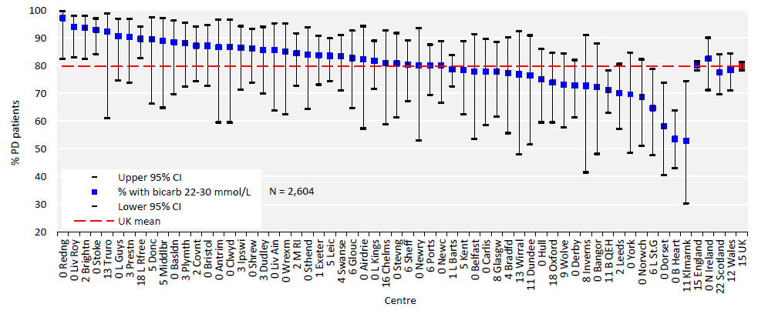
UK Renal Registry 22nd Annual Report
Data to 31/12/2018
Figure 5.4 Percentage of adult patients prevalent to PD on 31/12/2018 with bicarbonate (bicarb) within the target range
(22–30 mmol/L) by centre
CI – confidence interval

Slide 5
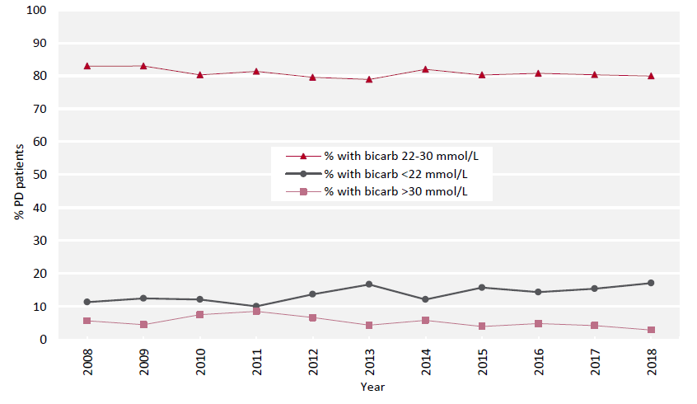
UK Renal Registry 22nd Annual Report
Data to 31/12/2018
Figure 5.5 Percentage of prevalent adult PD patients within, above and below the target range for bicarbonate
(bicarb 22–30 mmol/L) between 2008 and 2018

Slide 6
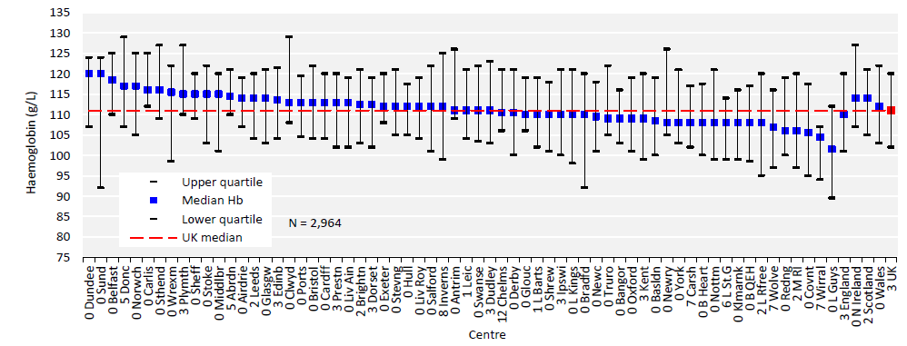
UK Renal Registry 22nd Annual Report
Data to 31/12/2018
Figure 5.6 Median haemoglobin (Hb) in adult patients prevalent to PD on 31/12/2018 by centre

Slide 7
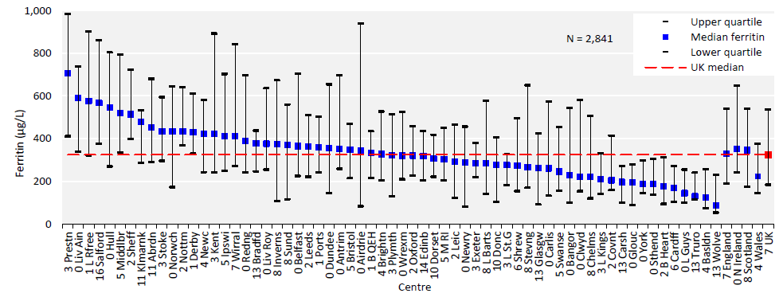
UK Renal Registry 22nd Annual Report
Data to 31/12/2018
Figure 5.7 Median ferritin in adult patients prevalent to PD on 31/12/2018 by centre

Slide 8
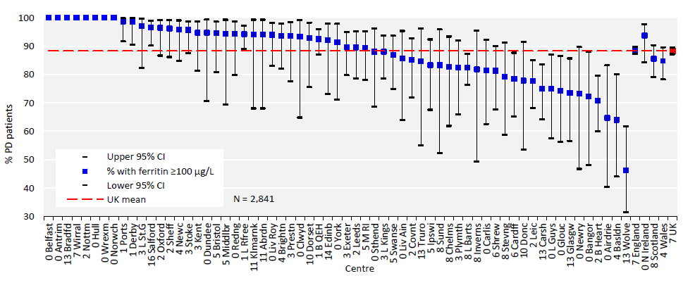
UK Renal Registry 22nd Annual Report
Data to 31/12/2018
Figure 5.8 Percentage of adult patients prevalent to PD on 31/12/2018 with ferritin ≥100 μg/L by centre
CI – confidence interval

Slide 9
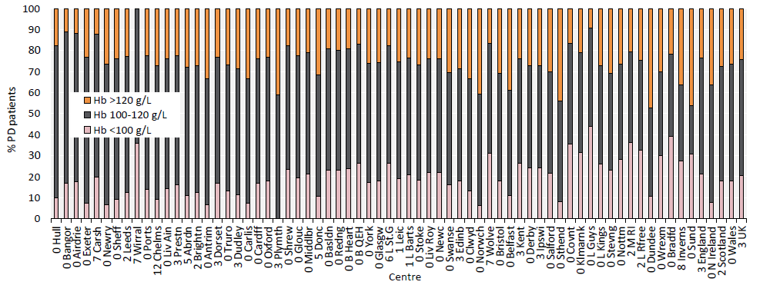
UK Renal Registry 22nd Annual Report
Data to 31/12/2018
Figure 5.9 Distribution of haemoglobin (Hb) in adult patients prevalent to PD on 31/12/2018 by centre

Slide 10
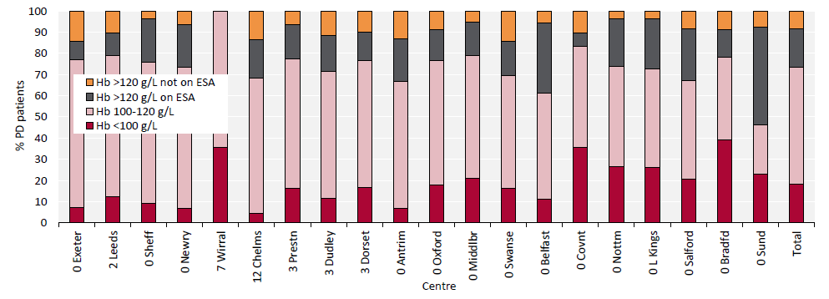
UK Renal Registry 22nd Annual Report
Data to 31/12/2018
Figure 5.10 Distribution of haemoglobin (Hb) in adult patients prevalent to PD on 31/12/2018 and the proportion with
haemoglobin >120 g/L receiving erythropoiesis stimulating agent (ESA) by centre
Figure (including total) does not include centres with <70% data completeness (or <70% ESA use).

Slide 11
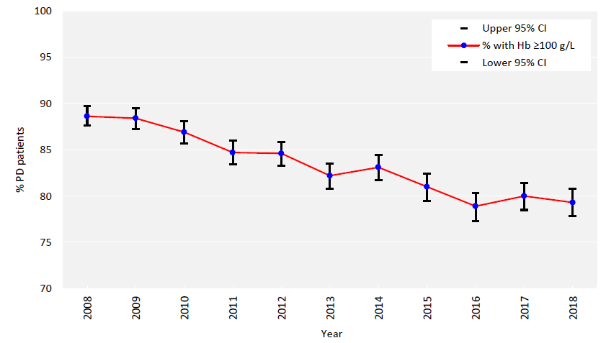
UK Renal Registry 22nd Annual Report
Data to 31/12/2018
Figure 5.11 Percentage of prevalent adult PD patients with haemoglobin (Hb) ≥100 g/L between 2008 and 2018
CI – confidence interval

Slide 12
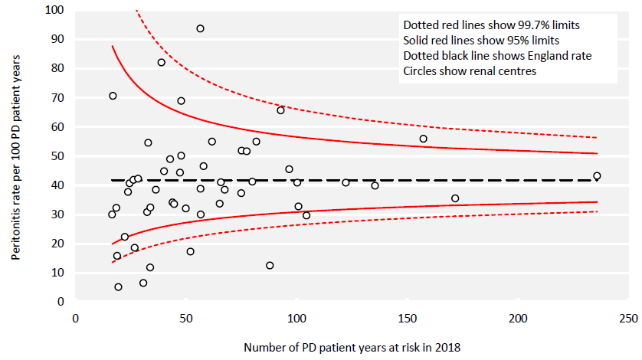
UK Renal Registry 22nd Annual Report
Data to 31/12/2018
Figure 5.12 PD peritonitis rates in adult patients receiving PD in 2018 per 100 PD patient years by centre in England

Slide 13
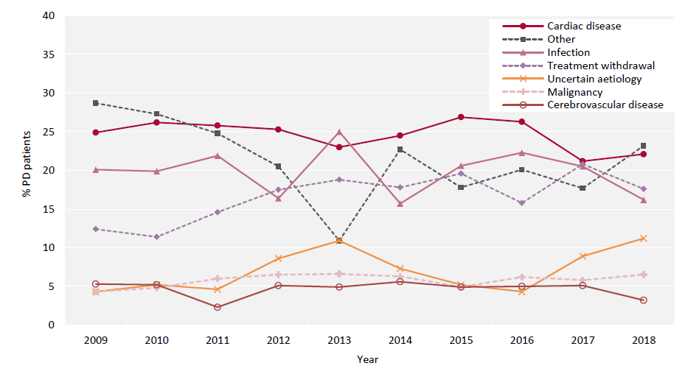
UK Renal Registry 22nd Annual Report
Data to 31/12/2018
Figure 5.13 Cause of death between 2009 and 2018 for adult patients prevalent to PD at the beginning of the year

