Slide 1

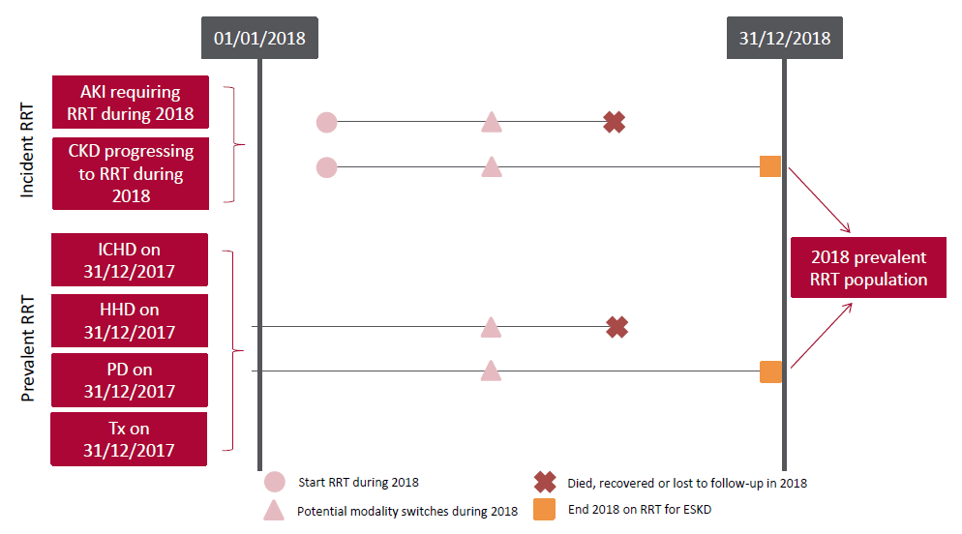
UK Renal Registry 22nd Annual Report
Data to 31/12/2018
Figure 2.1 Pathways adult patients could follow to be included in the UK 2018 prevalent RRT population
Note that patients receiving dialysis for acute kidney injury (AKI) are only included in this chapter if they had a timeline or RRT modality code for
chronic RRT at the end of 2018 or if they had been on RRT for ≥90 days and were on RRT at the end of 2018.
CKD – chronic kidney disease; Tx – transplant

Slide 2
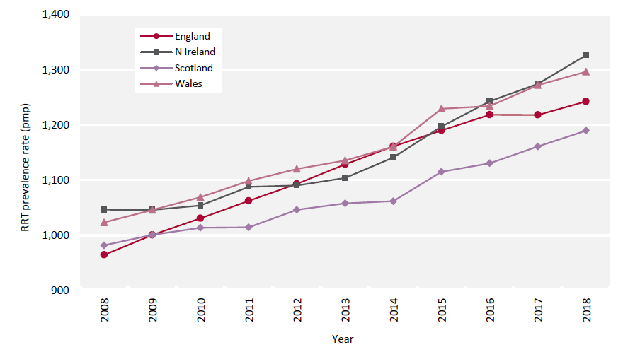
UK Renal Registry 22nd Annual Report
Data to 31/12/2018
Figure 2.2 Adult RRT prevalence rates by country between 2008 and 2018
Rates appear higher than in previous reports, because from this year those <18 years were excluded from estimated populations.
pmp – per million population

Slide 3
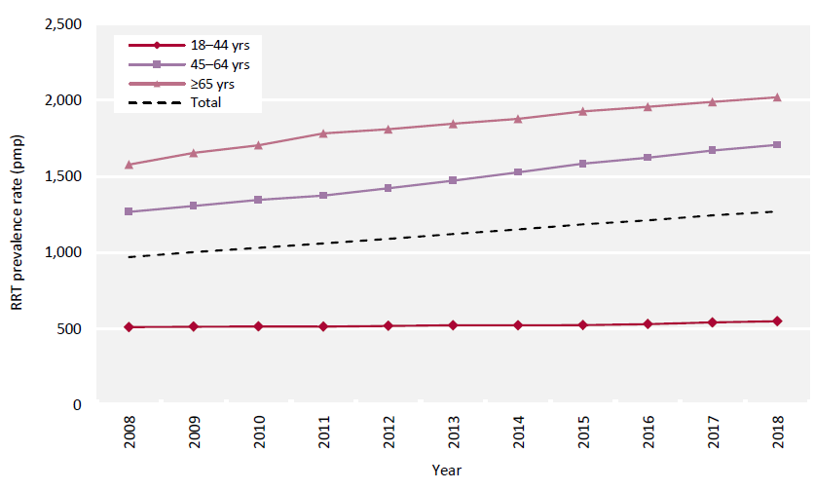
UK Renal Registry 22nd Annual Report
Data to 31/12/2018
Figure 2.3 Adult RRT prevalence rates by age group between 2008 and 2018
pmp – per million population

Slide 4
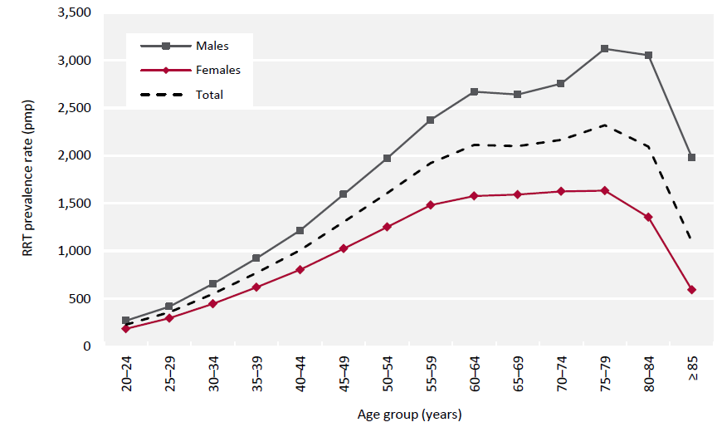
UK Renal Registry 22nd Annual Report
Data to 31/12/2018
Figure 2.4 Prevalence rates for adult patients on RRT on 31/12/2018 by age group and sex

Slide 5
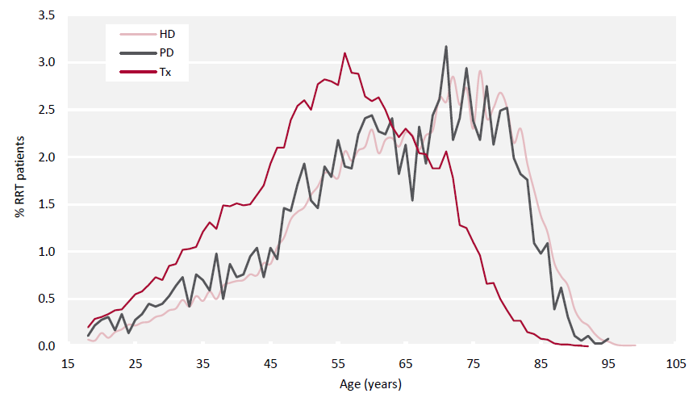
UK Renal Registry 22nd Annual Report
Data to 31/12/2018
Figure 2.5 Age profile of adult patients prevalent to RRT on 31/12/2018 by RRT modality

Slide 6
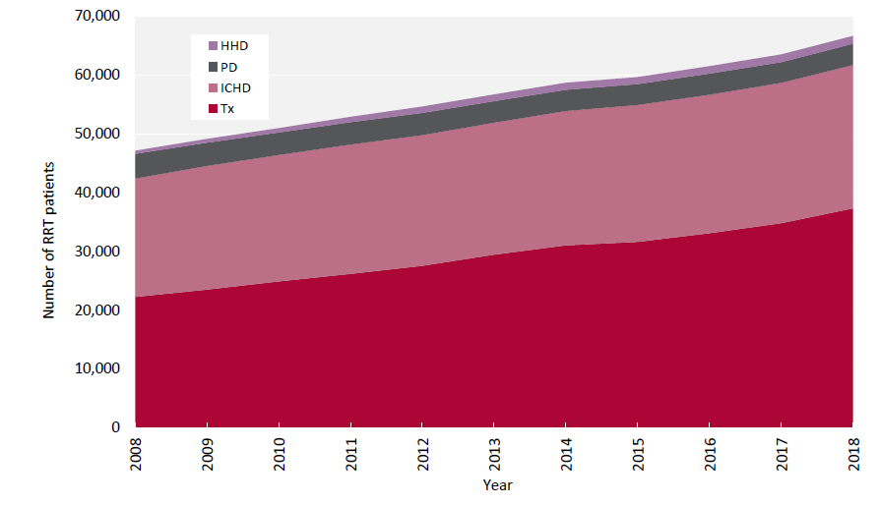
UK Renal Registry 22nd Annual Report
Data to 31/12/2018
Figure 2.6 Growth in numbers of prevalent adult RRT patients by treatment modality between 2008 and 2018

Slide 7
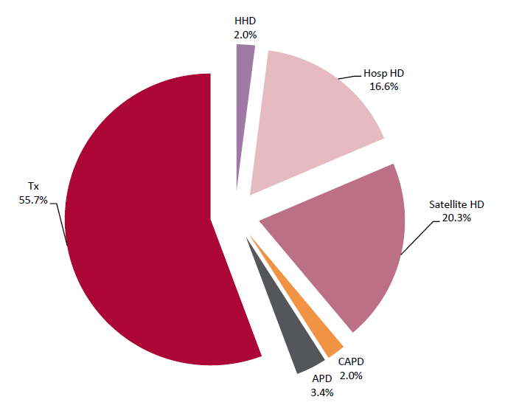
UK Renal Registry 22nd Annual Report
Data to 31/12/2018
Figure 2.7 Detailed treatment modality of adult patients prevalent to RRT on 31/12/2018
No Scottish centres were included because data on satellite HD were not available.
APD – automated PD; CAPD – continuous ambulatory PD

Slide 8
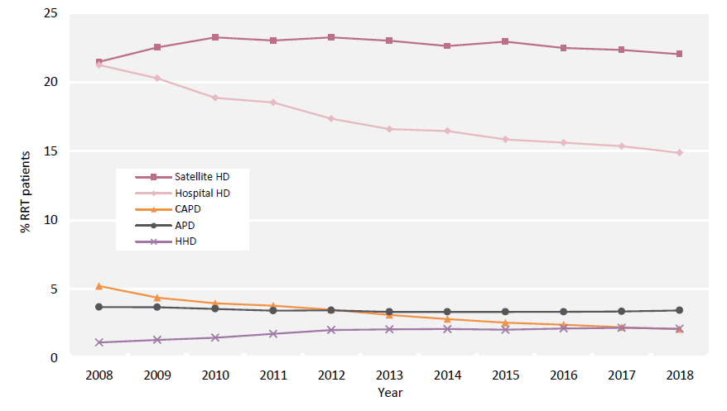
UK Renal Registry 22nd Annual Report
Data to 31/12/2018
Figure 2.8 Detailed dialysis modality changes in prevalent adult RRT patients between 2008 and 2018
No Scottish centres were included because data on satellite HD were not available.
APD – automated PD; CAPD – continuous ambulatory PD

Slide 9
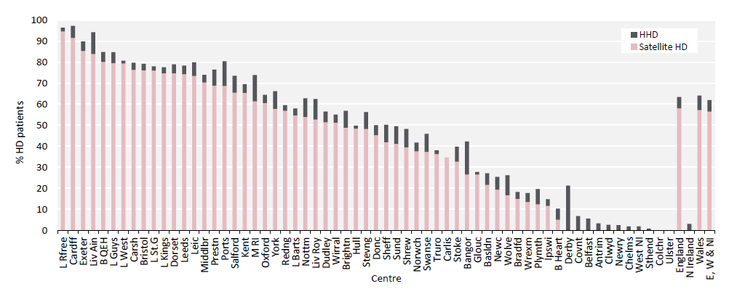
UK Renal Registry 22nd Annual Report
Data to 31/12/2018
Figure 2.9 Adult patients prevalent to HD on 31/12/2018 treated with satellite HD or HHD by centre
There were no satellite units in Northern Ireland and Scottish centres were excluded because data on satellite HD were not available.

Slide 10
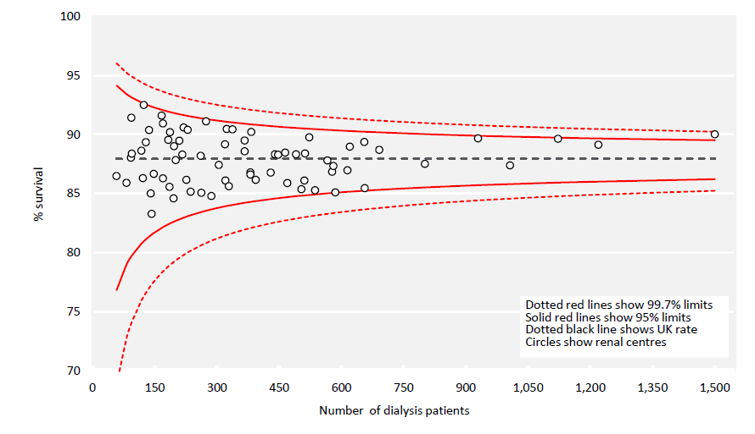
UK Renal Registry 22nd Annual Report
Data to 31/12/2018
Figure 2.10 1 year survival (adjusted to age 60 years) of adult patients prevalent to dialysis on 31/12/2017 by centre

Slide 11
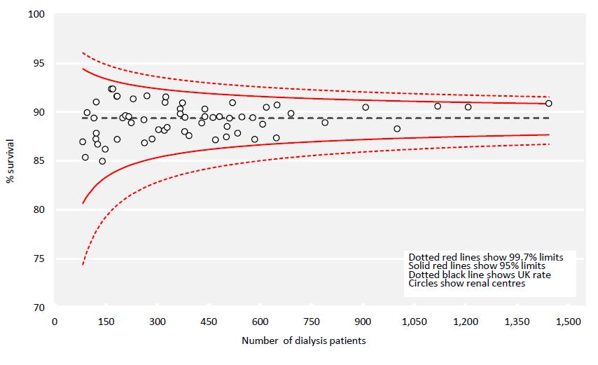
UK Renal Registry 22nd Annual Report
Data to 31/12/2018
Figure 2.11 1 year survival (adjusted to 60 years, male and median comorbidity score) of adult patients prevalent to dialysis on
31/12/2017 by centre

Slide 12
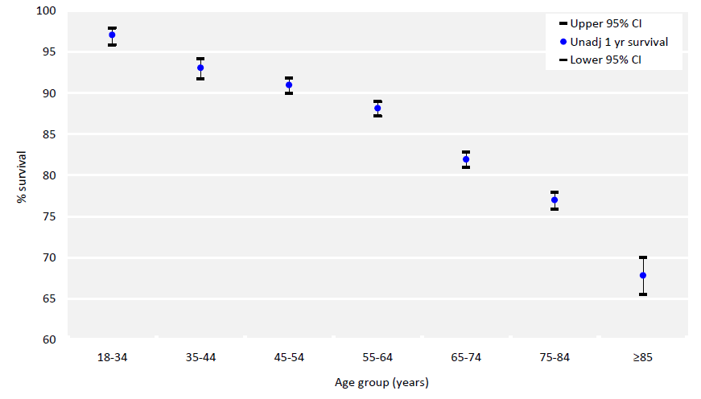
UK Renal Registry 22nd Annual Report
Data to 31/12/2018
Figure 2.12 1 year survival (unadjusted) of adult patients prevalent to dialysis on 31/12/2017 by age group
CI – confidence interval

Slide 13
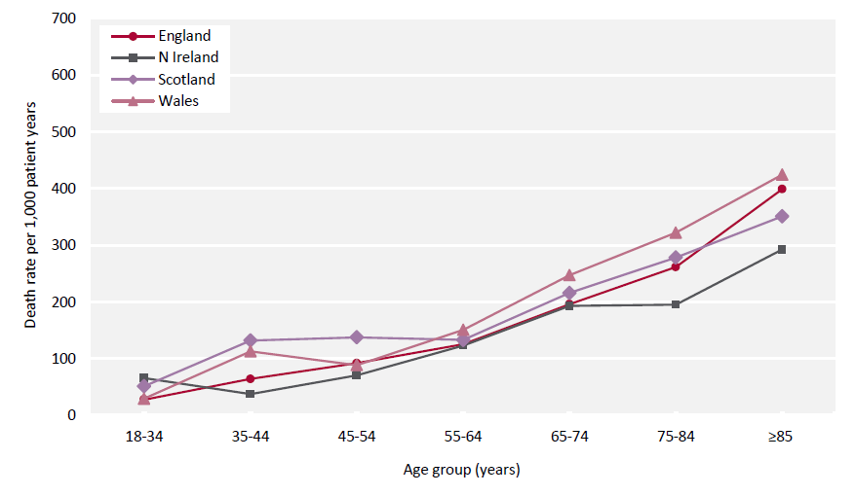
UK Renal Registry 22nd Annual Report
Data to 31/12/2018
Figure 2.13 1 year death rate per 1,000 patient years for adult patients prevalent to dialysis on 31/12/2017 by country and age group

Slide 14
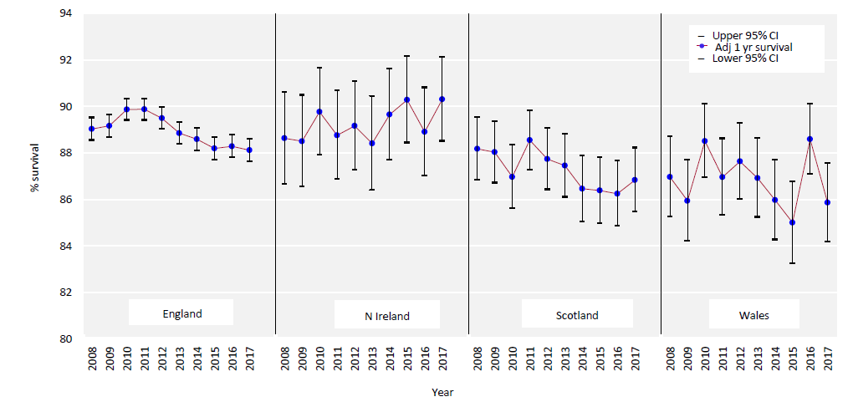
UK Renal Registry 22nd Annual Report
Data to 31/12/2018
Figure 2.14 1 year survival (adjusted to age 60 years) for prevalent adult dialysis patients by country between 2008 and 2017
CI – confidence interval

Slide 15
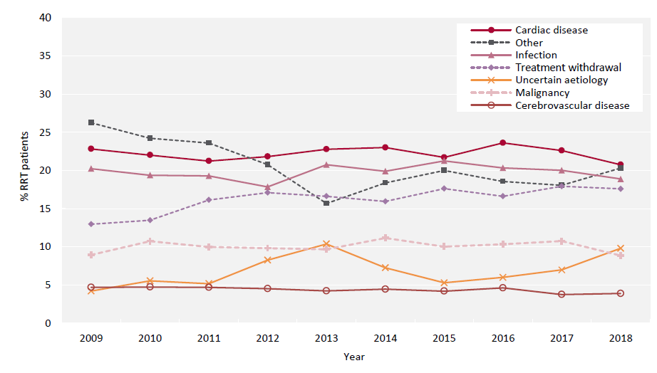
UK Renal Registry 22nd Annual Report
Data to 31/12/2018
Figure 2.15 Cause of death between 2009 and 2018 for adult patients prevalent to RRT at the beginning of the year

