Slide 1

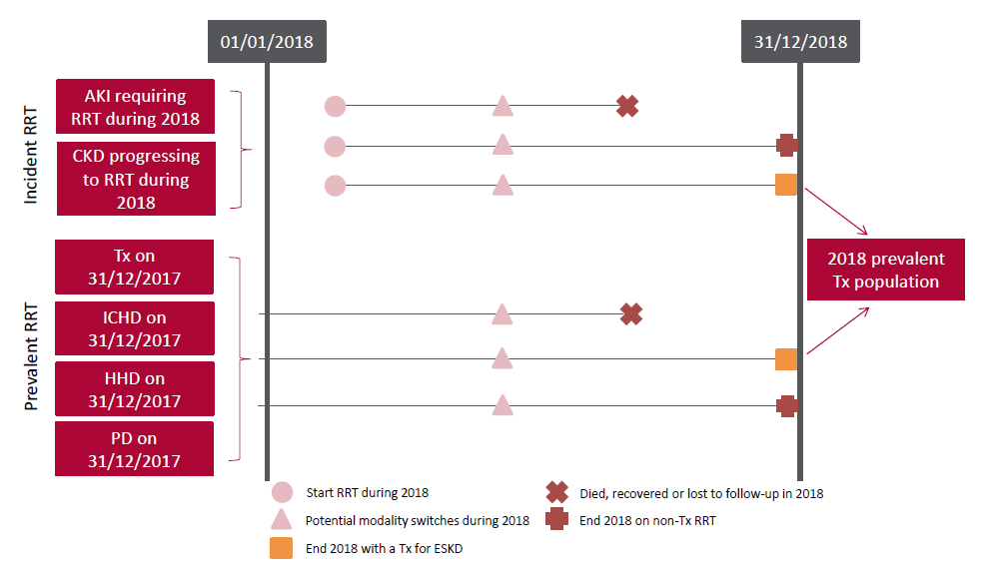
UK Renal Registry 22nd Annual Report
Data to 31/12/2018
Figure 3.1 Pathways adult patients could follow to be included in the UK 2018 prevalent Tx population
Note that patients receiving dialysis for acute kidney injury (AKI) are only included in this chapter if they had a timeline or RRT modality code for
chronic ICHD at the end of 2018 or if they had been on RRT for ≥90 days and were on ICHD at the end of 2018.
AKI – acute kidney injury; CKD – chronic kidney disease; HHD – home haemodialysis; ICHD – in-centre haemodialysis;
PD – peritoneal dialysis

Slide 2
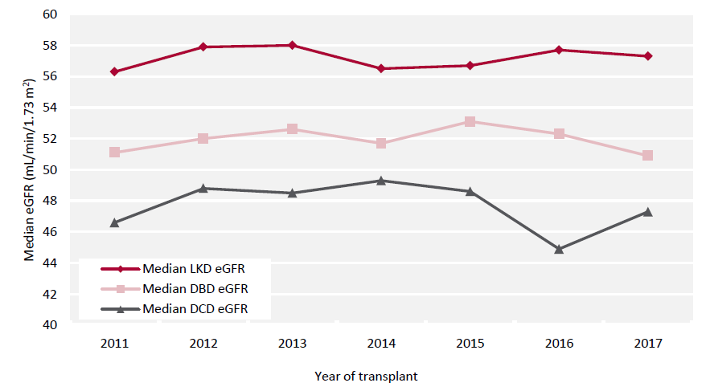
UK Renal Registry 22nd Annual Report
Data to 31/12/2018
Figure 3.2 Median estimated glomerular filtration rate (eGFR) for kidney Tx at 1 year by donor type and year of transplantation
between 2011 and 2017
DBD – donor after brain death; DCD – donor after circulatory death; LKD – living kidney donor

Slide 3
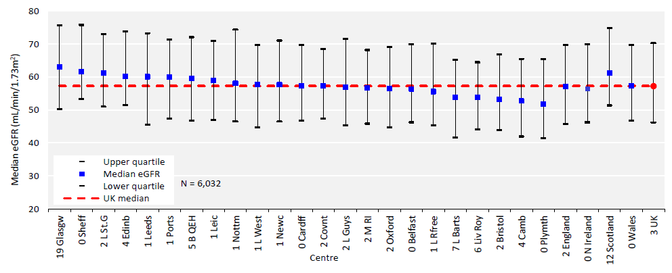
UK Renal Registry 22nd Annual Report
Data to 31/12/2018
Figure 3.3 Median estimated glomerular filtration rate (eGFR) at 1 year post-living kidney donor (LKD) Tx by transplanting centre
and year of transplantation between 2011 and 2017

Slide 4
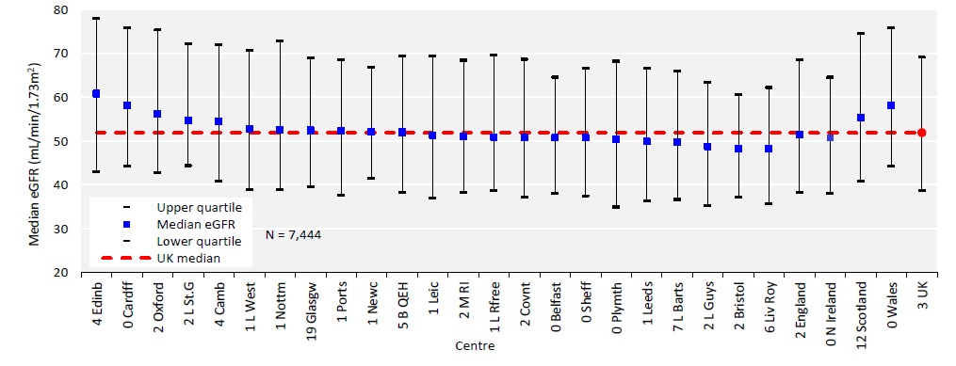
UK Renal Registry 22nd Annual Report
Data to 31/12/2018
Figure 3.4 Median estimated glomerular filtration rate (eGFR) at 1 year post-donor after brain death (DBD) Tx by transplanting
centre and by year of transplantation between 2011 and 2017

Slide 5
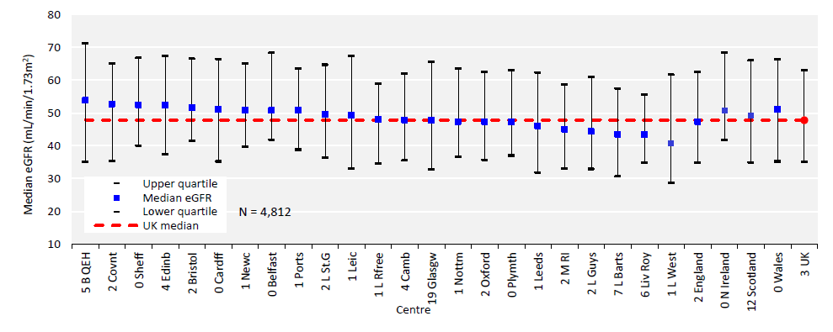
UK Renal Registry 22nd Annual Report
Data to 31/12/2018
Figure 3.5 Median estimated glomerular filtration rate (eGFR) at 1 year post-donor after circulatory death (DCD) Tx by
transplanting centre and by year of transplantation between 2011 and 2017

Slide 6
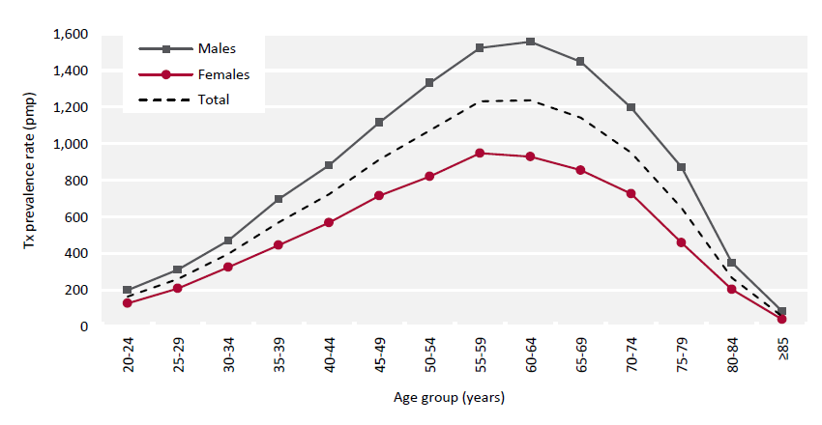
UK Renal Registry 22nd Annual Report
Data to 31/12/2018
Figure 3.6 Adult Tx prevalence rate on 31/12/2018 by age group and sex
pmp – per million population

Slide 7
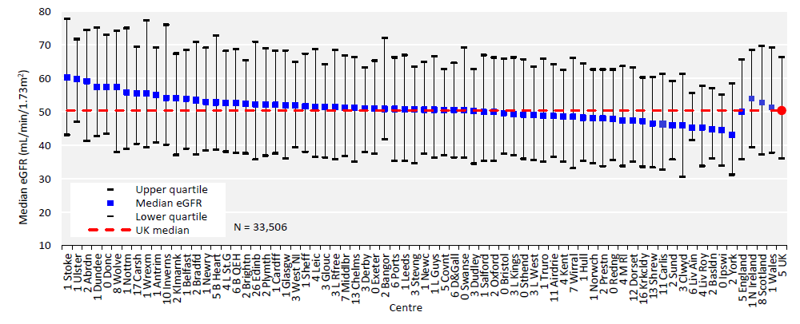
UK Renal Registry 22nd Annual Report
Data to 31/12/2018
Figure 3.7 Median estimated glomerular filtration rate (eGFR) in adult patients prevalent to Tx on 31/12/2018 by centre

Slide 8
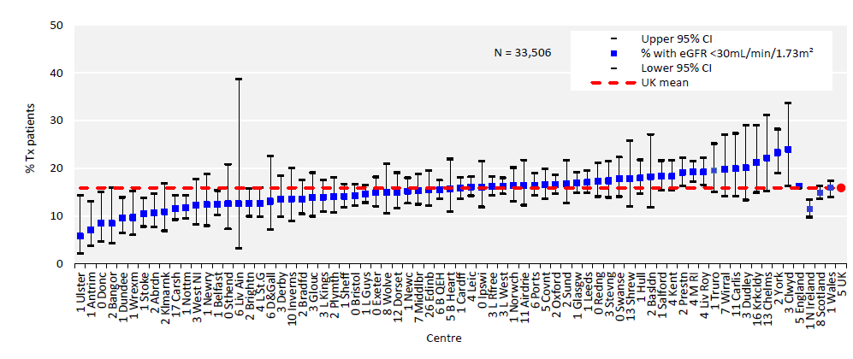
UK Renal Registry 22nd Annual Report
Data to 31/12/2018
Figure 3.8 Percentage of adult patients prevalent to Tx on 31/12/2018 with an estimated glomerular filtration rate (eGFR)
<30mL/min/1.73m2 by centre
CI – confidence interval

Slide 9
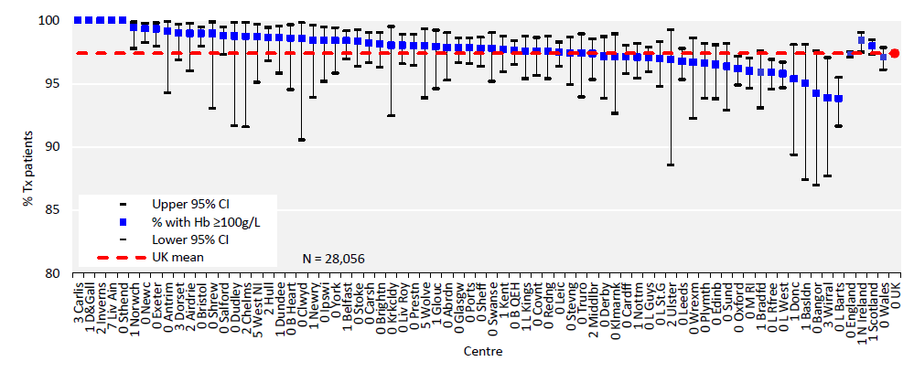
UK Renal Registry 22nd Annual Report
Data to 31/12/2018
Figure 3.9 Percentage of adult patients prevalent to Tx on 31/12/2018 with an estimated glomerular filtration rate (eGFR)
≥30mL/min/1.73m2 achieving haemoglobin (Hb) ≥100g/L by centre
CI – confidence interval

Slide 10
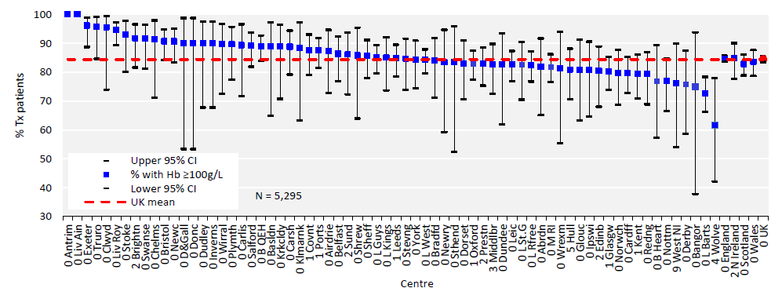
UK Renal Registry 22nd Annual Report
Data to 31/12/2018
Figure 3.10 Percentage of adult patients prevalent to Tx on 31/12/2018 with an estimated glomerular filtration rate (eGFR)
<30mL/min/1.73m2 achieving haemoglobin (Hb) ≥100g/L by centre
CI – confidence interval

Slide 11
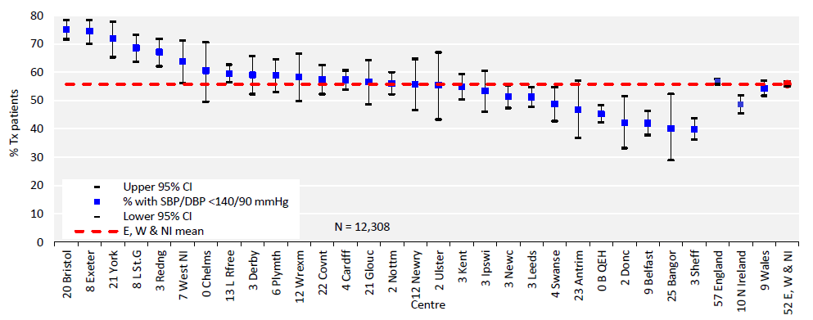
UK Renal Registry 22nd Annual Report
Data to 31/12/2018
Figure 3.11 Percentage of adult patients prevalent to Tx on 31/12/2018 with estimated glomerular filtration rate (eGFR)
≥30 mL/min/1.73m2 achieving blood pressure of <140/90 mmHg by centre
CI – confidence interval; DBP – diastolic blood pressure; SBP – systolic blood pressure

Slide 12
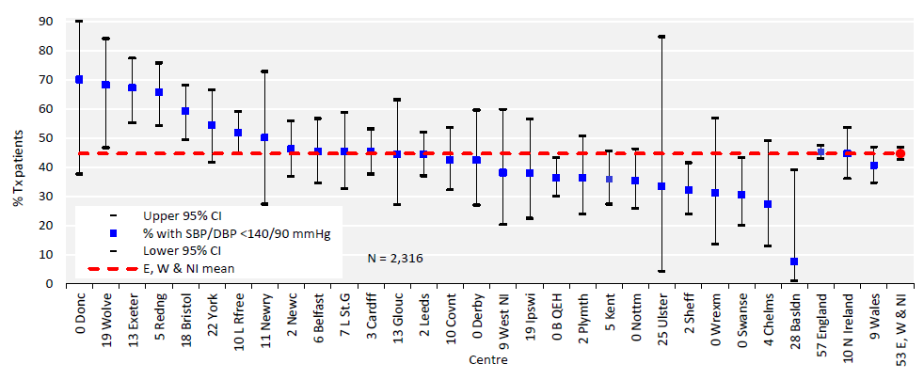
UK Renal Registry 22nd Annual Report
Data to 31/12/2018
Figure 3.12 Percentage of adult patients prevalent to Tx on 31/12/2018 with estimated glomerular filtration rate (eGFR)
<30 mL/min/1.73m2 achieving blood pressure of <140/90 mmHg by centre
CI – confidence interval; DBP – diastolic blood pressure; SBP – systolic blood pressure

Slide 13
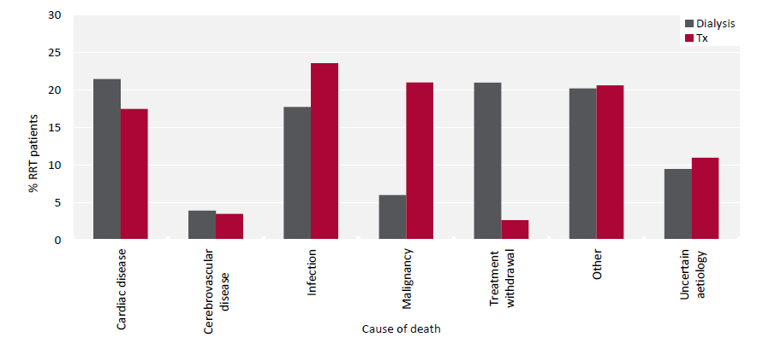
UK Renal Registry 22nd Annual Report
Data to 31/12/2018
Figure 3.13 Cause of death for adult patients prevalent to RRT on 31/12/2017 followed-up in 2018 by modality

Slide 14
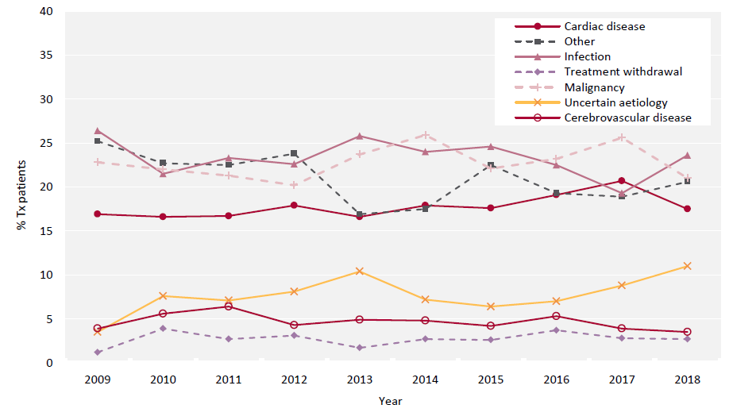
UK Renal Registry 22nd Annual Report
Data to 31/12/2018
Figure 3.14 Cause of death between 2009 and 2018 for adult patients prevalent to Tx at the beginning of the year

