Slide 1

UK Renal Registry 23rd Annual Report
Data to 31/12/2019
Figure 2.1 Example histories for patients starting RRT, illustrating the use of timeline codes to define dialysis as being ‘acute’ or for ESKD
Note that patients who recovered renal function before 90 days on dialysis are not included in this chapter, whether they were coded as AKI or ESKD.
Note that patients who followed patterns B–E received RRT for ESKD and are counted as ‘incident to RRT’ throughout this report.
Patients who followed pattern A are not counted as ‘incident to RRT’ and do not feature in this chapter.

Slide 2
UK Renal Registry 23rd Annual Report
Data to 31/12/2019
Figure 2.2 Adult RRT incidence rates by country between 2009 and 2019
pmp – per million population

Slide 3
UK Renal Registry 23rd Annual Report
Data to 31/12/2019
Figure 2.3 Adult RRT incidence rates by age group between 2009 and 2019
pmp – per million population

Slide 4
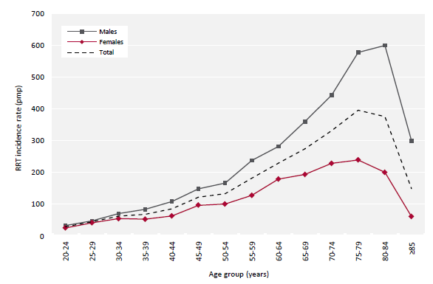
UK Renal Registry 23rd Annual Report
Data to 31/12/2019
Figure 2.4 Incidence rates for adult patients starting RRT in 2019 by age group and sex
pmp – per million population

Slide 5
UK Renal Registry 23rd Annual Report
Data to 31/12/2019
Figure 2.5 Transplant-status (listed or transplanted) at the start of RRT for adult patients incident to RRT in 2019 by centre
Analysis is adjusted for age, sex and PRD (diabetes versus non-diabetes).

Slide 6
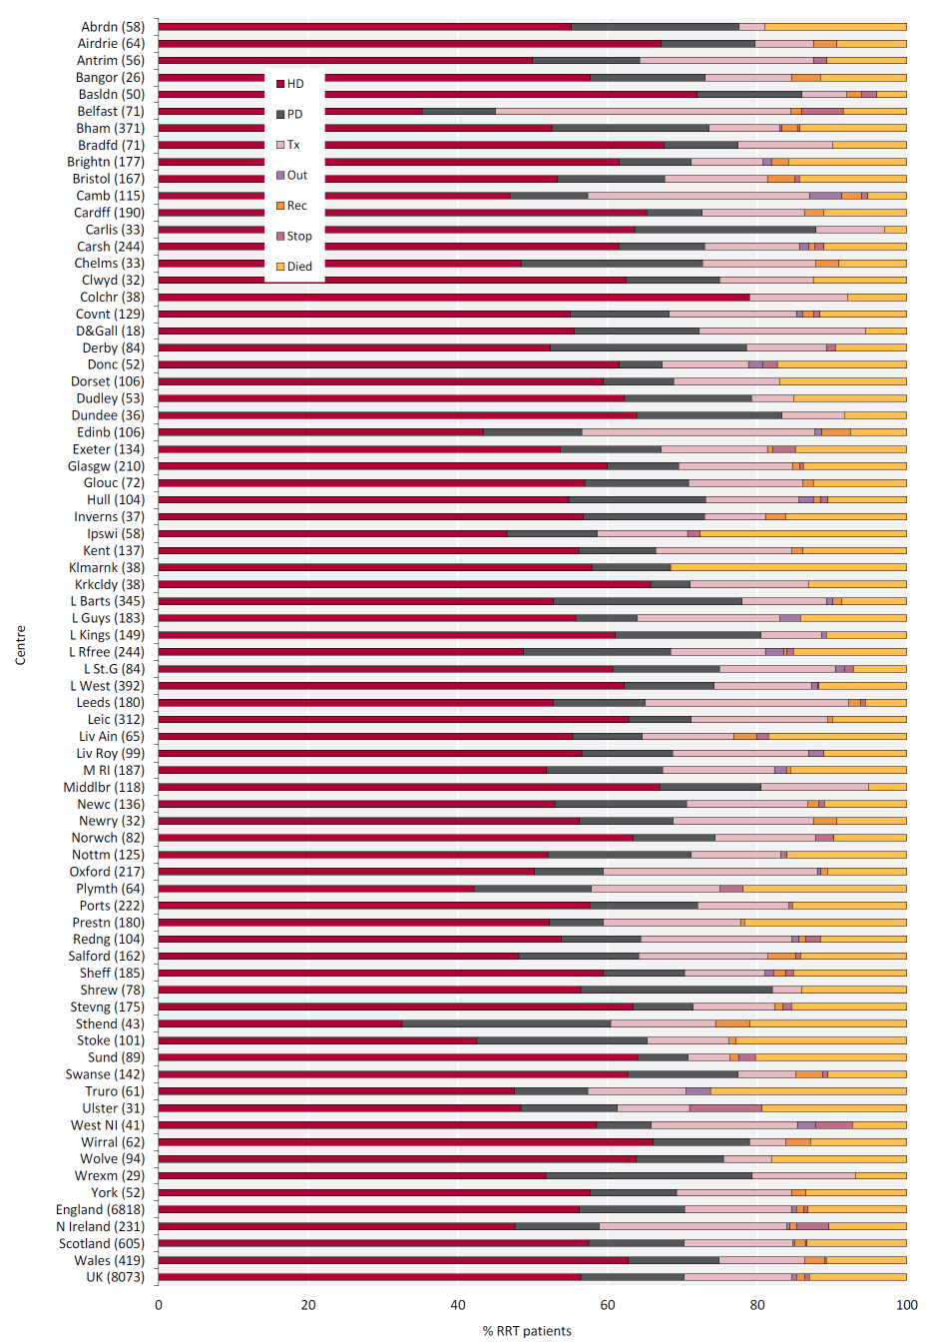
UK Renal Registry 23rd Annual Report
Data to 31/12/2019
Figure 2.6 RRT modality at 1 year for incident adult RRT patients who started RRT in 2018 by centre
Number of patients in a centre in brackets.
Out – moved out of a centre but did not reappear in another centre; Rec – recovered kidney function; Stop – treatment withdrawal

Slide 7
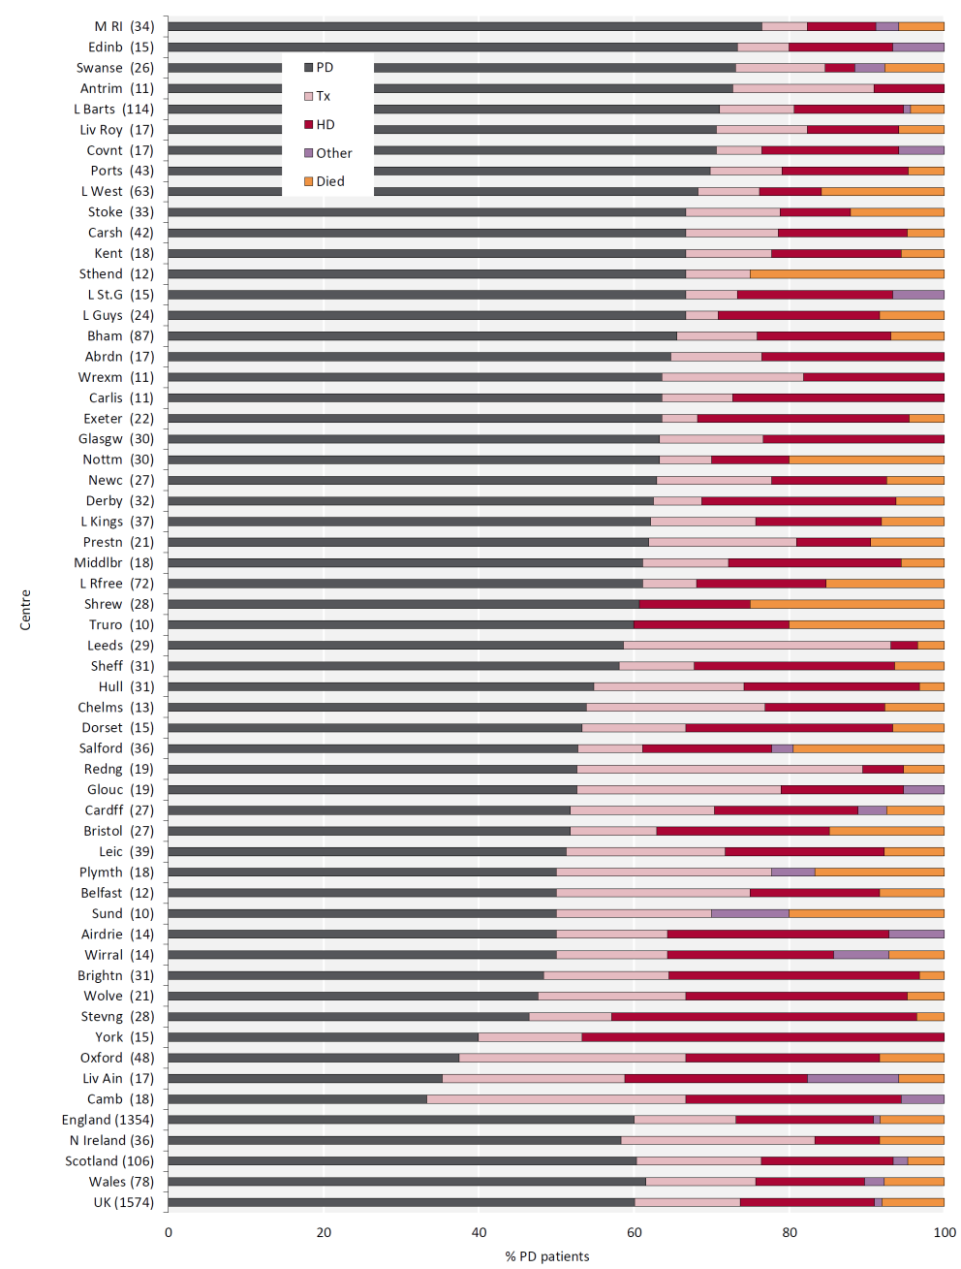
UK Renal Registry 23rd Annual Report
Data to 31/12/2019
Figure 2.7 RRT modality at 1 year for incident adult PD patients who started RRT in 2018 by centre
Number of patients in a centre in brackets.
Out – moved out of a centre but did not reappear in another centre; Rec – recovered kidney function; Stop – treatment withdrawal

Slide 8
UK Renal Registry 23rd Annual Report
Data to 31/12/2019
Figure 2.8 Percentage of incident adult RRT patients presenting late (<90 days) to a nephrologist (2018–2019 2 year cohort)
CI – confidence interval

Slide 9
UK Renal Registry 23rd Annual Report
Data to 31/12/2019
Figure 2.9 Geometric mean estimated glomerular filtration rates (eGFR) for adult patients incident to RRT in 2019 by age group and start modality
CI – confidence interval

Slide 10
UK Renal Registry 23rd Annual Report
Data to 31/12/2019
Figure 2.10 Percentage of adult patients incident to RRT in 2019 with haemoglobin (Hb) ≥100 g/L at start of RRT treatment by centre
CI – confidence interval

Slide 11
UK Renal Registry 23rd Annual Report
Data to 31/12/2019
Figure 2.11 Distribution of haemoglobin (Hb) in incident adult RRT patients by year of start between 2010 and 2019

Slide 12
UK Renal Registry 23rd Annual Report
Data to 31/12/2019
Figure 2.12 Percentage of adult patients incident to RRT in 2019 with adjusted calcium (Ca) above the normal range (>2.5 mmol/L) by centre
CI – confidence interval

Slide 13
UK Renal Registry 23rd Annual Report
Data to 31/12/2019
Figure 2.13 Dialysis access used for adult patients incident to RRT in 2019 by age group (2019 Multisite Dialysis Access Audit)
AVF – arteriovenous fistula; AVG – arteriovenous graft; NTL – non-tunnelled line; TL – tunnelled line

Slide 14
UK Renal Registry 23rd Annual Report
Data to 31/12/2019
Figure 2.14 Dialysis access used for adult patients incident to RRT in 2019 by primary renal disease (2019 Multisite Dialysis Access Audit)
AVF – arteriovenous fistula; AVG – arteriovenous graft; NTL – non-tunnelled line; TL – tunnelled line

Slide 15
UK Renal Registry 23rd Annual Report
Data to 31/12/2019
Figure 2.15 Dialysis access used for adult patients incident to RRT in 2019 by presentation time (2019 Multisite Dialysis Access Audit)
AVF – arteriovenous fistula; AVG – arteriovenous graft; NTL – non-tunnelled line; TL – tunnelled line

Slide 16
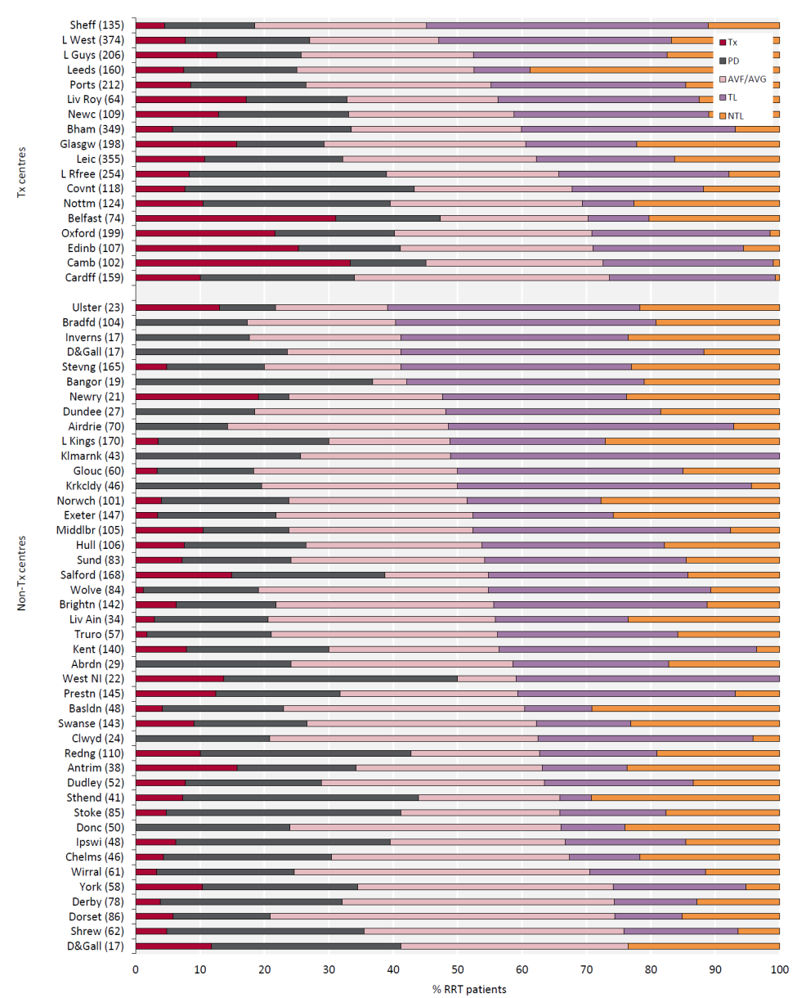
UK Renal Registry 23rd Annual Report
Data to 31/12/2019
Figure 2.16 First dialysis access used for adult patients incident to RRT in 2019 by centre (2019 Multisite Dialysis Access Audit)
Number of incident patients on RRT in a centre in brackets.
Centres are ordered by decreasing use of lines.
AVF – arteriovenous fistula; AVG – arteriovenous graft; NTL – non-tunnelled line; TL – tunnelled line

Slide 17
UK Renal Registry 23rd Annual Report
Data to 31/12/2019
Figure 2.17 Percentage of adult patients incident to HD in 2019 who started dialysis using either an arteriovenous fistula (AVF) or an arteriovenous graft (AVG) by centre, excluding late presenters (2019 Multisite Dialysis Access Audit)
Centres with <70% completeness of access data for all dialysis patients were excluded. No further exclusion for completeness in HD
patients was applied. Therefore, data completeness for some centres is less than in other caterpillar plots in this report.
CI – confidence interval

Slide 18
UK Renal Registry 23rd Annual Report
Data to 31/12/2019
Figure 2.18 1 year after 90 days survival (adjusted to age 60 years) of incident adult RRT patients by start modality between 2009 and 2018
CI – confidence interval

Slide 19
UK Renal Registry 23rd Annual Report
Data to 31/12/2019
Figure 2.19 90 days, 1 year and 1 year after 90 days survival of incident adult RRT patients by age group (2018 cohort)
CI – confidence interval

Slide 20
UK Renal Registry 23rd Annual Report
Data to 31/12/2019
Figure 2.20 1 year after 90 days death rate per 1,000 incident RRT adult patient years by age group and country (2015–2018 4 year cohort)

Slide 21
UK Renal Registry 23rd Annual Report
Data to 31/12/2019
Figure 2.21 Survival (unadjusted) of incident adult RRT patients from day 0 by age group (2009–2018 10 year cohort)

Slide 22
UK Renal Registry 23rd Annual Report
Data to 31/12/2019
Figure 2.22 Monthly hazard of death (unadjusted) of incident adult RRT patients from day 0 to 1 year by age group (2009–2018 10 year cohort)

Slide 23
UK Renal Registry 23rd Annual Report
Data to 31/12/2019
Figure 2.23 6 monthly hazard of death (unadjusted) of incident adult RRT patients from day 0 to 8 years by age group (2008–2017 10 year cohort)

Slide 24
UK Renal Registry 23rd Annual Report
Data to 31/12/2019
Figure 2.24 1 year after 90 days survival (adjusted to age 60 years) of incident adult RRT patients by centre (2015–2018 4 year cohort)

Slide 25
UK Renal Registry 23rd Annual Report
Data to 31/12/2019
Figure 2.25 1 year after 90 days survival (adjusted to age 60 years, male and median comorbidity score) of incident adult RRT patients by centre
(2015–2018 4 year cohort)

