Slide 1

UK Renal Registry 23rd Annual Report
Data to 31/12/2019
Figure 5.1 Pathways adult patients could follow to be included in the UK 2019 prevalent ICHD population
Note that patients receiving dialysis for acute kidney injury (AKI) are only included in this chapter if they had a timeline or RRT modality
code for chronic ICHD at the end of 2019 or if they had been on RRT for ≥90 days and were on ICHD at the end of 2019.
CKD – chronic kidney disease

Slide 2
UK Renal Registry 23rd Annual Report
Data to 31/12/2019
Figure 5.2 Percentage of adult patients prevalent to ICHD on 31/12/2019 with urea reduction ratio (URR) >65% by centre
CI – confidence interval

Slide 3
UK Renal Registry 23rd Annual Report
Data to 31/12/2019
Figure 5.3 Median urea reduction ratio (URR) achieved in adult patients prevalent to ICHD on 31/12/2019 by centre

Slide 4
UK Renal Registry 23rd Annual Report
Data to 31/12/2019
Figure 5.4 Change in the percentage of prevalent adult ICHD patients with urea reduction ratio (URR) >65% and the median URR by sex between 2009 and 2019
CI – confidence interval

Slide 5
UK Renal Registry 23rd Annual Report
Data to 31/12/2019
Figure 5.5 Percentage of prevalent adult ICHD patients achieving urea reduction ratio (URR) >65% by time on RRT between 2009 and 2019

Slide 6
UK Renal Registry 23rd Annual Report
Data to 31/12/2019
Figure 5.6 Percentage of adult patients prevalent to ICHD on 31/12/2019 with adjusted calcium (Ca) above the target range (>2.5 mmol/L) by centre
CI – confidence interval

Slide 7
UK Renal Registry 23rd Annual Report
Data to 31/12/2019
Figure 5.7 Change in percentage of prevalent adult ICHD patients within, above and below the target range for adjusted calcium (Ca 2.2–2.5 mmol/L) between 2009 and 2019

Slide 8
UK Renal Registry 23rd Annual Report
Data to 31/12/2019
Figure 5.8 Percentage of adult patients prevalent to ICHD on 31/12/2019 with pre-dialysis bicarbonate (bicarb) within the target range
(18–26 mmol/L) by centre
CI – confidence interval

Slide 9
UK Renal Registry 23rd Annual Report
Data to 31/12/2019
Figure 5.9 Percentage of adult patients prevalent to ICHD on 31/12/2019 with pre-dialysis potassium (K) within the target range (4.0–6.0 mmol/L) by centre
CI – confidence interval

Slide 10
UK Renal Registry 23rd Annual Report
Data to 31/12/2019
Figure 5.10 Change in percentage of prevalent adult ICHD patients within, above and below the target range for predialysis bicarbonate
(bicarb 18–26 mmol/L) between 2009 and 2019

Slide 11
UK Renal Registry 23rd Annual Report
Data to 31/12/2019
Figure 5.11 Median haemoglobin (Hb) in adult patients prevalent to ICHD on 31/12/2019 by centre

Slide 12
UK Renal Registry 23rd Annual Report
Data to 31/12/2019
Figure 5.12 Median ferritin in adult patients prevalent to ICHD on 31/12/2019 by centre

Slide 13
UK Renal Registry 23rd Annual Report
Data to 31/12/2019
Figure 5.13 Percentage of adult patients prevalent to ICHD on 31/12/2019 with ferritin ≥100 μg/L by centre
CI – confidence interval

Slide 14
UK Renal Registry 23rd Annual Report
Data to 31/12/2019
Figure 5.14 Distribution of haemoglobin (Hb) in adult patients prevalent to ICHD on 31/12/2019 by centre

Slide 15
UK Renal Registry 23rd Annual Report
Data to 31/12/2019
Figure 5.15 Distribution of haemoglobin (Hb) in adult patients prevalent to ICHD on 31/12/2019 and the proportion with haemoglobin >120 g/L receiving erythropoiesis stimulating agent (ESA) by centre
Figure (including total) does not include centres with <70% data completeness (or <70% ESA use).
Data for Scotland refer to patients prevalent to ICHD on 31/5/2019 due to ESA data availability.

Slide 16
UK Renal Registry 23rd Annual Report
Data to 31/12/2019
Figure 5.16 Percentage of prevalent adult ICHD patients with haemoglobin (Hb) ≥100 g/L between 2009 and 2019
CI – confidence interval

Slide 17
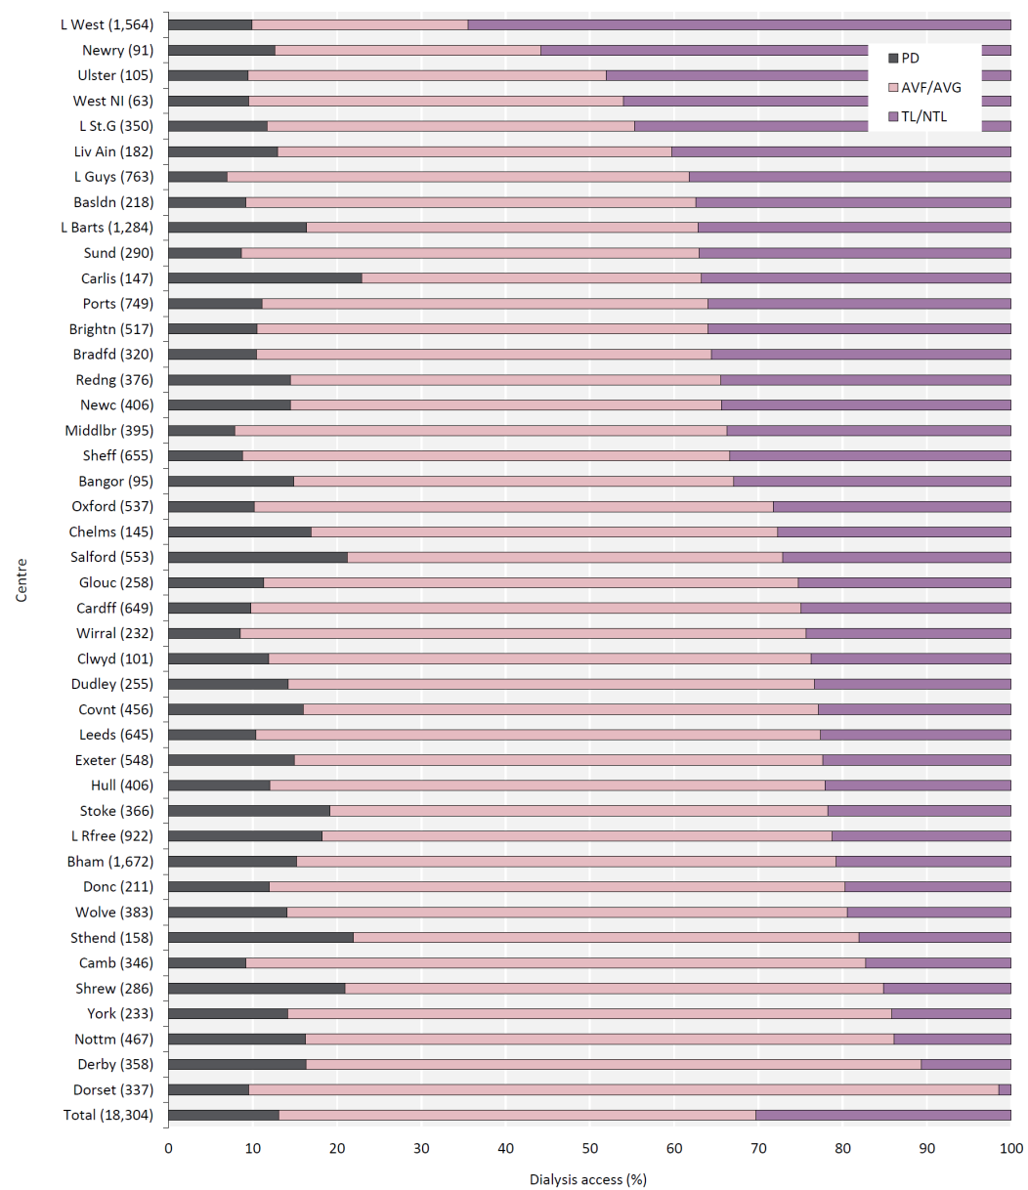
UK Renal Registry 23rd Annual Report
Data to 31/12/2019
Figure 5.17 Dialysis access in adult patients prevalent to dialysis on 31/12/2019 by centre (2019 Multisite Dialysis Access Audit)
Number of patients on dialysis in a centre in brackets (centres with <70% access data for the prevalent dialysis population were excluded).
AVF – arteriovenous fistula; AVG – arteriovenous graft; NTL – non-tunnelled line; TL – tunnelled line

Slide 18
UK Renal Registry 23rd Annual Report
Data to 31/12/2019
Figure 5.22 Cause of death between 2010 and 2019 for adult patients prevalent to ICHD at the beginning of the year

Slide 19
UK Renal Registry 23rd Annual Report
Data to 31/12/2019
Figure 5.23 Emergency inpatient days per ICHD patient-year in 2019 for patients prevalent to RRT in England and Wales on 31/12/2018 by centre

