Slide 1

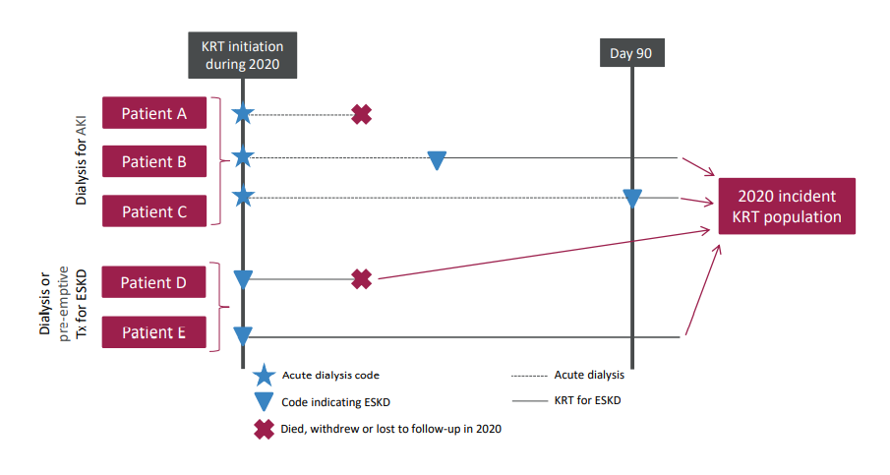
UK Renal Registry 24th Annual Report
Data to 31/12/2020
Figure 2.1 Example histories for patients starting KRT, illustrating the use of timeline codes to define dialysis as being ‘acute’ or for ESKD
Note that patients who recovered kidney function before 90 days on dialysis are not included in this chapter, whether they were coded as AKI or ESKD.
Note that patients who followed patterns B–E received KRT for ESKD and are counted as ‘incident to KRT’ throughout this report. Patients who followed pattern A are not counted as ‘incident to KRT’ and do not feature in this chapter
histories for patients starting KRT, illustrating the use of timeline codes to define dialysis as being ‘acute’ or for ESKD

Slide 2
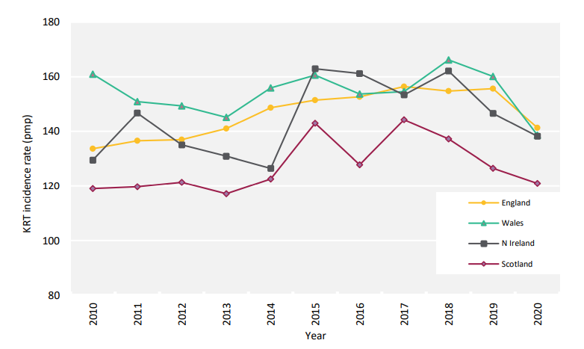
UK Renal Registry 24th Annual Report
Data to 31/12/2020
Figure 2.2 Adult KRT incidence rates by country between 2010 and 2020
^{pmp – per million population}

Slide 3
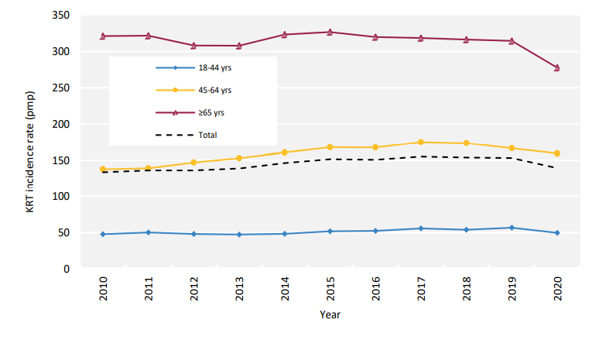
UK Renal Registry 24th Annual Report
Data to 31/12/2020
Figure 2.3 Adult KRT incidence rates by age group between 2010 and 2020
^{pmp – per million population}

Slide 4
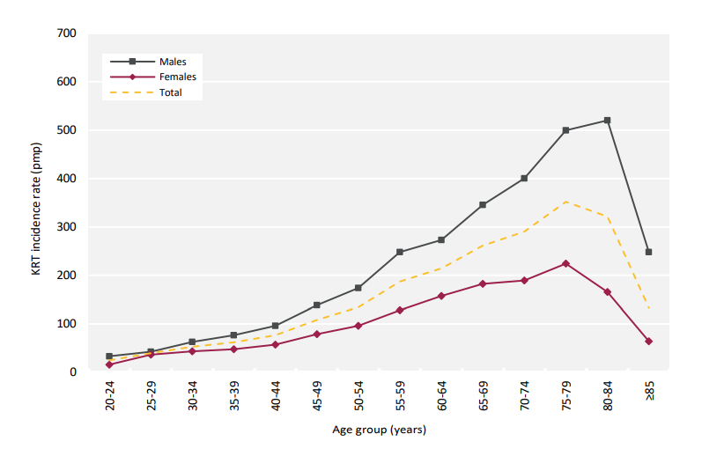
UK Renal Registry 24th Annual Report
Data to 31/12/2020
Figure 2.4 Incidence rates for adult patients starting KRT in 2020 by age group and sex
^{pmp – per million population}

Slide 5
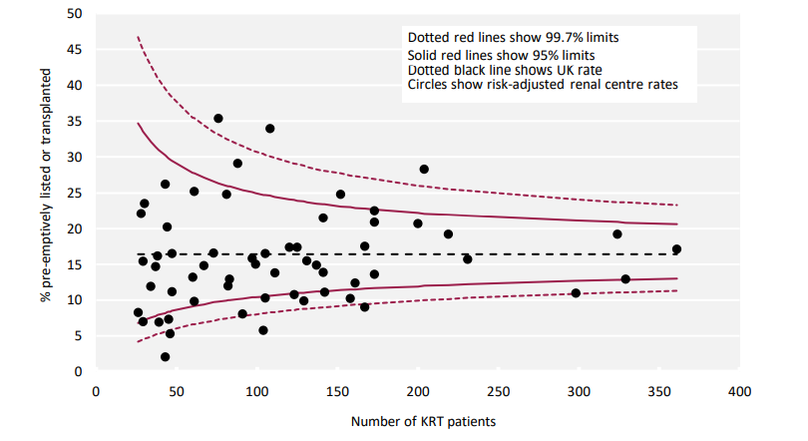
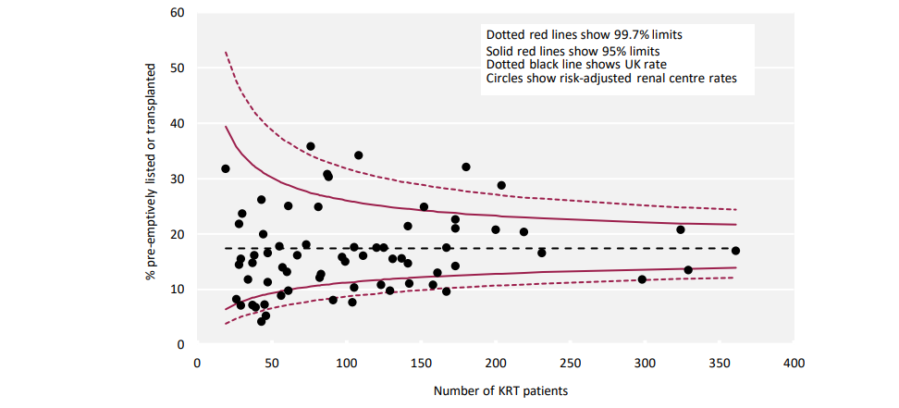
UK Renal Registry 24th Annual Report
Data to 31/12/2020
Figure 2.5 Transplant-status (listed or transplanted) at the start of KRT for adult patients incident to KRT in 2020 by centre
Analysis is adjusted for age, sex and PRD (diabetes versus non-diabetes).

Slide 6
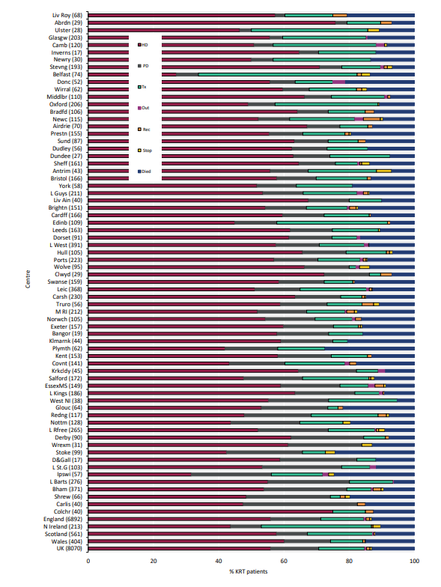
UK Renal Registry 24th Annual Report
Data to 31/12/2020
Figure 2.6 KRT modality at 1 year for incident adult KRT patients who started KRT in 2019 by centre
Number of patients in a centre in brackets.
Out – moved out of a centre but did not reappear in another centre; Rec – recovered kidney function; Stop – treatment withdrawal

Slide 7
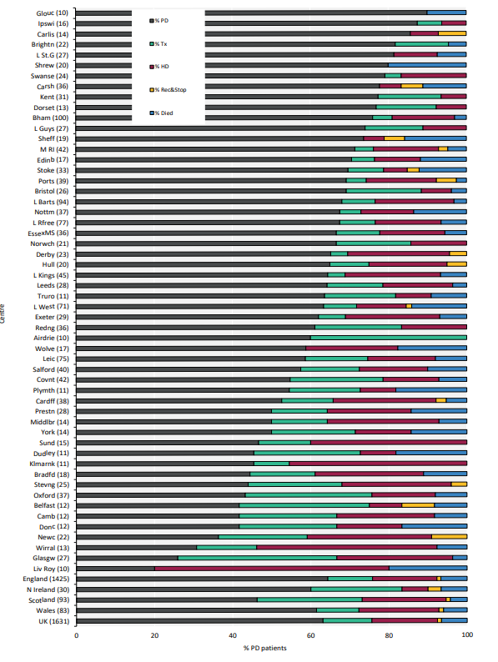
UK Renal Registry 24th Annual Report
Data to 31/12/2020
Figure 2.7 KRT modality at 1 year for incident adult PD patients who started KRT in 2019 by centre
Number of patients in a centre in brackets.
Out – moved out of a centre but did not reappear in another centre; Rec – recovered kidney function; Stop – treatment withdrawal

Slide 8
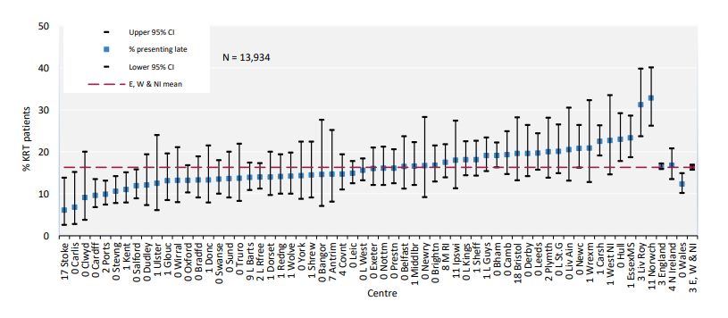
UK Renal Registry 24th Annual Report
Data to 31/12/2020
Figure 2.8 Percentage of incident adult KRT patients presenting late (<90 days) to a nephrologist (2018–2020 2 year cohort)
^{CI – confidence interval}

Slide 9
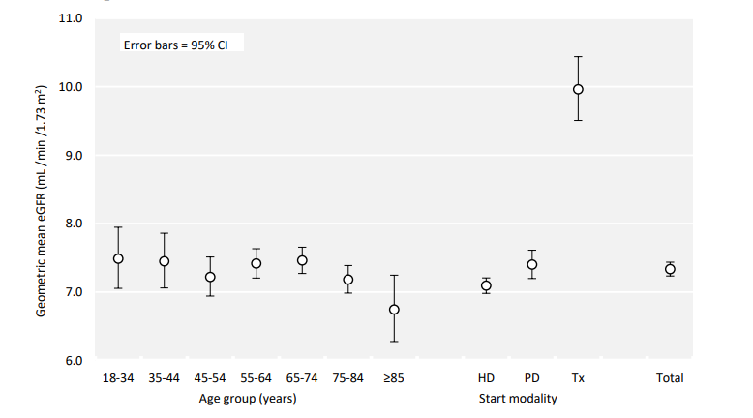
UK Renal Registry 24th Annual Report
Data to 31/12/2020
Figure 2.9 Geometric mean estimated glomerular filtration rates (eGFR) for adult patients incident to KRT in 2020 by age group and start modality
^{CI – confidence interval}

Slide 10
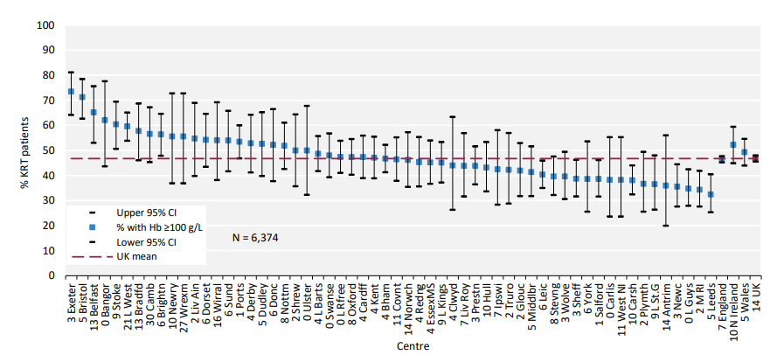
UK Renal Registry 24th Annual Report
Data to 31/12/2020
Figure 2.10 Percentage of adult patients incident to KRT in 2020 with haemoglobin (Hb) ≥100 g/L at start of KRT treatment by centre

Slide 11
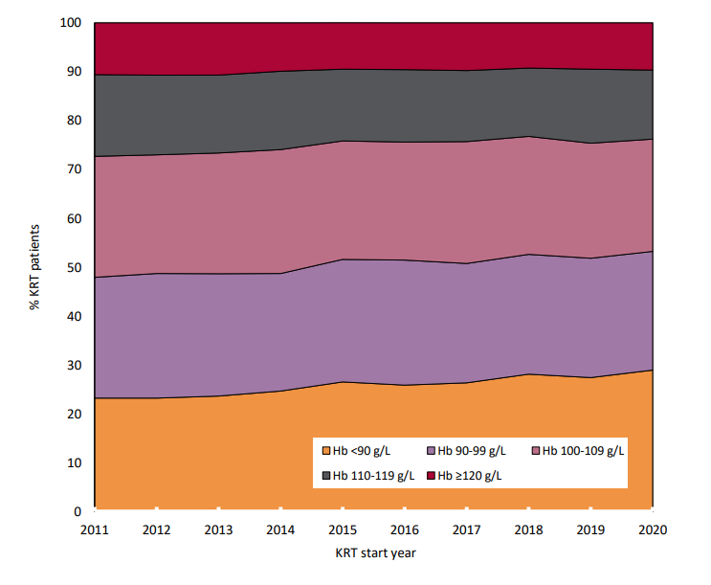
UK Renal Registry 24th Annual Report
Data to 31/12/2020
Figure 2.11 Distribution of haemoglobin (Hb) in incident adult KRT patients by year of start between 2011 and 2020

Slide 12
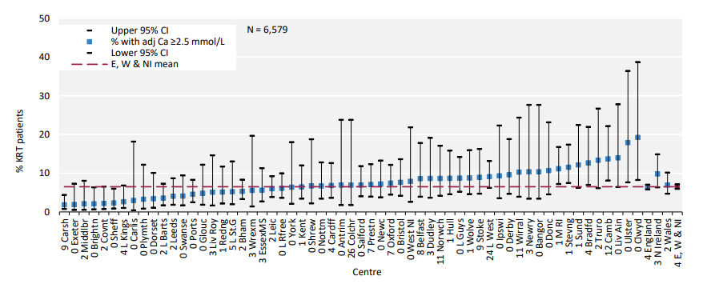
UK Renal Registry 24th Annual Report
Data to 31/12/2020
Figure 2.12 Percentage of adult patients incident to KRT in 2020 with adjusted calcium (Ca) above the normal range (>2.5 mmol/L) by centre
^{CI – confidence interval}

Slide 13
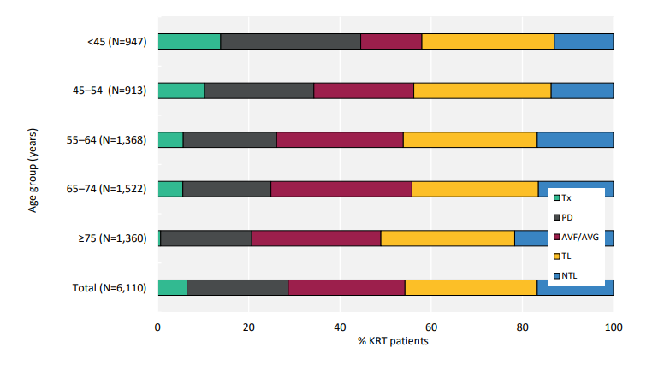
UK Renal Registry 24th Annual Report
Data to 31/12/2020
Figure 2.13 Dialysis access used for adult patients incident to KRT in 2020 by age group (2020 Multisite Dialysis Access Audit)
AVF – arteriovenous ﬁstula; AVG – arteriovenous graft; NTL – non-tunnelled line; TL – tunnelled line

Slide 14
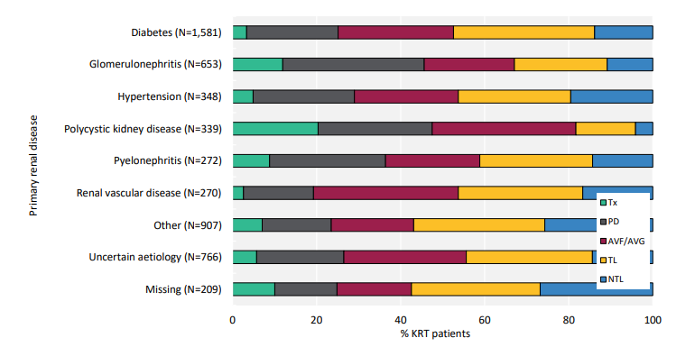
UK Renal Registry 24th Annual Report
Data to 31/12/2020
Figure 2.14 Dialysis access used for adult patients incident to KRT in 2020 by primary renal disease (2020 Multisite Dialysis Access Audit)
AVF – arteriovenous ﬁstula; AVG – arteriovenous graft; NTL – non-tunnelled line; TL – tunnelled line

Slide 15
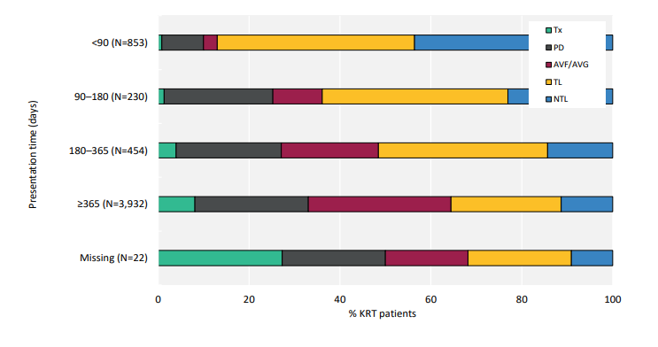
UK Renal Registry 24th Annual Report
Data to 31/12/2020
Figure 2.15 Dialysis access used for adult patients incident to KRT in 2020 by presentation time (2020 Multisite Dialysis Access Audit)
AVF – arteriovenous ﬁstula; AVG – arteriovenous graft; NTL – non-tunnelled line; TL – tunnelled line

Slide 16
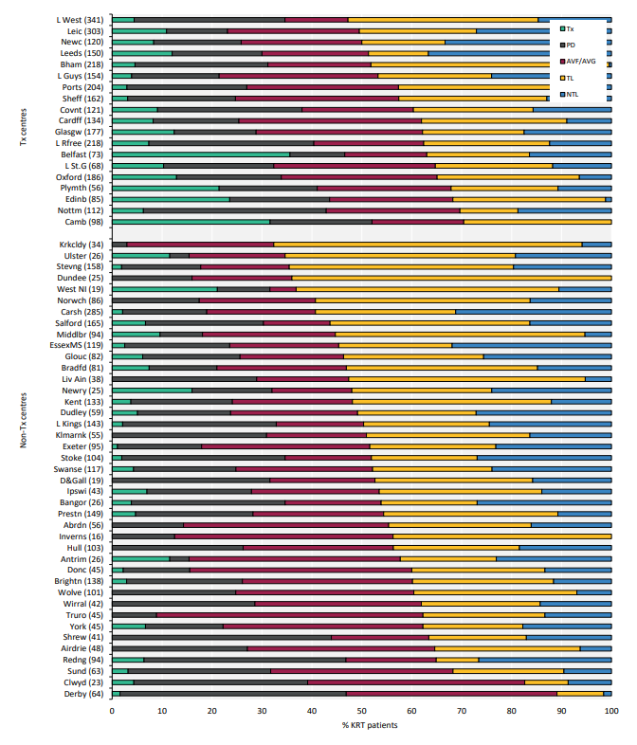
UK Renal Registry 24th Annual Report
Data to 31/12/2020
Figure 2.16 First dialysis access used for adult patients incident to KRT in 2020 by centre (2020 Multisite Dialysis Access Audit)
Number of incident patients on KRT in a centre in brackets.
Centres are ordered by decreasing use of lines.
AVF – arteriovenous ﬁstula; AVG – arteriovenous graft; NTL – non-tunnelled line; TL – tunnelled line

Slide 17
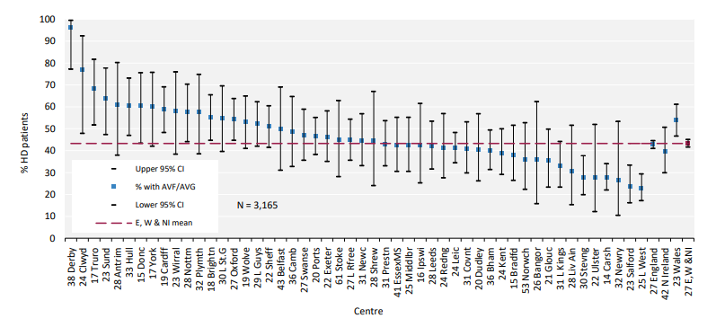
UK Renal Registry 24th Annual Report
Data to 31/12/2020
Figure 2.17 Percentage of adult patients incident to HD in 2020 who started dialysis using either an arteriovenous fistula (AVF) or an arteriovenous graft (AVG) by centre, excluding late presenters (2020 Multisite Dialysis Access Audit)
Centres with <70% completeness of access data for all dialysis patients were excluded. No further exclusion for completeness in HD patients was applied. Therefore, data completeness for some centres is less than in other caterpillar plots in this report.
^{CI – confidence interval}

Slide 18
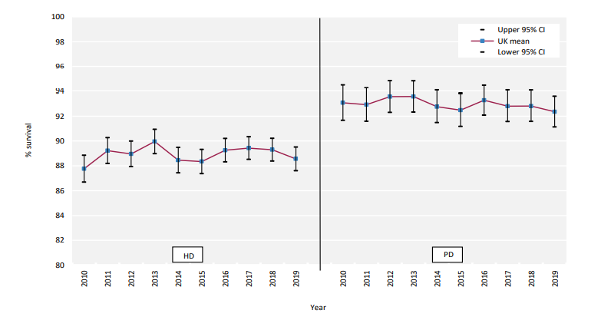
UK Renal Registry 24th Annual Report
Data to 31/12/2020
Figure 2.18 1 year after 90 days survival (adjusted to age 60 years) of incident adult KRT patients by start modality between 2010 and 2019
^{CI – confidence interval}

Slide 19
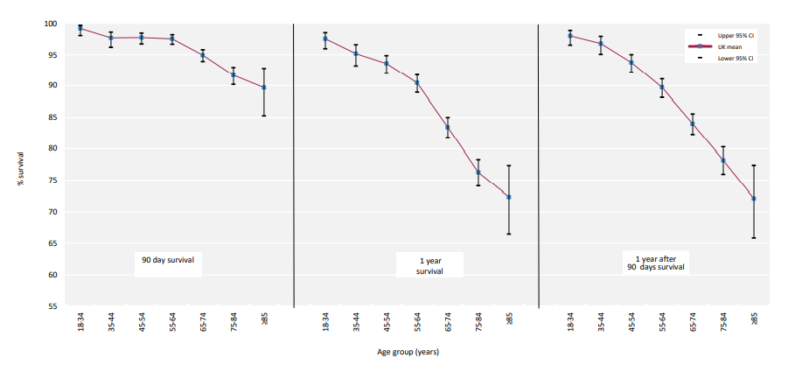
UK Renal Registry 24th Annual Report
Data to 31/12/2020
Figure 2.19 90 days, 1 year and 1 year after 90 days survival of incident adult KRT patients by age group (2019 cohort)
^{CI – confidence interval}

Slide 20
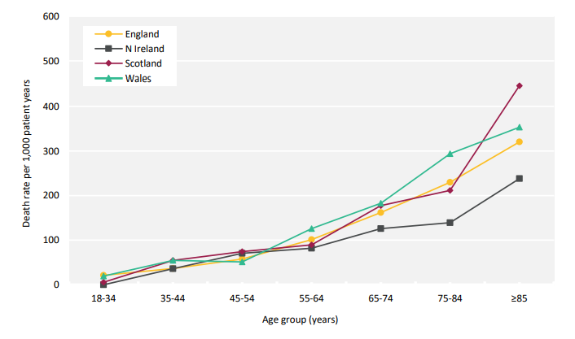
UK Renal Registry 24th Annual Report
Data to 31/12/2020
Figure 2.20 1 year after 90 days death rate per 1,000 incident KRT adult patient years by age group and country (2016–2019 4 year cohort)

Slide 21
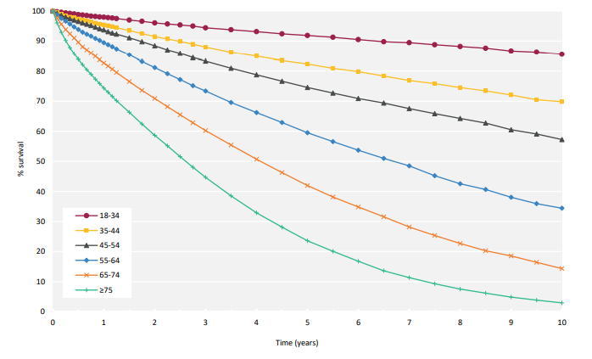
UK Renal Registry 24th Annual Report
Data to 31/12/2020
Figure 2.21 Survival (unadjusted) of incident adult KRT patients from day 0 by age group (2010–2019 10 year cohort)

Slide 22
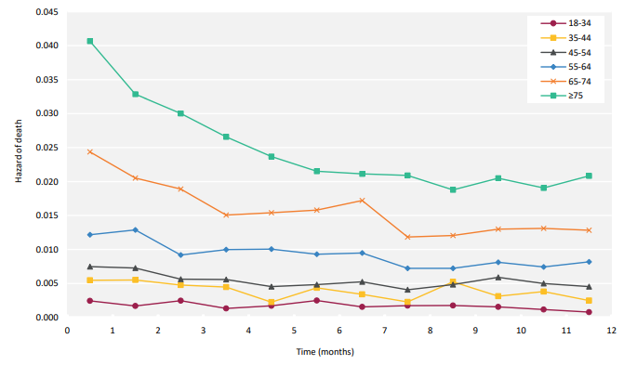
UK Renal Registry 24th Annual Report
Data to 31/12/2020
Figure 2.22 Monthly hazard of death (unadjusted) of incident adult KRT patients from day 0 to 1 year by age group (2010–2019 10 year cohort)

Slide 23
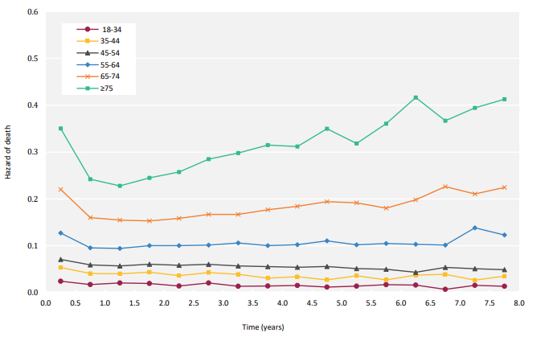
UK Renal Registry 24th Annual Report
Data to 31/12/2020
Figure 2.23 6 monthly hazard of death (unadjusted) of incident adult KRT patients from day 0 to 8 years by age group (2010–2019 10 year cohort)

Slide 24
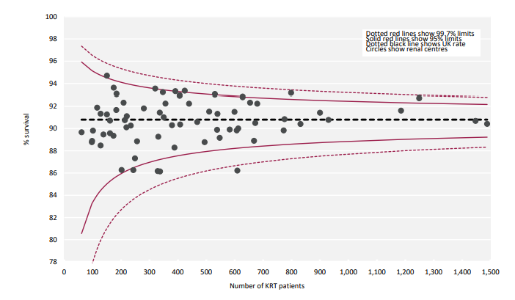
UK Renal Registry 24th Annual Report
Data to 31/12/2020
Figure 2.24 1 year after 90 days survival (adjusted to age 60 years) of incident adult KRT patients by centre (2016–2019 4 year cohort)

Slide 25
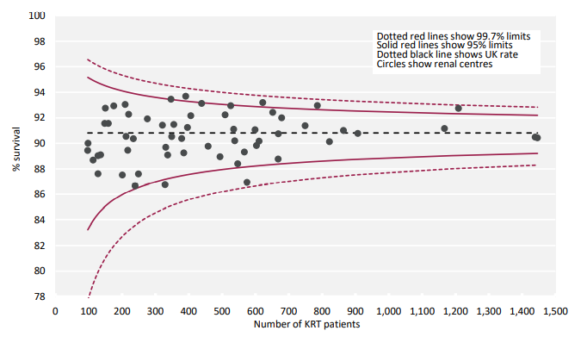
UK Renal Registry 24th Annual Report
Data to 31/12/2020
Figure 2.25 1 year after 90 days survival (adjusted to age 60 years, male and median comorbidity score) of incident adult KRT patients by centre (2016–2019 4 year cohort)

