Slide 1

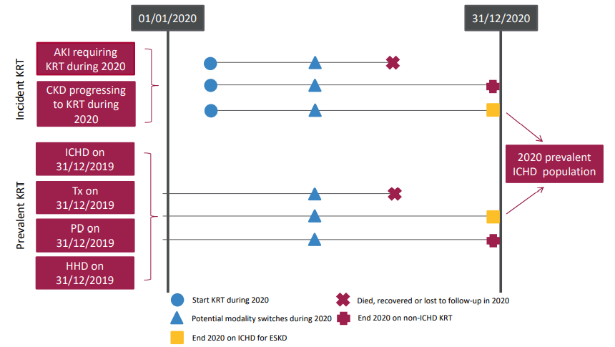
UK Renal Registry 24th Annual Report
Data to 31/12/2020
Figure 5.1 Pathways adult patients could follow to be included in the UK 2020 prevalent ICHD population
Note that patients receiving dialysis for acute kidney injury (AKI) are only included in this chapter if they had a timeline or KRT modality code for chronic ICHD at the end of 2020 or if they had been on KRT for ≥90 days and were on ICHD at the end of 2020.
^{CKD – chronic kidney disease}

Slide 2
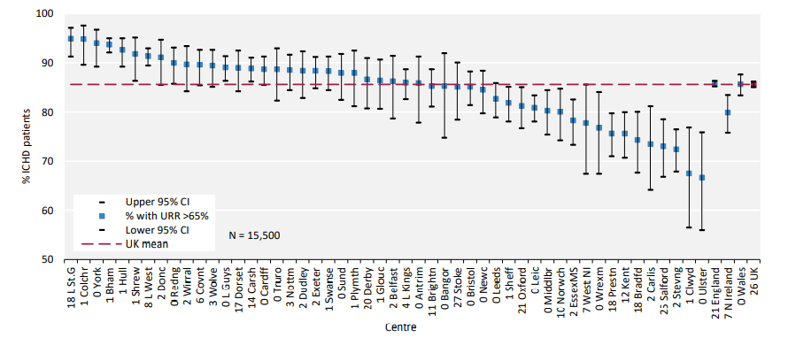
UK Renal Registry 24th Annual Report
Data to 31/12/2020
Figure 5.2 Percentage of adult patients prevalent to ICHD on 31/12/2020 with urea reduction ratio (URR) >65% by centre
^{CI – confidence interval}

Slide 3
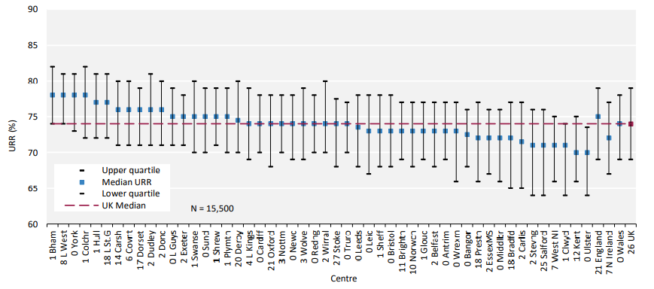
UK Renal Registry 24th Annual Report
Data to 31/12/2020
Figure 5.3 Median urea reduction ratio (URR) achieved in adult patients prevalent to ICHD on 31/12/2020 by centre

Slide 4
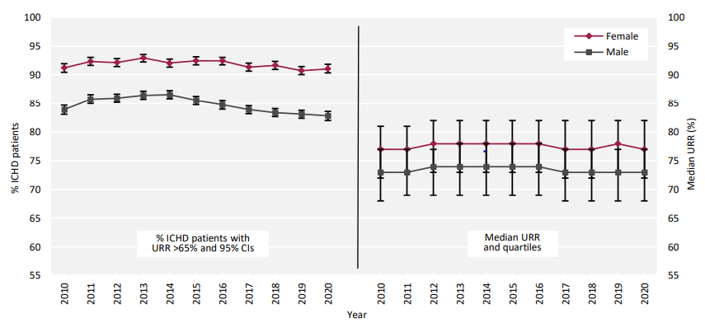
UK Renal Registry 24th Annual Report
Data to 31/12/2020
Figure 5.4 Change in the percentage of prevalent adult ICHD patients with urea reduction ratio (URR) >65% and the median URR by sex between 2010 and 2020
^{CI – confidence interval}

Slide 5
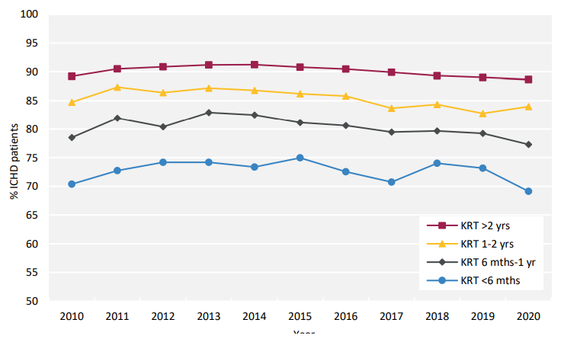
UK Renal Registry 24th Annual Report
Data to 31/12/2020
Figure 5.5 Percentage of prevalent adult ICHD patients achieving urea reduction ratio (URR) >65% by time on KRT between 2010 and 2020

Slide 6
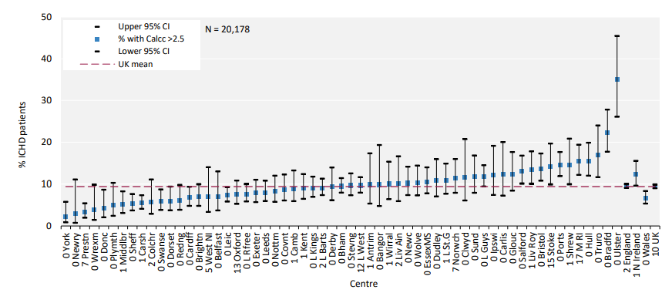
UK Renal Registry 24th Annual Report
Data to 31/12/2020
Figure 5.6 Percentage of adult patients prevalent to ICHD on 31/12/2020 with adjusted calcium (Ca) above the target range (>2.5 mmol/L) by centre
^{CI – confidence interval}

Slide 7
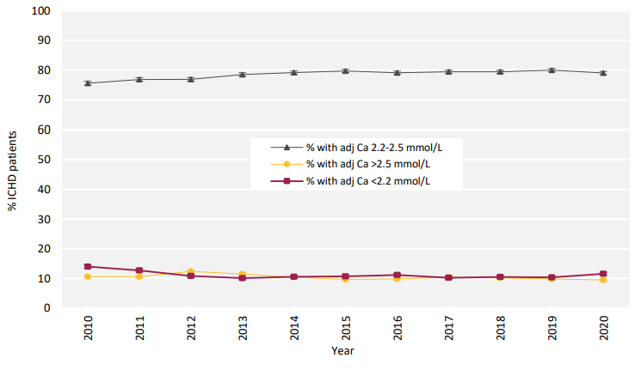
UK Renal Registry 24th Annual Report
Data to 31/12/2020
Figure 5.7 Change in percentage of prevalent adult ICHD patients within, above and below the target range for adjusted calcium (Ca 2.2–2.5 mmol/L) between 2010 and 2020

Slide 8
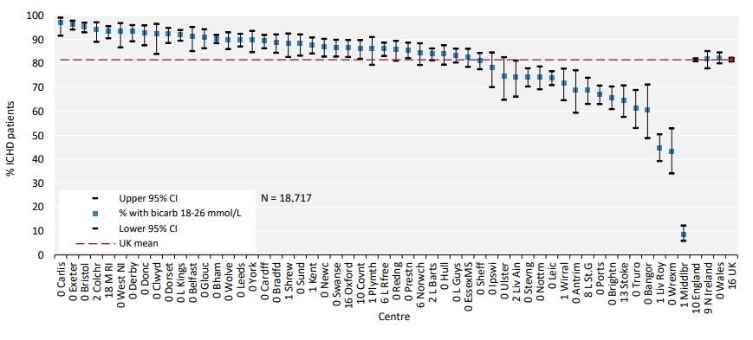
UK Renal Registry 24th Annual Report
Data to 31/12/2020
Figure 5.8 Percentage of adult patients prevalent to ICHD on 31/12/2020 with pre-dialysis bicarbonate (bicarb) within the target range (18–26 mmol/L) by centre
^{CI – confidence interval}

Slide 9
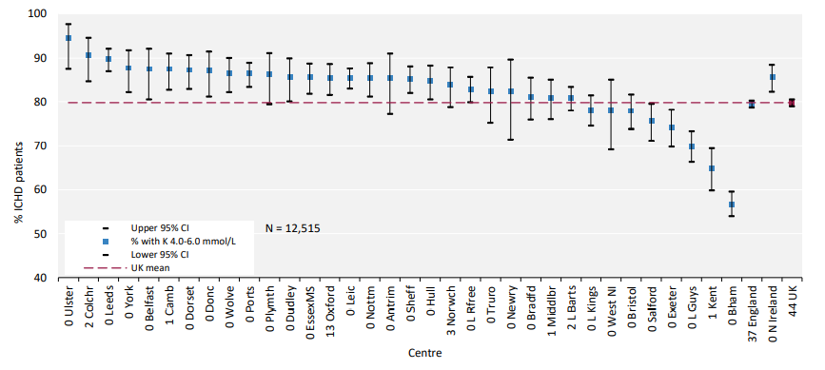
UK Renal Registry 24th Annual Report
Data to 31/12/2020
Figure 5.9 Percentage of adult patients prevalent to ICHD on 31/12/2020 with pre-dialysis potassium (K) within the target range (4.0–6.0 mmol/L) by centre
^{CI – confidence interval}

Slide 10
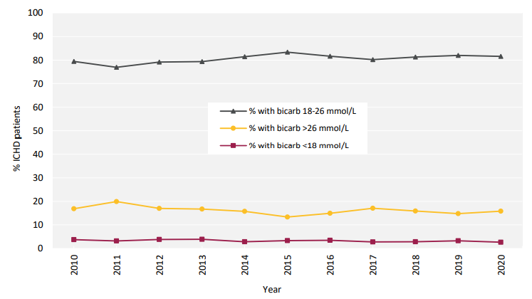
UK Renal Registry 24th Annual Report
Data to 31/12/2020
Figure 5.10 Change in percentage of prevalent adult ICHD patients within, above and below the target range for pre-dialysis bicarbonate (bicarb 18–26 mmol/L) between 2010 and 2020

Slide 11
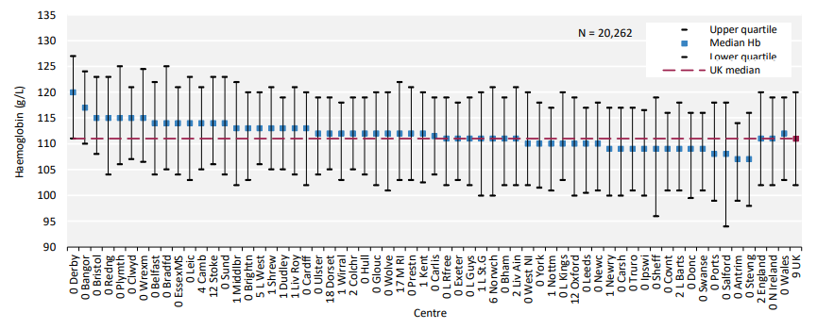
UK Renal Registry 24th Annual Report
Data to 31/12/2020
Figure 5.11 Median haemoglobin (Hb) in adult patients prevalent to ICHD on 31/12/2020 by centre

Slide 12
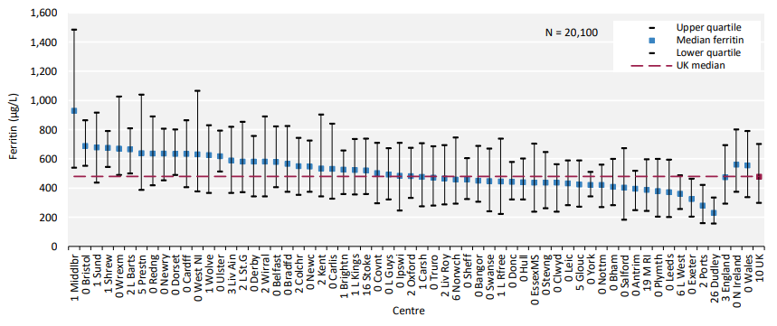
UK Renal Registry 24th Annual Report
Data to 31/12/2020
Figure 5.12 Median ferritin in adult patients prevalent to ICHD on 31/12/2020 by centre

Slide 13
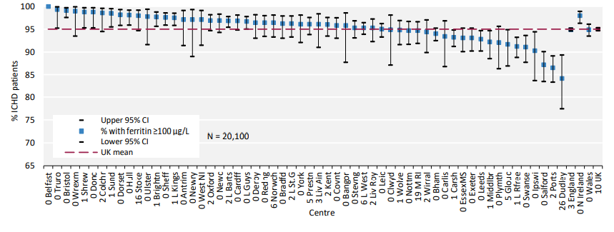
UK Renal Registry 24th Annual Report
Data to 31/12/2020
Figure 5.13 Percentage of adult patients prevalent to ICHD on 31/12/2020 with ferritin ≥100 µg/L by centre
^{CI – confidence interval}

Slide 14
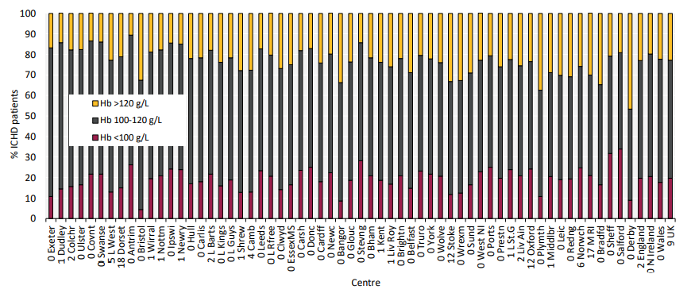
UK Renal Registry 24th Annual Report
Data to 31/12/2020
Figure 5.14 Distribution of haemoglobin (Hb) in adult patients prevalent to ICHD on 31/12/2020 by centre

Slide 15
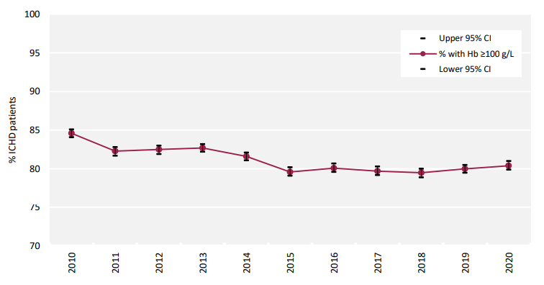
UK Renal Registry 24th Annual Report
Data to 31/12/2020
Figure 5.15 Percentage of prevalent adult ICHD patients with haemoglobin (Hb) ≥100 g/L between 2010 and 2020
^{CI – confidence interval}

Slide 16
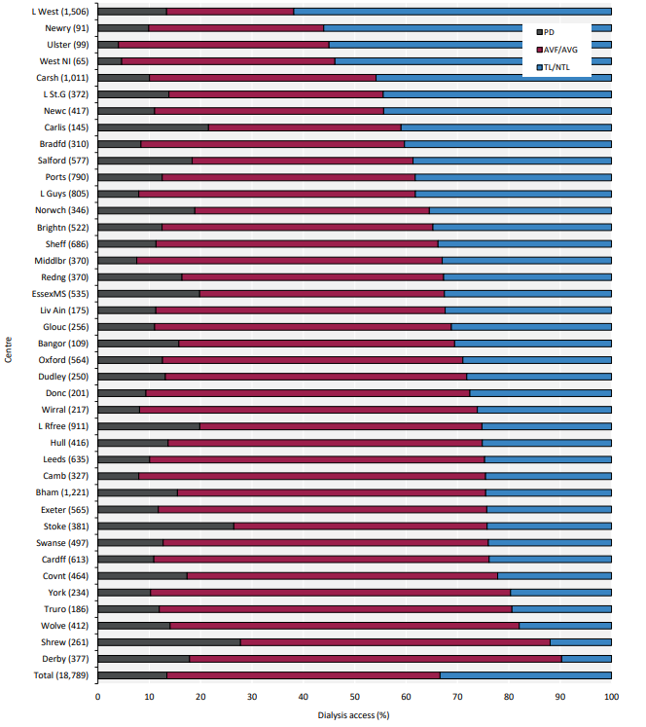
UK Renal Registry 24th Annual Report
Data to 31/12/2020
Figure 5.16 Dialysis access in adult patients prevalent to dialysis on 31/12/2020 by centre (2020 Multisite Dialysis Access Audit)
Number of patients on dialysis in a centre in brackets (centres with <70% access data for the prevalent dialysis population were excluded).
AVF – arteriovenous fistula; AVG – arteriovenous graft; NTL – non-tunnelled line; TL – tunnelled line

Slide 17
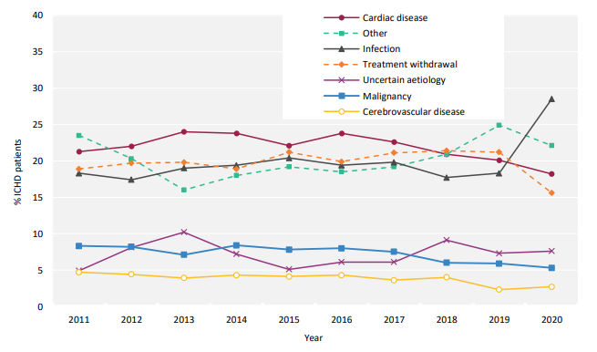
UK Renal Registry 24th Annual Report
Data to 31/12/2020
Figure 5.21 Cause of death between 2011 and 2020 for adult patients prevalent to ICHD at the beginning of the year.

