Slide 1

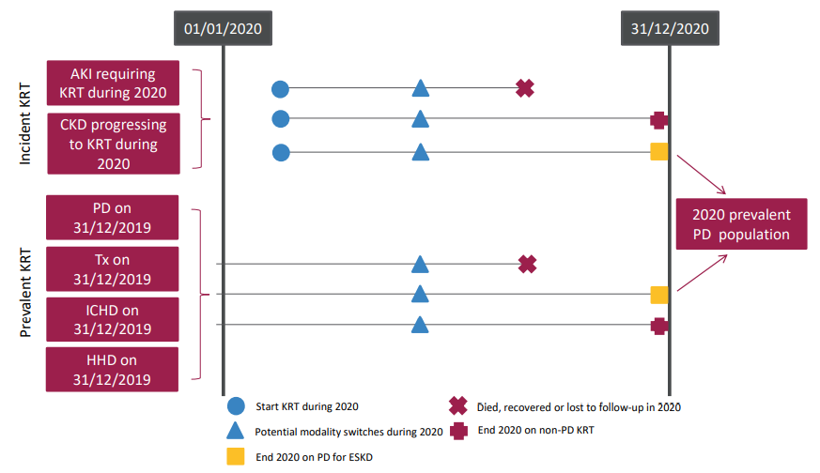
UK Renal Registry 24th Annual Report
Data to 31/12/2020
Figure 6.1 Pathways adult patients could follow to be included in the UK 2020 prevalent PD population
Note that patients receiving dialysis for acute kidney injury (AKI) are only included in this chapter if they had a timeline or KRT modality code for chronic PD at the end of 2020 or if they had been on KRT for ≥90 days and were on PD at the end of 2020.
^{CKD – chronic kidney disease}

Slide 2
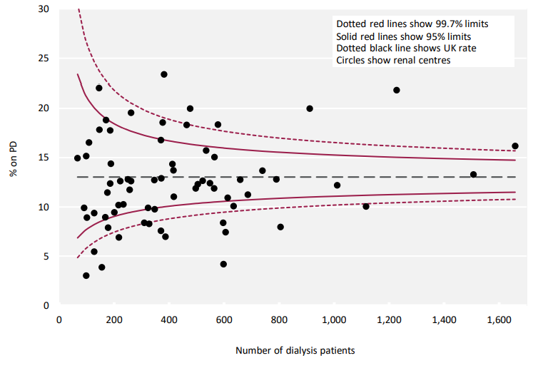
UK Renal Registry 24th Annual Report
Data to 31/12/2020
Figure 6.2 Percentage of adult patients prevalent to dialysis on 31/12/2020 who were on PD by centre

Slide 3
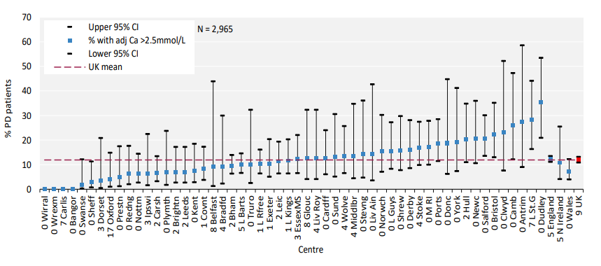
UK Renal Registry 24th Annual Report
Data to 31/12/2020
Figure 6.3 Percentage of adult patients prevalent to PD on 31/12/2020 with adjusted calcium (Ca) above the target range (>2.5 mmol/L) by centre
^{CI – confidence interval}

Slide 4
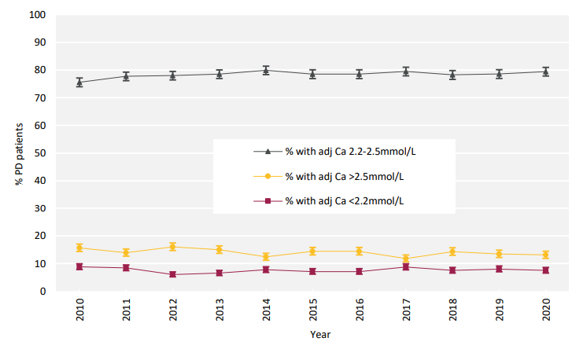
UK Renal Registry 24th Annual Report
Data to 31/12/2020
Figure 6.4 Change in percentage of prevalent adult PD patients within, above and below the target range for adjusted calcium (Ca 2.2–2.5 mmol/L) between 2010 and 2020

Slide 5
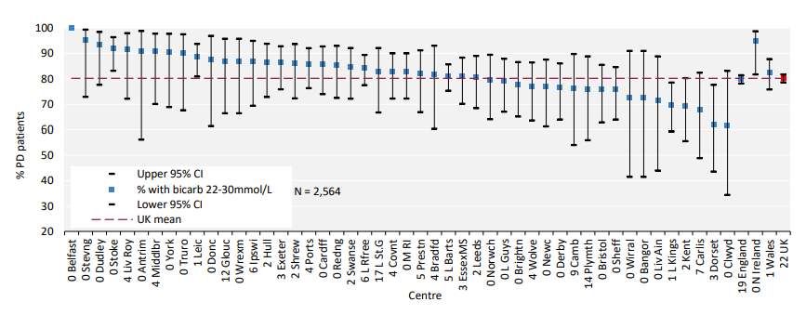
UK Renal Registry 24th Annual Report
Data to 31/12/2020
Figure 6.5 Percentage of adult patients prevalent to PD on 31/12/2020 with bicarbonate (bicarb) within the target range (22–30 mmol/L) by centre
^{CI – confidence interval}

Slide 6
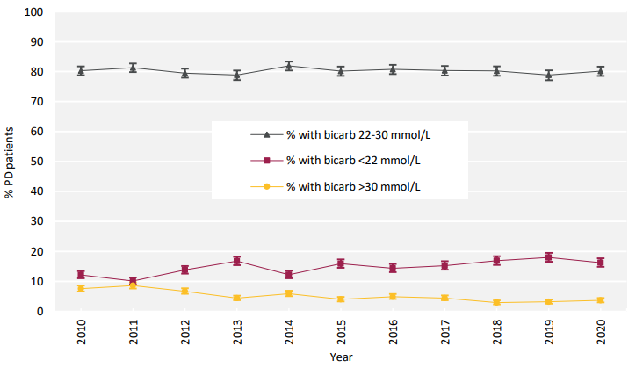
UK Renal Registry 24th Annual Report
Data to 31/12/2020
Figure 6.6 Percentage of prevalent adult PD patients within, above and below the target range for bicarbonate (bicarb 22–30 mmol/L) between 2010 and 2020

Slide 7
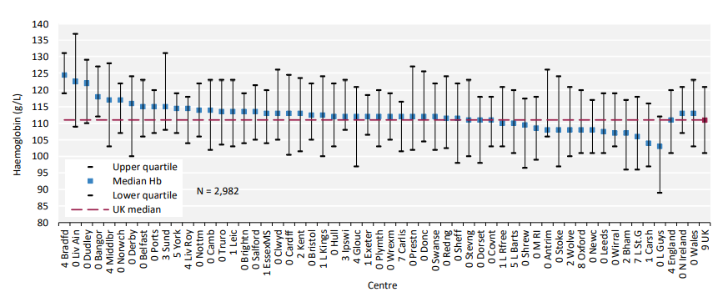
UK Renal Registry 24th Annual Report
Data to 31/12/2020
Figure 6.7 Median haemoglobin (Hb) in adult patients prevalent to PD on 31/12/2020 by centre

Slide 8
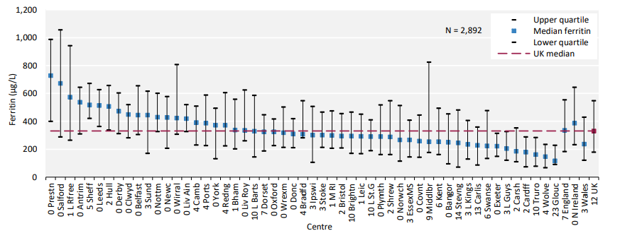
UK Renal Registry 24th Annual Report
Data to 31/12/2020
Figure 6.8 Median ferritin in adult patients prevalent to PD on 31/12/2020 by centre

Slide 9
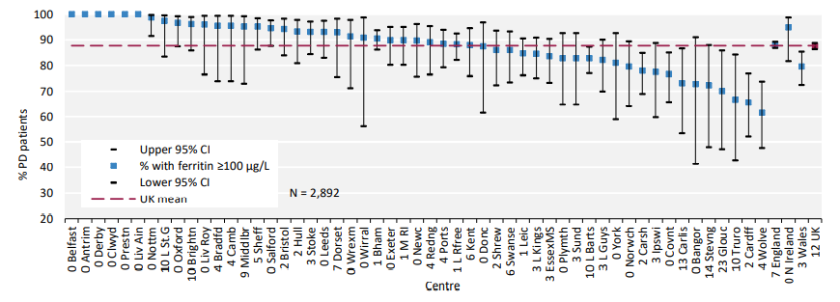
UK Renal Registry 24th Annual Report
Data to 31/12/2020
Figure 6.9 Percentage of adult patients prevalent to PD on 31/12/2020 with ferritin ≥100 µg/L by centre
^{CI – confidence interval}

Slide 10
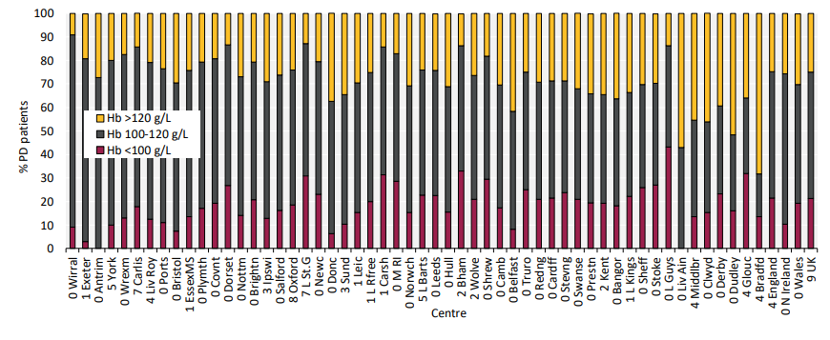
UK Renal Registry 24th Annual Report
Data to 31/12/2020
Figure 6.10 Distribution of haemoglobin (Hb) in adult patients prevalent to PD on 31/12/2020 by centre

Slide 11
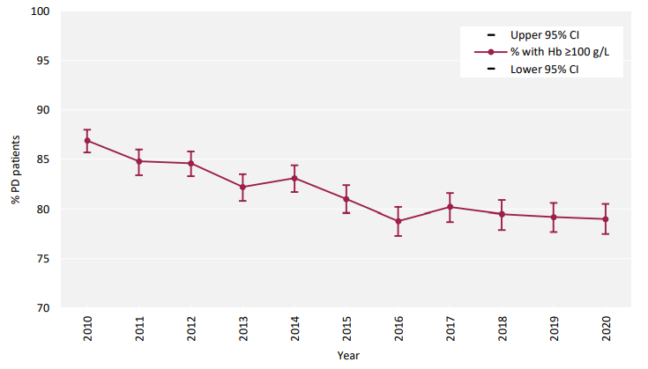
UK Renal Registry 24th Annual Report
Data to 31/12/2020
Figure 6.11 Percentage of prevalent adult PD patients with haemoglobin (Hb) ≥100 g/L between 2010 and 2020
^{CI – confidence interval}

Slide 12
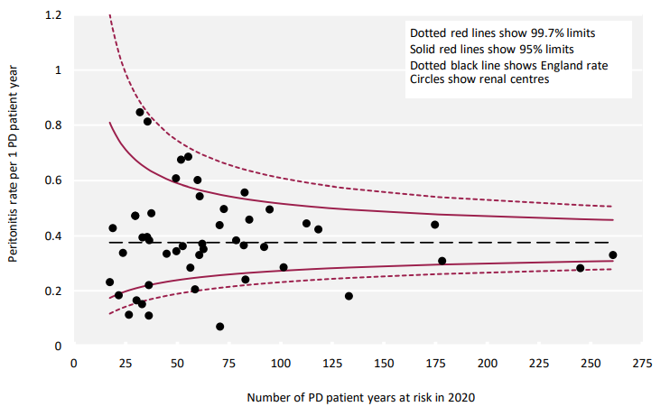
UK Renal Registry 24th Annual Report
Data to 31/12/2020
Figure 6.12 PD peritonitis rates in adult patients receiving PD in 2020 per 1 PD patient-year by centre in England
Please visit the UKRR data portal () to identify individual kidney centres.

Slide 13
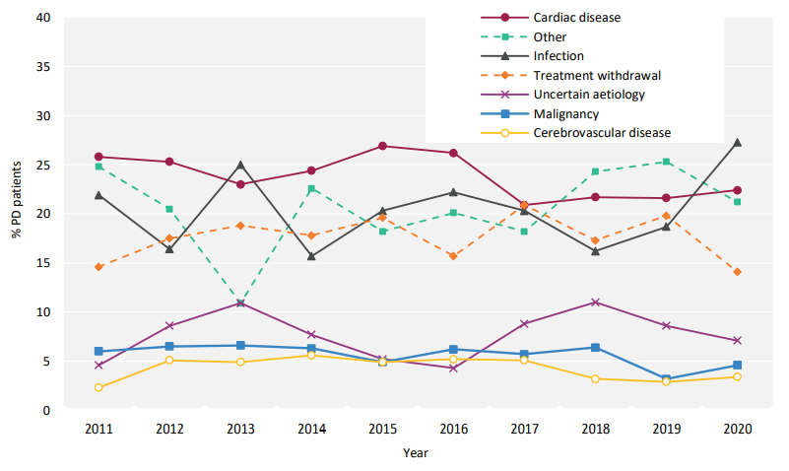
UK Renal Registry 24th Annual Report
Data to 31/12/2020
Figure 6.13 Cause of death between 2011 and 2020 for adult patients prevalent to PD at the beginning of the year

