Slide 1

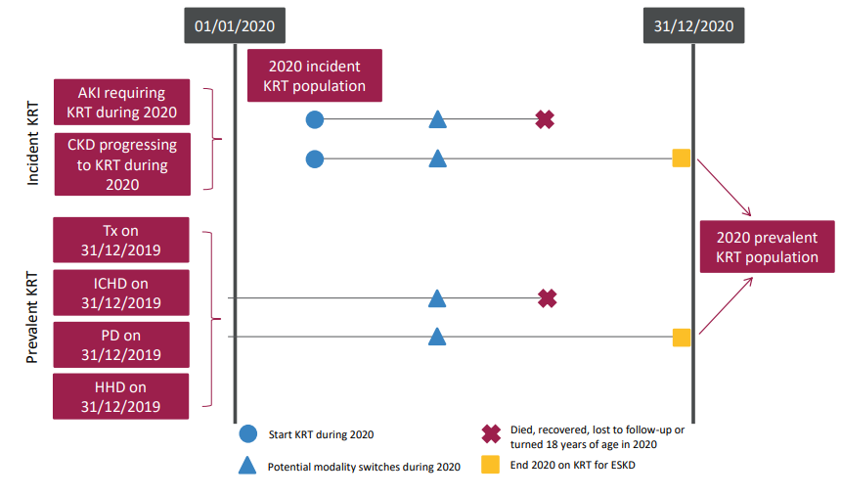
UK Renal Registry 24th Annual Report
Data to 31/12/2020
Figure 8.1 Pathways children and young people could follow to be included in the UK 2020 incident and/or prevalent KRT populations
Note that patients who recovered kidney function before 90 days on dialysis are not included in this chapter.
^{CKD – chronic kidney disease}

Slide 2
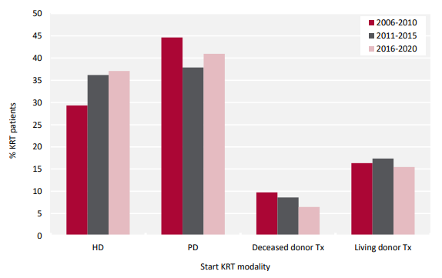
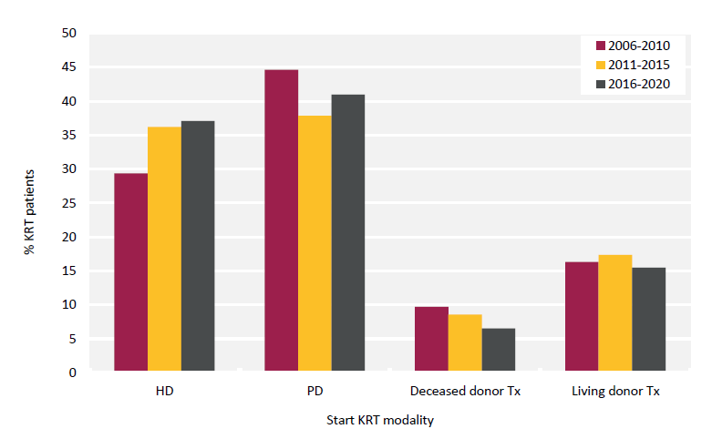
UK Renal Registry 24th Annual Report
Data to 31/12/2020
Figure 8.2 Start KRT modality for paediatric patients (<16 years old) incident to KRT by 5 year time period

Slide 3
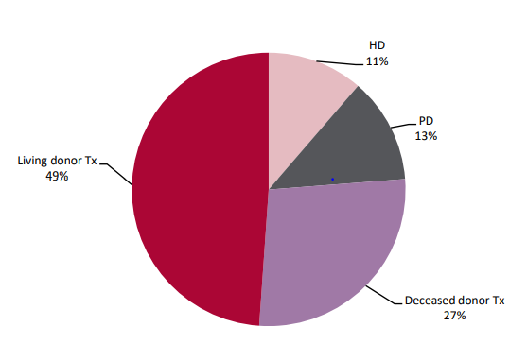
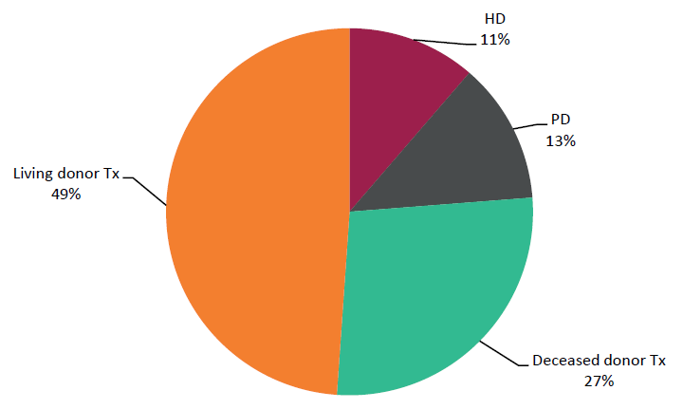
UK Renal Registry 24th Annual Report
Data to 31/12/2020
Figure 8.3 KRT modality used by paediatric patients (<16 years old) prevalent to KRT on 31/12/2020

Slide 4
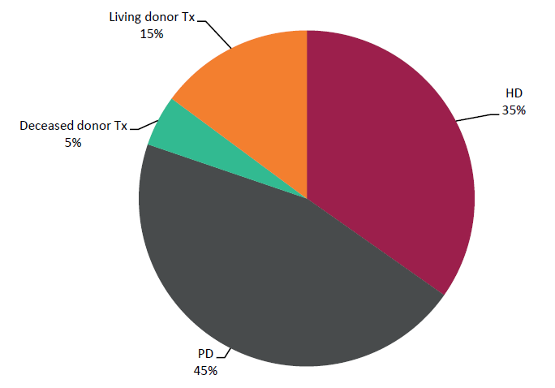
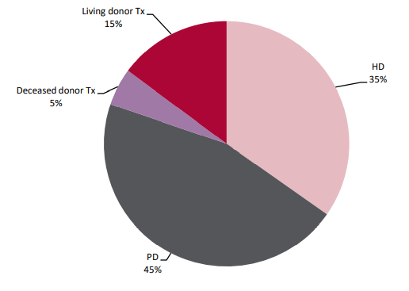
UK Renal Registry 24th Annual Report
Data to 31/12/2020
Figure 8.4 KRT modality used at the start of KRT by paediatric patients (<16 years old) prevalent to KRT on 31/12/2020

Slide 5
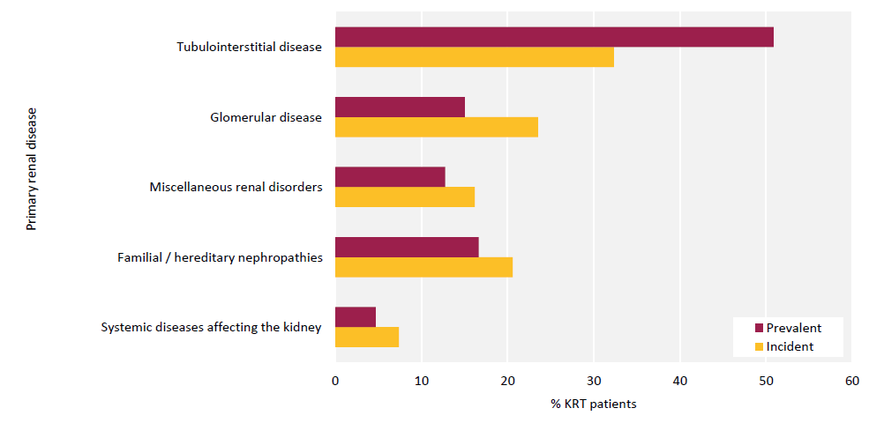
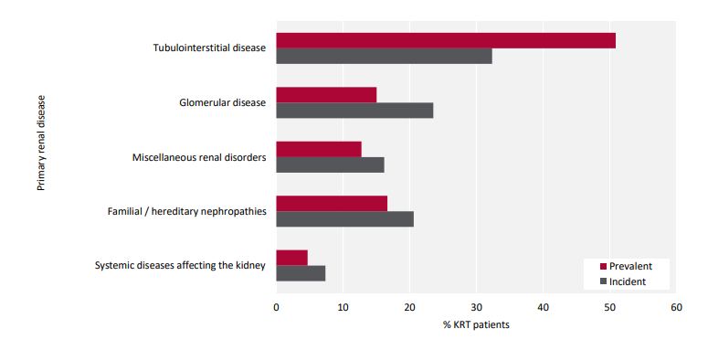
UK Renal Registry 24th Annual Report
Data to 31/12/2020
Figure 8.5 Comparison of primary renal diseases for paediatric patients (<16 years old) incident and prevalent to KRT in 2020 with no missing data

Slide 6
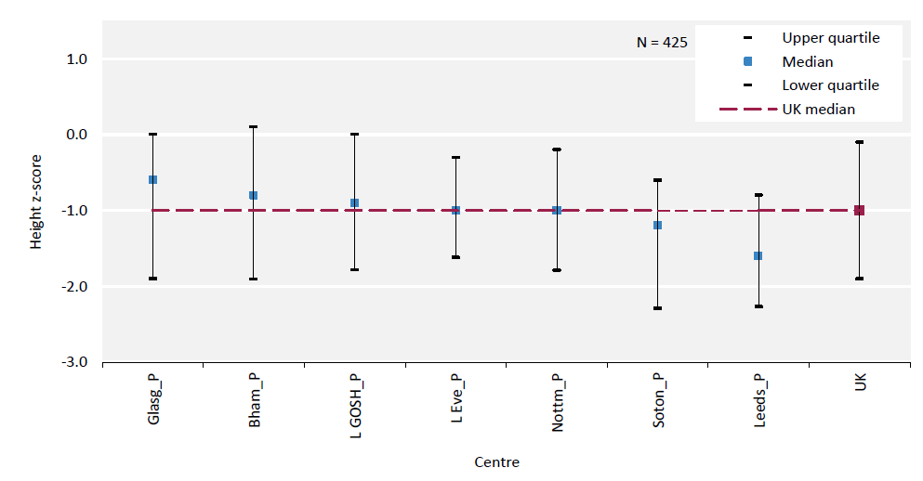
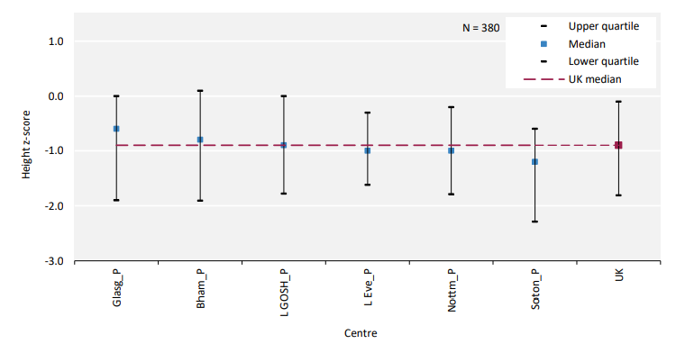
UK Renal Registry 24th Annual Report
Data to 31/12/2020
Figure 8.6 Median height z-scores for paediatric patients (<16 years old) prevalent to Tx on 31/12/2020 by centre

Slide 7
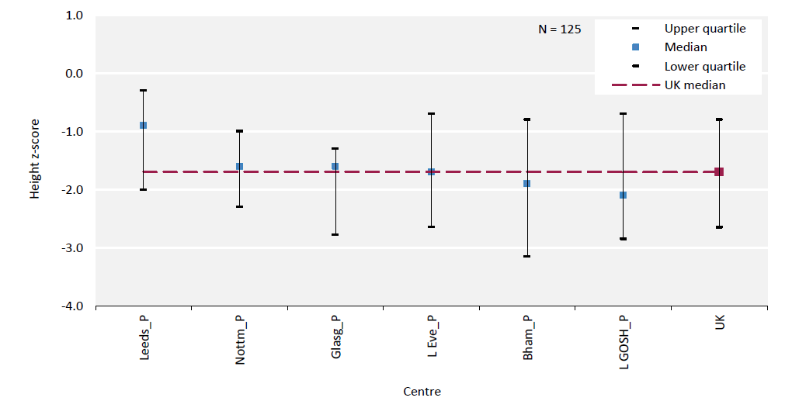
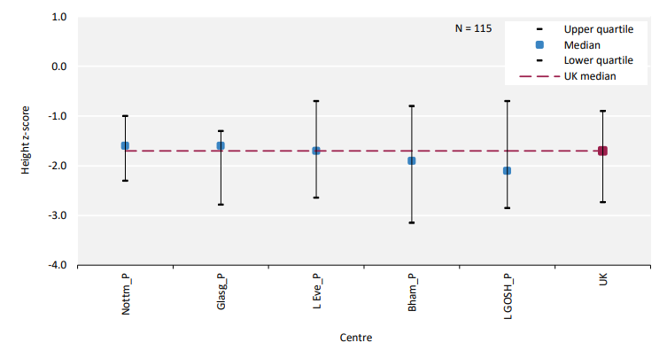
UK Renal Registry 24th Annual Report
Data to 31/12/2020
Figure 8.7 Median height z-scores for paediatric patients (<16 years old) prevalent to dialysis on 31/12/2020 by centre

Slide 8
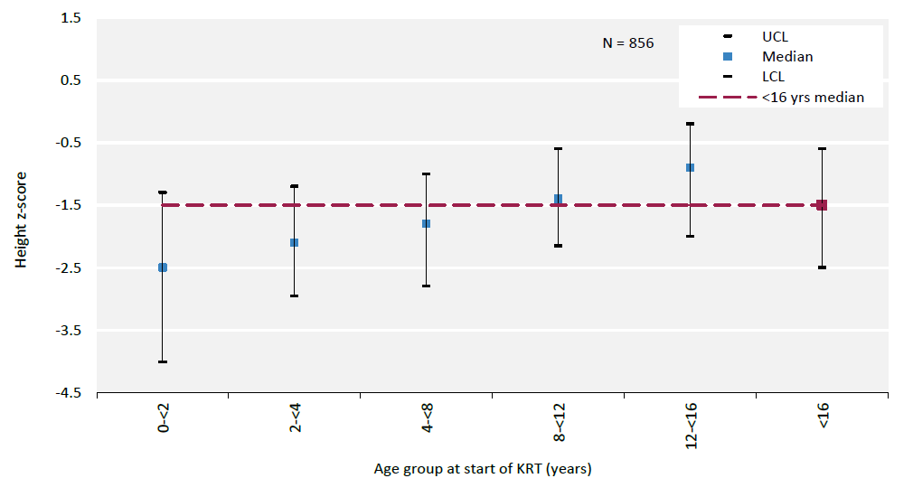
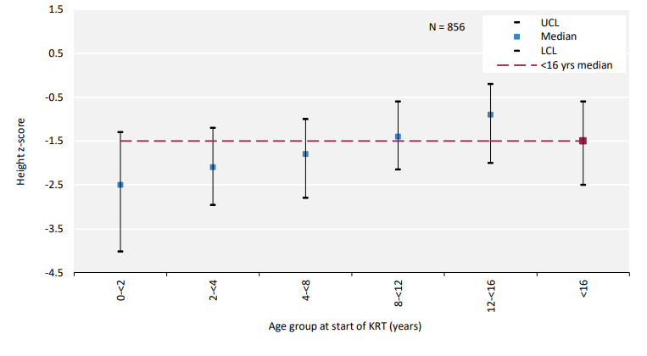
UK Renal Registry 24th Annual Report
Data to 31/12/2020
Figure 8.8 Median height z-scores at start of KRT for incident paediatric KRT patients (<16 years old) between 2006 and 2020 by age group at start of KRT

Slide 9
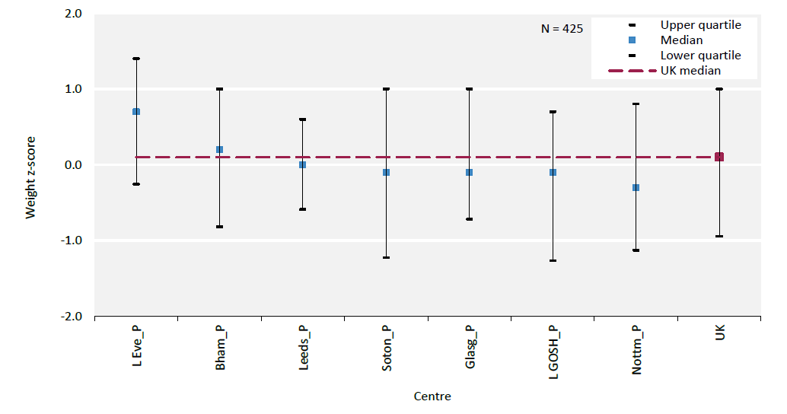
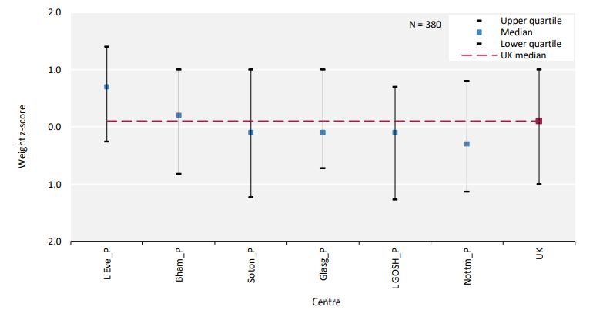
UK Renal Registry 24th Annual Report
Data to 31/12/2020
Figure 8.9 Median weight z-scores for paediatric patients (<16 years old) prevalent to Tx on 31/12/2020 by centre

Slide 10
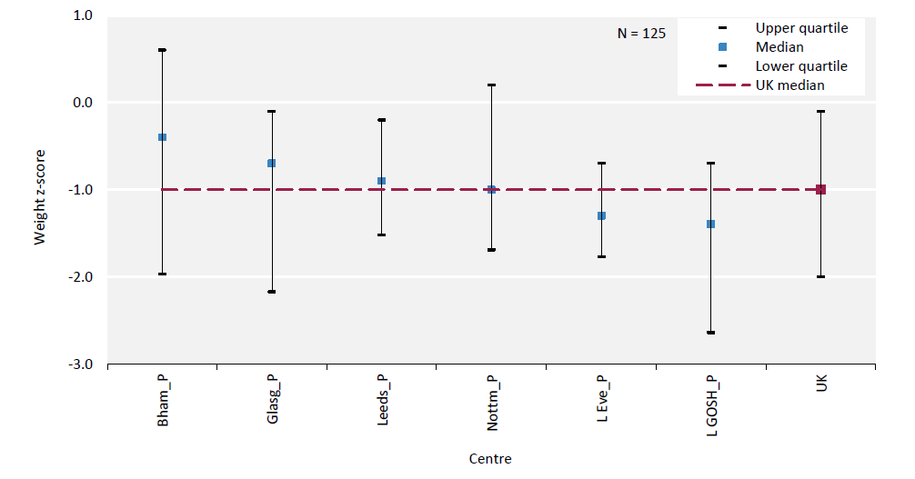
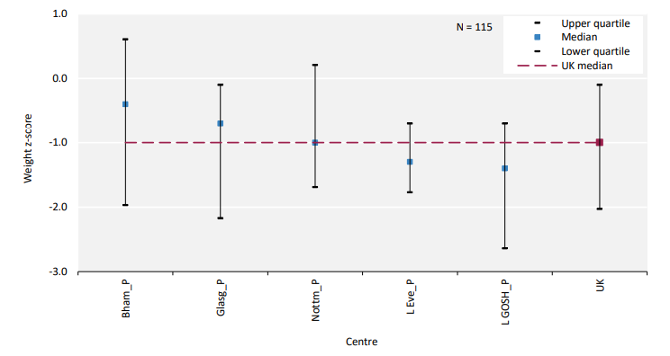
UK Renal Registry 24th Annual Report
Data to 31/12/2020
Figure 8.10 Median weight z-scores for paediatric patients (<16 years old) prevalent to dialysis on 31/12/2020 by centre

Slide 11
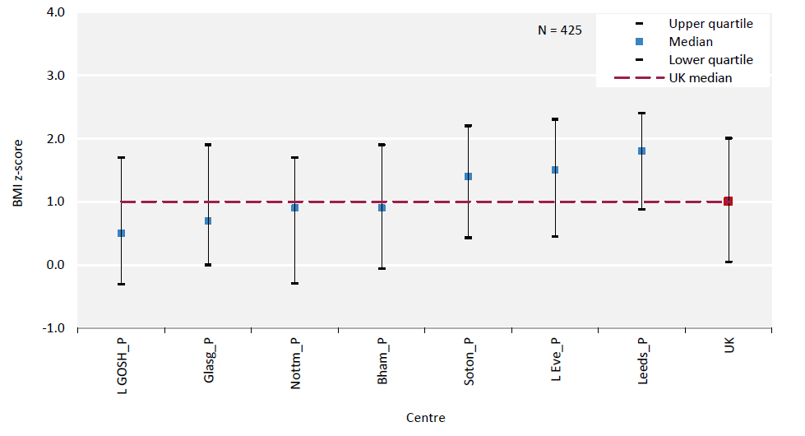
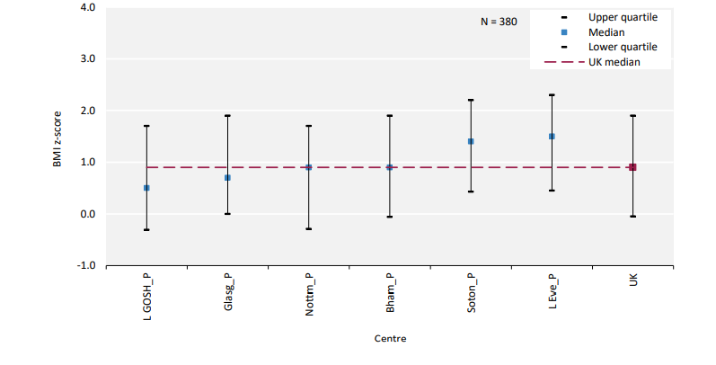
UK Renal Registry 24th Annual Report
Data to 31/12/2020
Figure 8.11 Median body mass index (BMI) z-scores for paediatric patients (<16 years old) prevalent to Tx on 31/12/2020 by centre

Slide 12
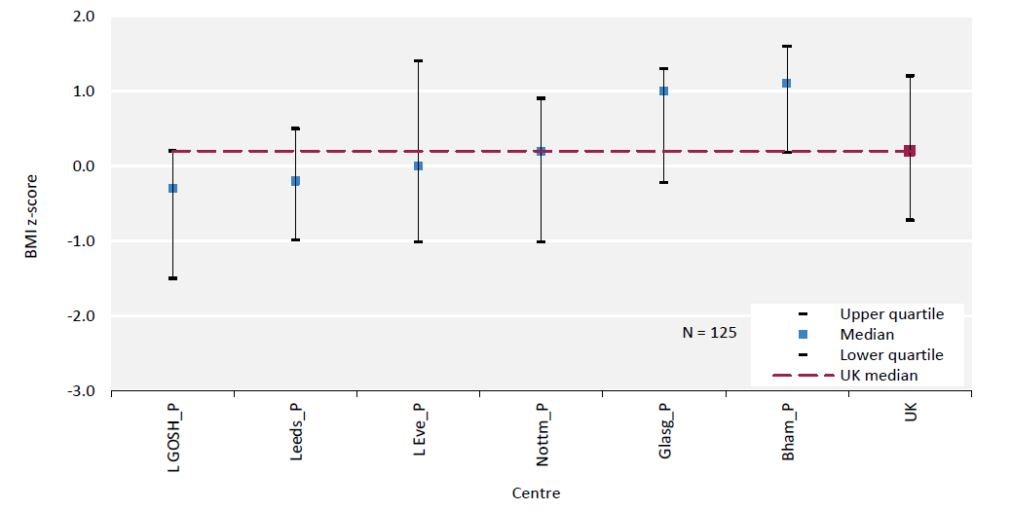
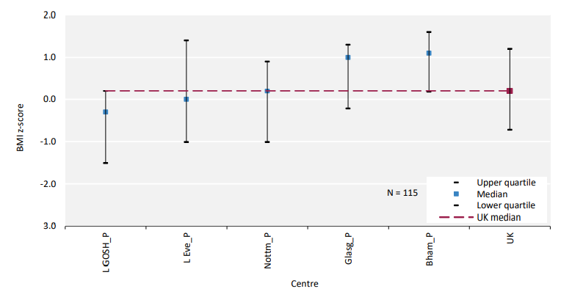
UK Renal Registry 24th Annual Report
Data to 31/12/2020
Figure 8.12 Median body mass index (BMI) z-scores for paediatric patients (<16 years old) prevalent to dialysis on 31/12/2020 by centre

Slide 13
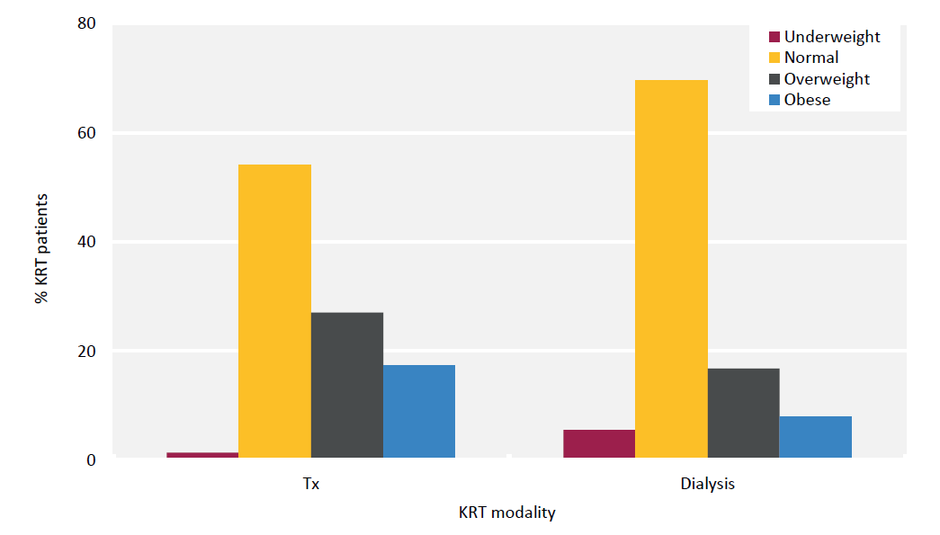
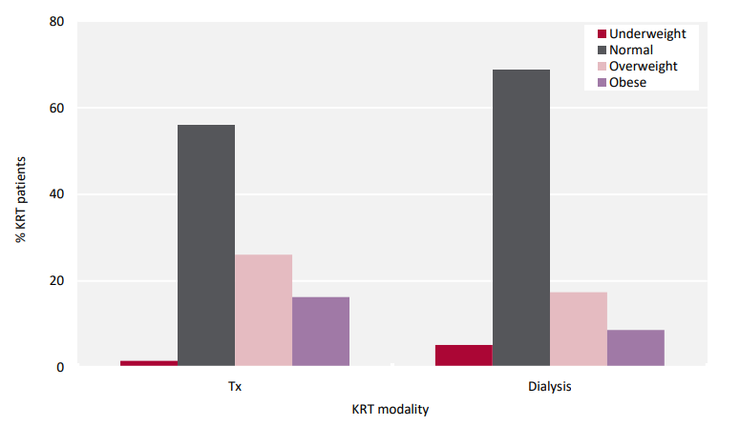
UK Renal Registry 24th Annual Report
Data to 31/12/2020
Figure 8.13 Body mass index categorisation of paediatric patients (<16 years old) prevalent to KRT on 31/12/2020 by KRT modality

Slide 14
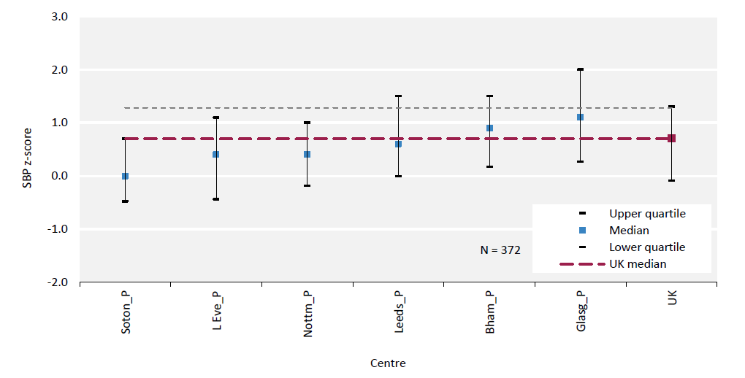
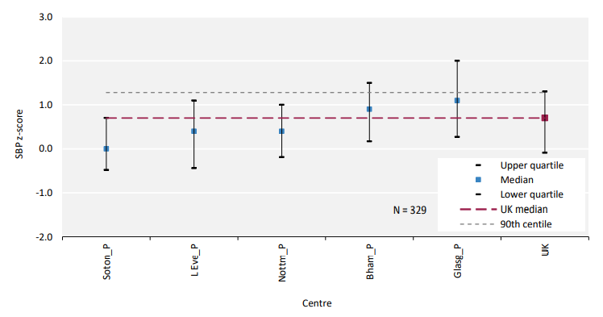
UK Renal Registry 24th Annual Report
Data to 31/12/2020
Figure 8.14 Median systolic blood pressure (SBP) z-scores for paediatric patients (<16 years old) prevalent to Tx on 31/12/2020 by centre

Slide 15
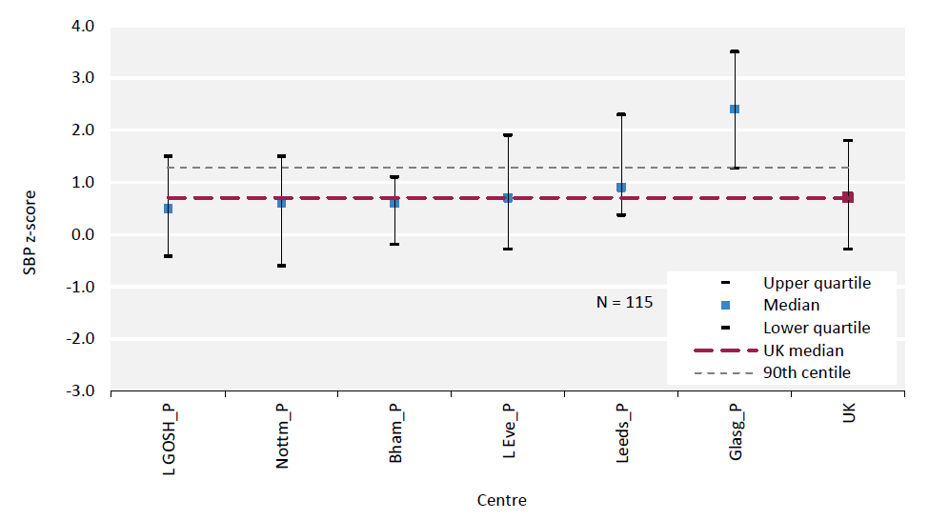
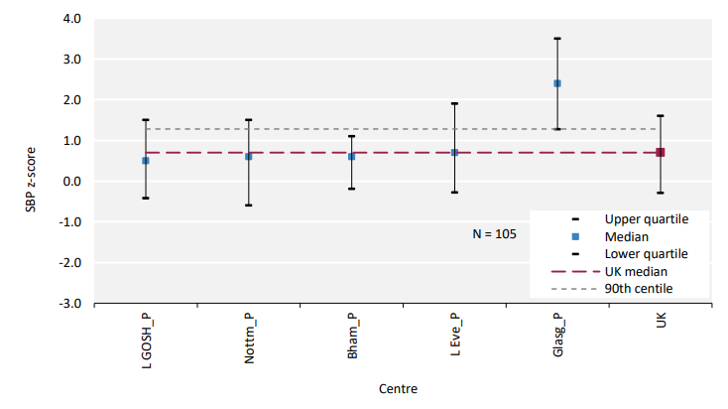
UK Renal Registry 24th Annual Report
Data to 31/12/2020
Figure 8.15 Median systolic blood pressure (SBP) z-scores for paediatric patients (<16 years old) prevalent to dialysis on 31/12/2020 by centre

Slide 16
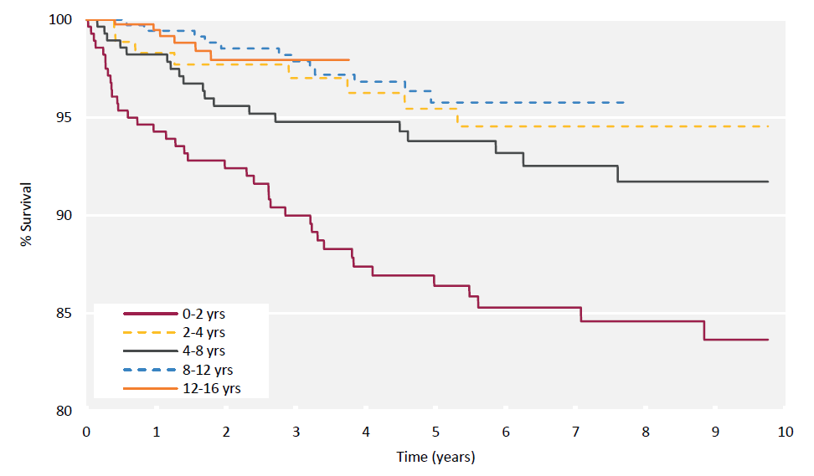
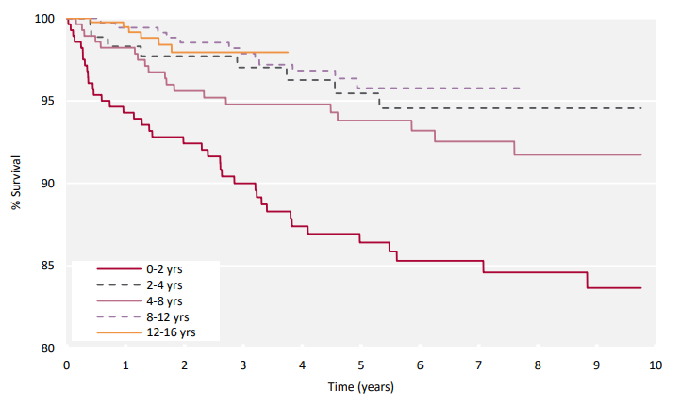
UK Renal Registry 24th Annual Report
Data to 31/12/2020
Figure 8.16 Unadjusted Kaplan-Meier survival (from day 90) of incident paediatric KRT patients (<16 years old) between 2006 and 2019 by age group at start of KRT
The 8–12 yrs and 12–16 yrs lines stop before 10 years, because the analysis was censored at age 16 years.

