Slide 1

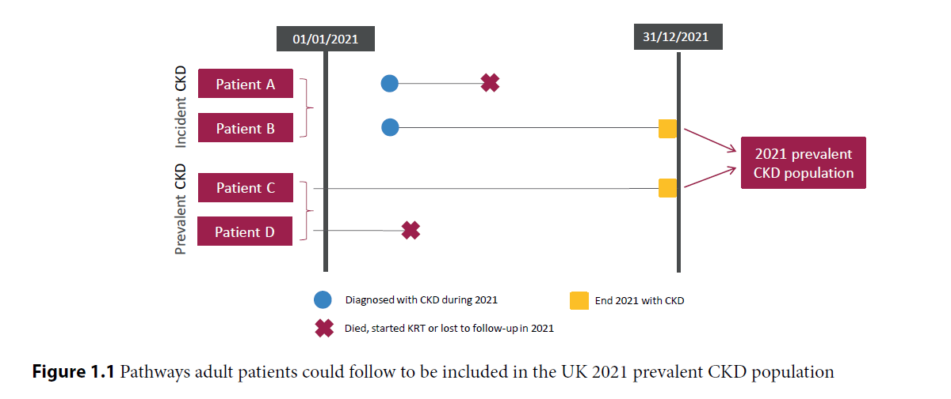
UK Renal Registry 25th Annual Report
Data to 31/12/2021

Slide 2
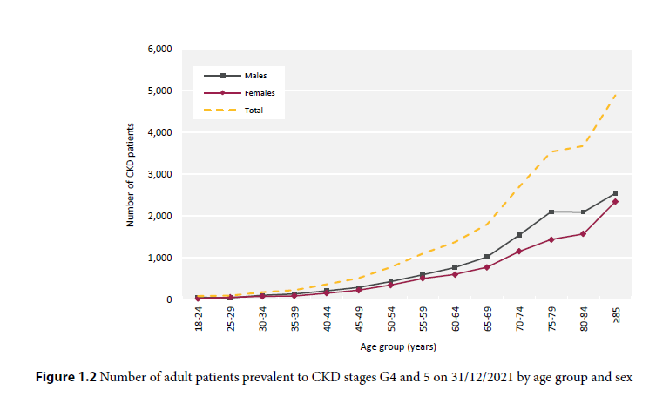
UK Renal Registry 25th Annual Report
Data to 31/12/2021

Slide 3
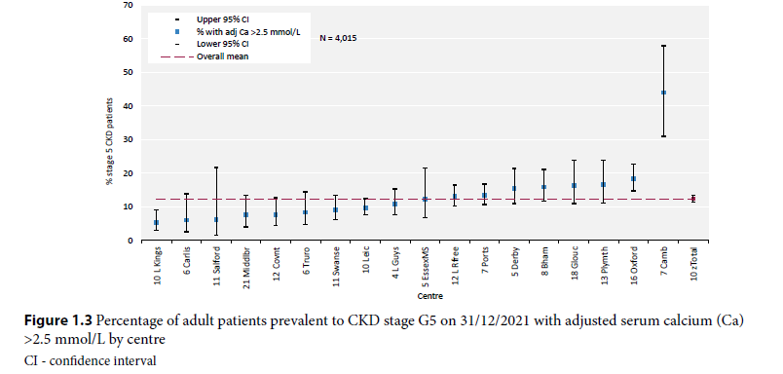
UK Renal Registry 25th Annual Report
Data to 31/12/2021

Slide 4
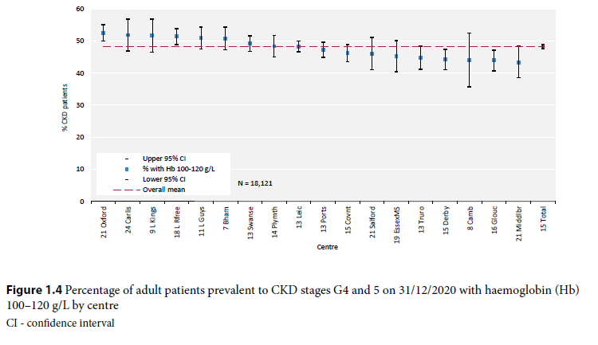
UK Renal Registry 25th Annual Report
Data to 31/12/2021

Slide 5
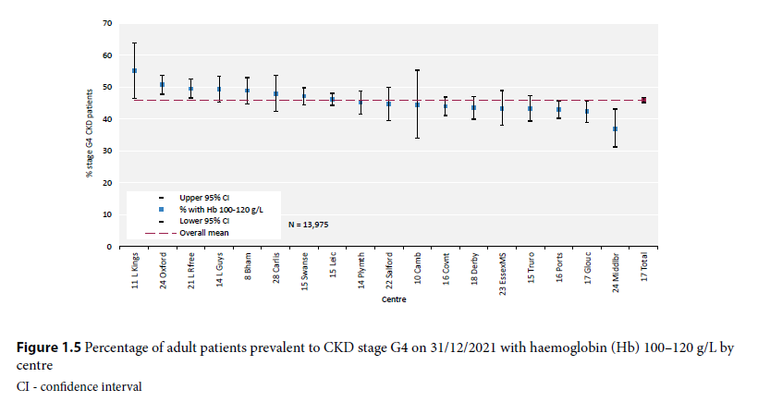
UK Renal Registry 25th Annual Report
Data to 31/12/2021

Slide 6
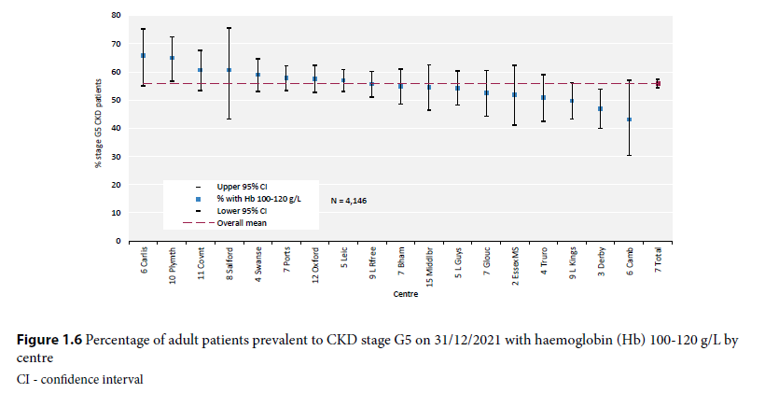
UK Renal Registry 25th Annual Report
Data to 31/12/2021

