Slide 1

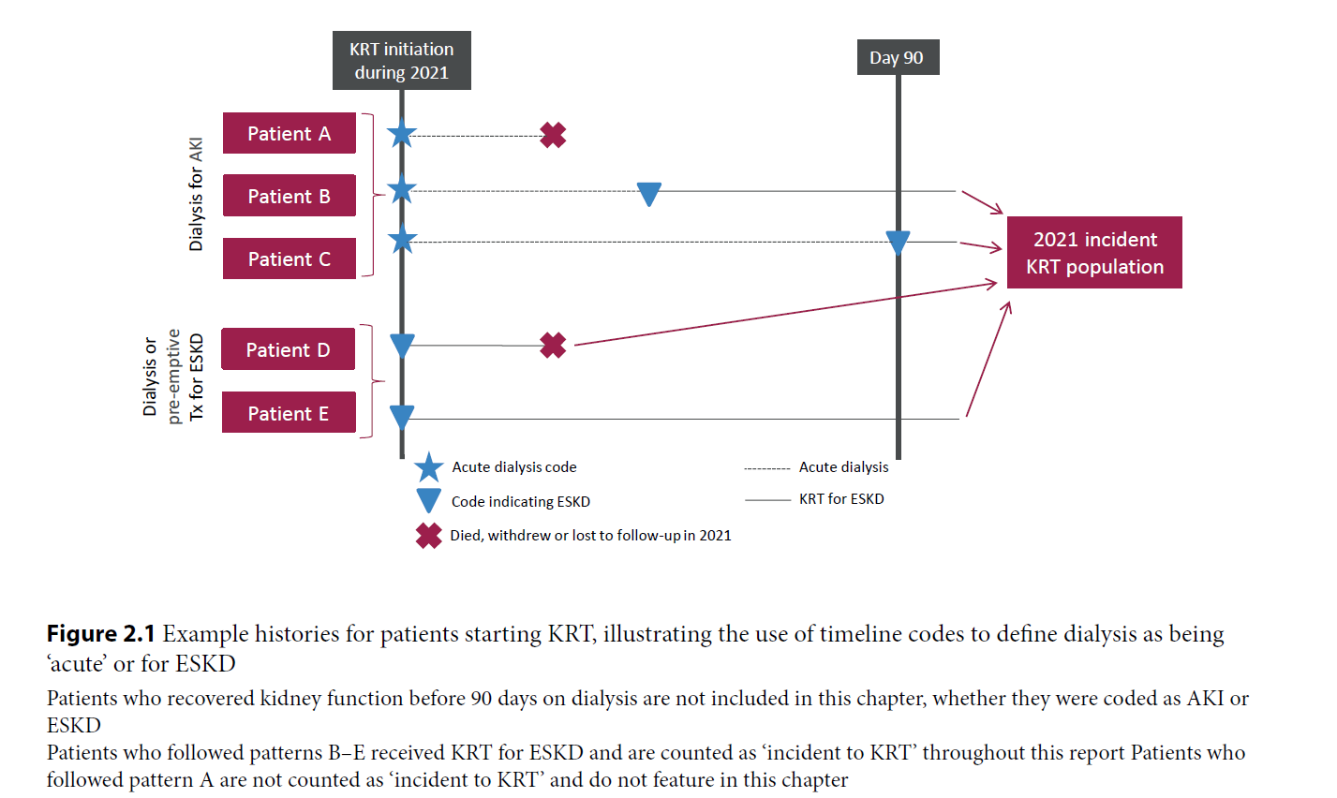
UK Renal Registry 25th Annual Report
Data to 31/12/2021

Slide 2
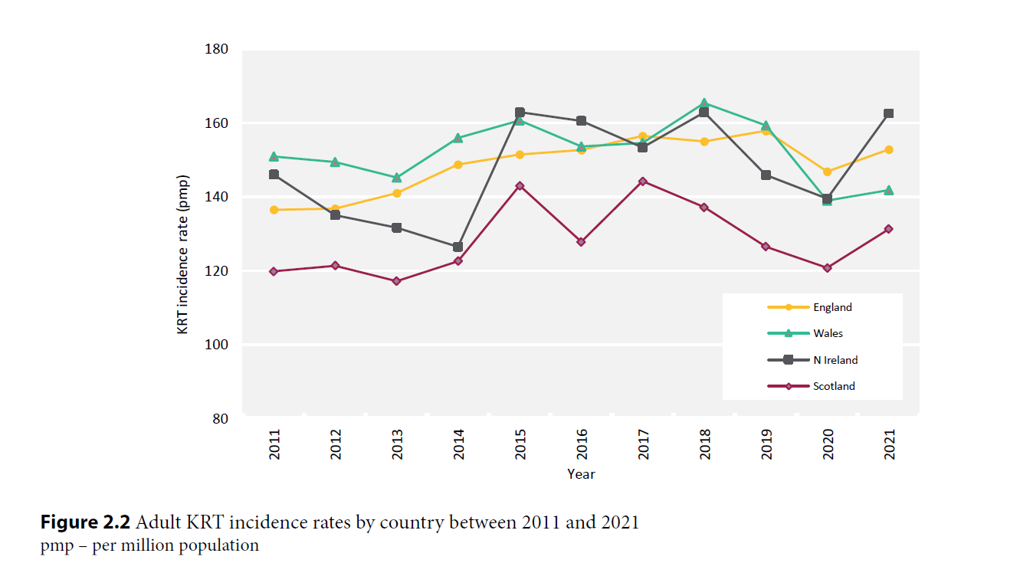
UK Renal Registry 25th Annual Report
Data to 31/12/2021

Slide 3
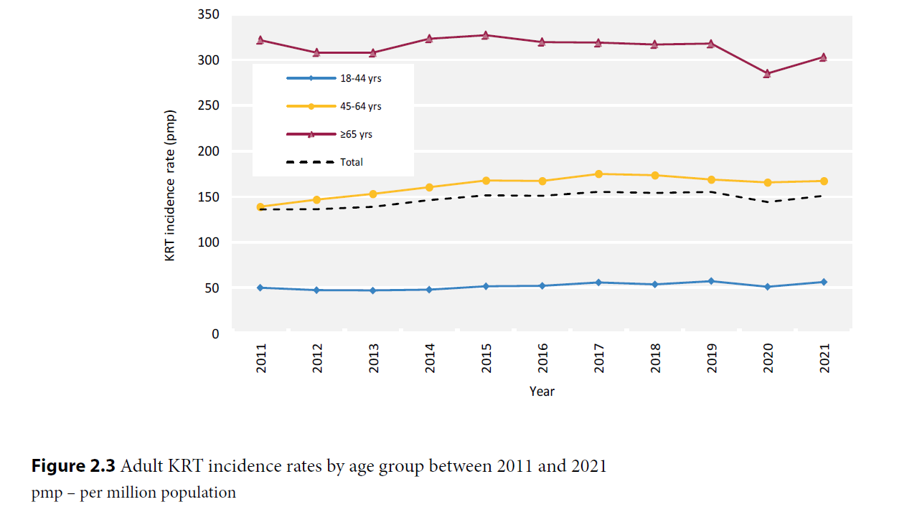
UK Renal Registry 25th Annual Report
Data to 31/12/2021

Slide 4
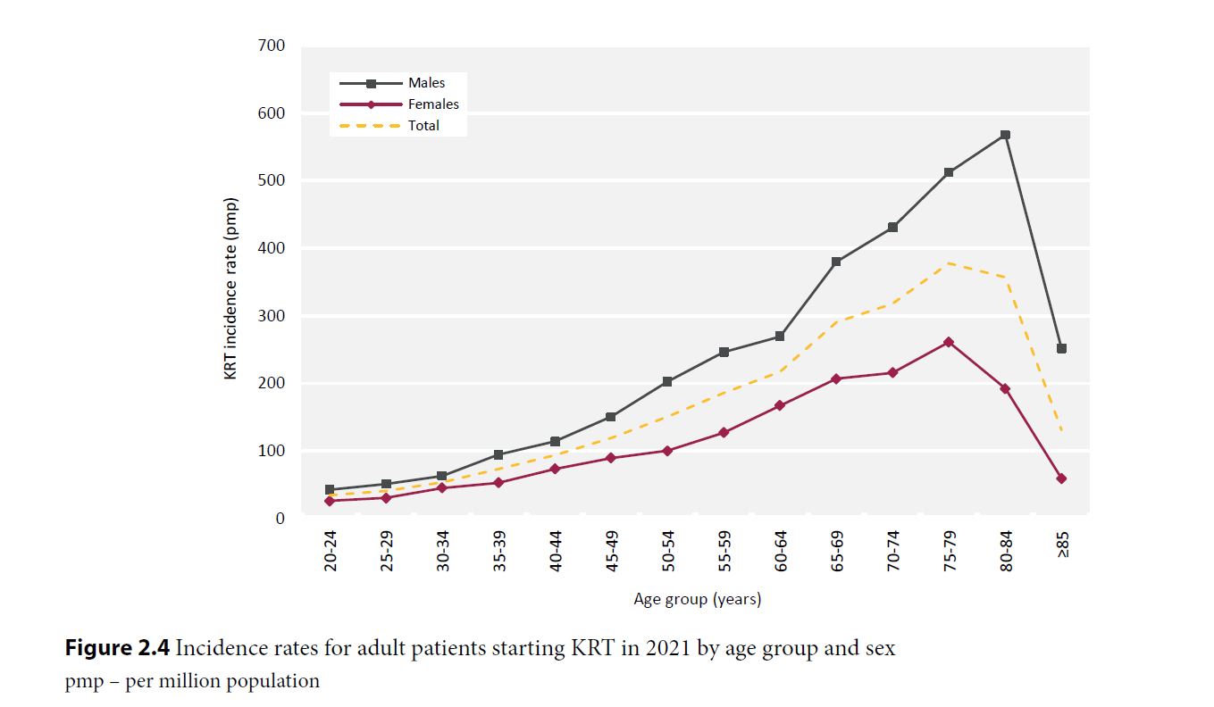
UK Renal Registry 25th Annual Report
Data to 31/12/2021

Slide 5
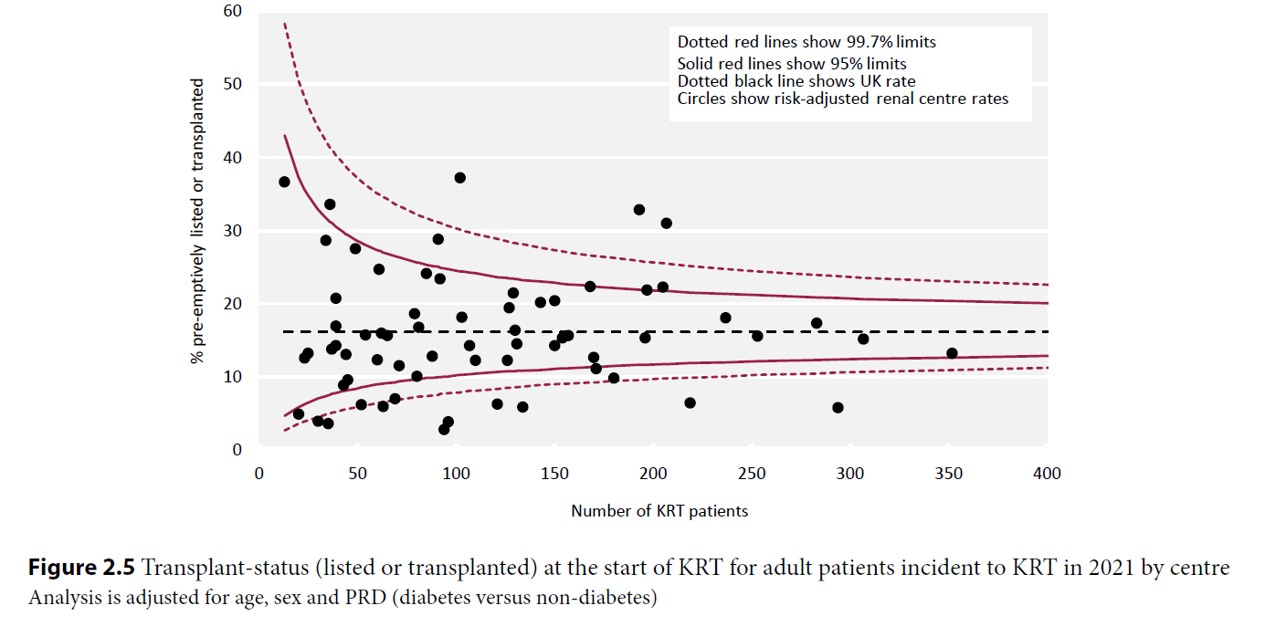
UK Renal Registry 25th Annual Report
Data to 31/12/2021

Slide 6
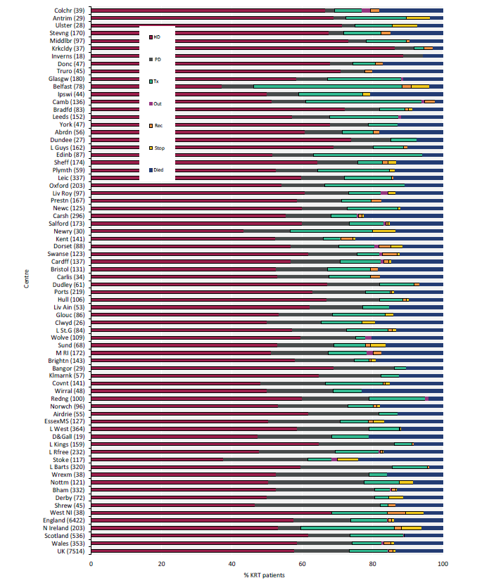

UK Renal Registry 25th Annual Report
Data to 31/12/2021

Slide 7
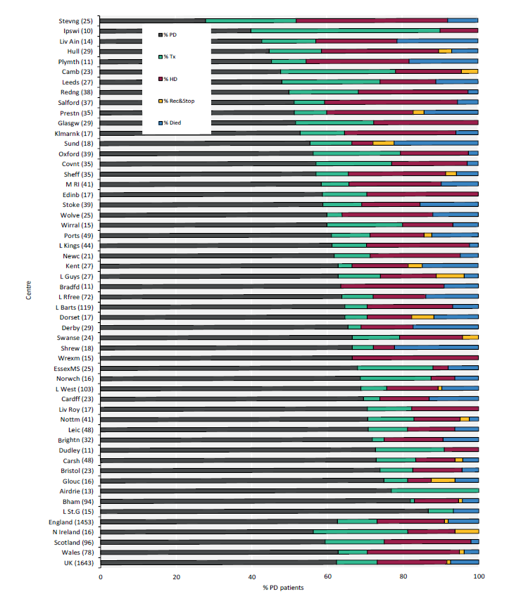

UK Renal Registry 25th Annual Report
Data to 31/12/2021

Slide 8
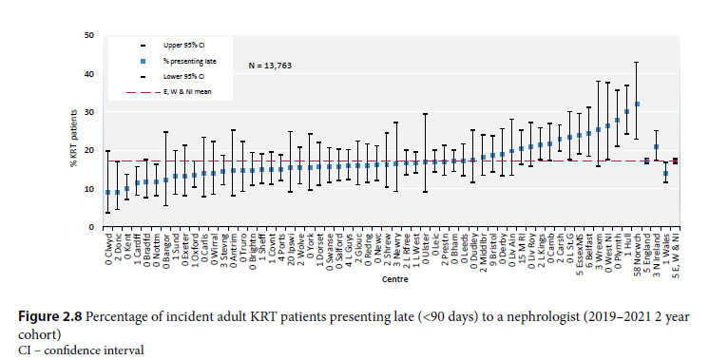
UK Renal Registry 25th Annual Report
Data to 31/12/2021

Slide 9
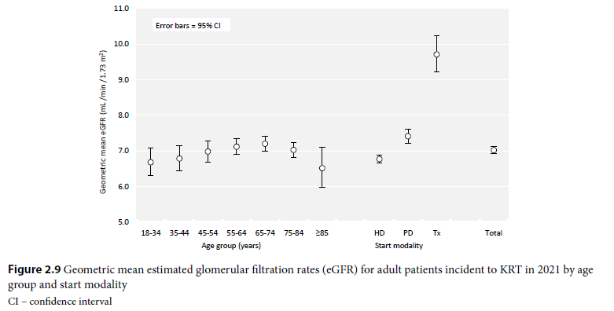
UK Renal Registry 25th Annual Report
Data to 31/12/2021

Slide 10
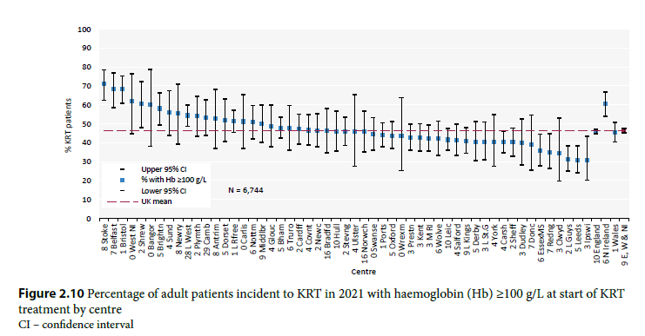
UK Renal Registry 25th Annual Report
Data to 31/12/2021

Slide 11
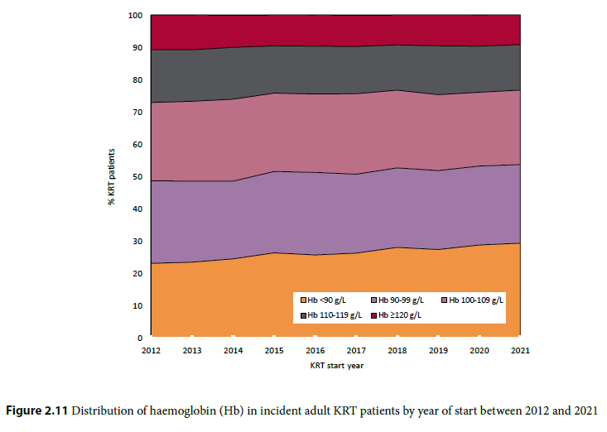
UK Renal Registry 25th Annual Report
Data to 31/12/2021

Slide 12
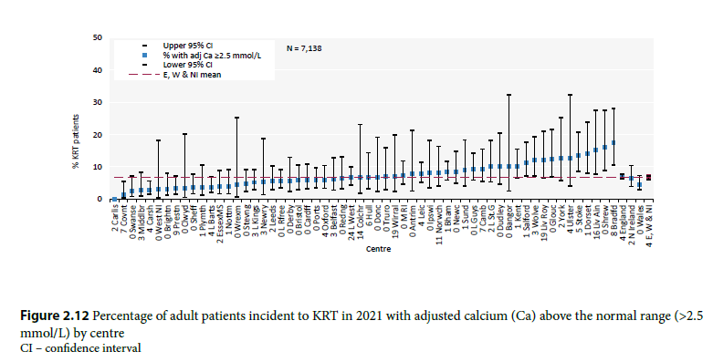
UK Renal Registry 25th Annual Report
Data to 31/12/2021

Slide 13
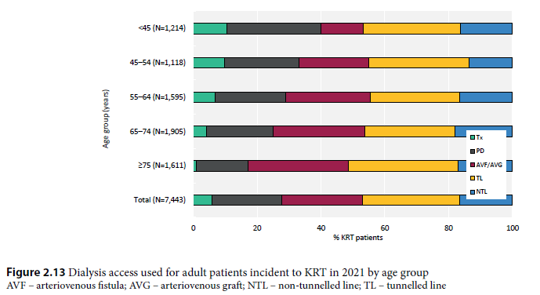
UK Renal Registry 25th Annual Report
Data to 31/12/2021

Slide 14
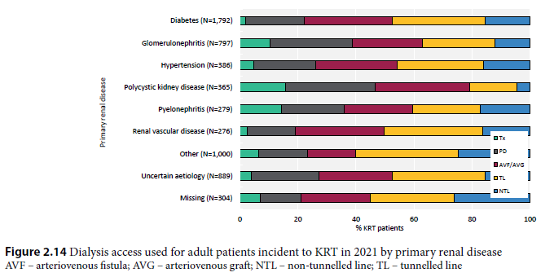
UK Renal Registry 25th Annual Report
Data to 31/12/2021

Slide 15
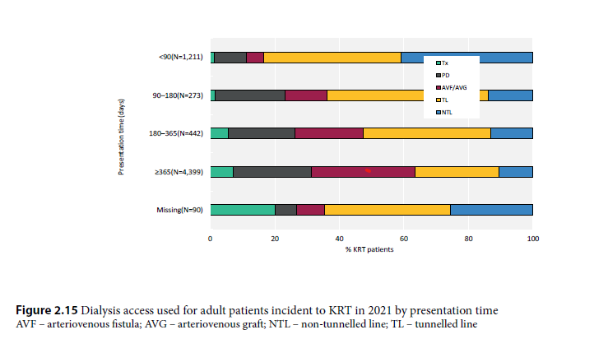
UK Renal Registry 25th Annual Report
Data to 31/12/2021

Slide 16
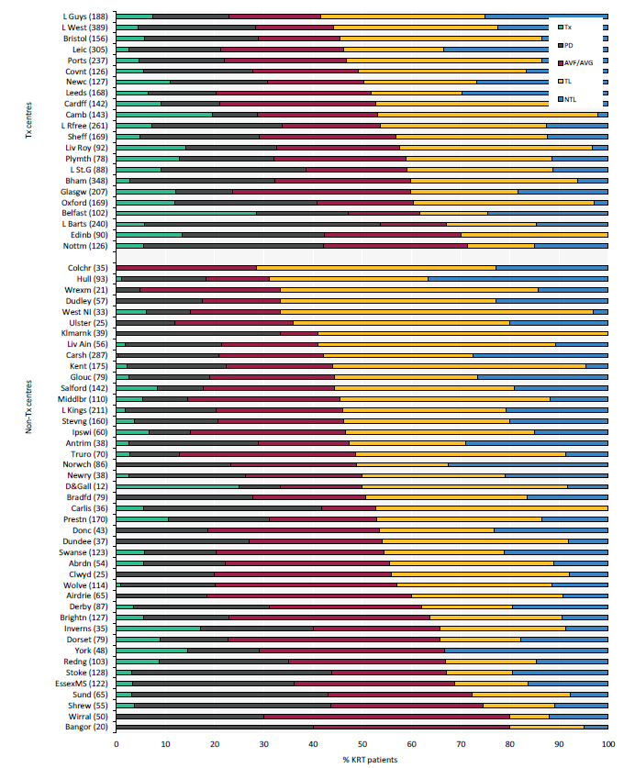

UK Renal Registry 25th Annual Report
Data to 31/12/2021

Slide 17
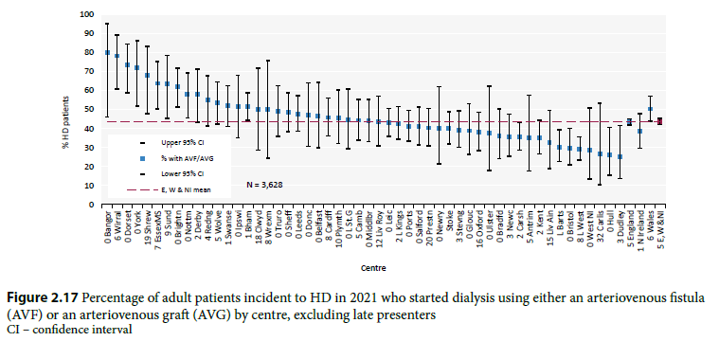
UK Renal Registry 25th Annual Report
Data to 31/12/2021

Slide 18
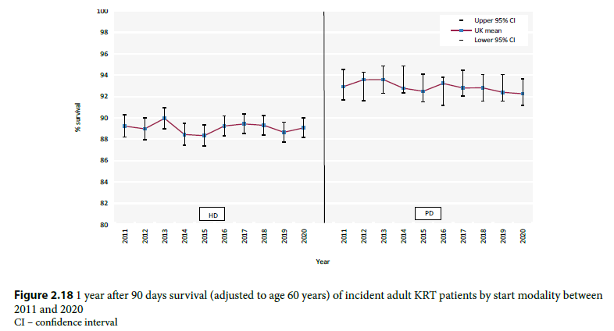
UK Renal Registry 25th Annual Report
Data to 31/12/2021

Slide 19
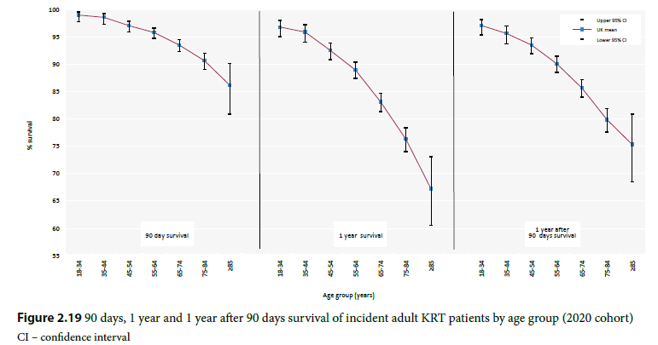
UK Renal Registry 25th Annual Report
Data to 31/12/2021

Slide 20
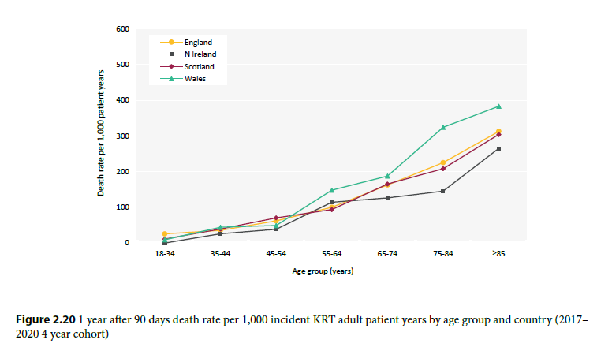
UK Renal Registry 25th Annual Report
Data to 31/12/2021

Slide 21
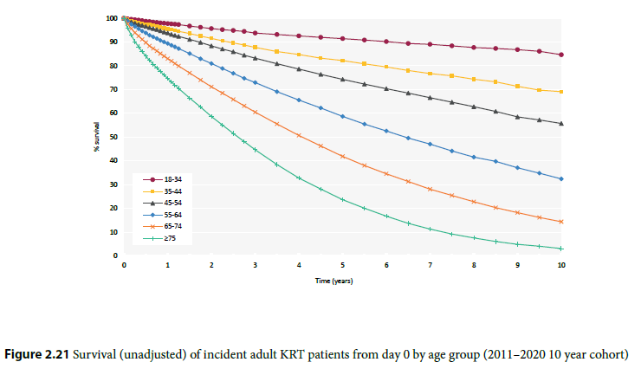
UK Renal Registry 25th Annual Report
Data to 31/12/2021

Slide 22
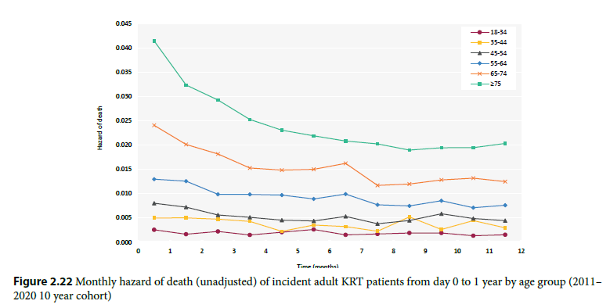
UK Renal Registry 25th Annual Report
Data to 31/12/2021

Slide 23
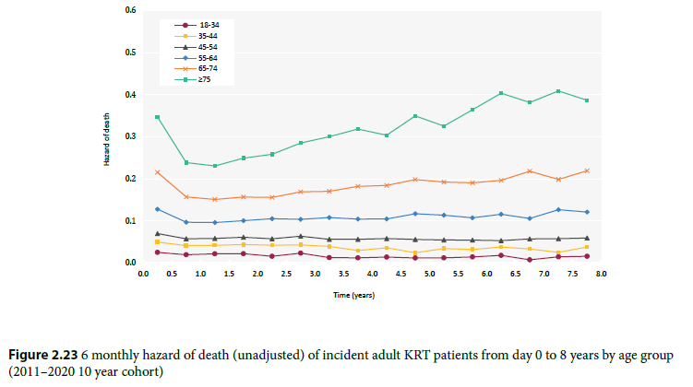
UK Renal Registry 25th Annual Report
Data to 31/12/2021

Slide 24
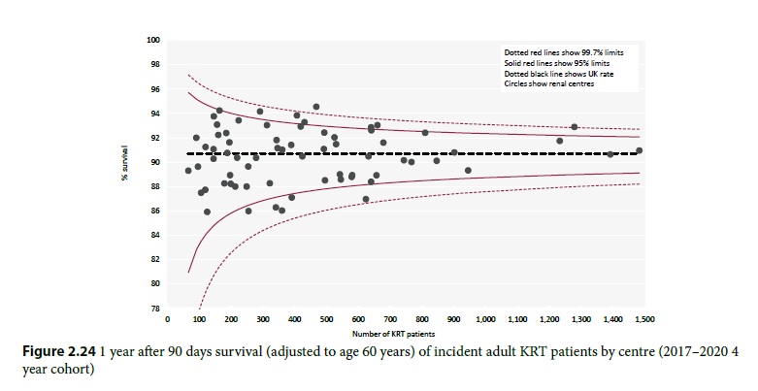
UK Renal Registry 25th Annual Report
Data to 31/12/2021

Slide 25
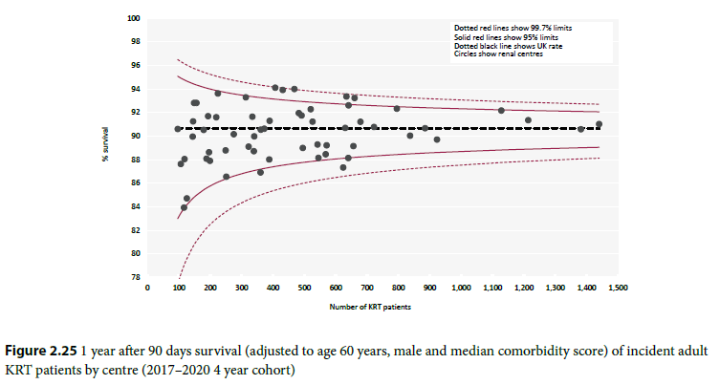
UK Renal Registry 25th Annual Report
Data to 31/12/2021

