Slide 1
A brief introduction to the UKRDC Dashboard
In relation to this presentation, I declare that there are no conflicts of interest.

Slide 2
Why?
Visibility
You can view all the data we hold for your renal unit
Insight
Improve data quality with timely error reporting, and real-time patient cohort statistics*
Control
Manage patient data flow and program memberships
*Statistics available for sites sending RDA feeds

Slide 3
What?
Secure
Robust authentication
Granular permissions
Flexible
Rapid development cycle
Early access – You decide what’s next
Open
Transparent development, open-source code
Public issue tracker

Slide 4
Authenticating with the UKRDC Dashboard

Slide 5
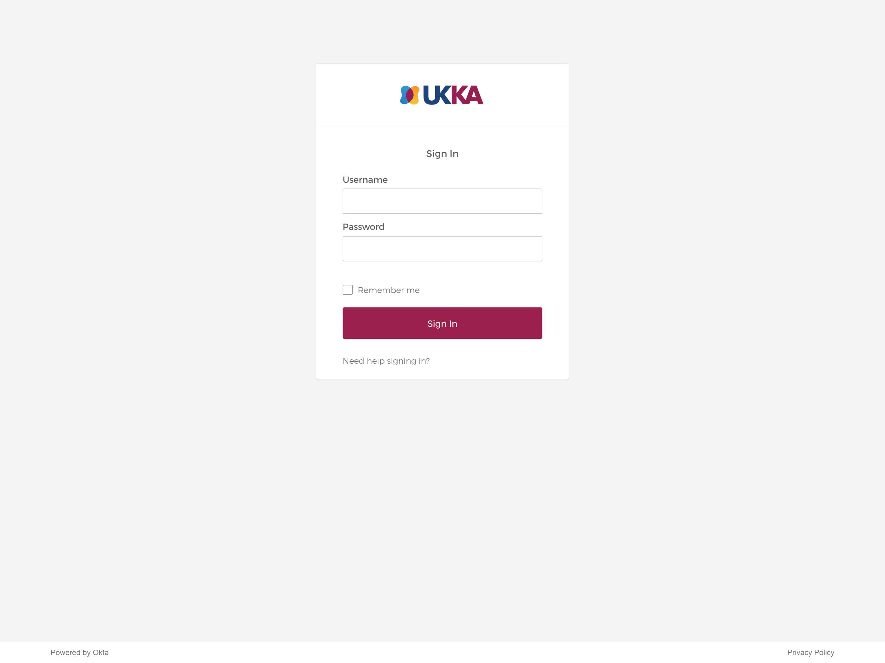

Slide 7
Data quality insights

Slide 8
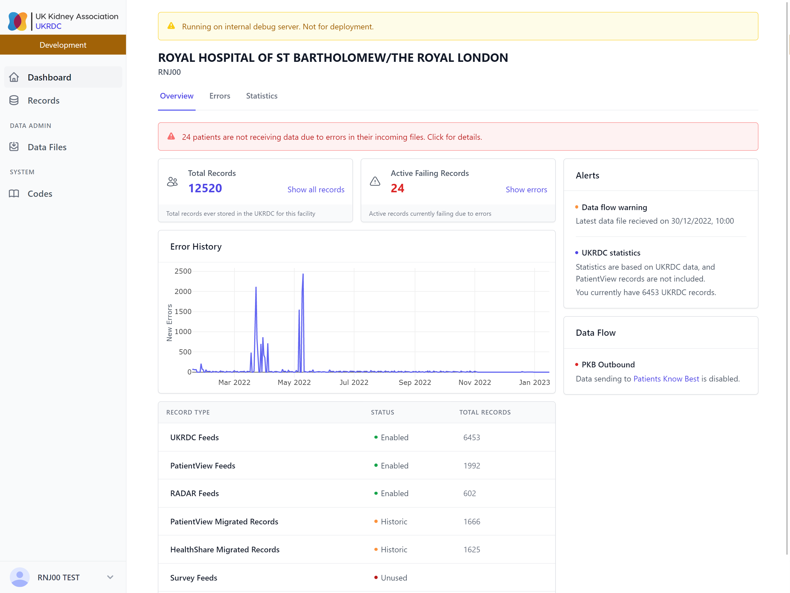

Slide 9
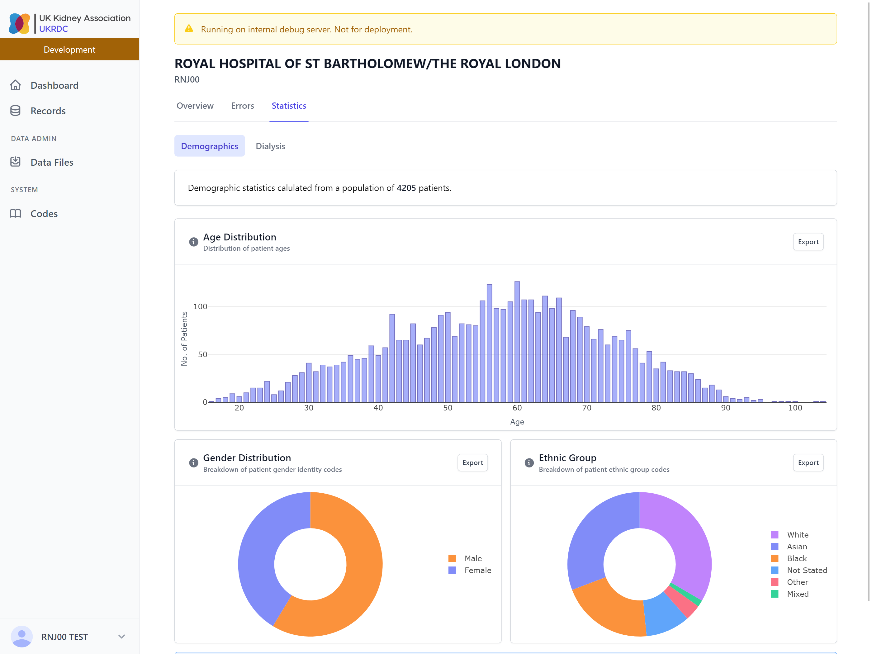

Slide 10
Exclusive to RDA feeds
More details from Phil later

Slide 11
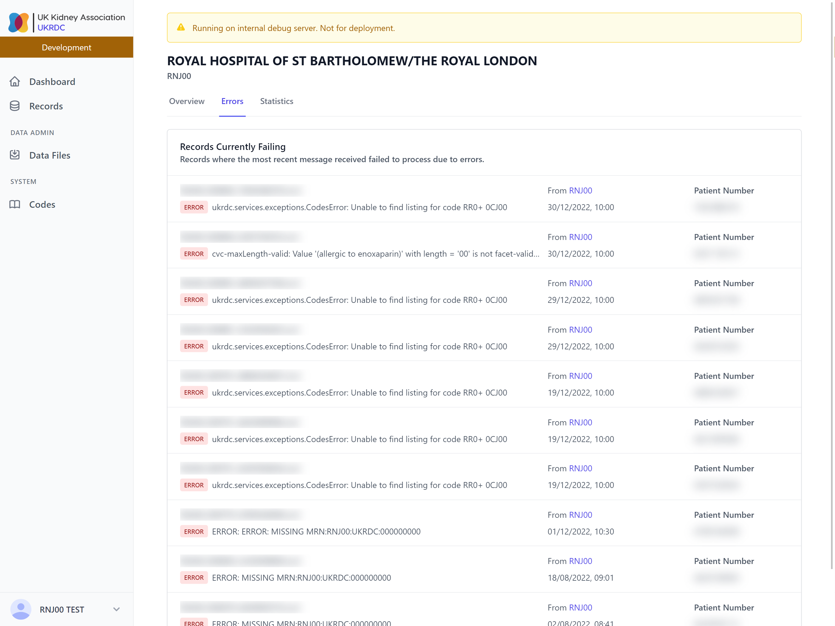

Slide 12
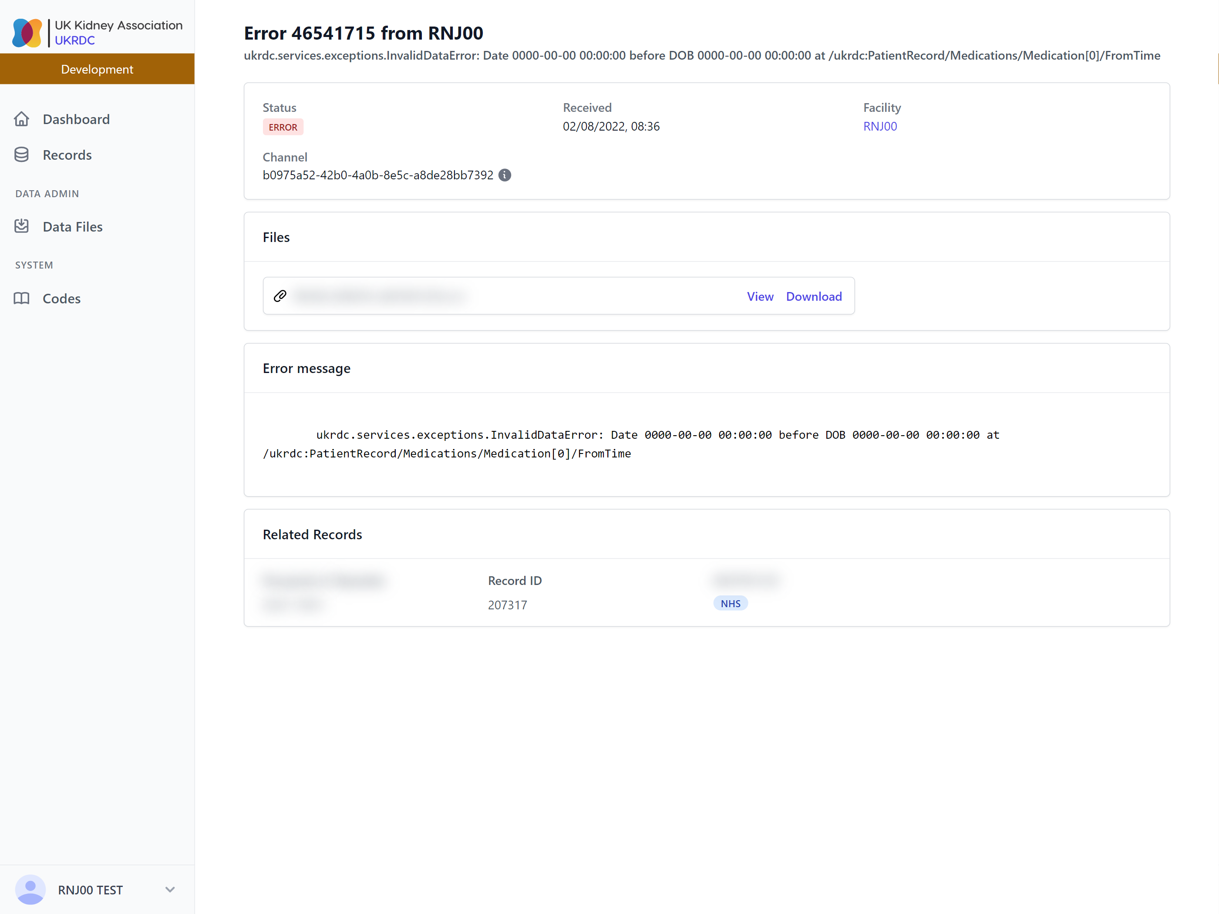

Slide 14
Viewing your data in the UKRDC

Slide 15
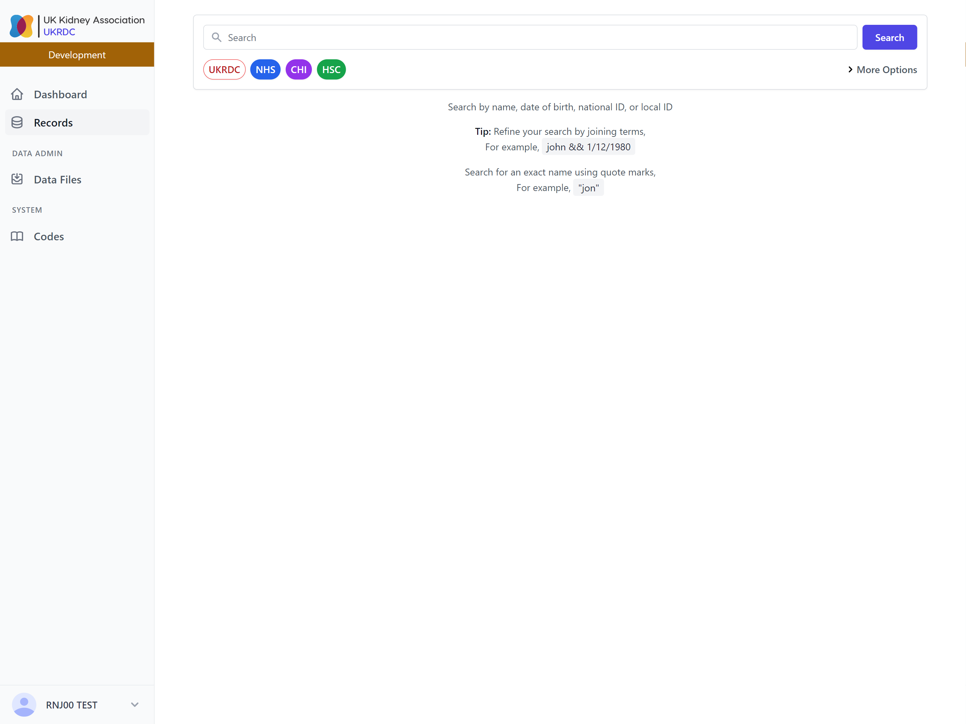

Slide 16
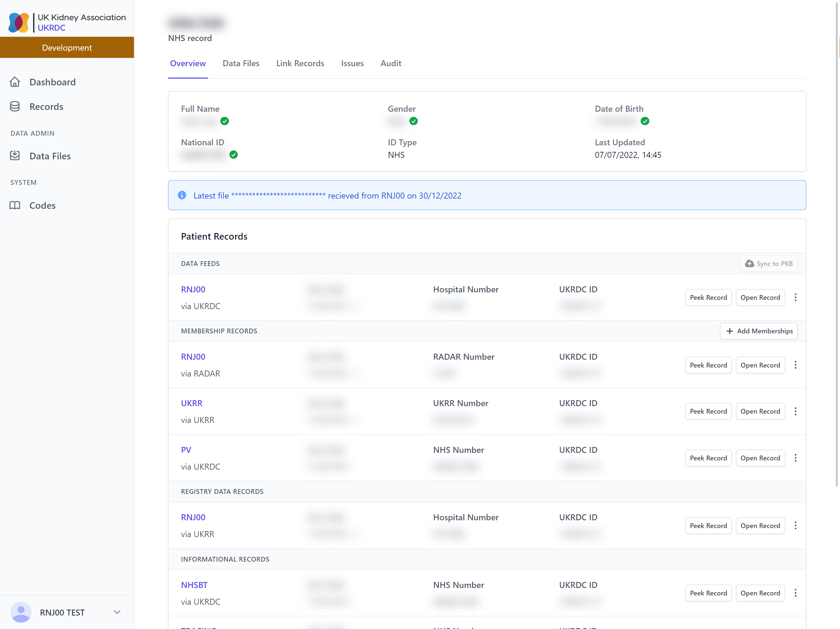

Slide 17
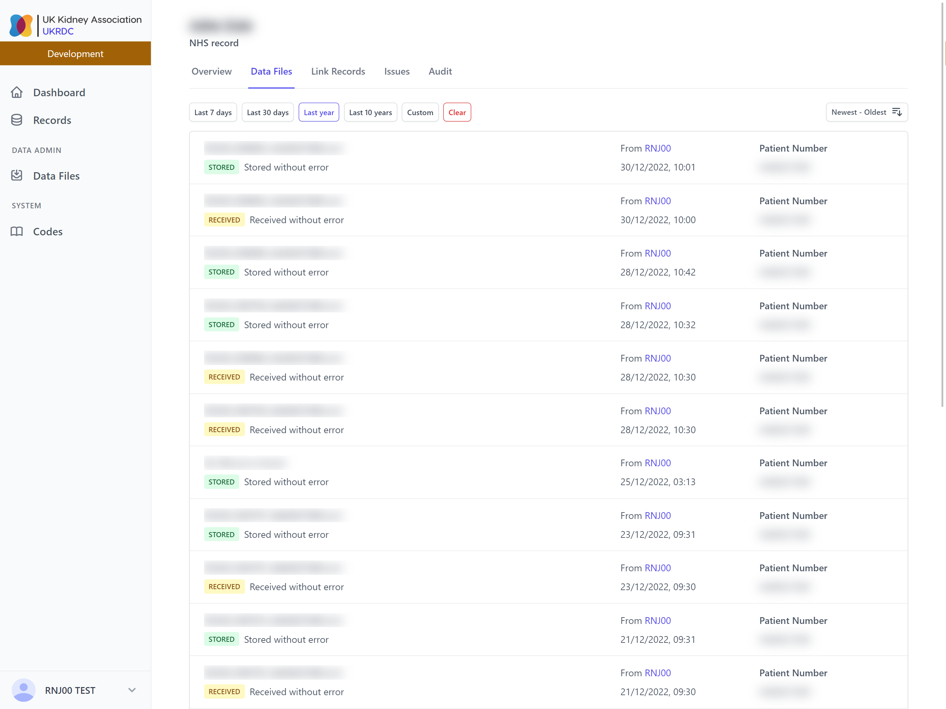

Slide 20
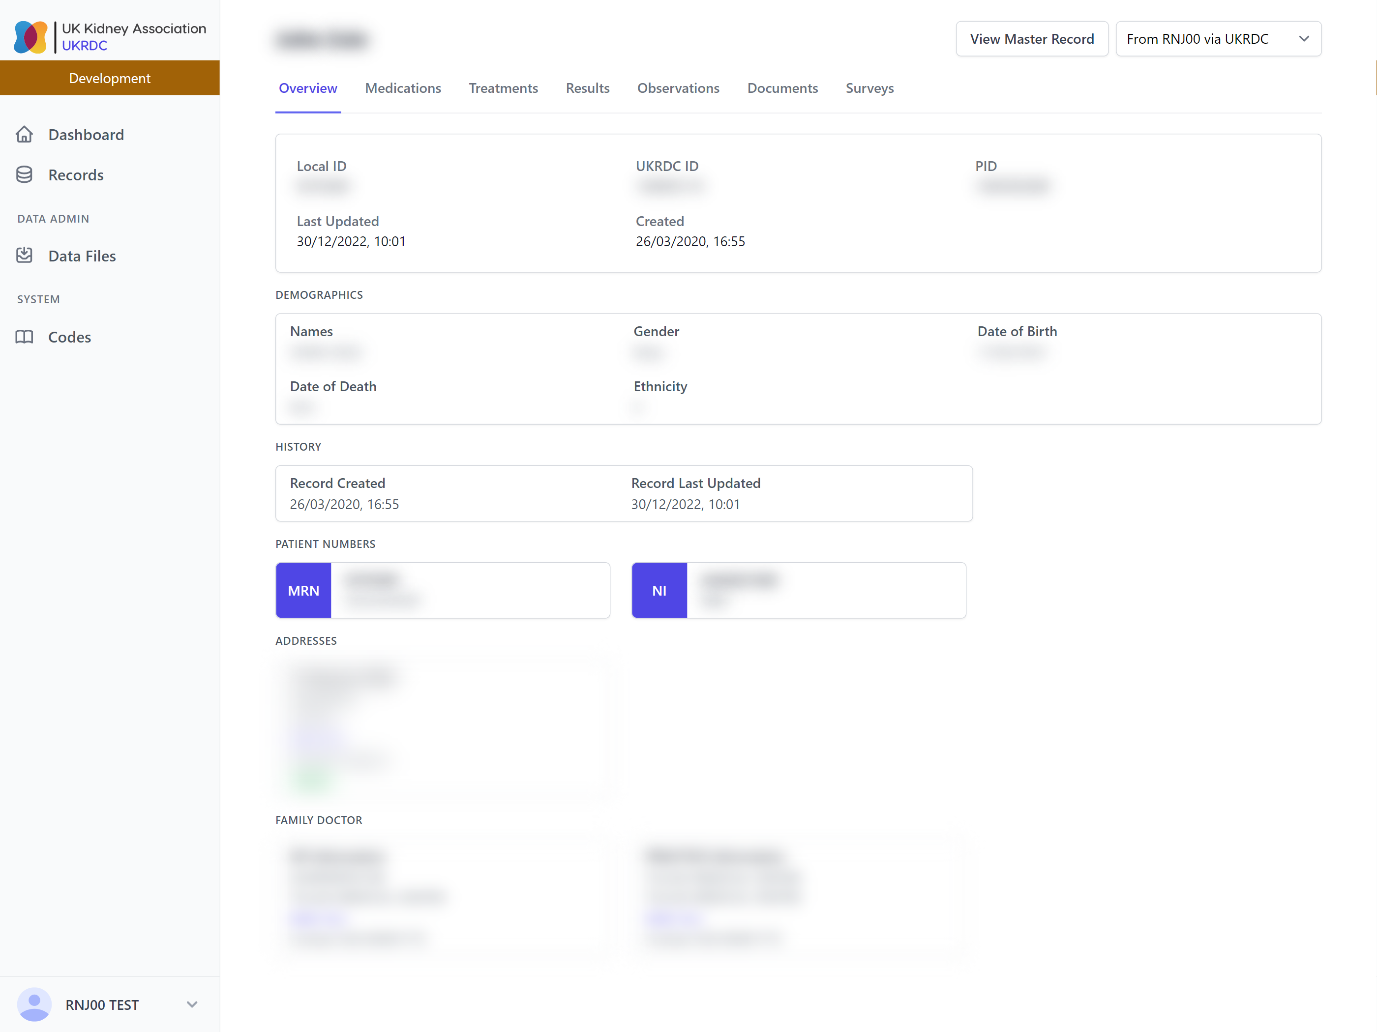

Slide 22
Managing patient data flow

Slide 25
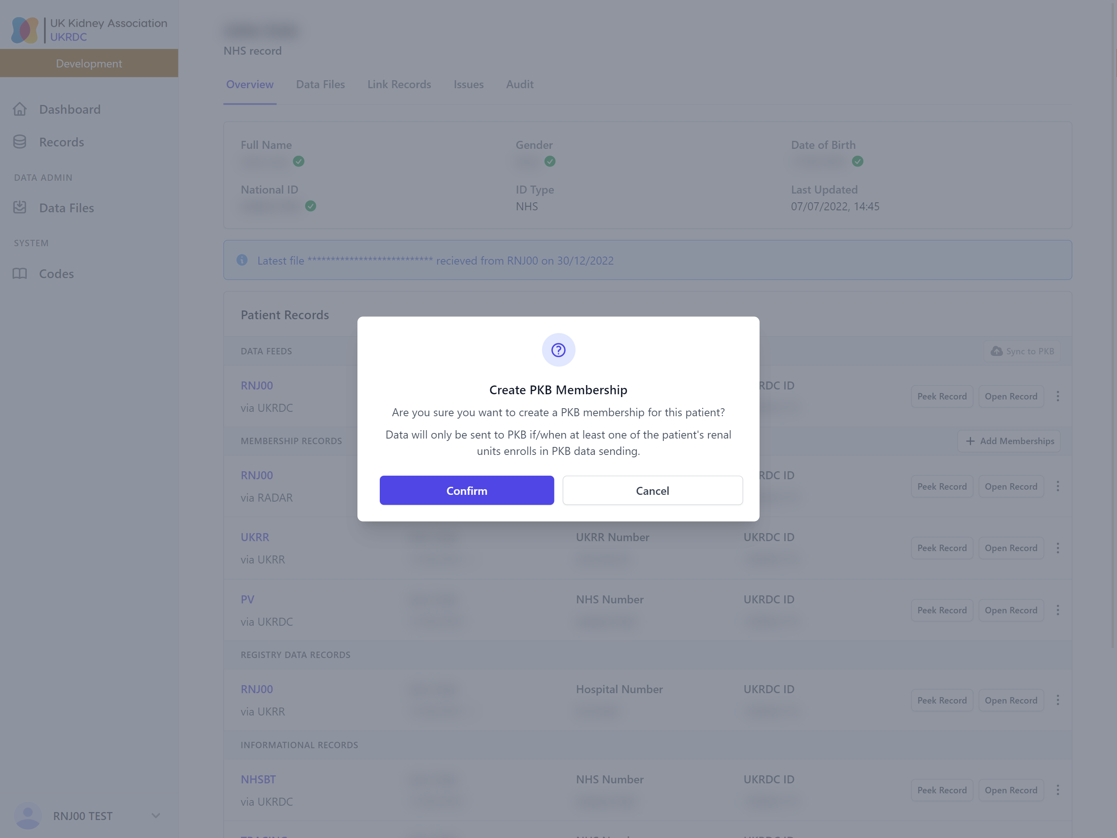

Slide 26
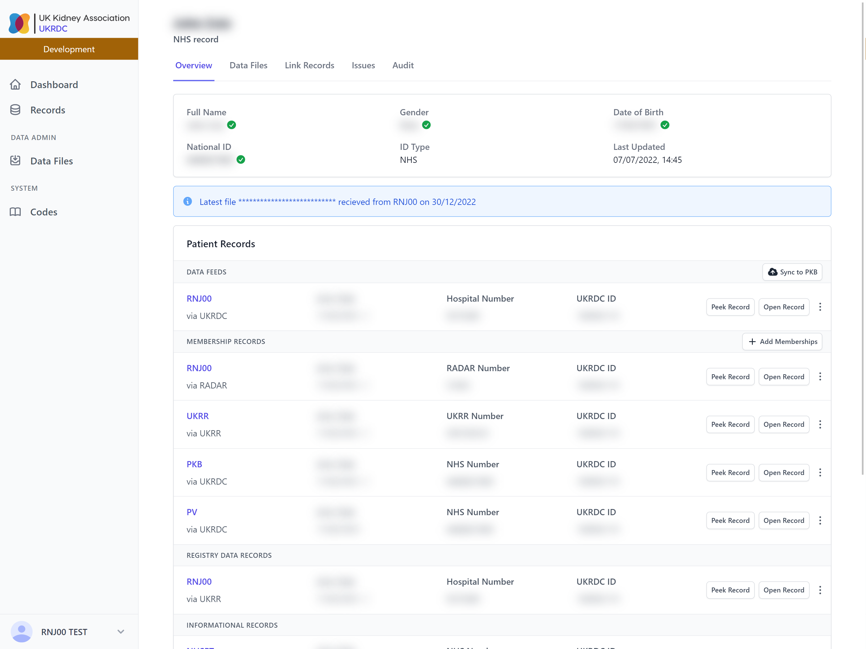

Slide 30
Roadmap
“Soft-launch” last month
Primarily testing PKB data flow management
Wider rollout starts today
Get in touch, we’ll send you the application form
More data quality insights/statistics to be added over the coming months

Slide 31
Key Resources
github.com/renalreg/ukrdc-fastapi
Dashboard API code + issue tracker
github.com/renalreg/ukrdc-nuxt
Dashboard web UI code + issue tracker
renalregistry.atlassian.net/wiki/spaces/UDD
Dashboard wiki / “living manual”
Email joel.collins@ukkidney.org

