Slide 1
MAGIC e-Learning
What I learned

Slide 2
Getting started
Once on the Dashboard I got stuck on the pre Quiz ( completed it four times)
It does not automatically take you to the next course.

Slide 3
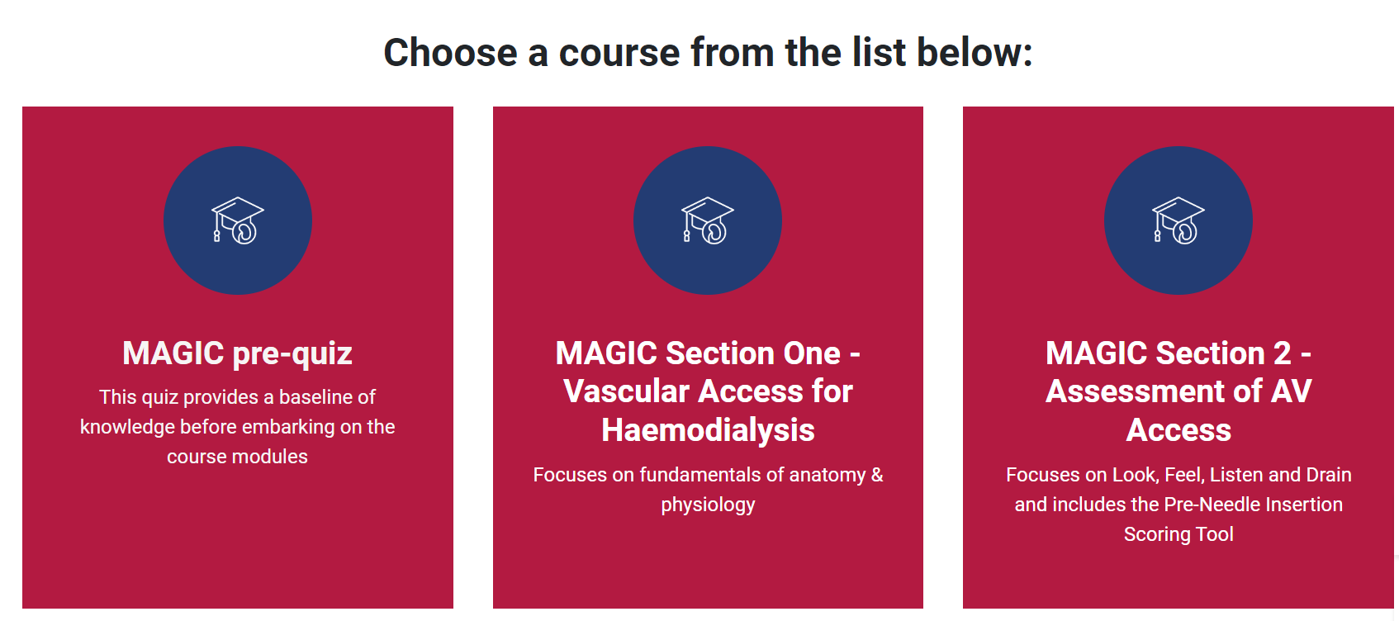

Slide 5
Vascular access for Haemodialysis
Section one. Expected time 1.5Hours
YouTube videos from Portsmouth are great but to watch them all will take 1hour 15mins.
Need to sign with a Google account to prove you are over 18 due to content.
Recommend you focus on:
Brachiocephalic Fistula 5.27
Radiocephalic 8.42
Brachiobasilic Transposition AVF 8.11
PTFE Legg loop (5.35) or Upper arm (6.15)
Dialysis line insertion 6.50

Slide 6
What I learned
You tube videos did give a greater respect for the surgery our patients need to undergo and the vascular surgeons.
When you see the effort, skill and trauma to the patient = a greater desire to protect the fragile AV access
It took me 1.5 hours but I did not watch all the videos

Slide 7
Assessment of AV Access
Estimated time of 30mins/ Took me an hour
Lots of great information and learning recourses definitely need more time to reflect on practice and process the information
Unit policy could also be reviewed at this time.
Articles definitely worth a read

Slide 8
Cannulation of AV access
Estimated 1 hour time/ took me 1.45 !
I was tired at this stage and disturbed by emails and calls
Every HD patient should see the video of the amazingly brave kids of Great Ormond street.
Lots to read from PREM report and BRS/VASBI needling recommendations. I had already read them but if they are new to you will take longer.
Take a note of the pages to read as difficult to go back and check

Slide 11
Complications associated with AV access
Estimated 30 mins and it took me about 25
Did this one separately at a quieter time, definitely recommend taking breaks between each section.

Slide 12
Recommendations
Allow more time than they say
Make sure it is quite. Turn off emails don’t get distracted.
Break it down if needed, don’t need to do it all in the same sitting
Get copies of the articles for your team
Revisit the site
Review the renal access policy for your unit
A lot of excellent content but will all staff take it in ?
Follow up with a learning pack ?

Slide 13
QUIZ
Got 100% ☺
….on my second try !

