Slide 1
Kidney
Patient Reported Experience Measure
Looking at your results

Slide 2
Review and share your local results
You can review how your centre is doing against the national average using the graphs in the Kidney PREM national report
Means where the 95% confidence interval falls entirely beyond the 25th or 75th percentiles are worse than or better than most centres in that theme
This graph is showing centre results for the question “How well would you grade your overall experience of the service provided by your renal unit on a scale from 1 (worst it can be) to 7 (best it can be)?”
Above 75th percentile
Below 25th percentile

Slide 3
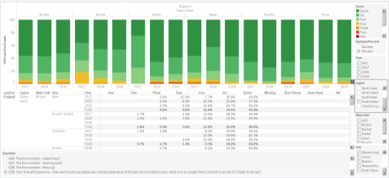
Review and share your local results
The Kidney PREM will have the greatest impact when renal centres review, share and act on their local findings in partnership with patients and make improvements to care identified as necessary by their own patients
Access the portal at
www.renal.org/audit-research/data-portal/prem
You can select the relevant year, centre, renal unit and question to review how patients at your unit responded to each of the Kidney PREM questions

Slide 4
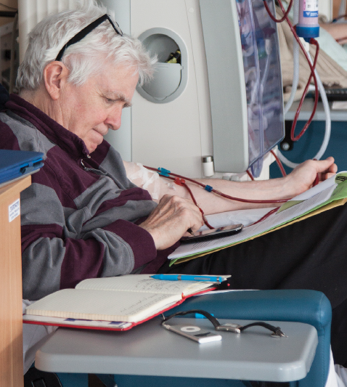
Review and share your local results
Share the link below with your patients by text or email so they can see the Kidney PREM results too
www.kidneycareuk.org/prem2020

Slide 5
Share your progress
We would like to hear what you are doing and how you are using the Kidney PREM.
Please send feedback on the following to Catherine.Stannard@renalregistry.nhs.uk
Examples of project plans aiming to improve patient experience
Examples of project plans inspired by the Kidney PREM
Examples of good practice from units performing particularly well on any of the Kidney PREM themes
Your experience of coordinating the Kidney PREM locally
Your ideas for improving the Kidney PREM

Slide 6
Kidney
Patient Reported Experience Measure
What is the Kidney PREM?
Kidney PREM 2020 results
Acting on the Kidney PREM
Notes:
This slide-set is to support you in sharing your PREM results with your team and patients – you can use it as a frame-work and amend it to suit your local need

Slide 7
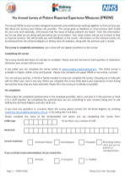
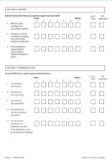

What is the Kidney PREM?
Patient Reported Experience Measures - PREMs - are measures which gather data on the experience of patients in health care settings
The results of PREM’s can be used to improve services in areas identified as important by patients; and tailor care by identifying the impact it has on patients (Aiyegbusi et al., 2017)
The Kidney PREM is a questionnaire measuring kidney patients’ perceptions of their experience whilst receiving renal care.
“The Renal Association and Kidney Care UK are committed to improving the patient experience of kidney care, to have a positive impact on patient quality of life. Kidney PREM is available annually…. to give patients the opportunity to feed into service improvement by sharing what matters most to them.”

Slide 8
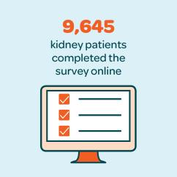
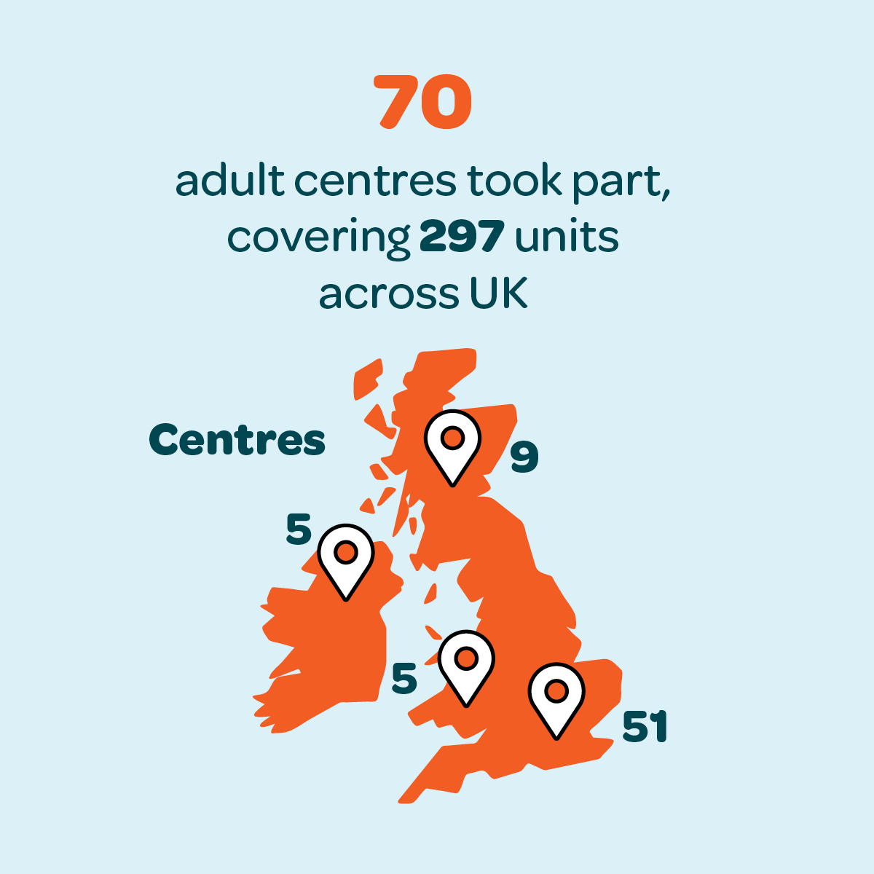
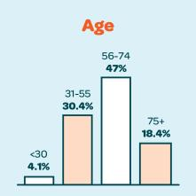
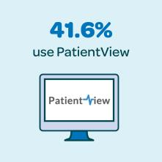
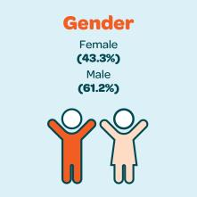
Kidney PREM 2020 – who took part?
Notes:
This will be an info-graphic

Slide 9
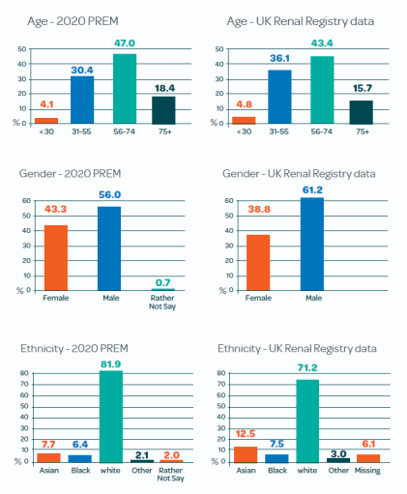
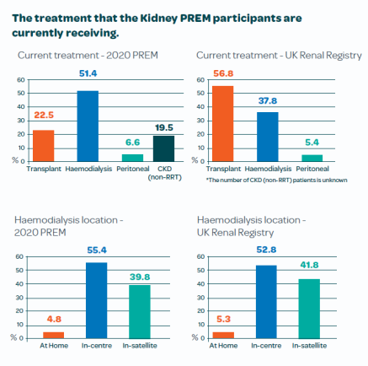
Kidney PREM 2020 - patient characteristics (%)

Slide 10
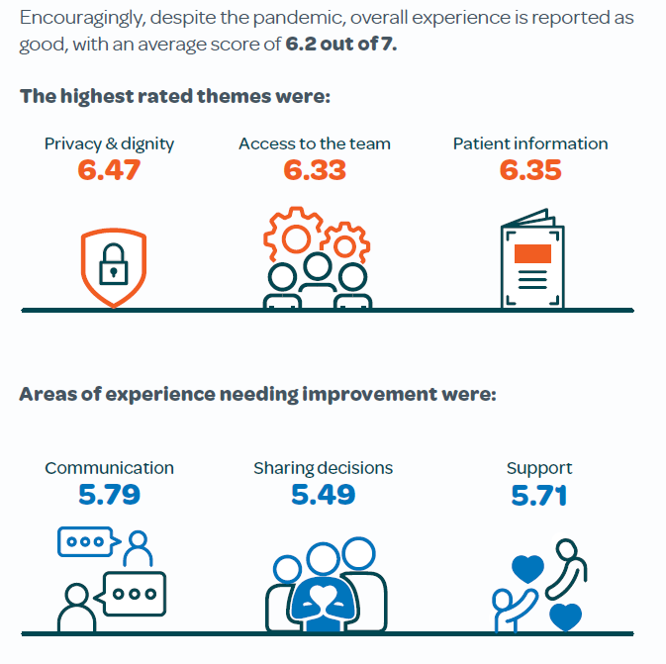
Kidney PREM – the national results

Slide 11
Mean scores by theme 2020, 2019 and 2018

Slide 12


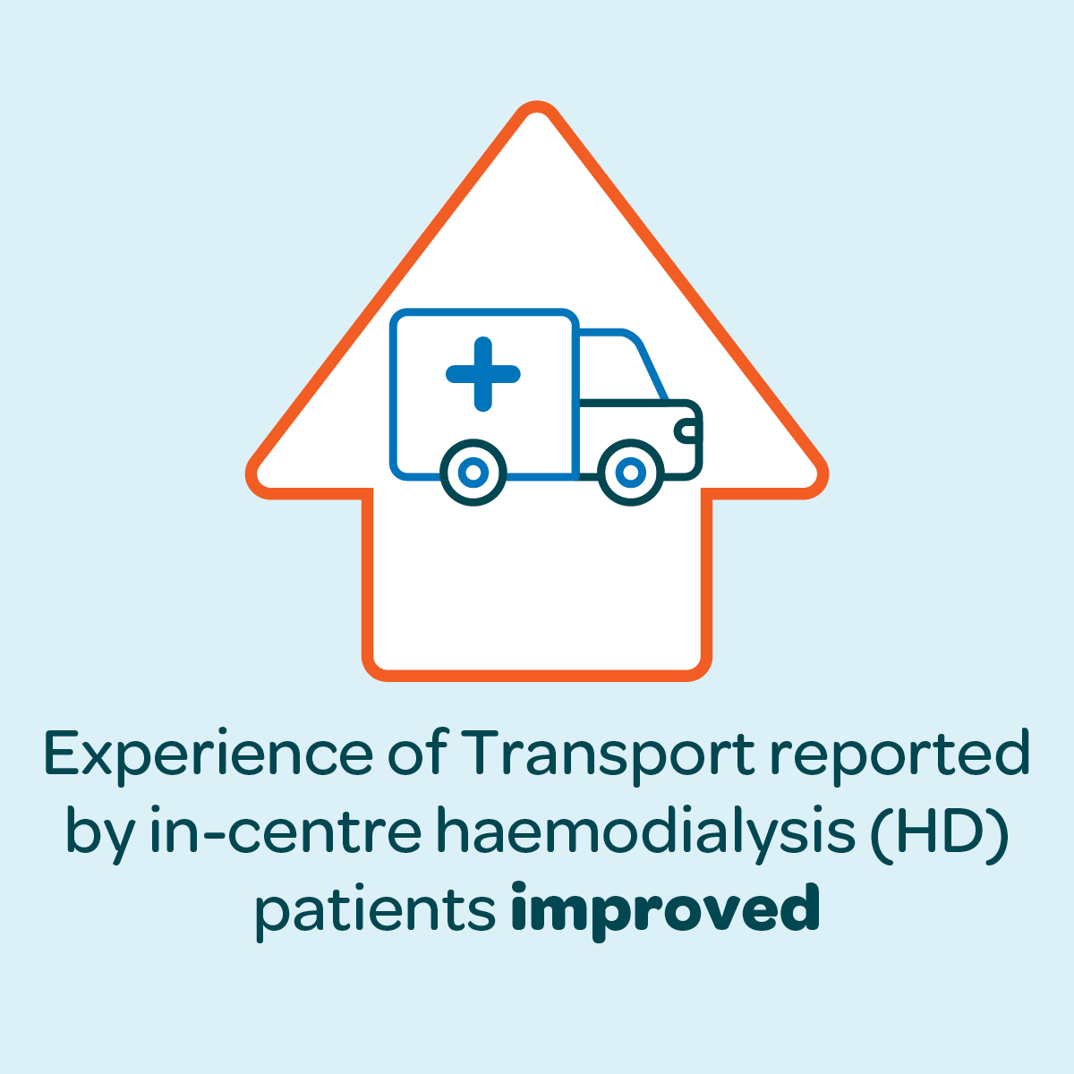
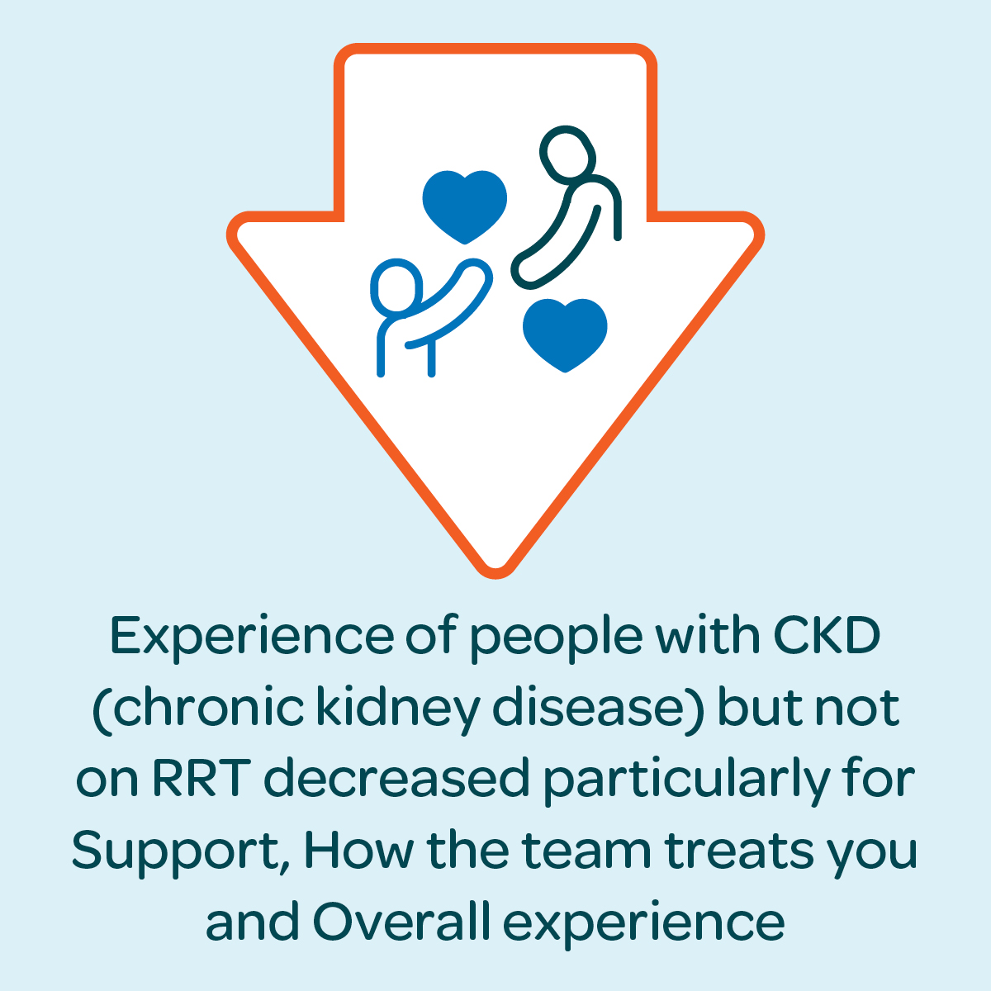
Kidney PREM – the national results

Slide 13

Written comments on patient experience
“If there is any other aspect of your experience of kidney care that you would like to comment on that has not already been covered, during COVID-19 or another time, please tell us below.”
7,364 participants left a comment
The majority of comments were thanking staff for their kindness and dedication to patients throughout what was acknowledged as a difficult year

Slide 14
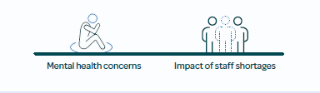
Written comments on patient experience
New themes emerging from patient comments included:

Slide 15

Acting on the Kidney PREM
This data is one part of the improvement journey.
The report is designed to open up conversations with patients and staff – locally and between centres – about what is good or bad about kidney patient experience and how experience can be improved and best practice shared

Slide 16
How do we compare?
 | Privacy & dignity | Patient information | Access | Tests | Overall | Scheduling | Treats | Environment | Diet & Fluid | Transport | Communication | Needling | Support | Sharing decision
National Average | 6.47 | 6.35 | 6.33 | 6.23 | 6.21 | 6.19 | 6.00 | 5.98 | 5.86 | 5.79 | 5.79 | 5.79 | 5.71 | 5.49
Main centre Name
Satellite Unit Name

Slide 17
How do we improve? Step 1: Listen and discuss
Review, share and compare our results/
What change is needed?
Plan our Project
Be creative and open to new ideas and doing things differently
Talk to local patients, involve KPA’s and get staff on board
Prioritise the areas at our unit needing quality improvement
Notes:
The Kidney Quality Improvement Partnership (KQuIP) can support you in using the Kidney PREM data for improvement
Visit www.renal.org/kquip or contact the KQuIP team on kquip@renalregistry.nhs.uk

Slide 18
Step 2 – Plan
What is our aim? What do we want to achieve? By when?
Who do we need to involve?
Prioritise ideas that have come from our discussions with patients, staff and others
Plan what we want to achieve in the next 30-60-90 days
Continue to meet regularly with our project team
Communicate what we are trying to do with our wider team and senior management
Notes:
The Kidney Quality Improvement Partnership (KQuIP) can support you in using the Kidney PREM data for improvement
Visit www.renal.org/kquip or contact the KQuIP team on kquip@renalregistry.nhs.uk

Slide 19
Step 3 – Implement and review
How can we ask patients how they feel about any changes we try out?
If it does not work first time, how can we adjust our ideas and plan our next cycle of change?
If our ideas are a success, how can we share our progress?
Step 1.
Plan
What changes are needed?
Step 2.
Do
Set aims and objectives
Step 3.
Study
Implement
Step 4.
Act
Analyse
Prioritise
Make a plan
Collect data
Document
Observe and record data
Compare results
Review impact
Listen to stakeholders
Involve the right people
Meet regularly
Communicate
Notes:
The Kidney Quality Improvement Partnership (KQuIP) can support you in using the Kidney PREM data for improvement
Visit www.renal.org/kquip or contact the KQuIP team on kquip@renalregistry.nhs.uk

Slide 20
Actions | Lead | When | Monitoring Notes
30 days:
60 days:
90 days:
Notes:
The Kidney Quality Improvement Partnership (KQuIP) can support you in using the Kidney PREM data for improvement
Visit www.renal.org/kquip or contact the KQuIP team on kquip@renalregistry.nhs.uk

