Slide 1
Kidney
Patient Reported Experience Measure
Looking at your results

Slide 2
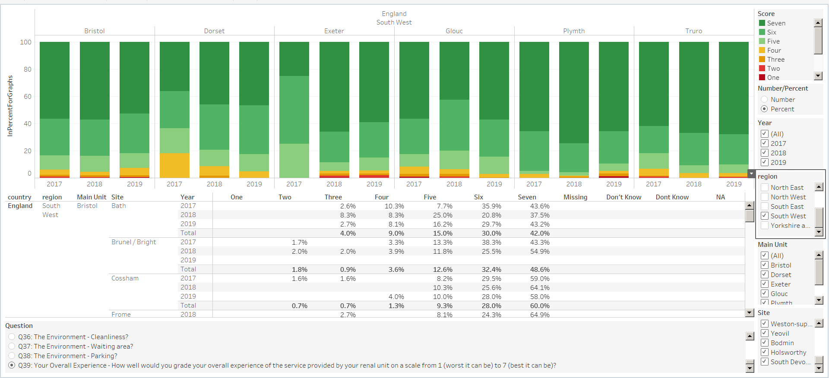
Review and share your local results
The Kidney PREM will have the greatest impact when renal centres review, share and act on their local findings in partnership with patients and make improvements to care identified as necessary by their own patients
Access the portal at
www.renalreg.org/datasets/prem-portal/
You can select the relevant year, centre, renal unit and question to review how patients at your unit responded to each of the Kidney PREM questions

Slide 3
Review and share your local results
You can review how your centre is doing against the national average using the graphs in the Kidney PREM national report
Means where the confidence interval falls entirely beyond the 25th or 75th percentiles are worse than or better than most centres in that theme
This graph is showing centre results for the question “How well would you grade your overall experience of the service provided by your renal unit on a scale from 1 (worst it can be) to 7 (best it can be)?”
Below 25th percentile
Above 75th percentile

Slide 4
Share your progress
We would like to hear what you are doing and how you are using the kidney PREM.
Please send feedback on the following to Catherine.Stannard@renalregistry.nhs.uk
Examples of project plans aiming to improve patient experience
Examples of project plans inspired by the Kidney PREM
Examples of good practice from units performing particularly well on any of the Kidney PREM themes - especially Sharing Decisions about Care, Needling and Transport
Your experience of coordinating the Kidney PREM locally
Your ideas for improving the Kidney PREM

Slide 5
Kidney
Patient Reported Experience Measure
What is the Kidney PREM?
Kidney PREM 2019 results
Acting on the Kidney PREM
Notes:
This slide-set is to support you in sharing your PREM results with your team and patients – you can use it as a frame-work and amend it to suit your local need

Slide 6
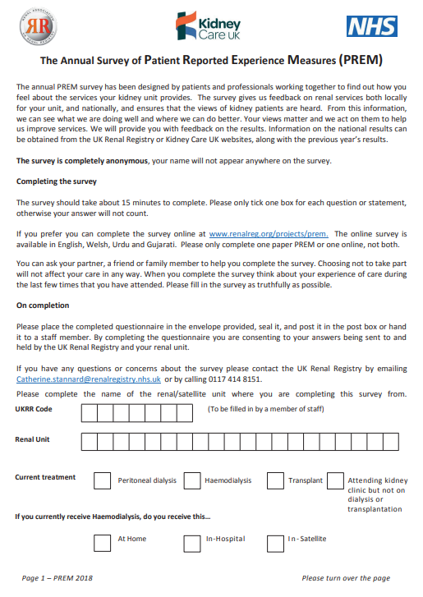
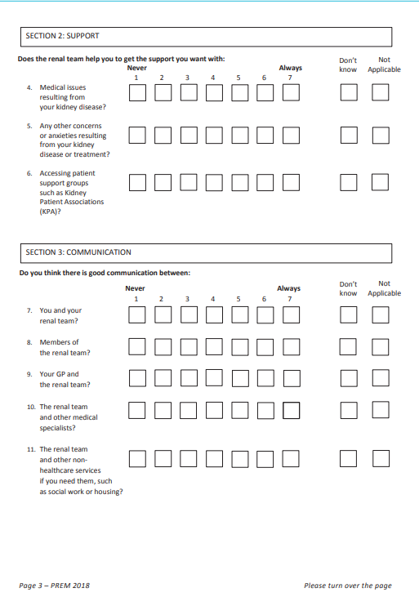

What is the Kidney PREM?
Patient Reported Experience Measures - PREMs - are measures which gather data on the experience of patients in health care settings
The results of PREM’s can be used to improve services in areas identified as important by patients; and tailor care by identifying the impact it has on patients (Aiyegbusi et al., 2017)
The Kidney PREM is a questionnaire measuring kidney patients’ perceptions of their experience whilst receiving renal care.
“The Renal Association and Kidney Care UK are committed to improving the patient experience of kidney care, to have a positive impact on patient quality of life. Kidney PREM is available annually…. to give patients the opportunity to feed into service improvement by sharing what matters most to them.”

Slide 7
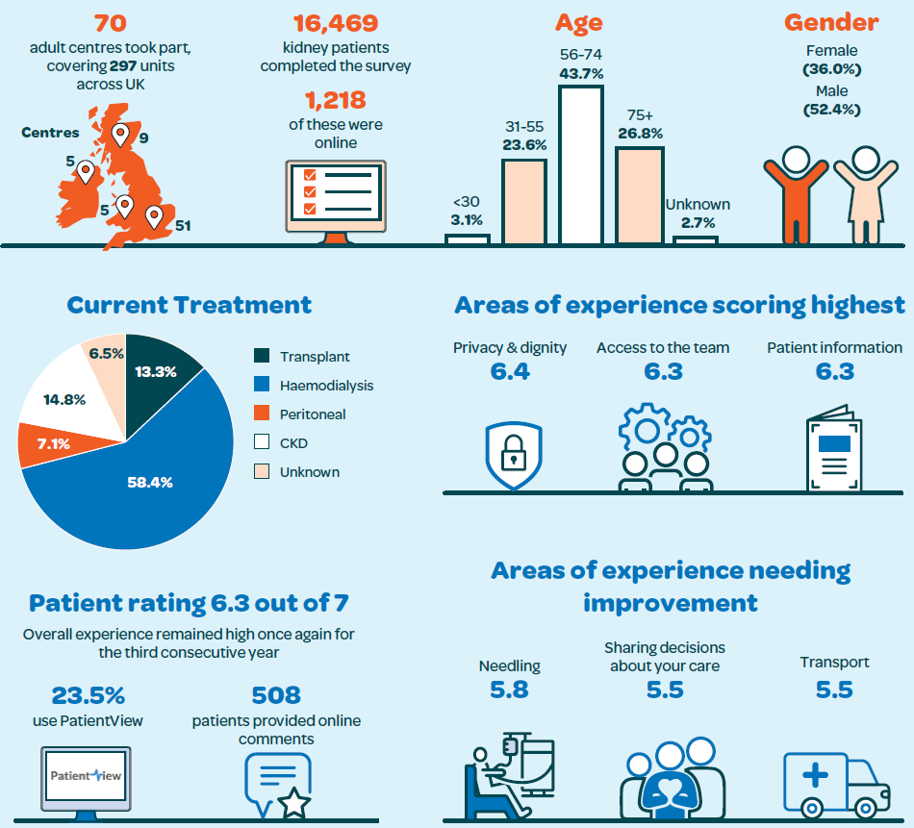
Kidney PREM 2019 – the national results

Slide 8
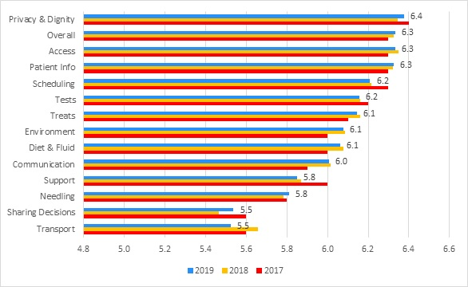
Mean scores by theme 2019, 2018 and 2017

Slide 9
How do we compare?
 | Overall | Privacy & dignity | Access | Patient information | Scheduling | Tests | Treatment | Environment | Diet & Fluid | Communication | Support | Needling | Sharing decision | Transport
National Average | 6.3 | 6.4 | 6.3 | 6.3 | 6.2 | 6.2 | 6.1 | 6.1 | 6.1 | 6.0 | 5.8 | 5.8 | 5.5 | 5.5
Main centre Name
Satellite Unit Name

Slide 10

Acting on the Kidney PREM
Sharing decisions
Transport
Needling
Nationally these are the three consistent and unchanged lowest scoring areas of patient experience for the past 4 years.
There is a call to action from kidney patients and the wider community to address the aspects of kidney care that impact most negatively on their experience
We know this is not simple but lets make a plan!

Slide 11
Step 1 – Listen to our stakeholders
Review, share and compare our results/
What change is needed?
Plan our Project
Be creative and open to new ideas and doing things differently
Talk to local patients, involve KPA’s and get staff on board
Prioritise the areas at our unit needing quality improvement

Slide 12
Step 2 – Plan our project
What is our aim? What do we want to achieve? By when?
Who do we need to involve?
Prioritise ideas that have come from our discussions with patients, staff and others
Plan what we want to achieve in the next 30-60-90 days
Continue to meet regularly with our project team
Communicate what we are trying to do with our wider team and senior management
Notes:
There are lots of quality improvement resources available on the Kidney Quality Improvement Partnership (KQuIP) hub: www.thinkkidneys.nhs.uk/kquip/hub/or you can contact the KQuIP team for QI support on kquip@renalregistry.nhs.uk

Slide 13
Step 3 – Implement and review
We might want to ask patients how they feel about changes we are making – we don’t have to wait until the next year’s Kidney PREM to ask!
If it does not work first time, we won’t give up – we will adjust our ideas and plan our next cycle of change
If our ideas are a success, let’s share our progress
Step 1.
Plan
What changes are needed?
Step 2.
Do
Set aims and objectives
Step 3.
Study
Implement
Step 4.
Act
Analyse
Prioritise
Make a plan
Collect data
Document
Observe and record data
Compare results
Review impact
Listen to stakeholders
Involve the right people
Meet regularly
Communicate

Slide 14

Actions | Lead | When | Monitoring Notes
30 days:
60 days:
90 days:

