Slide 1

UK RPG Conference 2023
Registration NOW OPEN
Welcome to the July Q&A!
– Open Session
Trusts represented today include: Cambridge, Oxford, Bristol, Imperial, Exeter, Northampton, NNUH, Royal Cornwall, Lister, Worcestershire, Glasgow and Clyde

Slide 2
UKKW themes – June Q&A
Available on the Clinical Sub-Group Members Section

Slide 3
UKKW themes: RSTP
Launched in June by Smeeta Sinha and Ahmad Saleem
Toolkits launched on NHS Futures
Need to register for NHS futures then request to join the regional/RSTP workspaces
UKKA update: Kathrine Parker is new academic vice president for UKKA
Clinical (non-medical) VP post open for applications
Focus for next 12/12 will be education.
Renal pharmacists are encouraged to apply/partake

Slide 4
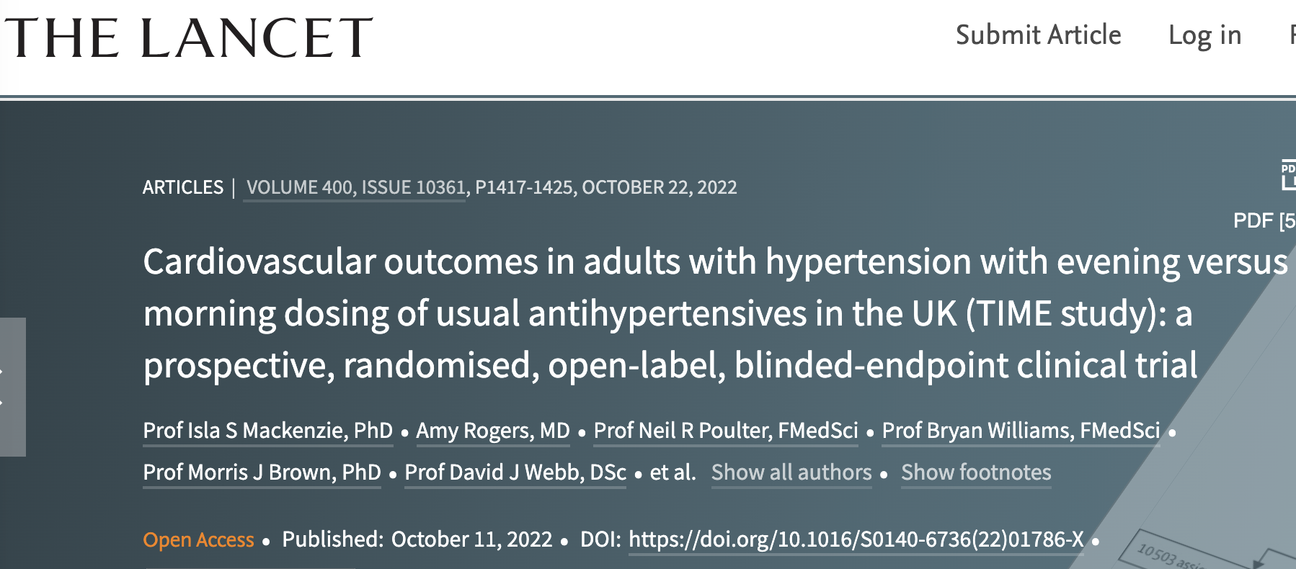
UKKW themes: Hypertension
Cardiologist/pharmacologist from Cambridge
British & Irish Hypertension Society (BIHS) guidelines recommending longer acting agents (e.g. amlodipine) and gradual BP reductions Vs rapid reduction (increases risk)
TIME study (Lancet) looking at timing of antihypertensives (PM Vs AM)
  Question re Spanish study several years ago in contrast to this data. Previous literature suggested night time dosing improves CV outcomes.
  TIME study suggests not

Slide 5
UKKW themes: Hypertension
UKKA working group looking at guidelines for hypertension in dialysis
  Charlotte at Lister working on this
  Should be available end of summer
  Little evidence but will provide some recommendations
  Dosing for dialysis days vs non-dialysis days
  Targets for BP and measuring BP

Slide 6
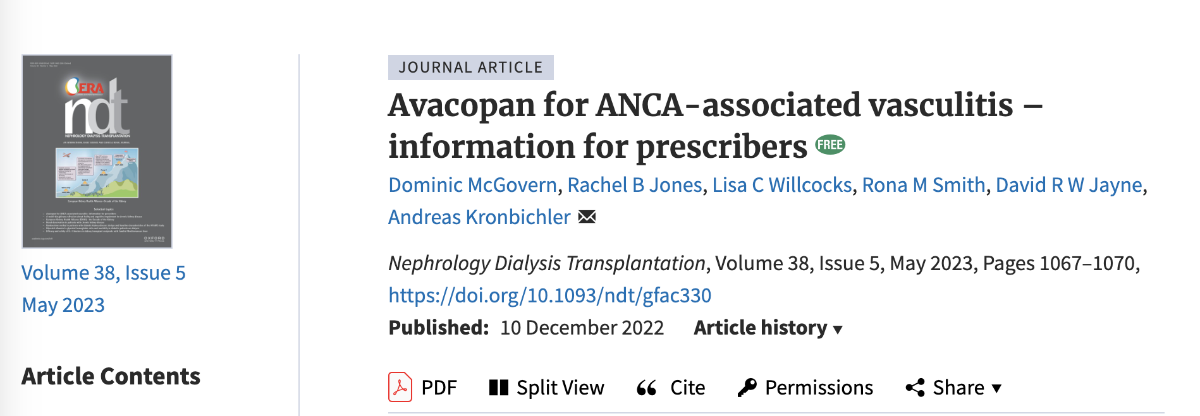
UKKW themes: New treatments in ANCA vasculitis
Avacopan not yet studied without steroids
  Wide variability in steroid reduction plans across centres
  Transaminitis seen in some observational data (not common)
  Discussion around using avacopan >1yr – not yet studied
  Paper in NDT

Slide 7
UKKW themes: New treatments in ANCA vasculitis
Cambridge using in avacopan in ~ 10 pts. All are having concurrent steroids
No standard steroid reduction
  Fairly rapid reduction in all patients not based on disease severity

Slide 8

UKKW themes: EMPA kidney update
SMART-C; Useful study to demonstrate v low risks of ketoacidosis and AKI
EMPA kidney (lesser extent but also with dapa) also included patients with glomerular disease to add confidence in treating these groups
UKKA revised guidance on SGLT2i’s

Slide 9

UKKA SGLT2 inhibitor CKD guideline:
2023 UPDATE
To reduce risk of kidney disease and cardiovascular outcomes |  | Urinary albumin-to-creatinine ratio (mg/mmol)
 |  | <25 | ≥25
eGFR (mL/min/1.73m²) | ≥60 |  | Recommended
 | ≥45 <60 | Suggested (in type 2 diabetes) | Recommended
 | ≥20 <45 | Recommended (For diabetes=1A) (For no diabetes=1B†) | Recommended (All =1A)
 | <20 | Suggested | Suggested
 | Dialysis | Not recommended | Not recommended
Note: People with type 1 diabetes, polycystic kidney disease, or kidney transplant excluded from the definitive trials
† Safety profile better in patients without diabetes vs without, and can be used to slow rate of decline in eGFR

Slide 10
July: Supply Problems
Dailiport 5mg issues (other strengths available)
Sodium thiosulphate (?resolving)
Oxycodone Liquid – seems resolved
Bumetanide – GP query, ?won’t be made for a few months,

Slide 11
Q&A Themes - Renal
? Sevelamer reformulation as liquid
Roxadustat dosing advice
RSTP toolkits on NHS Futures page
Vedolizumab at GFR 34 (not answered)
Renal pharmacy workforce calculator – deadline extended
Enoxaparin levels in dialysis/non-dialysis
Steroid wean protocols for vasculitis using avacopan
Finererone 20mg – anyone protocolising use GFR > 60 – NO as not NICE TA’d
Nephrotrans – on formulary anywhere?
MHRA – patient safety alert – calcium gluconate 30ml hyperkalaemia (6.8mmol)
  ?rate to give. To give over 5-10 minutes. MHRA warning states 10.
Pharmacy 2 u – or equivalent postal service – any experience?
  Looking at remote dispensing service at Imperial. Similar to Homecare but just dispensing. Please reach out if any experience from other trusts.
Paxlovid – anyone using in GFR < 30ml/min (England centric Q – commissioning statement etc)
  No experience yet.
  CMDUs - ?closing down, plan for community patients. National guidance required. Patient report results to GP/111 rather than into portal.
Ciclosporin dosing – minimal change – IBW or oedematous weight?
  Ensure dry weight for IBW
  Tacrolimus used in many trusts, start low dose, monitor levels
Ponticelli / Modified Ponticelli protocols.
  Most trusts use IV methylpred for 3 days. 500 mg rather than 1g
Lokelma use in <18yrs age
  GOSH use down to 6 months, no issue

Slide 12
Q&A Themes - Dialysis
IP plus PO fluconazole for peritonitis
Acetazolamide in HD
  To be reviewed for RRD, dialysis dose. Has been used daily with no ill effects.
Levetiracetam as CSCI at ESRF (Not RRT)
Apixaban in RRT - ? Levels/LMWH interaction advice
Enoxaparin in ESRF
Ability to do PD dialysis in satellite hospitals
Meropenem – dialysis dosing for twice a week protocol…
Alteplase – ‘push lock’ versus dwell
Entresto and/or dapagliflozin – conservative management
Retacrit –conversion rate 1:1 or not?
Nyststin PD peritonitis guideline
  Not in most guideline, may consider if on additional immunosuppression.

Slide 13
Q&A Themes - Transplant
Egg donation on MMF
Myfortic doses >720mg BD
I?S via shared care with primary care
Imlifidase – progressing. Dane/Dawn/Sara working on some pt and pharmacy info
  Patient Information leaflet draft written, awaiting comments.
  Working on some information for reconstituting etc. NHS Futures page
Timing of rATG, PlEx and IVIG.
Co-trimoxazole 480mg o.d.
Mycophenolic acid and sirolimus – commissioning status NHSE
  July list to improve!

Slide 14
Updates
NICE TA’s for difelikefalin have gone to CRG for clarification of commissioning
Difelikefalin for treating pruritus in people having haemodialysis [ID3890 ]
  In development [GID-TA10793]Expected publication date: 26 April 2023
  TA out ?next week
  Can be used for moderate-severe pruritis, not specified in NICE order of treatment.
  Can have up to four times weekly in wash-back on dialysis
  Need to use itching scale as per clinical trials.
  Olivia to share scoring system on whatsapp group
  Stopping criteria
Voclosporin with immunosuppressives for treating lupus nephritis [ID3962]
  In development [GID-TA10878]Expected publication date: 26 April 2023
  ?monitoring required
  Blueteq

Slide 15
New Q
IM vitamin D
  Ever used in kidney disease?
  Oxford given without any issues.
  ?moderate the dose if issues with calcium
  Query with Q+A group

Slide 16

Conference Update:
UK RPG Conference 2023
Registration NOW OPEN
Abstracts by 4th August

Slide 17
May Q&A - Close
Thank you for attending!
Next Q&A: Wednesday 9th August
Keep in touch throughout the month on WhatsApp Q&A Group
90 participants throughout UK and Ireland
Useful real time forum for clinical Q’s
Please consider joining!

