Slide 1
Welcome to the January Q&A!
Trusts represented today include: Cambridge, Guys, Sheffield, Lister, Barts, Shrewsbury & Telford, Glasgow, NHS Ayrshire & Arran, Derby, Northampton, North Bristol, Hammersmith, Liverpool, St George’s

Slide 2
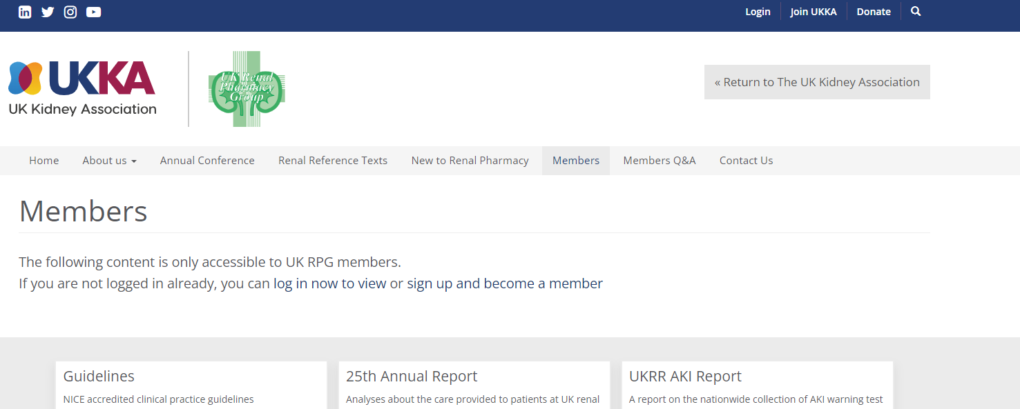
Updates
UKKA membership - Please can all members log into the website to check your renewal status
  A number of Whatsapp members have lapsed membership and we are working to ensure all active Q&A members have a current membership
    Check your contact emails +/- spam boxes as some of the renewals appear to be going there

Slide 3
Updates
Reminder to check your RPG membership is up to date
  Large number of lapsed memberships, currently being checked against the Q&A whastapp group list
RPG conference 2024 11th/12th October - save the date!! ☺
  Birmingham Arden Hotel
UK Kidney week 10-12th June 2024
  Edinburgh Conference Centre
  Liaise with Cathy Pogson to get involved (cathy.pogson@porthosp.nhs.uk)
  Abstract submission extended to 16th January
  Volunteers to mark abstracts
Weekly teams chat for advanced/consultant portfolios
  Email cathy.pogson@porthosp.nhs.uk if you would like to join

Slide 4
NICE TAs
Empagliflozin for treating chronic kidney disease
Technology Appraisal guidance [TA842] Published 20 December 2023
Recommendations
1.1 Empagliflozin is recommended as an option for treating chronic kidney disease (CKD) in adults only if:
  Is it an add-on to optimised standard care including the highest tolerated licensed dose of angiotensin-converting enzyme (ACE) inhibitors or angiotensin-receptor clockers (ARBs), unless these are contraindicated, and
  People have an estimated glomerular filtration rate of:
    20 ml/min/1.73 m2 to less than 45 ml/min/1.73 m2 or
    45 ml/min/1.73 m2 to 90 ml/min/1.73m2 and either:
      A urine albumin to creatinine ration of 22.6 mg/mmol or more, or
      Type 2 diabetes

Slide 5
NICE TAs
Targeted-release budesonide for treating primary IgA nephropathy
Technology appraisal guidance [TA937] Published 20 December 2023
Recommendations
1.1 Targeted-release budesonide is recommended as an option for treating primary immunoglobulin A nephropathy (IgAN) when there is a risk of rapid disease progression in adults with a urine protein-to-creatinine ratio of 1.5 g/g or more. Targeted release budesonide is recommended only if:
  It is an add-on to optimised standard care including the highest tolerated licensed dose of angiotensin-converting enzyme (ACE) inhibitors or angiotensin-receptor blockers (ARBs), unless they are contra-indicated
  The company provides it according to commercial arrangement

Slide 6
Updates
NICE TA: Empagliflozin - released 20th December
  CKD/DKD/Proteinuria
  RPG have responded to confusion related emails
  Plenty of CKD pathways
NICE TA: Budesonide (Nefocon) released 20th December
  IgA Nephropathy
  No Blueteq required
Other recent NICE TAs
  Difelikafalin
  Avacopan
  Voclosporin
  Roxadustat
  Finerenone
UKKA Expressions of interest:
  Co-chair guidelines committee for UKKA
  Contact Katherine Parker for info (currently on the committee)

Slide 7
Supply Problems
Alteplase OOS again
Bumetanide tablets OOS until January 2024
Sando K and Phosphate Sandoz until March 24
?Cinacelcet 30 mg tablets
Basilixumab - ?potential disruption
10 % Mannitol
Sodium bicarbonate – 1.26 % OOS so using 1.4 % as an alternative
Human albumin – allocation
Slow sodium

Slide 8
Q&A Themes - Guidelines
Steroid dosing post kidney transplant embolism
IV iron protocols
PILs for avacopan and voclosporin
LMWH for renal patient with higher weight

Slide 9
Q&A Themes - Renal
Malignant hypercalcaemia treatment
Urology – supply of Pentosan/Cystostat/iAluril
Voclosporin – QT monitoring with hydroxychloroquine
  Jude to share answer from company via Q&A whatsapp
AKI/sick day comms/leaflets for patients
  Potential project for E&T subgroup / renal networks
  Charlotte to add sick days info card to whatsapp group
Crushing sevelamer for NG tube
Sodium thiosulfate in pre-dialysis patient
Avacopan in Hep B patient
Acitretin in CKD 4/5
Oral Mg Formulations

Slide 10
Q&A Themes - Dialysis
HUS treatment on dialysis
Nefopam in dialysis
Ustekinumab in dialysis
Bowel prep in dialysis patient
Ertepenum doing on dialysis
Vanc hep line locks for line associated bacteraemia
Eosinophilia with Taurolock U or tauro-hep
Lithium management in dialysis
High dose Ciprofloxacin in dialysis. ?levels
Vitamin A for dialysis patient
Melphalan dosing on HD for stem cell transpolant for myeloma
Soium thiosulfate in CVVHD
?continue dapagliflozin in ESRD
Tamiflu dosing in HD
GLP-1 agonist in ESRF for weight loss
Urokinase overdose
Oral semaglutide in dialysis
Inclisiran in HD patients
Ceftriaxone dosing on dialysis
Actions:
  Potential to write a decision-making tool for medicines where little data is available
  Write up experience (and email Aileen for addition to RDH)
Notes:
Potential to write a decision-making tool for medicines where little data is available
Write up experience (and email Aileen for addition to RDH)

Slide 11
Q&A Themes - Transplant
MMF in men wanting to start families
Tivozanib with tacrolimus or sirolimus
Steroid dosing pre-belimumab
TB prophylaxis if patients can’t have isoniazid
Prograf via sublingual route
MMF levels – MPA levels at Imperial

Slide 12
Q&A – New Qu
PPIs and tac
  Helpful document now on homepage of RPG website
  Consider need for PPI and consider individual patients
Advice for new renal pharmacists (networking and general tips)
  Q&As (monthly) / whatsapp
  Subgroups – Clinical, E&T, R&D
  Wider UKKA – website, bulletins, guidelines
  RPG Conference (40th anniversary this year ☺) networking and learning
Bursaries will be available for RPG Conference – start writing your abstracts and posters now!
Next meeting Weds 14th Feb

Slide 13
January Q&A - Close
Thank you for attending!
Next Q&A:
Keep in touch throughout the month on WhatsApp Q&A Group
>100 participants throughout UK and Ireland
Useful real time forum for clinical Q’s
Please consider joining!

