Slide 1
UI Data Visualisations
In relation to this presentation, I declare that there are no conflicts of interest.
Notes:
Joel has taken you through the ukrdc user interface. I’m going to talk about the development of the dashboard stats library and the kind of things that are in the pipline.

Slide 2
Overview
Visualisation to aid in improvement to UKRDC data quality
Tailored to specific needs of different UKRDC stakeholders
Development will be flexible, modular and configurable, user-friendly, granular
Functionality to be rolled out in stages, basic statistics currently available and more advanced features in the future.
Notes:
The overall aim of the dashboard stats is to enhance the process of cleaning and enhancing the data quality. The UI visualisations allow units to get a snapshot of key metrics with current data and identify where the limitations might occur. We expect a variety of different users for the UKRDC UI so rather than being all things to all men the dashboard stats should be tailored to the specific needs of different users. Increasingly we would like the experience to be customisable so that a renal data manager might see something different to say a s statistician. To allow this we have designed a modular system where different sets of stats can be calculated in a self contained way and the front end will be customisable for different users depending on their interest and role in UKRDC. You have seen from Joels talk that some basic statistics are already available for units with a UKRDC feed and I hope to give you an idea of what kind things are upcoming, and how to collaborate with the future development so we can build a really useful tool. With that said I am going to give a quick overview of the architecture of the system.

Slide 3
Architecture
Visualizations are powered by a dedicated dashboard-stats library
Library queries UKRDC database
Api uses library to process events in the UI
UI displays output of API
Notes:
The visualisations are powered by the dashboard stats library this is what queries the database and runs all the calculations to produce the visualisations. This is a stand alone python library which we have developed independently of the other compenants. The libaray is called by an API which acts like a bit of a middleman and handles all the requests from the UI. This means when you click on something in the UI, for example the stats tab, then the api will process that and decide what it need to make the UI respond accordingly. In the case of the realtime stats the API will call the dashboard stats library and make the calculations required to produce the output you see in the UI. These results are then cached so the stats don’t have to be recalculated everytime they are needed. With that in mind I’m going to start with the most recent development which we are testing and will come to the dashboard fairly soon and then progress to some of the things which are further down the pipeline.

Slide 4
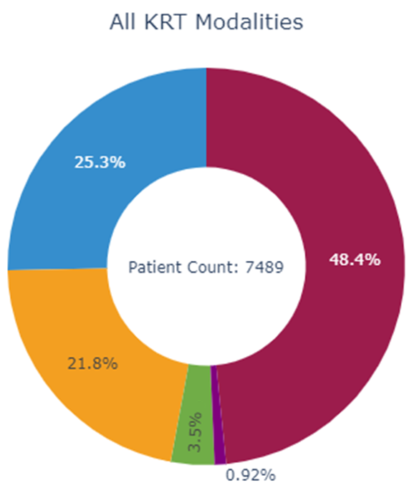
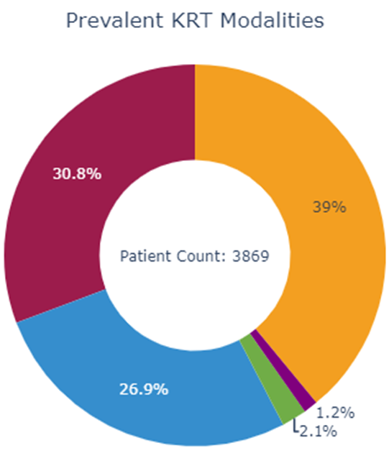
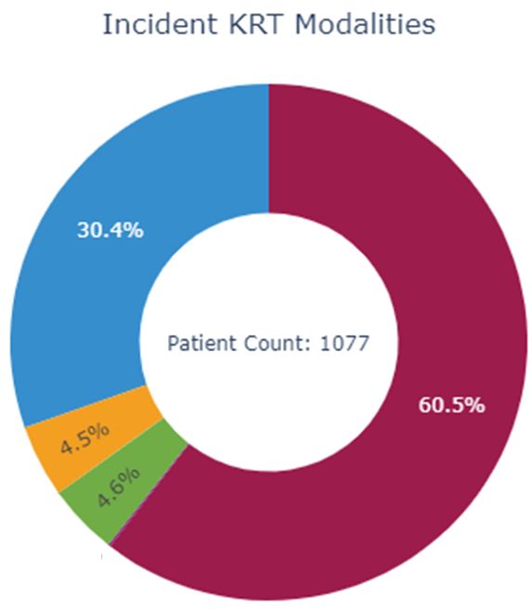
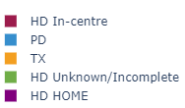
Updates to Kidney Replacement Therapy (KRT) Stats
Notes:
The upcoming changes will overhaul the dialysis tab in the current UI based on the internal feedback we have had so far. It will be more like a kidney replacement therapy tab now and the visualisations will now include transplants as well as dialysis modalities. They are also now going to be pie charts to give a bit more clarity. The visualisation calculates the modalities based on a three month window and displays the break down of KRT modalities in that time. That includes patients that are incident during the period and patients which are prevalent on it and anyone at all receiving Kidney replacement therapy in that time. The total number of patients in each of these groups will now be displayed in the centre of the plot. If you are interested there is a detailed description on the exact methodology used to calculate them then that is displayed in the information section of the UI.

Slide 5
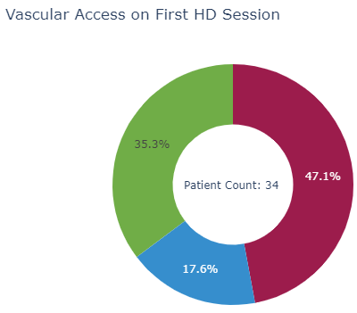
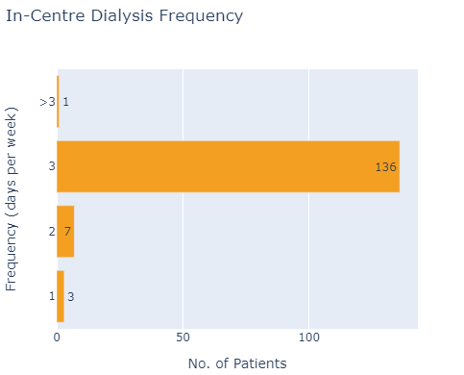

Updates to Kidney Replacement (KRT) Therapy Stats
Stats can be filtered by satellite unit:
Notes:
The major other change which is lined up for the modality statistics is going to be the ability to filter on dialysis statistics by satellite unit. In particular this will affect the vascular access chart and the in-centre dialysis frequency chart shown here. This will allow more granular viewing and comparison of the stats within the sending facility. We are unit testing this update and it should be ready to deploy fairly soon however we have encounter a bit of a problem. As the stats scale in complexity and unit size they require more and more resources to calculate in real time. I will illustrate this in more detail on the next slide.

Slide 6
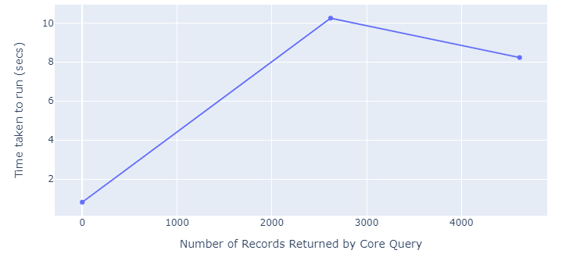
Just-in-time vs ahead –of-time
Benchmarking…
Notes:
This is a benchmark I did on the three units with RDA feeds. The dialysis stats are hitting a limit of how long you are willing to wait for the api to generate results. While in general writing code which calculates the answer you want in 10 secs isn’t such a bad thing…in this case it affects the user experience and as more units and more complex statistics are added to the mix it becomes increasingly unwieldy to calculate the answers just in time. As a reminder just in time means that first time the API calls the dashboard stats library with a particular set of inputs it will calculate that on the spot and store the results for when they are next needed. Really we want the UI to be as responsive and when you click into a particular stat for it to appear before you run out of patience.

Slide 7
Just-in-time vs Ahead –of-time
Stats are currently calculated on request and then stored for quick retrieval
When the stored data expires, next request must be recalculated, causing delays for users.
Stats that are slow to calculate (large units, complicated queries) will be calculated ahead of time
This will allow more complex calculations without detriment to UI speed
Notes:
We are developing the capability to have a combination of just in time and ahead of time. As I explained in the previous slide just in time involves running the stats calculator at the point where the user first opens the realtime stats. This result is cached so it only needs to be calculated once until the data store expires and should be fine for everything below a threshold of unit size and complexity. Doing it this way prevents repeated computation and unnecessary computations. However for stats that run slowly we are moving to ahead of time calculations. This will work in a very similar way but the api will schedule some of the slower calculations automatically when the database is being lightly used and cache the results. This will mean that even more computationally intensive stats will be available without delays to the UI. With that background I will now demonstrate some of the modules which are under development.

Slide 8
Upcoming Calculators
Stats are grouped around self contained calculators
These are grouped around particular extracts/tasks
Will allow custom dashboard in UI for different stakeholders as they get RDA feeds
Upcoming calculator will focus group demographics around primary renal diagnosis, time dependence of modalities and pathways between modalities
Notes:
Each module of the dashboard stats is called a calculator. So that means the library works by grouping around a particular extract with a specific use case. This means they can be specified and designed with a particular user and set of permissions in mind. Users will then get a UI experience which is targeted more specifically to their needs. To demonstrate I will show you a couple of calculators we are working on. The first is to do with primary renal diagnosis. You have seen the demographics page in the current UI and now we wish to create a fancier version of that which breaks that data down by primary renal diagnosis.

Slide 9
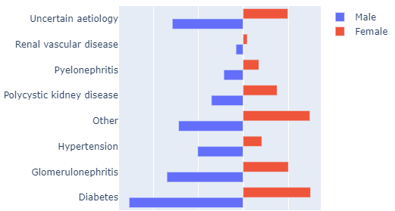
Primary Renal Diagnosis (PRD) - Sex
Notes:
The first of these stats is the breakdown by gender. We have represented this using a split bar and you can see the contrast between the types of diagnosis in male and female. You might have to grab a friendly statistician for interpretation of this figure.

Slide 10
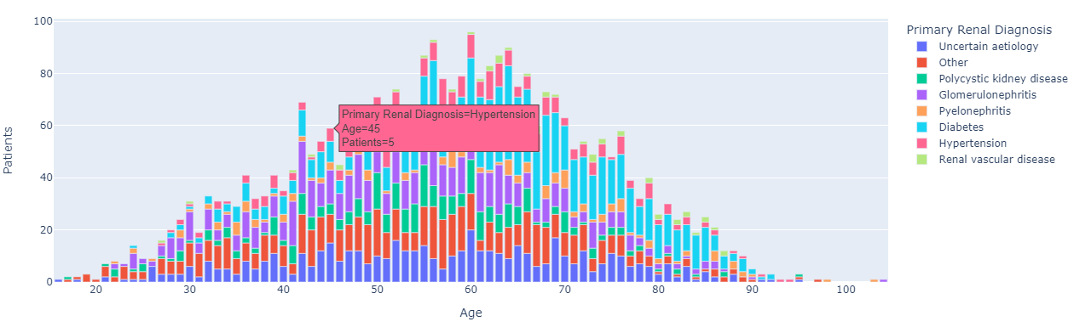
Primary Renal Diagnosis (PRD) - Age
Notes:
In this next plot you can see we have played a similar trick with the age distribution. These plots will be interactive so I have screen shotted it with the datatip hovering over one of the bars. As the development progresses we aim to add more interactivity. For example click events which allow the records for groups of patients like this to be opened up and examined.

Slide 11
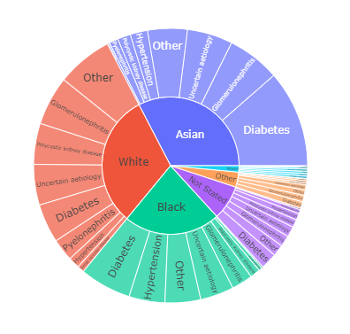
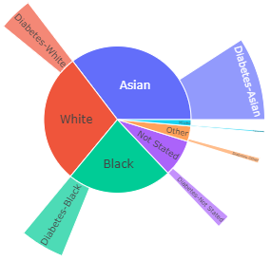
Primary Renal Diagnosis (PRD) - Ethnicity
Notes:
Finally breakdown of ethnicity and primary renal diagnosis. You can see the difference in the type of PRD which different ethnic groups experience. On the right is an example of a way in which a plot like this might be customisable for example showing just the diabetes. A stable release of this particular calculator is a bit further down then line but moving on I like to show you some other prototypes.

Slide 12
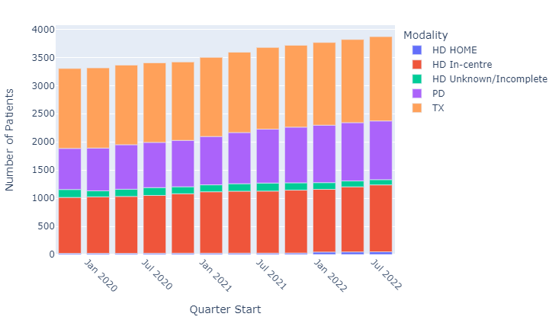
Prevalent Patients
Notes:
This particular on is not massively dissimilar to the kind of thing you might see in the annual report. It is related to the very first set of visualisations I show and at its core is essential calling that calculator but repeatedly over 12 time bins. As you can imagine this would have to be one of the ahead of time calculations but it show the change in the number of patients on kidney replacement modalities over time.

Slide 13
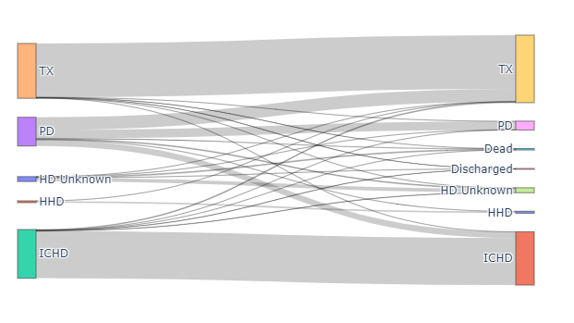
Prevalent Patients Modality Changes
Notes:
This visualization shows the flow of patient between modalities over a period of 3 months and it shows the first modality change. So this might be a way of showing what different patients progress onto.

Slide 14
Conclusion
UKRDC visualisations will allow of current data to be viewed without a lag
New caching AOT allows more complexity and larger datasets than JOT
As more units get RDA feeds uses will expand and more calculators will be developed
More interactivity will be rolled into UI as development progresses
Notes:
So that’s every thing I have to show. The UKRDC dashboard visualisations will be able to show in current data without a lag. The new caching just in time and ahead of time calculations will allow for as much complexity as required. As new feeds get set up and go on line more calculators will get developed and ultimately we need your feedback on developing new calculators and setting up use cases which will be as beneficial as possible. Finally something I haven’t covered in much depth is as further down the line we will are aiming to increase the interactivity of the plots. There will be the ability to click into patient cohorts and open up the record to correct data and to see with granularity the data being represented by the visualisations.

Slide 15
Thank you
Contact info:
philip.main@ukkidney.org
Notes:
Thank you if you have feedback, good ideas of useful visualisations that might be good to go on the UKRDC UI please get in touch.

