Slide 1
UKRR Collection of AKI Alert Data from Laboratories
“In relation to this presentation, I declare that there are no conflicts of interest.”
Notes:
Hi my name is Beth Carter-Crosby and I am one of the data managers here at the Registry. I am here to talk through the UKRR collection of AKI data from the laboratories.
Next slide please.

Slide 2
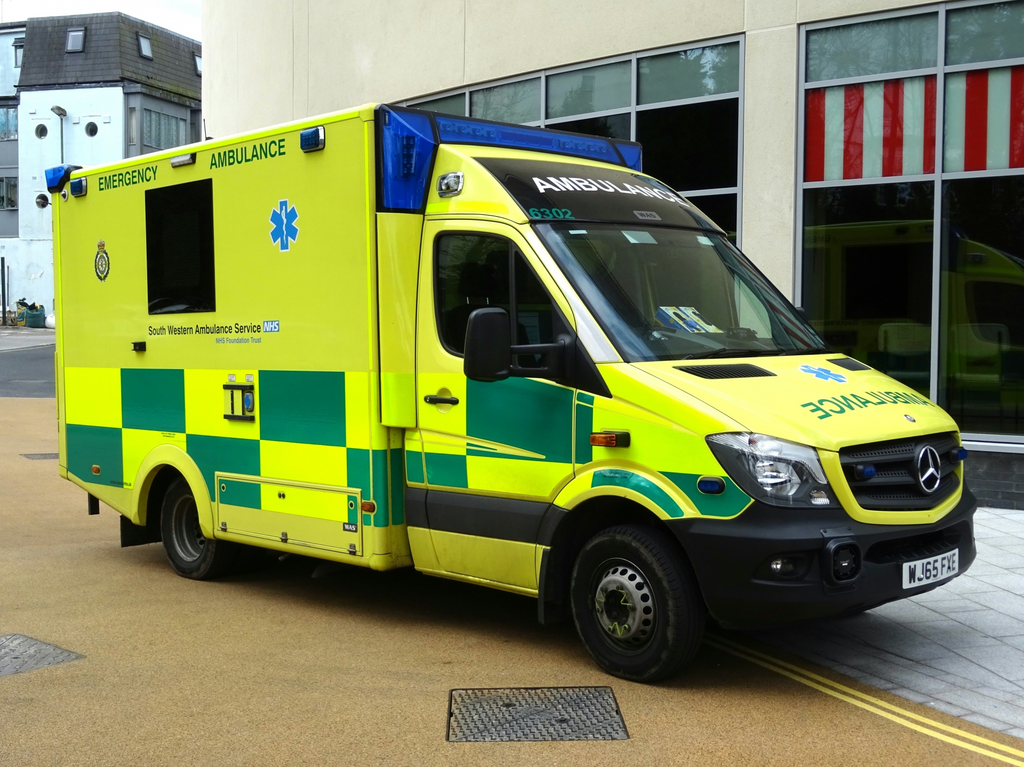
Background – The High Cost of AKI
It is estimated that 1 in 5 emergency admissions into hospital are associated with AKI (Wang HE et al, 2012)
Approximately 1 in 3 patients with AKI in hospital, developed AKI during their time in hospital - A fifth of these cases are considered avoidable (Anastasios A et al 2019)
Up to 100,000 deaths in hospitals, a quarter to a third could potentially be prevented (National Confidential Enquiry into Patient Outcome and Death (NCEPOD) Adding Insult to Injury 2009)
The estimated costs to NHS per annum:
£434-620 million in 2011 (Kerr et al, 2014)
£500 million in 2012 (NHS Kidneycare 2012, now NHS IQ)
are rising to £1.02 billion in 2014 (Kerr et al, 2014)
.... more than the costs associated with breast, lung and skin cancers combined
Notes:
To give you a little background on AKI first , what prompted the collection of lab AKI was awareness, interest and information.
It is estimated that 1 in 5 emergency admissions into hospital are associated with AKI .
Approximately 1 in 3 patients with AKI in hospital developed AKI during their stay, and a fifth of these cases are considered avoidable.
Up to 100,000 deaths in hospital, could potentially be prevented.
It is estimated that this is costing the NHS £1.2 billion pounds per annum.
….That’s more than costs associated with breast, lung, and skin cancer combined .
Next slide please.
References:
Wang et all - https://www.karger.com/Article/FullText/337487
Anastasios A et al - https://bmcnephrol.biomedcentral.com/articles/10.1186/s12882-019-1237-x
National Confidential Enquiry - https://www.ncepod.org.uk/CommonThemes.pdf
Kerr et all - https://pubmed.ncbi.nlm.nih.gov/24753459/

Slide 3
Background continued…
NHS Patient Safety Alert
Alert issued to all NHS acute and foundation trusts providing pathology services on 09/06/2014
Agreed national algorithm, standardising the definition of AKI, that provided the ability to ensure a timely and consistent approach to the diagnosis of patient with AKI is now taken across the NHS
When integrated into a LIMS, the algorithm will identify cases of AKI from the lab in real time and produce a test result and this result then gets sent to patient management systems.
5 action points (2015)
1 – Alert Director of Pathology/IT with responsibility for the upgrading of LIMS systems
2 - Work with local LIMS supplier to integrate AKI algorithm into LIMS system
3 - Work with local LIMS supplier to ensure the test result goes to local Patient management systems and into a data message sent to a central point for national monitoring purposes
4- Communicate with appropriate primary care providers to ensure they seek advice if test results are received
5- Regularly access NHS England AKI website where additional resources and information will be provided as developed
Notes:
This resulted in an alert back in 2014 to all NHS acute and foundation Trusts that provide pathology services.
Within the patient safety alert was an national algorithm, which standardised the definition of AKI.
This provided the ability to ensure that a timeline and a consistent approach to the detection and diagnosis of patients with AKI was taken across the NHS.
When integrated into a LIMS, the algorithm will identify potential cases of AKI from the lab data in real time and produce a test result.
This result then gets sent, using existing IT connections to patient management systems.
There were 5 action points as part of the patient safety alert, which involved alerting Pathology & IT to work with and upgrade LIMS systems.
This got the algorithm integrated.
Next slide please.
(https://www.england.nhs.uk/patientsafety/wp-content/uploads/sites/32/2014/06/psa-aki2.pdf) issued in 2014, to be introduced by March 2
https://www.england.nhs.uk/2014/06/psa-aki/

Slide 4
UKRR and AKI
The AKI National Programme Board was established and first met in 2013 – it consisted of biochemists, nephrologists and software providers and an initial algorithm was produced
In 2014 Think Kidneys became the national programme of NHSE in partnership of UK Renal Registry
The board established 6 workstreams
After some time and effort, the algorithm was agreed and implemented….
NHS England Patient Safety Steering Group
AKI National Programme Board
Risk
Education
Detection
Intervention
Implementation
Measurement
The algorithm compares serial creatinine measures detecting changes of creatinine, consistent with acute kidney injury. Clinicians are now receiving AKI results and labs are able to start sending their data to the UKRR
Notes:
Alongside the patient safety alert, the AKI national Programme Board was established.
This was made up of biochemists, nephrologists and software providers where an initial algorithm was produced.
In 2014, Think Kidneys became the national programme of NHS England in partnership with the UK Renal Registry.
The Programme Board reported to NHS England and they established the themes and priorities for the national programme, this was divided into 6 workstreams.
Risk, education, detection, intervention, implementation and measurement.
It was then the job of the programmes team to turn these into a reality. This involved monitoring the implementation of the AKI algorithm into labs, and submission of alert files.
Clinicians and labs were then able to receive AKI results and start sending data to the Registry.
Next slide please.

Slide 5
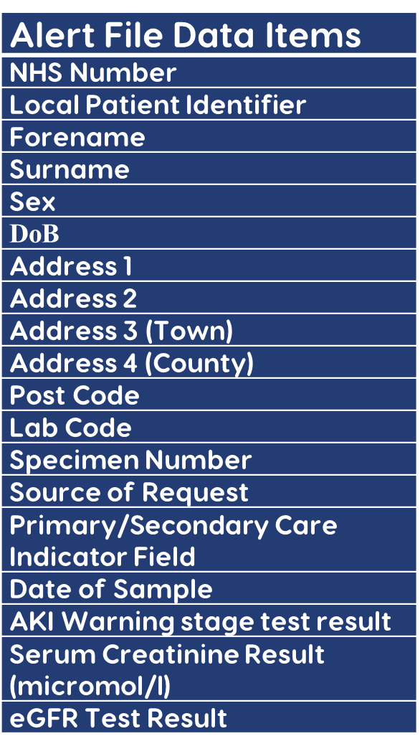
What Data do we collect?
The dataset is smaller than the quarterly dataset, containing 20 data item fields for the ALERT file and 14 data fields for the CREATININE file
Includes patient identifiable information such as NHS number, DoB, sex, address and local hosp number
One row of data, per alert generated is included in each file for the month
The ALERT file contains a date of sample triggering the alert and a creatinine result which is associated with the warning
If possible an associated creatinine file should also be submitted – these results should include where an AKI alert was recorded for the patient within the month and the test result occurred less than 15 months prior to the date the alert was generated
Although the dataset is smaller, there are still many errors than can occur and the files often need cleaning before validating – sometimes queries are sent back to the lab
Notes:
What data does the registry collect?
It is a relatively small dataset with only 20 data item fields for the ALERT file.
The file includes patient identifiable information such as NHS no, local patient identifier, full name, DOB and address, alongside the triggered alert and associated date and creatinine result. There is one row of data for each alert within the month generated.
There is also an additional creatinine file that is requested from sites if it can be produced, which has 14 data fields.
This includes creatinine results for 15 months prior to the AKI alert being generated.
There are still many errors unfortunately that can occur within the file.
Using a robust validation tool and database, it is the job of the data manager to clean the file and provide feedback to the site if required.
Next slide please.

Slide 6
Lab AKI Alert Data Collection and Processing
Warning alert and creatinine files created
Files sent to UKRR
File validated
Errors
No
Yes
File loaded
No
UKRR request a revised file
End result
Site contacted for further info or confirmation of data
No
Sufficient quality and completeness to load?
Errors reviewed by DM
Sufficient quality and completeness to load?
Yes
Notes:
Initially the data collection was undertaken by the Programmes team, the data team were then involved in refinement of the process.
This work is now part of the core data team work.
So what’s the process?
The AKI alert and creatinine files are sent securely to the UKRR from the labs
The labs send one submission per month containing the data for the previous full calendar month
The files should get submitted to the UKRR by the end of the month and processed using the AKI validation tool by the data manager.
If there are no errors, the file gets loaded straight away. However, errors are often generated and they get reviewed here at the registry.
Sometimes the file can be cleaned and revalidated without going back to the lab, however if there are queries, we may need to go back for further information
Next slide please.

Slide 7
Update – where we are now…
Now have 98% of labs submitting data to the UK Renal Registry, and of that about 78% submit monthly on a regular basis.
We continue to liaise with sites not yet sending data, or where submissions have stopped / slowed down. We also continue to review the data quality.
The AKI national report was published in 2020, where it can be found on the UK Kidney Association website.
Here you will also find the AKI data, which are uploaded on the AKI laboratory portal
Notes:
Where are we now?
We now have 98% of labs submitting data to the UK Renal registry and of that around 78% submit monthly on a regular basis.
We continue to liaise with sites not yet sending data, or where submissions have stopped or slowed down.
We also continue to review the data quality.
The AKI national report was published in 2020 where it can be found on the UK Renal Association website
Here you will also find the AKI data which is uploaded on the AKI laboratory portal.
Next slide please.
https://ukkidney.org/audit-research/publications-presentations/report/acute-kidney-injury-aki-england-report-nationwide
This can be found here liaise - see next slide for snapshot

Slide 8
Snapshot of UKKA data portal – AKI Laboratory portal
Includes:
The number of AKI episodes reported by each lab by quarter, by AKI stage at the start of the episode
Summary of AKI data by Sustainability and Transformation Partnerships (STP’s) in England
STP dashboard and AKI rate maps (England)
Link to portal https://ukkidney.org/audit-research/publications-presentations/report/acute-kidney-injury-aki-england-report-nationwide
Notes:
The portal shows the number of AKI episodes reported by lab and the STP dashboard and AKI rate maps.
Click on the picture of the portal
Next slide please.

Slide 9
Any questions?......
Notes:
Any questions before passing over to my colleague who will discuss the results?
Thank you.

