Slide 1
Vision for the UKRDC Data-set version 5
James Medcalf
Medical Director UKRR
In relation to this presentation, I declare that there are no conflicts of interest.

Slide 2
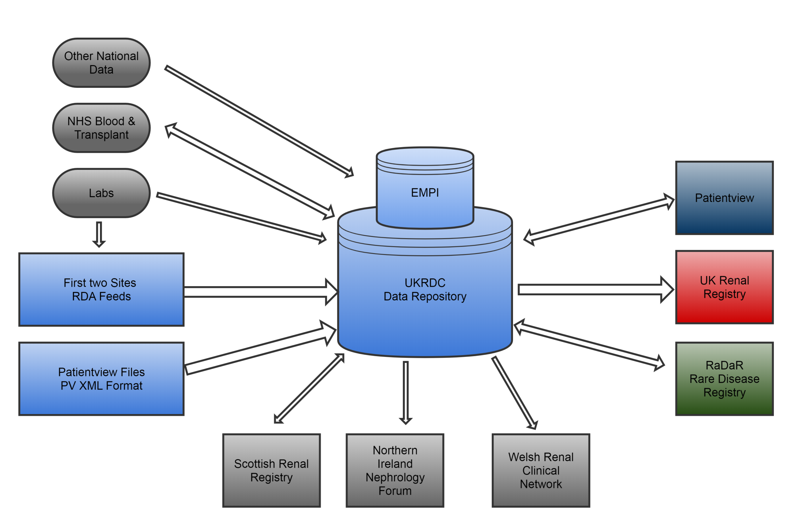
Quarterly
Files
Notes:
Many of you will remember that the original goals of the UKRDC were about simplying the exchange of information by reducing the number of individual data-flows, and adopting the developing information standards (SNOMED).
This remains a key vision for the UKRDC combining the flows for a) Audit b) Patient viewer c) RaDaR
It could still represent a ‘data-exchange’ format between kidney centres although to our knowledge this has never been attempted.

Slide 3
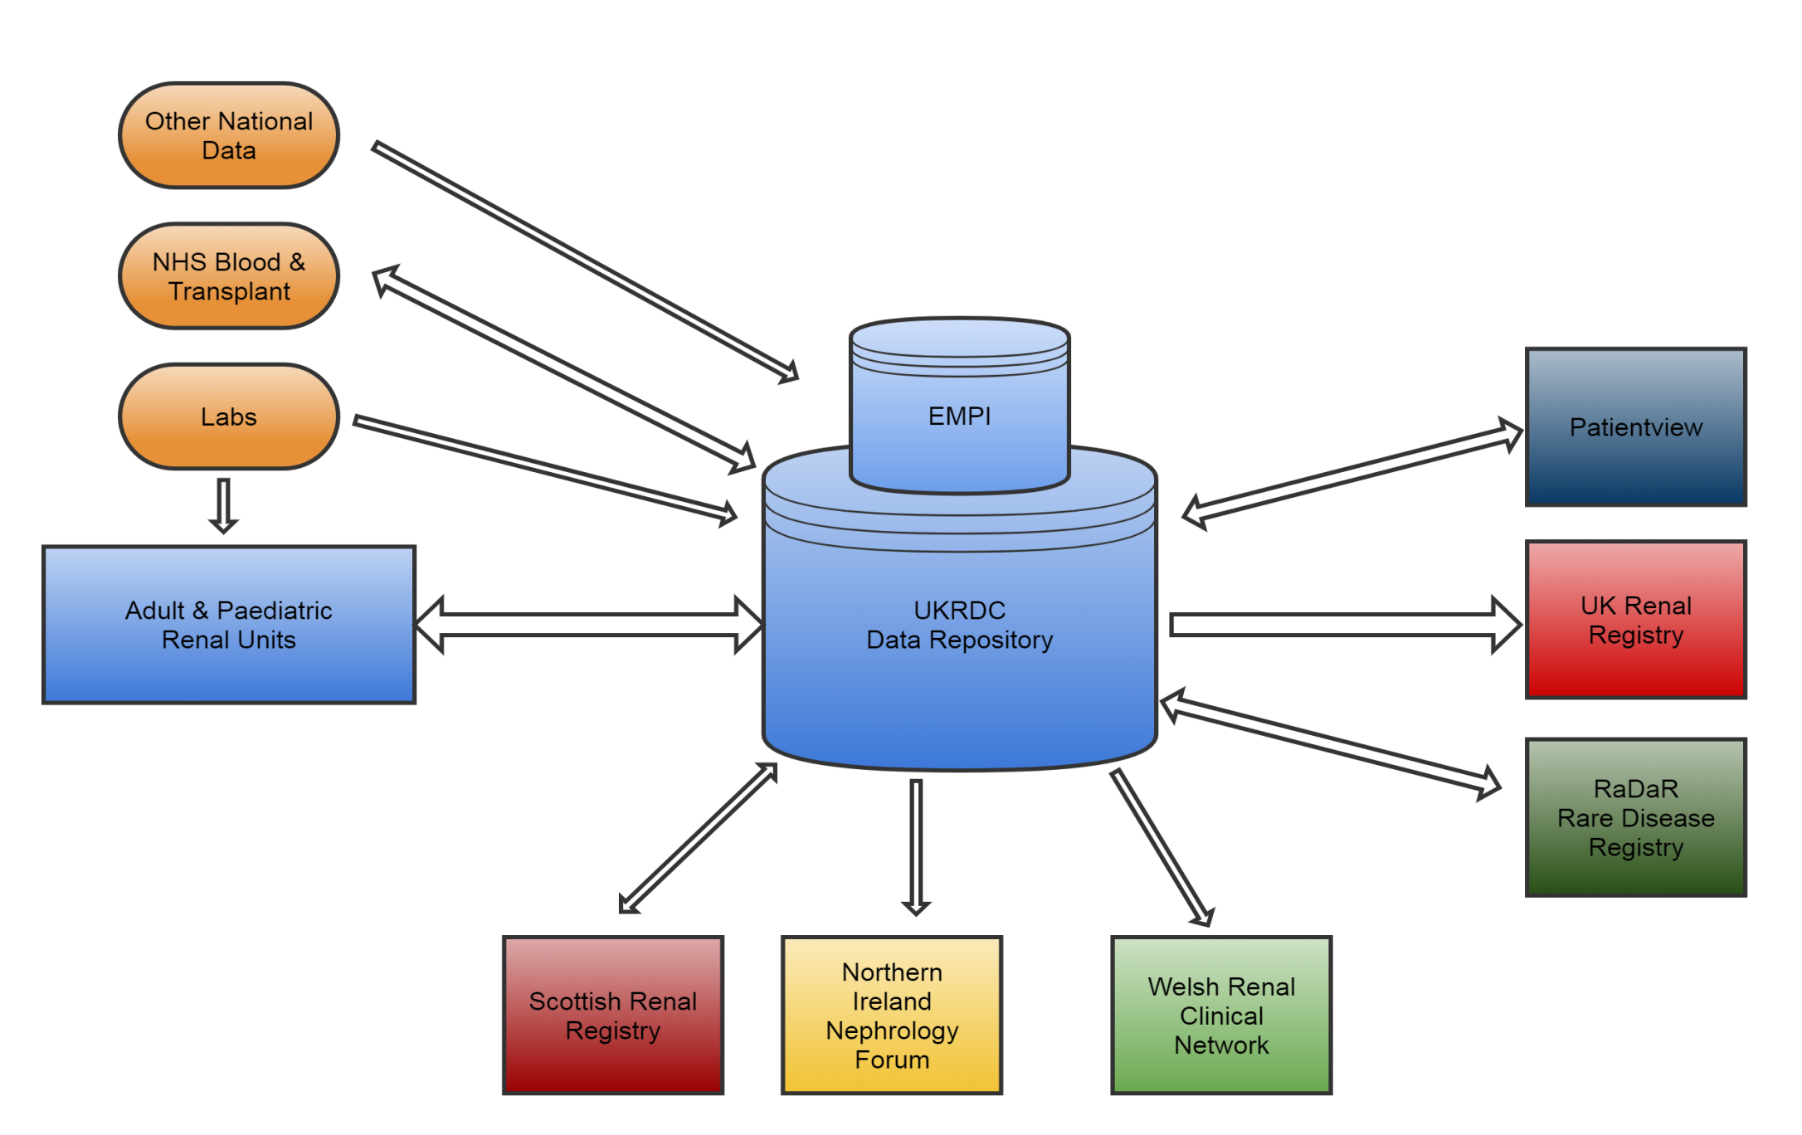

Slide 4
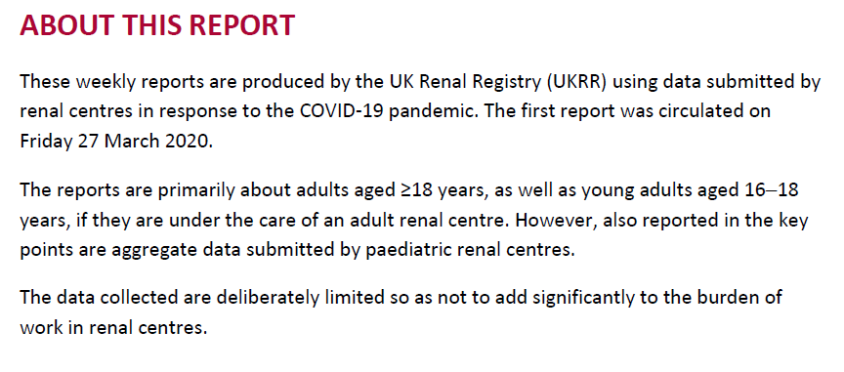

Slide 5
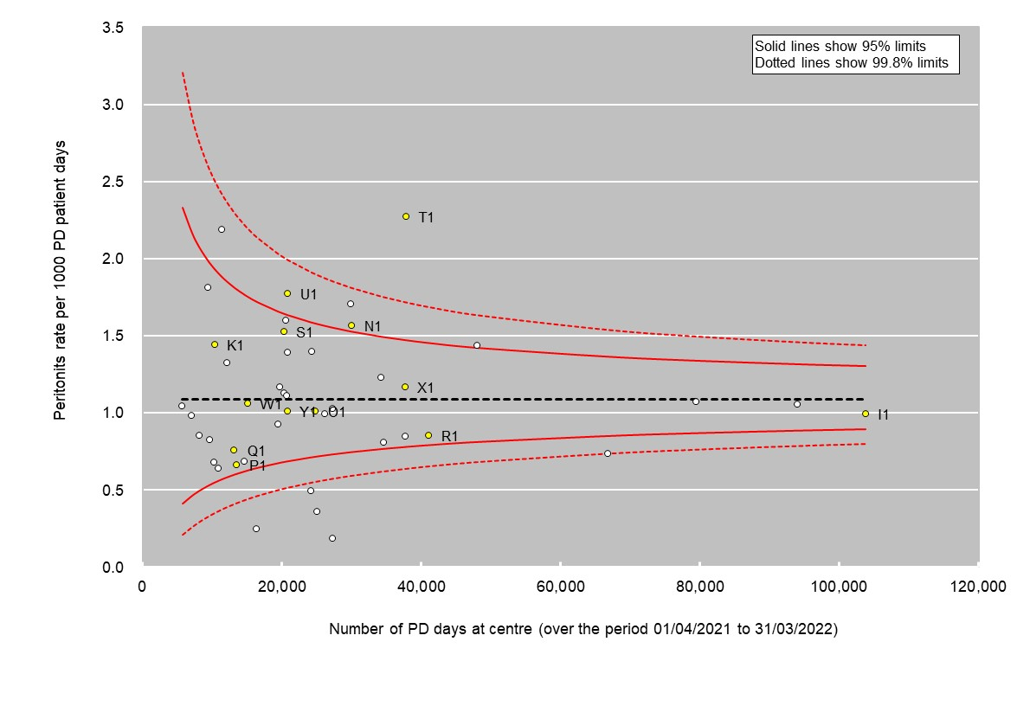
SSQD PD peritonitis

Slide 6
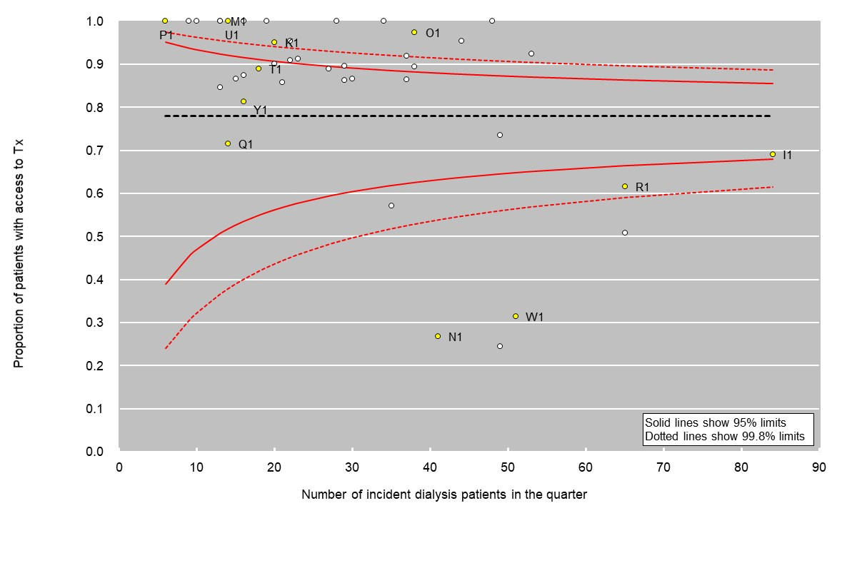
SSQD – any kidney transplant assessment prior to KRT
Notes:
So – the time to make a change is now – when we have a series of good reasons to change both what we are collecting, and how we are collecting it.
The UKRR (and RSTP / CRG) can then use that rich, and real-time information to produce dashboards (conformance) and improvement measures.

Slide 7
Where are we currently?
Three sites using RenalWare are submitting live UKRDC files [3]
Four CCL sites piloting UKRDC feed. [11 CV sites, 8 eMed ]
One Cybernius site piloting and file received [4]
One Proton site piloting and files received [6]
Development work at EPIC [5 + GOSH + NI]
Engaged with VitalPulse [16]
Other EPR, Bespoke (paeds sites without an adult renal IT system)

Slide 8
Timely data reporting - Road map
UKRR process quarterly files for annual reporting (from UKRDC feed or direct from site)
UKRR produce increasing numbers of existing measures ‘real time’ for centres with UKRDC feed
UKRR produce increasing numbers of v5 dataset measures ‘real time’ for centres with UKRDC feed

Slide 9
What is needed to move to a UKRDC feed
Software development (contact UKRR; aim to first reproduce the PV feed; add current audit items; add new items)
Support from Trust IT (to make firewall / file transfer changes, but also to duplicate database / lab interfaces)
Mapping of lab-test, local timelines
Evaluation of which data is reliably present and valid vs. often absent or invalid
Agreeing any new processes for data quality in a system where data is flowing daily
Decide who / how-often to look at the error-reporting GUI

Slide 10
What support is there available?
UKRR is supporting developers with systems in more that one renal unit (please discuss with us)
Some regions (e.g. Midlands) accepting applications from renal units for a one off sum to make the change
Encouragement from NHSE / RSTP / Regional networks

Slide 11
UKRR Dataset - The key changes
Information on all patients with an eGFR < 30 under the care of the kidney centre (similar to existing data on patients receiving KRT)
Version 5 dataset – but ONLY in a UKRDC feed

Slide 12
Demographics
Field ID | Format | Item Description | CODES / CODELISTS
IDN01 | C20 | Patient Surname
IDN02 | C20 | Patient Forename
IDN03 | D | Date of Birth
IDN04 | C15 | Local Hospital Number
IDN05 | Code | Flag for Opted out of sending identifiable data to UKRR | Y
IDN06 | N4 | Year of birth | Submit as BirthTime in form YYYY-01-01 which will be interpreted as year only if IDN05 = Y
IDN07 | C20 | Unique identifier not attributable to patient. | Site code plus internal record number or similar eg. REE01-12345
IDN08 | C20 | Patient birth name = name on birth certificate - also 'Maiden name'
IDN09 | C20 | Alias - other surname by which patient also known
PAT00 | Code | Sex, Gender on birth certificate | https://datadictionary.nhs.uk/attributes/person_gender_code.html
PAT01 | Code | Hospital centre code | Codelist RR1
PAT11 | C10 | CHI number - Patients registered in Scotland
PAT13 | C10 | NHS number format- without spaces

Slide 13
Demographics
PAT18 | C10 | H & C Number - Patients registered in Northern Ireland
PAT20 | C40 | Address line 1
PAT21 | C40 | Address line 2
PAT22 | C40 | Address line 3
PAT19 | C40 | Address line 4
PAT23 | P | Postcode
PAT25 | Code | Ethnicity | https://datadictionary.nhs.uk/data_elements/ethnic_category.html
PAT38 | Code | GP Practice code (current) | https://digital.nhs.uk/services/organisation-data-service/file-downloads/gp-and-gp-practice-related-data
PAT40 | D | Date of death
PAT42 | Code | Main Cause of death 1 EDTA | Codelist RR5
PAT43 | Code | Cause of death 2 EDTA | Codelist RR5
PAT44 | S | Cause of death - free text if no appropriate code available

Slide 14
Diagnosis
Field ID | Format | Item Description | CODES / CODELISTS
DXS01 | N4 | EDTA primary renal disease code | https://era-edta-reg.org/prd.jsp?disclaim=1
DXS02 | S | SNOMED primary renal disease code | Please contact UKRR for constrained list
DXS03 | Code | Was primary renal disease diagnosis confirmed by kidney biopsy | Y, N, UNKNOWN
DXS04 | Code | Secondary renal disease code | https://era-edta-reg.org/prd.jsp?disclaim=1
DXS05 | S | Primary disease free text if no suitable code available
DXS06 | D | Date of diagnosis of primary renal disease
DXS07 | Code | Diabetes | N, TYPE1, TYPE2, TYPE UNKNOWN
DXS08 | D | Date diabetes diagnosed
DXS09 | Code | Malignancy Yes / No | Y, N, UNKNOWN
DXS10 | Code | Malignancy site, first primary site only | Codelist RR19
DXS11 | D | Malignancy - date first diagnosed

Slide 15
Renal Treatment
Field ID | Format | Item Description | CODES / CODELISTS
TXT00 | D | Date start treatment
TXT01 | D | Date end treatment
TXT02 | Code | Treatment modality code | Codelist UKRDC7
TXT20 | Code | Treatment site/centre code | Codelist RR1 or Satellite codes ('RR1+')
TXT21 | Code | Treatment Supervision | Codelist RR8
TXT40 | Code | Transfer in from - site patient originated from | Codelist RR1
TXT41 | Code | Transfer out to - destination site of patient transferring out | Codelist RR1

Slide 16
‘Admission’ reasons (UKRDC7 previously RR7)
New number | New Description | Notes | TXT21/QBL05 qualifier
1 | Haemodialysis |  | Incentre/Home
2 | Haemofiltration |  | Incentre/Home
3 | Haemodiafiltration |  | Incentre/Home
5 | Ultrafiltration |  | Incentre/Home
110 | Plasmapheresis / Plasma exchange | Although this is not a CKD/RRT status and we will collect this using the dialysis session record it can be a nested treatment occurring simultaneous with an HD or transplant.
11 | CAPD |  | Blank/Assisted
12 | APD |  | Blank/Assisted
20 | Kidney Transplant ; Cadaver donor
78 | Kidney Transplant ; Live donor
29 | Kidney Transplant ; type unknown | Although we discourage the routine use of this code
120 | Patient - Transplant clinic follow up | This is intended to be used in a similar manner to Patient - CKD clinic follow up where a patient with a functioning kidney transplant transfers care between settings within one network; for example to allow identification of people repatriated to a 'satellite' transplant clinic of the main UKRR centre. For a renal transplant recipient it can be used in the same context as 'Haemodialysis' (code 1) would be used repeatedly if a haemodialysis patient changes centre

Slide 17
80 | Acute Kidney Injury no dialysis treatment
81 | Acute Kidney Injury receiving haemodialysis | Delivered by renal unit staff whether or not in renal unit setting.
82 | Acute Kidney Injury receiving haemofiltration | Delivered by renal unit staff whether or not in renal unit setting.
83 | Acute Kidney Injury receiving peritoneal dialysis | Delivered by renal unit staff whether or not in renal unit setting.
88 | Acute Kidney Injury receiving RRT not by renal service | Examples would include CVVH delivered by an intensive care department. Allows recording of RRT start especially if protracted stay in ITU
101 | First assessment in Kidney Service | Any direct contact between kidney clinician and a patient (for example telephone or face-to-face consultation as inpatient or outpatient)
904 | Patient - CKD-remote monitoring | Virtual MDT with GP about a patient, or an IT system which searches for GFR<xx without patient present
903 | Patient - CKD-clinic follow-up | Phone / Face-to-Face / video with the patient
902 | Patient - CKD-advanced MDT clinic | Low-clearance, predialysis, or anticipatory of symptomatic care
900 | Patient - CKD (excluding ESKD) | Depreciated term as unclear if the patient is under renal unit monitoring or not. Please use the new codes above. It is retained for backward compatibility.
901 | Patient - ESKD with no RRT | CKD5 with symptoms of uraemia treated symptomatically but without RRT. If the patient/clinician had chosen RRT it would have been started at this point

Slide 18
‘Discharge’ reasons
30 | Kidney Transplant failure
38 | Patient transfer to another renal centre
90 | Patient – RRT stopped (with recovery of kidney function)
91 | Patient – RRT stopped (without recovery of kidney function)
95 | Patient - Discharged (no monitoring by kidney service)

Slide 19
Encounters/Treatment
<Encounters>
<Treatment>
<EncounterNumber>1</EncounterNumber>
<FromTime>2006-05-04</FromTime>
<ToTime>2006-06-01</ToTime>
<HealthCareFacility>
<CodingStandard>RR1+</CodingStandard>
<Code>ABC123</Code>
</HealthCareFacility>
<AdmitReason>
<CodingStandard>CF_RR7_TREATMENT</CodingStandard>
<Code>1</Code>
<Description>Haemodialysis</Description>
</AdmitReason>
<AdmissionSource>
<CodingStandard>RR1+</CodingStandard>
<Code>995</Code>
<Description>UNKNOWN</Description>
</AdmissionSource>
<DischargeReason>
<CodingStandard>CF_RR7_DISCHARGE</CodingStandard>
<Code>38</Code>
<Description>Patient transfer to another renal centre</Description>
</DischargeReason>
<Attributes>
<QBL05>HOSP</QBL05>
</Attributes>
</Treatment>
</Encounters>

Slide 20
HD sessions
Field ID | Format | Item Description | CODES / CODELISTS
QHD00 | D | Date of HD /PEX session
QHD40 | T | Clock time session started
QHD41 | Code | Haemodialysis or Plasma exchange | HD / PEX
QHD20 | Code | Vascular access used for this treatment | Codelist RR02
QHD31 | N3 | Duration of treatment in minutes

Slide 21
HD prescription
Field ID | Format | Item Description | CODES / CODELISTS
HDP00 | D | Date of Dialysis Prescription
HDP01 | N1 | Times per week
HDP02 | N3 | Time dialysed in minutes
HDP04 | Code | Vascular access in use | Codelist RR02
Required for Audit for HD patients when no HD sessions data is available (for example satellite centre not submitting session data, or HOME HD patients)

Slide 22
Prescriptions
Field ID | Format | Item Description | CODES / CODELISTS
MED01 | D | Drug start date
MED02 | D | Drug stop date
MED03 | S | Generic drug name
MED04 | S | Branded drug name
MED05 | Code | Drug unit of measurement | Codelist RR23
MED06 | N8 | Drug dose
MED07 | Code | Drug route | Codelist RR22
MED08 | C20 | Drug frequency of administration
MED09 | S | Drug comments

Slide 23
Observations
Field ID | Format | Item Description | CODES / CODELISTS | Unit of Measurement
QBLG1 | nnn.n | Weight |  | kg
QBLG2 | D | Date of weight
QBLGB | nnn.n | Height |  | cm
QBLGC | D | Date of Height
QBLG3 | N3 | Systolic Blood Pressure |  | mmHg
QBLG4 | N3 | Diastolic Blood Pressure |  | mmHg
QBLG5 | D | Date of Blood Pressure
QBLG6 | N3 | Post dialysis Systolic Blood Pressure |  | mmHg
QBLG7 | N3 | Post dialysis Diastolic Blood Pressure |  | mmHg
QBLG8 | D | Date of post dialysis blood pressure
QBLKS | nnn.n | Body weight measured post dialysis |  | kg
QBLKT | D | Date of body weight measured post dialysis
QBL | Code | Symptoms of Peritonitis |  | Y, N, UNKNOWN
QBL | D | Date of Peritonitis symptoms

Slide 24
Lab Results
Field ID | Format | Required for audit | Item Description
QBLA6 | N3 |  | Serum sodium
QBLA7 | D |  | Date of sodium
QBLKN | N3 |  | Serum sodium -post dialysis
QBLKP | D |  | Date of post dialysis sodium
QBLA9 | n.n |  | Serum potassium
QBLAA | D |  | Date of potassium
QBLKL | n.n |  | Serum potassium -post dialysis
QBLKM | D |  | Date of post dialysis potassium
QBLA3 | nnn.n | Y | Serum urea
QBLAJ | D | Y | Date of Serum urea
QBLKG | nnn.n | Y | Serum urea -post dialysis
QBLKH | D | Y | Date of Post dialysis Urea
QBLA1 | N4 | Y | Serum creatinine
QBLA2 | D | Y | Date of serum creatinine
QBLKE | N4 |  | Serum creatinine --post dialysis
QBLKF | D |  | Date of post dialysis creatinine
QBLA4 | nn.n |  | Serum bicarbonate
QBLA5 | D |  | Date of bicarbonate
QBLKQ | nn.n |  | Serum bicarbonate -post dialysis
QBLKR | D |  | Date of Post dialysis bicarbonate

Slide 25
Lab Results
Field ID | Format | Required for audit | Item Description
QBLC4 | D | Y | Date of urine albumin:creatinine ratio
QBLHX | N4 | Y | Urine creatinine concentration
QBLHY | D | Y | Date of urine creatinine concentration
QBLJS | N | Y | Urine protein concentration
QBLJT | D | Y | Date of urinary protein concentration
QBLJL | Code |  | Proteinuria dipstick test
QBLJM | D |  | Date of Proteinuria dipstick test
QBLHV | N4 |  | Urine volume in 24 hours
QBLHU | D |  | Date of urine volume in 24 hours
QBLJN | C | Y | PD Fluid WCC count
QBLJP | D | Y | Date of PD Fluid WCC count
QBLJQ | C | Y | PD fluid Culture organism grown text
QBLJR | D | Y | Date of PD Fluid Culture test
QBLJX | C | Y | Blood Culture organism grown text **
QBLJY | D | Y | Date of blood culture test

Slide 26
Unified Test List
https://hscic.kahootz.com/PathologyandDiagnostics/view?objectID=39691536

Slide 27
Kidney Transplant
UKRR Field ID | NHSBT Field ID | Format | Item Description
TRA61 | UKTR_TXDATEn | D | Date of kidney transplant
TRA64 |  | D | Date of kidney transplant failure
TRA77 | UKTR_DGRPn | Code | UKTR donor type of transplant:
TRA70 | UKTR_ID | N6 | UKTR recipient ID
TRA72 | UKTR_DATE_ONn | D | Date registered for transplantation (1 to n)
TRA73 | UKTR_TX_UNITn | N5 | Transplant centre
TRA91 | UKTR_CIT_mins | N4 | CIT in minutes
TRA83,84,85 | UKTR_HLA_MM |  | HLA mismatch

Slide 28
Care Planning (assessment)
Start Date, End Date
Assessment type
Assessment Outcome
Type of assessment Code | Types of assessment text | Outcome Code | Outcome Text
TPLTassess | Suitability for renal transplant | 1 | Unsuitable
 |  | 2 | Workup commenced
 |  | 3 | Suitable
RRTassess | Shared future RRT choice | 4 | Referred for assessment
 |  | 5 | Assessment in progress
 |  | 6 | Opts for transplant
 |  | 7 | Opts for ICHD
 |  | 8 | Opts for HHD
 |  | 9 | Opts for PD
 |  | 10 | Opts for supportive care
PPDassess | Preferred place of dying | 11 | Current Home
 |  | 12 | Nursing Home
 |  | 13 | Hospice
 |  | 14 | Hospital
 |  | 15 | Other

Slide 29
Kidney Transplant Assessment prior to KRT

Slide 30
Care Planning (assessment) – XML example
<Assessment>
<AssessmentStart>2022-01-01</AssessmentStart>
<AssessmentEnd>2022-06-01</AssessmentEnd>
<AssessmentType>
<CodingStandard></CodingStandard>
<Code>TPLTassess</Code>
<Description>Suitability for renal transplant</Description>
</AssessmentType>
<AssessmentOutcome>
<CodingStandard></CodingStandard>
<Code>1</Code>
<Description>Unsuitable</Description>
</AssessmentOutcome>
</Assessment>

Slide 31
Care Planning (assessment) – measures examples
What proportion of a population (e.g. those with an eGFR < 15 and under follow-up) have evidence for starting an assessment of KRT or a Kidney Transplant
What proportion of a population have opted to have ‘supportive care’
Of those who opted for ‘supportive care’ what proportion have
Evidence of an ‘advanced care plan’ (preferred place of dying)
Have died / started KRT / remain alive
What proportion of a population have opted to have home-dialysis therapy
Of those what proportion were doing a home-dialysis therapy at 3 months after KRT start

Slide 32
Summary
UKRDC has significant benefits to monitoring and improving kidney care
Unifying information flows for several purposes
Making invalid information visible to centres promptly to allow for validation and correction
Allowing for ‘real-time’ reporting of information
UKRR dataset version 5
Starts at CKD4 (eGFR 30) under centre follow-up
Overall significantly fewer data items
Harmonised with NHS Data standards where ever possible (SNOMED)
Contains new concept of care planning

