Slide 1

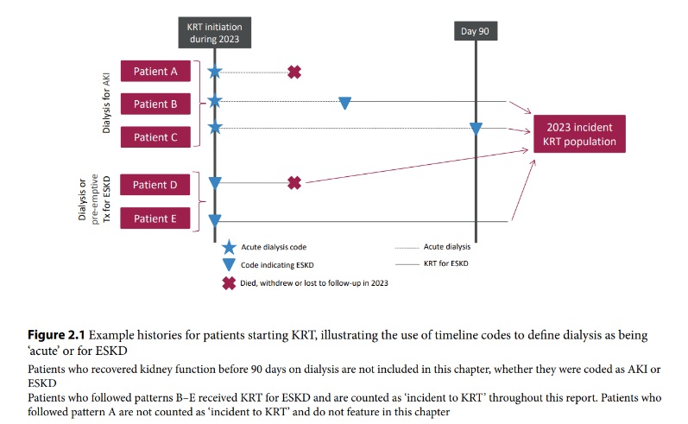
UK Renal Registry 27th Annual Report
Data to 31/12/2023

Slide 2
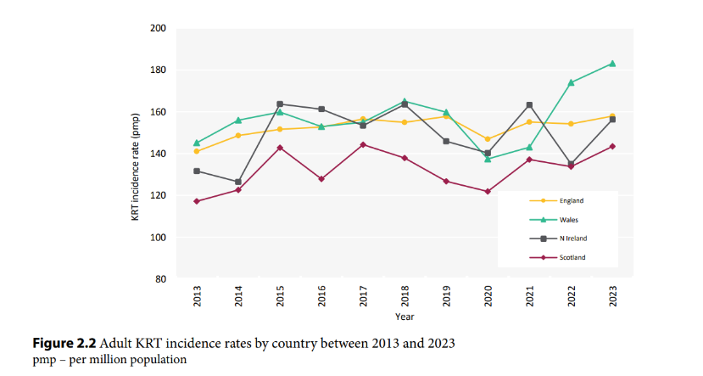
UK Renal Registry 27th Annual Report
Data to 31/12/2023

Slide 3
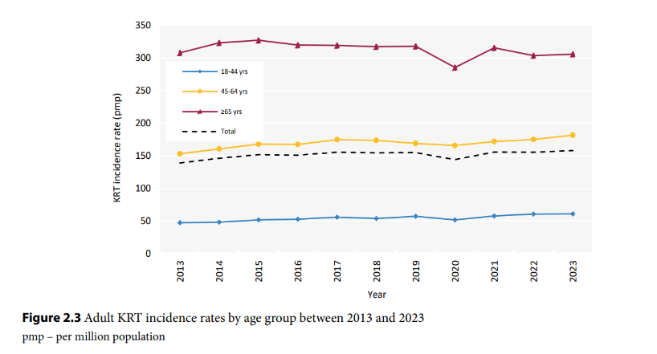
UK Renal Registry 27th Annual Report
Data to 31/12/2023

Slide 4
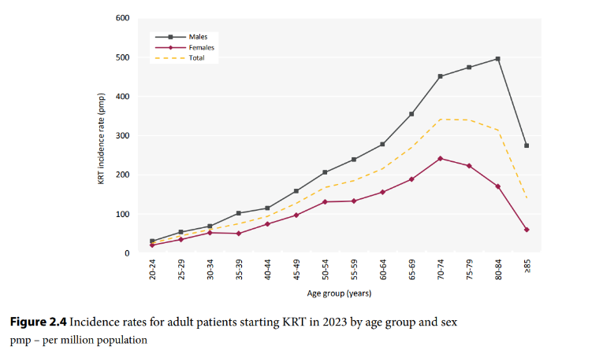
UK Renal Registry 27th Annual Report
Data to 31/12/2023

Slide 5
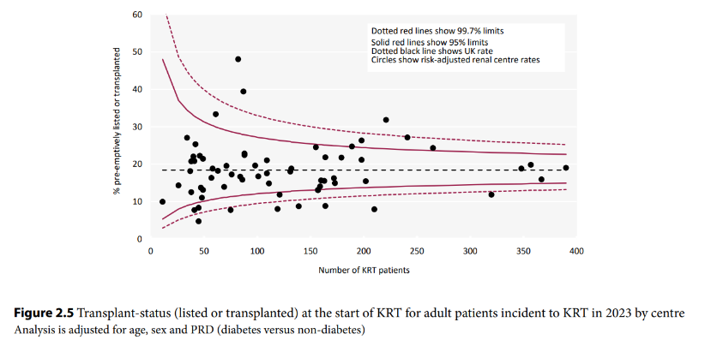
UK Renal Registry 27th Annual Report
Data to 31/12/2023

Slide 6
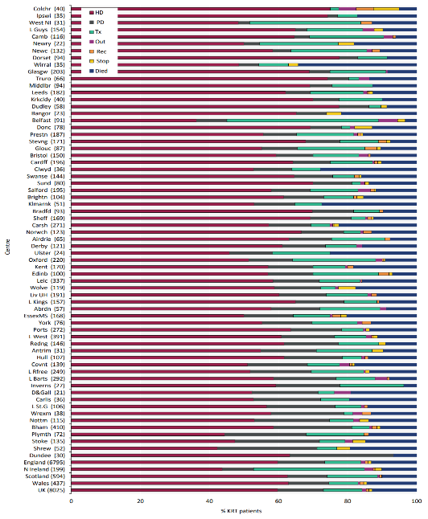
UK Renal Registry 27th Annual Report
Data to 31/12/2023
Figure 2.6 KRT modality at 1 year for incident adult KRT patients who started KRT in 2022 by centre
Number of patients in a centre in brackets
Out – moved out of a centre but did not reappear in another centre;
Rec – recovered kidney function;
Stop – treatment withdrawal
Centres are ordered by increasing use of PD at 1 year

Slide 7
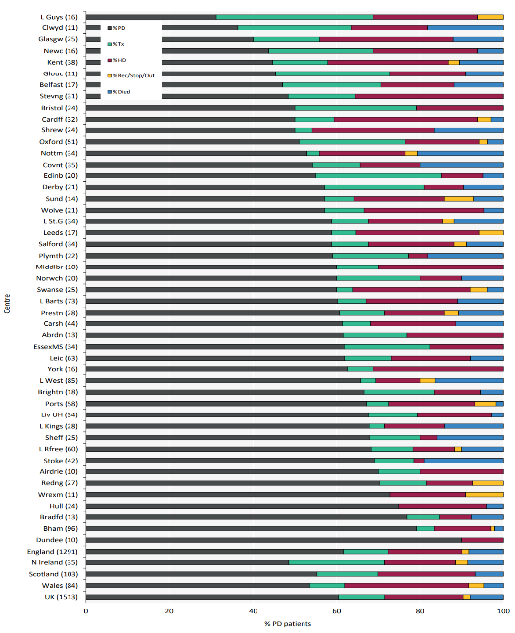
UK Renal Registry 27th Annual Report
Data to 31/12/2023
Figure 2.7 KRT modality at 1 year for incident adult PD patients who started KRT in 2022 by centre
Number of patients in a centre in brackets
Out – moved out of a centre but did not reappear in another centre;
Rec – recovered kidney function;
Stop – treatment withdrawal
Centres are ordered by increasing use of PD at 1 year

Slide 8
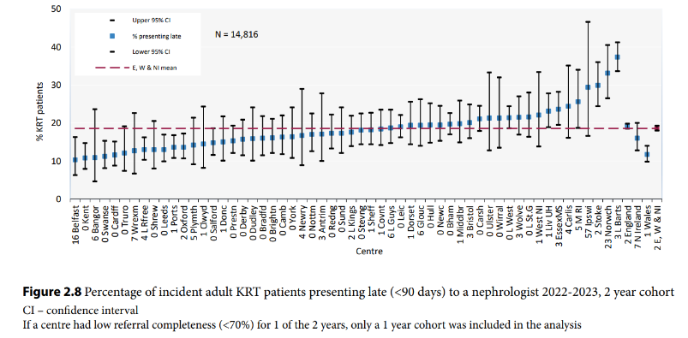
UK Renal Registry 27th Annual Report
Data to 31/12/2023

Slide 9
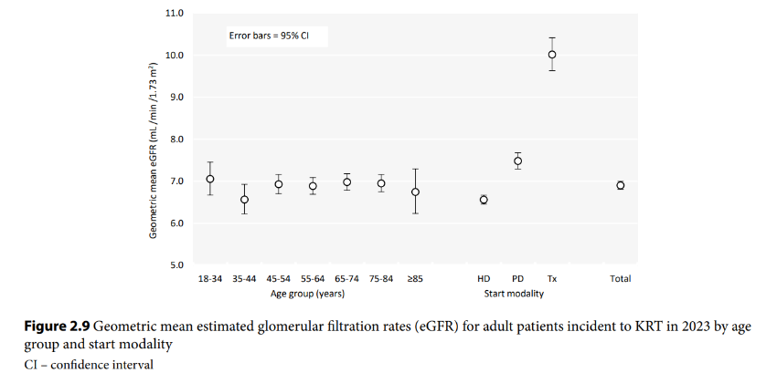
UK Renal Registry 27th Annual Report
Data to 31/12/2023

Slide 10
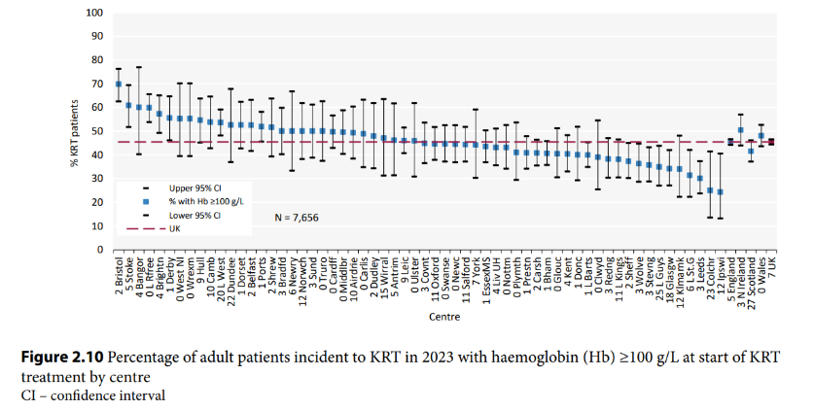
UK Renal Registry 27th Annual Report
Data to 31/12/2023

Slide 11
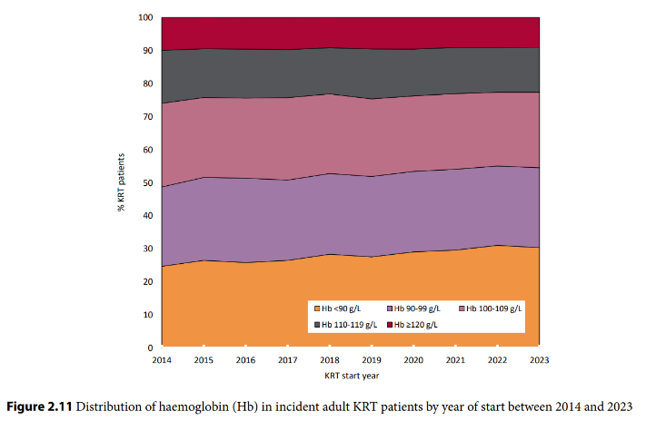
UK Renal Registry 27th Annual Report
Data to 31/12/2023

Slide 12
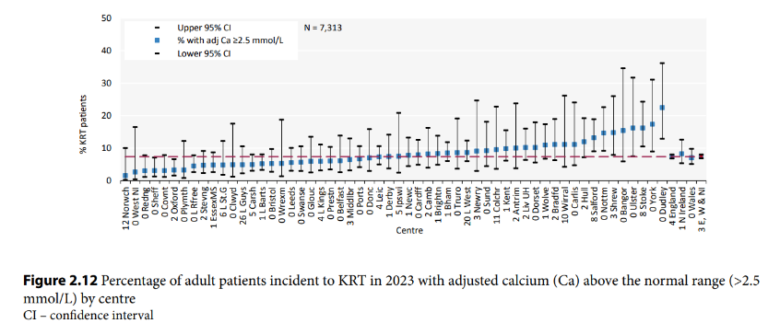
UK Renal Registry 27th Annual Report
Data to 31/12/2023

Slide 13
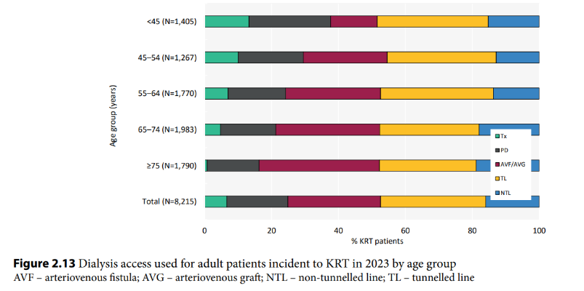
UK Renal Registry 27th Annual Report
Data to 31/12/2023

Slide 14
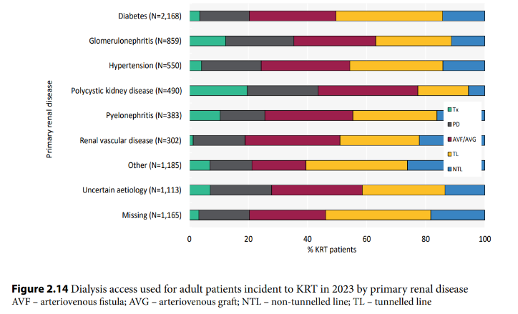
UK Renal Registry 27th Annual Report
Data to 31/12/2023

Slide 15
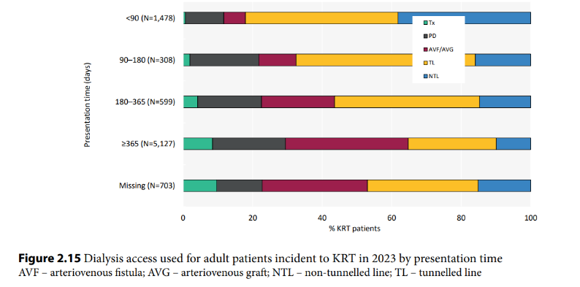
UK Renal Registry 27th Annual Report
Data to 31/12/2023

Slide 16
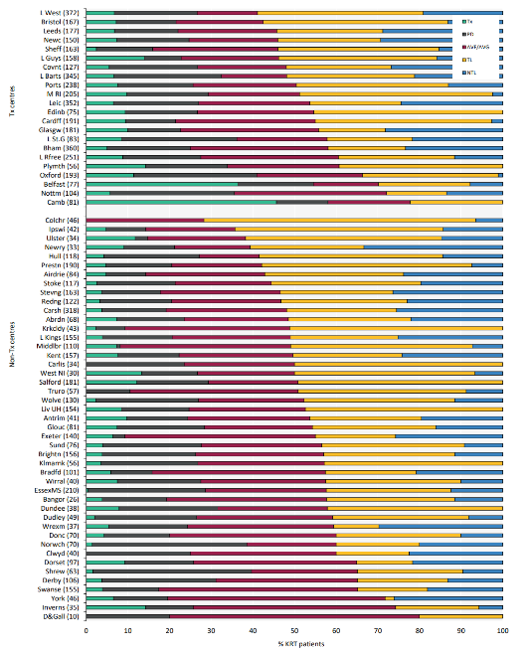
UK Renal Registry 27th Annual Report
Data to 31/12/2023
Figure 2.16 First dialysis access used for adult patients incident to KRT in 2023 by centre
Number of incident patients on KRT in a centre in brackets
Centres are ordered by decreasing use of lines
AVF – arteriovenous fistula; AVG – arteriovenous graft; NTL – non-tunnelled line; TL – tunnelled line

Slide 17
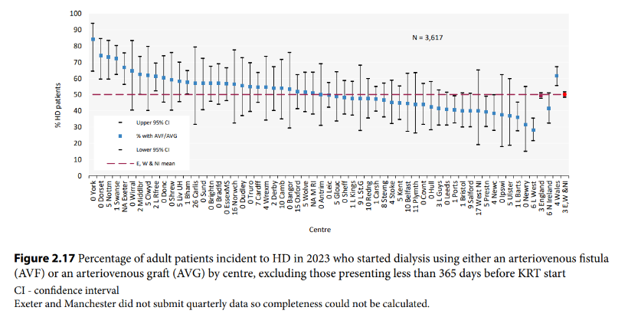
UK Renal Registry 27th Annual Report
Data to 31/12/2023

Slide 18
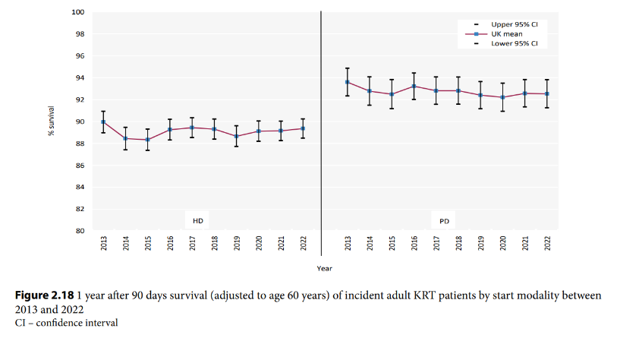
UK Renal Registry 27th Annual Report
Data to 31/12/2023

Slide 19
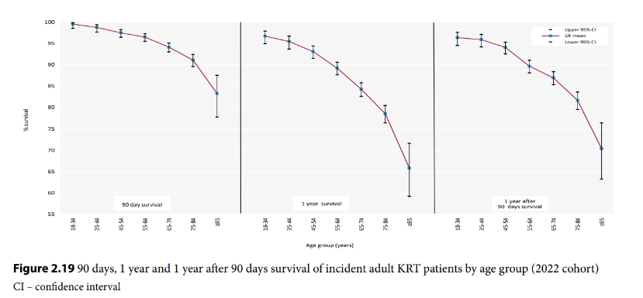
UK Renal Registry 27th Annual Report
Data to 31/12/2023

Slide 20
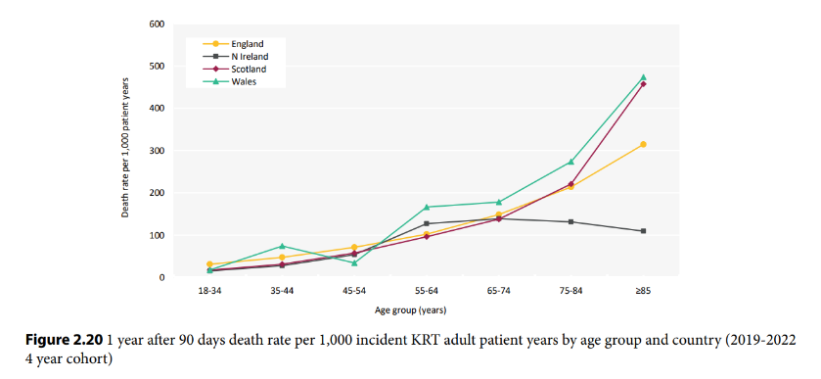
UK Renal Registry 27th Annual Report
Data to 31/12/2023

Slide 21
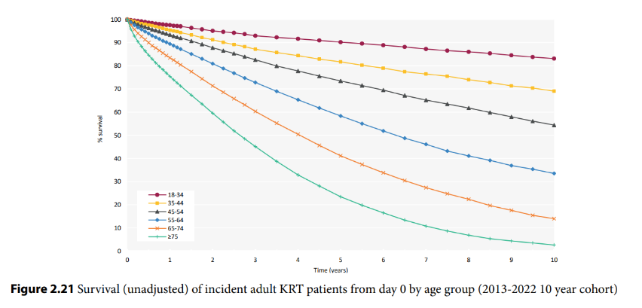
UK Renal Registry 27th Annual Report
Data to 31/12/2023

Slide 22
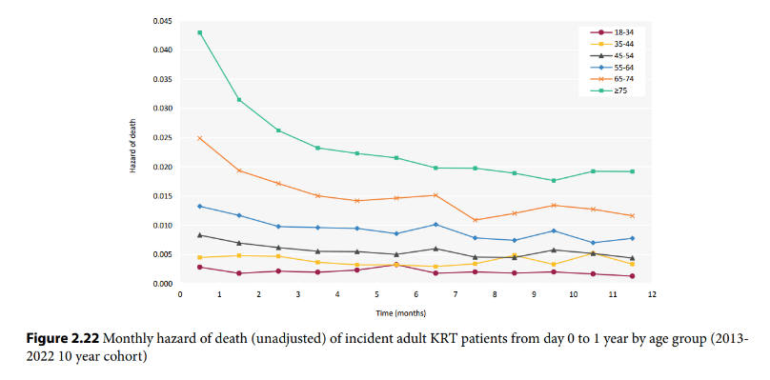
UK Renal Registry 27th Annual Report
Data to 31/12/2023

Slide 23
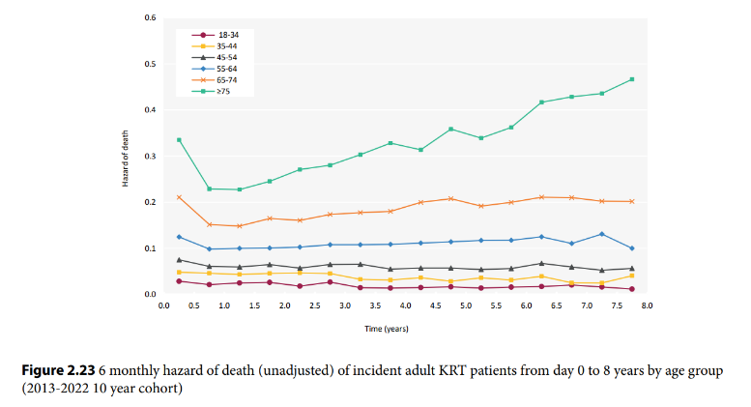
UK Renal Registry 27th Annual Report
Data to 31/12/2023

Slide 24
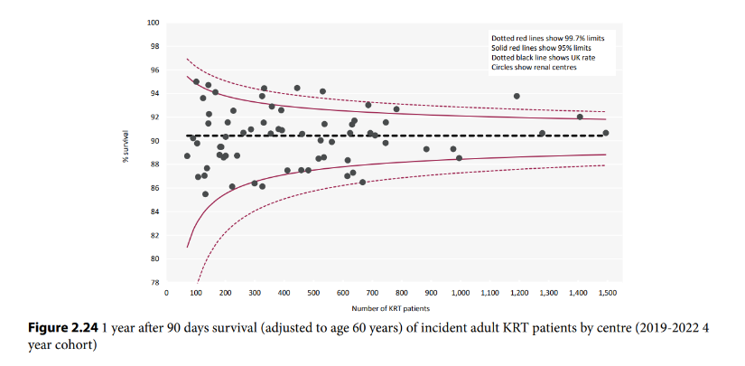
UK Renal Registry 27th Annual Report
Data to 31/12/2023

Slide 25
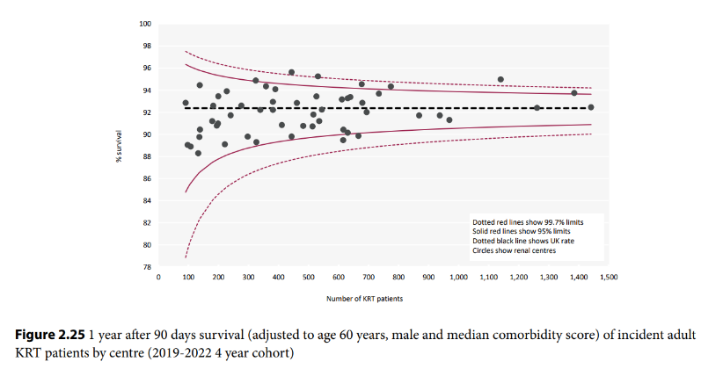
UK Renal Registry 27th Annual Report
Data to 31/12/2023

