Slide 1

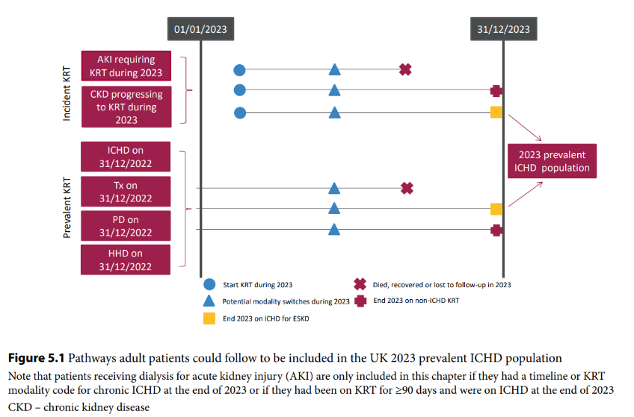
UK Renal Registry 27th Annual Report
Data to 31/12/2023

Slide 2
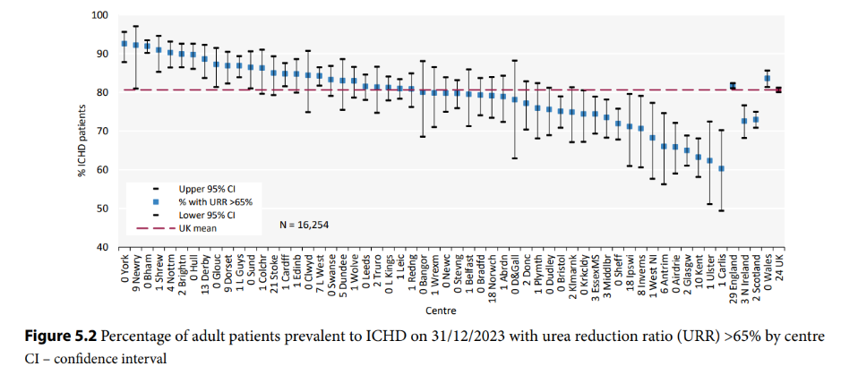
UK Renal Registry 27th Annual Report
Data to 31/12/2023

Slide 3
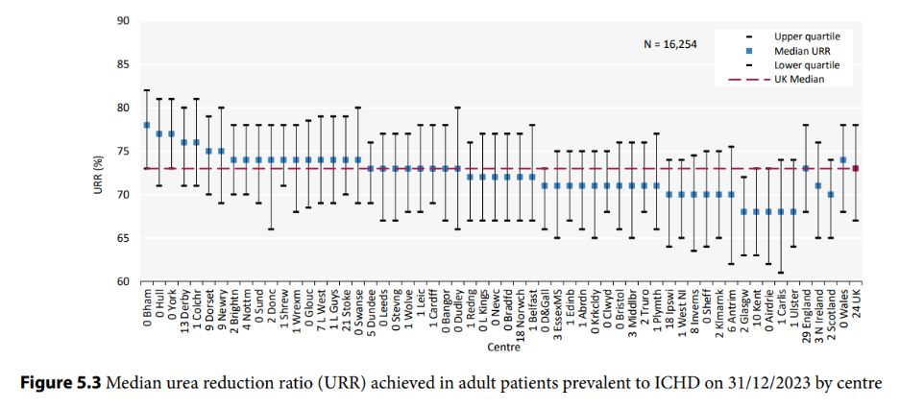
UK Renal Registry 27th Annual Report
Data to 31/12/2023

Slide 4
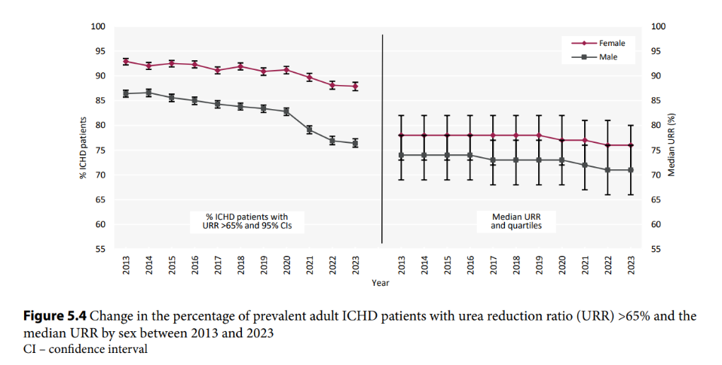
UK Renal Registry 27th Annual Report
Data to 31/12/2023

Slide 5
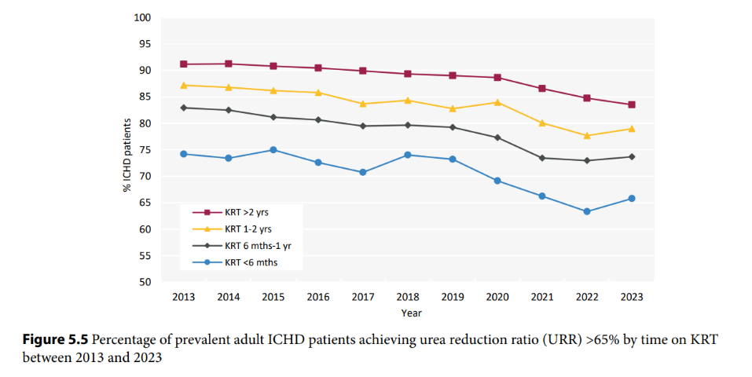
UK Renal Registry 27th Annual Report
Data to 31/12/2023

Slide 6
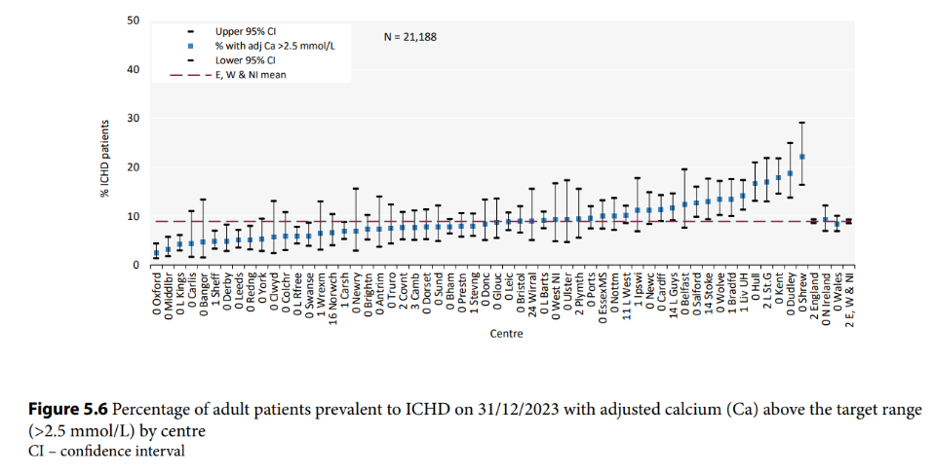
UK Renal Registry 27th Annual Report
Data to 31/12/2023

Slide 7
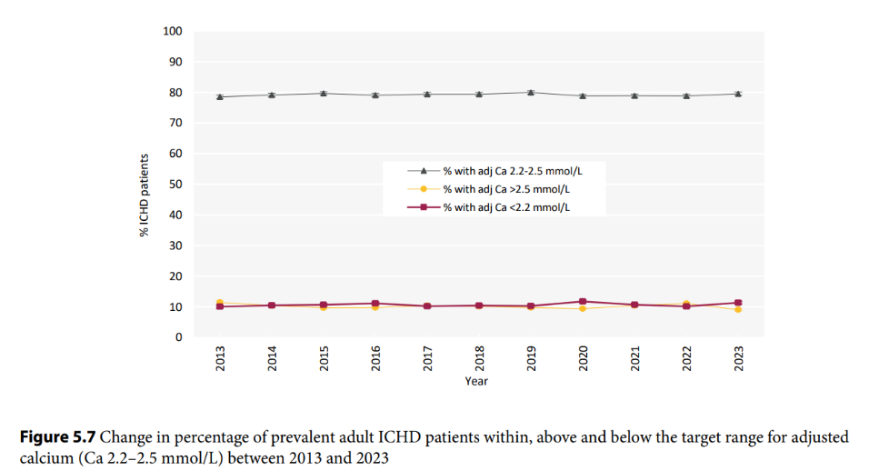
UK Renal Registry 27th Annual Report
Data to 31/12/2023

Slide 8
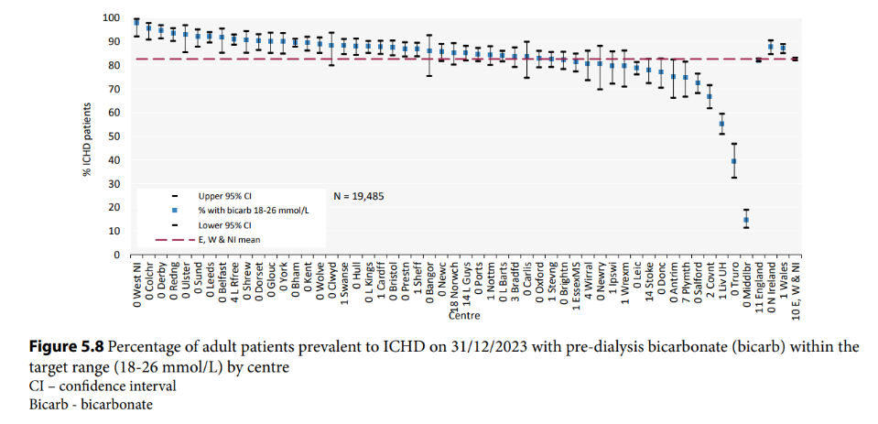
UK Renal Registry 27th Annual Report
Data to 31/12/2023

Slide 9
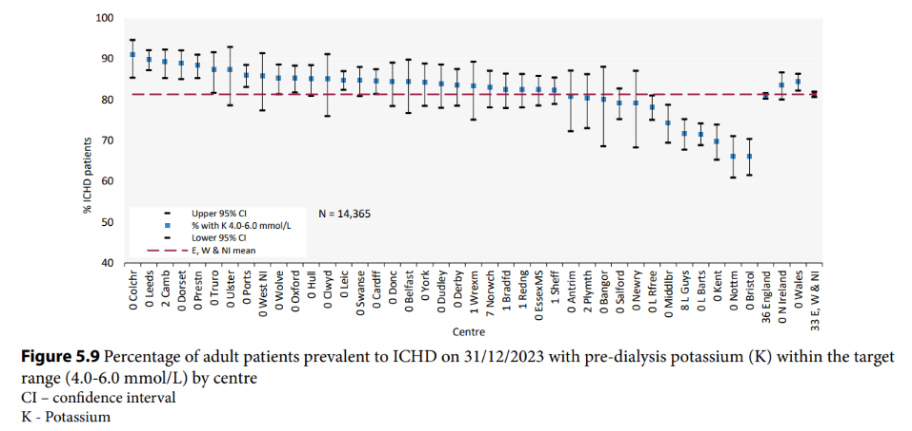
UK Renal Registry 27th Annual Report
Data to 31/12/2023

Slide 10
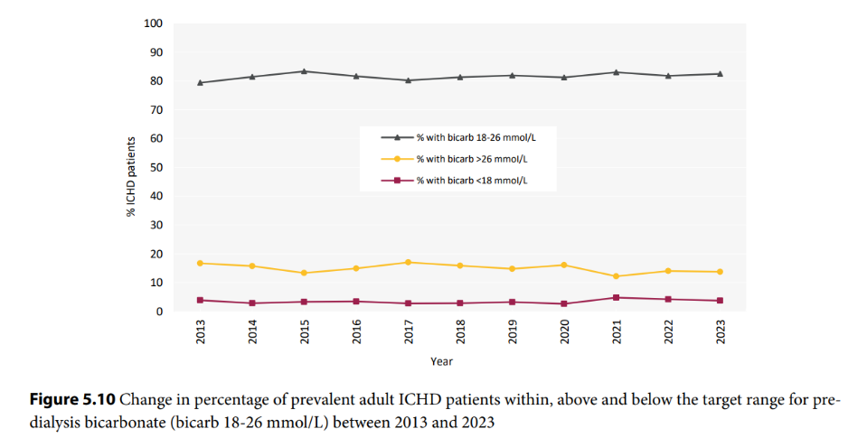
UK Renal Registry 27th Annual Report
Data to 31/12/2023

Slide 11
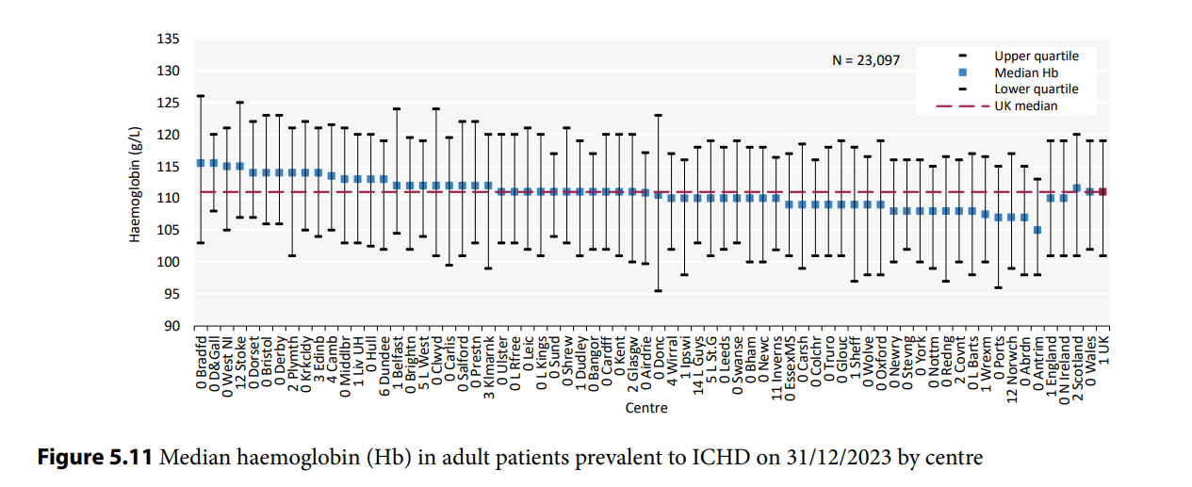
UK Renal Registry 27th Annual Report
Data to 31/12/2023

Slide 12
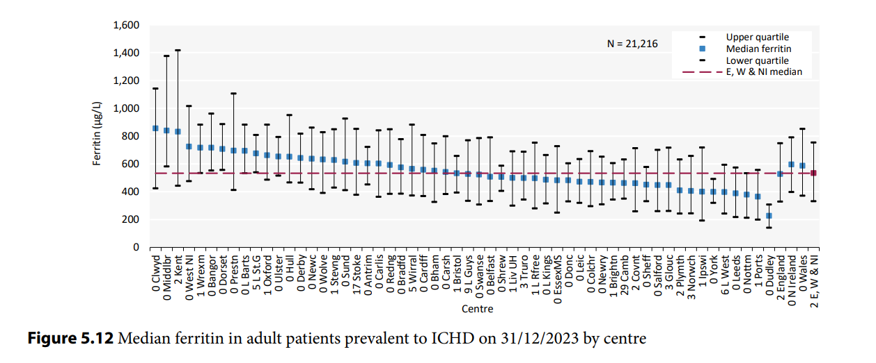
UK Renal Registry 27th Annual Report
Data to 31/12/2023

Slide 13
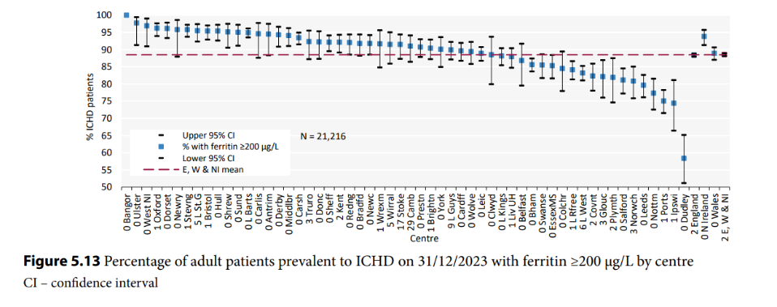
UK Renal Registry 27th Annual Report
Data to 31/12/2023

Slide 14
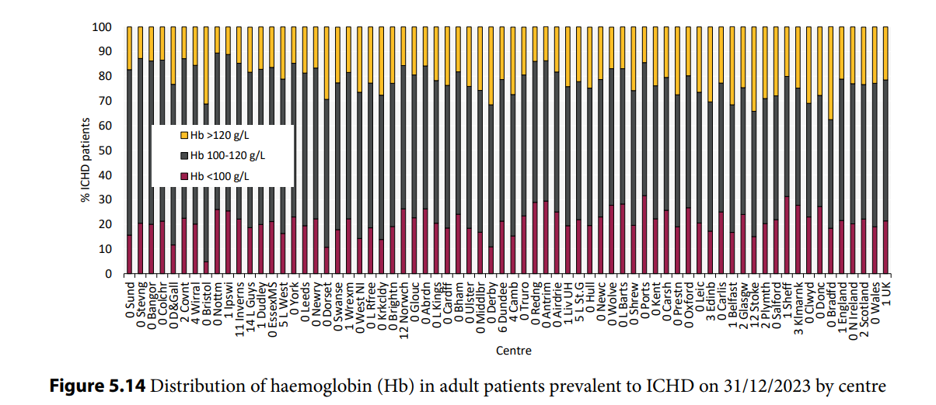
UK Renal Registry 27th Annual Report
Data to 31/12/2023

Slide 15
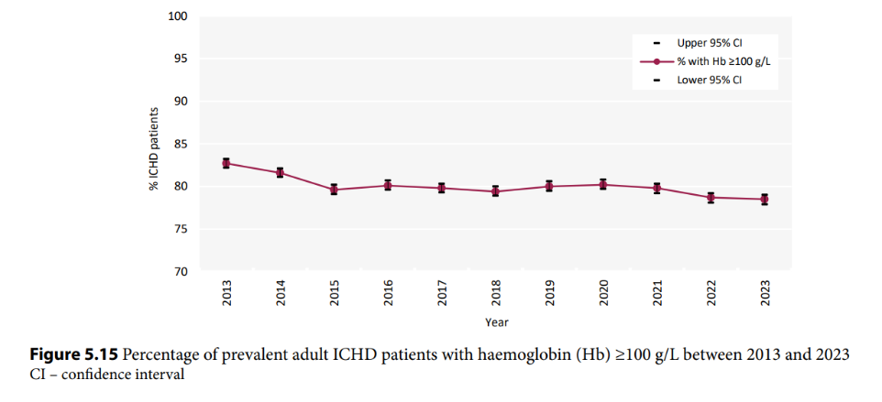
UK Renal Registry 27th Annual Report
Data to 31/12/2023

Slide 16
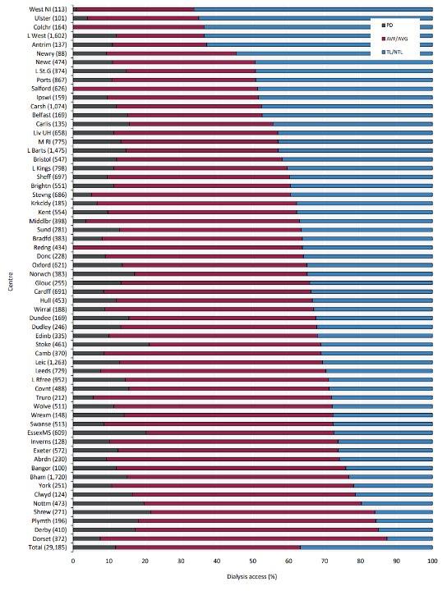
UK Renal Registry 27th Annual Report
Data to 31/12/2023
Figure 5.16 Dialysis access in adult patients prevalent to dialysis on 31/12/2023 by centre
Number of patients on dialysis in a centre in brackets (centres with <70% access data for the prevalent dialysis population were excluded).
For Reading, a prevalent date of 30/9/2023 was used due to poor data quality in the final quarter.
Data for the four excluded Scottish centres (Kilmnarnock, Glasgow, Airdrie, Dumfries and Galloway) using alternative time points are published by the Scottish Renal Registry.
AVF – arteriovenous fistula; AVG – arteriovenous graft; NTL – non-tunnelled line; TL – tunnelled line

Slide 17
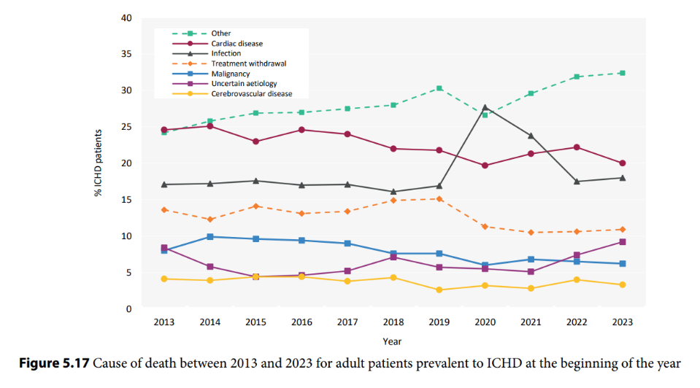
UK Renal Registry 27th Annual Report
Data to 31/12/2023

