Slide 1
HNF1B and the brain
Dr Rhian Clissold
Consultant Nephrologist, Exeter Kidney Unit
15/05/21

Slide 2
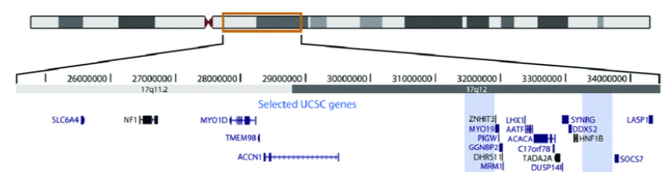
Most people with HNF1B whole gene deletion have large 17q12 deletion

Slide 3
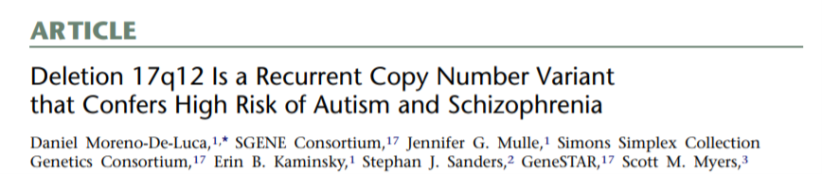
17q12 deletion not initially thought to be associated with neurodevelopmental disorders
Notes:
Unlike most genomic disorders…
More recent work has shown that neurodevelopmental disorders, including autism spectrum disorders (ASD), are part of the phenotype in patients referred for testing via clinical genetics rather than renal services.
A study by Laffargue et al. suggests that the neuropsychological phenotype is less severe than that previously reported when the 17q12 deletion is identified secondary to renal abnormalities.

Slide 4
Aim
To compare neurodevelopmental features of people with either an HNF1B mutation or large gene deletion
  To see if having only one copy of the HNF1B gene is the cause
Notes:
HNF1B is involved in hindbrain development in both zebra fish and mice and so is a good candidate to be the aetiological gene.[99, 100] There have been rare reports of learning difficulties and epilepsy in five patients with HNF1B gene mutations, which would support this.[5, 22, 101] Another candidate is LHX1, which is also expressed in the brain during early development; a mouse model with a targeted mutation of Lhx1 confirms its role as a key regulator of the vertebrate head organiser.[102, 103] A study investigating new hotspots of copy-number variation associated with ASD has implicated ACACA within the 17q12 deletion.[104] However, no single gene deletions or mutations resulting in haploinsufficiency and neurological disease in humans have been detected in either of these genes to date.
In this study, we systematically compared the neurodevelopmental phenotype of patients with either an HNF1B intragenic mutation or 17q12 deletion to determine whether haploinsufficiency of the HNF1B gene is responsible for this aspect of the phenotype.

Slide 5
Methods
Individuals recruited from four sites in UK
  Total=38
Clinical evaluation
Review of medical records and participant/parent interview
Brief behavioural screening: Strengths and Difficulties Questionnaire (SDQ)
Autistic traits: Autism Spectrum Quotient (AQ)
Cognitive ability: Kaufman Brief Intelligence Test
Notes:
Participants were recruited from January 2013 to October 2015 from four sites in the UK (adult renal and diabetes units at the Royal Devon and Exeter Hospital; paediatric renal units at Great Ormond Street Hospital for Children, Evelina London Children’s Hospital and Birmingham Children’s Hospital). Inclusion criteria included the presence of either an HNF1B intragenic mutation or whole-gene deletion on genetic testing performed due to underlying renal abnormalities or diabetes and current age ≥4 years. All eligible patients were invited to participate.
Initial mutation screening was performed by sequencing of coding exons and exon-intron boundaries together with gene dosage assessment by multiplex ligation-dependent probe amplification as previously described.[20, 26] Droplet digital PCR was used to confirm the presence of an approximate 1.3 Mb deletion at chromosome 17q12 in the 20 patients with an HNF1B whole-gene deletion.

Slide 6
Brief behavioural screening
Carried out in 4-16 year olds using the SDQ (total=14)
Questionnaire completed by parents and included 25 items on psychological attributes covering 5 areas:
  1) emotional symptoms
  2) conduct problems
  3) hyperactivity/inattention
  4) peer relationship problems
  5) prosocial behaviour
An impact supplement was also administered
Notes:
A similar questionnaire with slightly different wording was given to adolescents for self-completion. This self-report version is suitable for young people aged around 11-16 years, depending on their level of understanding and literacy.

Slide 7
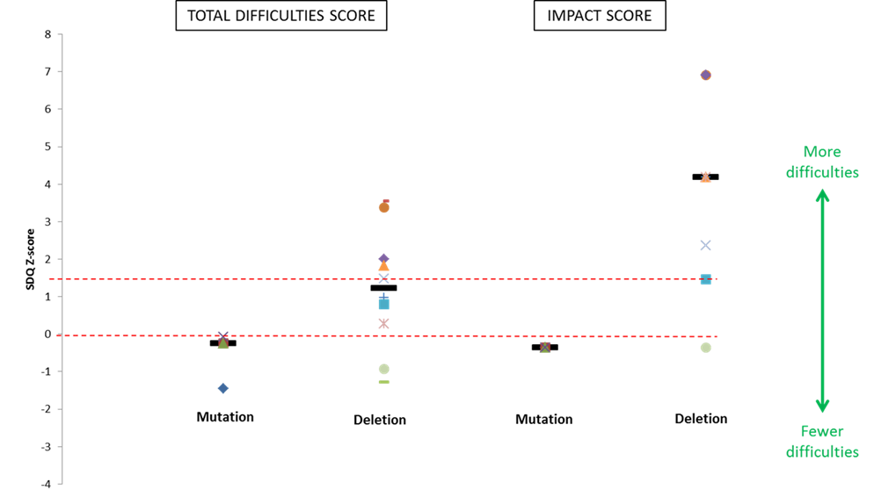
Higher levels of difficulties and impact in children with a deletion
Notes:
Figure 3.1 Patient difficulties as shown by parent-report Strengths and Difficulties Questionnaire (SDQ) scores (presented as Z-scores) for individuals <18 years with both HNF1B gene mutations (n=4) and 17q12 microdeletions (n=10).
Individual scores are represented as different-shaped points and group medians as black bold horizontal lines. X axis represents school-age population mean, red dashed horizontal line above represents suggested clinical cut-point (90th percentile).
Use of the parent-report SDQ revealed more patient difficulties in the deletion group with a median total difficulties score of 15.5 (IQR 10-20) compared to 7 in the mutation group (IQR 3.5-7.5, P=0.048; Figure 3.1). This is also higher than the mean total difficulties score of 8 (standard deviation 5.8) obtained in a normative sample of 10,438 British school-aged children.[114]
When analysing the four subsections of the total difficulties score, conduct problems and peer relationship problems were more common in the deletion group: median scores were 2.5 (IQR 2-5) and 4.5 (IQR 1-6), respectively vs. 0.5 (IQR 0-1) and 0 (IQR 0-0.5) in the mutation group, P=0.04 and 0.02, respectively (Figure 3.2).
Five of the ten children with a deletion scored above the suggested clinical cut-point of 15; all of these children apart from one had already been referred for further psychological evaluation.
Parental scores for the impact of these difficulties on the child’s life were similarly high in the deletion group with a median score of 5 (IQR 2-8). This was compared to a median score of 0 in the mutation group (IQR 0-0, P=0.02) and a mean score of 0.4 (standard deviation 1.1) in the large normative sample mentioned previously.[114]

Slide 8
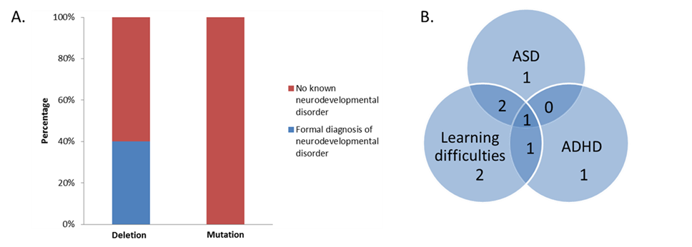
Clinical diagnosis
Notes:
8/20 (40%) participants with a deletion had a clinical diagnosis of either an ASD, attention deficit hyperactivity disorder (ADHD) and/or learning difficulties requiring a Statement of Special Educational Needs or attendance at a special school compared to 0/18 with a mutation, P=0.004 (Figure 3.3A). Of these eight patients, four had co-morbidity with learning difficulties accompanying a diagnosis of ASD and/or ADHD

Slide 9
Other findings
Large deletions were associated with more autistic traits
IQ was similar in both HNF1B mutation and deletion groups

Slide 10
Summary
Neurodevelopmental features only seen in individuals with a deletion
Having only one copy of HNF1B gene not the cause
Ensure referral for appropriate psychological assessment if concerns arise
Notes:
However, several limitations were associated with this work. Despite inviting all eligible patients from the four different sites to take part, the study cohort represented only 45% of the total due to either inability to contact individuals despite several attempts or a negative response to participation. Therefore, the exact prevalence and spectrum of neurodevelopmental disorders in HNF1B-associated renal disease and diabetes remains unknown. Although individuals were systematically assessed using a combination of screening tools, participant/parent interview and review of medical records, comprehensive screening tools and diagnostic tests for ASD and ADHD were not used. This means less severe disease may have been missed. Finally, genetic screening for other known causes of neurodevelopmental disease (e.g. Fragile X, other copy number variants) was not undertaken.

Slide 11
Limitations
Not everyone wanted to participate
  Exact prevalence and scope of neurodevelopmental involvement remains unknown
Diagnostic tests for autism/ADHD not used
  Less severe involvement may have been missed
Genetic screening for other causes not carried out
Notes:
However, several limitations were associated with this work. Despite inviting all eligible patients from the four different sites to take part, the study cohort represented only 45% of the total due to either inability to contact individuals despite several attempts or a negative response to participation. Therefore, the exact prevalence and spectrum of neurodevelopmental disorders in HNF1B-associated renal disease and diabetes remains unknown. Although individuals were systematically assessed using a combination of screening tools, participant/parent interview and review of medical records, comprehensive screening tools and diagnostic tests for ASD and ADHD were not used. This means less severe disease may have been missed. Finally, genetic screening for other known causes of neurodevelopmental disease (e.g. Fragile X, other copy number variants) was not undertaken.

Slide 12
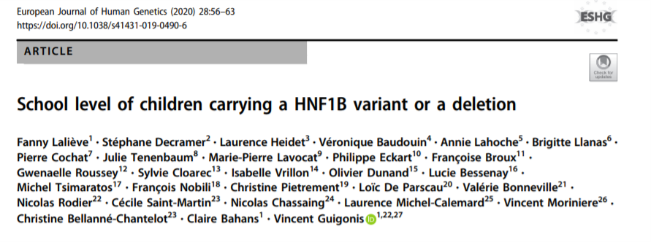
Update
Notes:
The prevalence of neurological involvement in patients with a deletion of or a variant in the HNF1B gene remains discussed.
The aim of this study was to investigate the neuropsychological outcomes in a large cohort of children carrying either a
HNF1B whole-gene deletion or a disease-associated variant, revealed by the presence of kidney anomalies. The
neuropsychological development—based on school level—of 223 children included in this prospective cohort was studied.

Slide 13
Total=180, average age=9.6 years
119 children with deletion, 61 with mutation
Special educational needs:
  12.7% of children with an HNF1B deletion
  3.6% of children with an HNF1B variant
~90% of children carrying an HNF1B mutation or deletion have a normal schooling in a general educational environment
These results should be taken into account in prenatal counselling
Notes:
Data from 180 children were available for analysis. Patients mean age was 9.6 years, with 39.9% of girls. Among these
patients, 119 carried a HNF1B deletion and 61 a disease-associated variant. In the school-aged population, 12.7 and 3.6% of
patients carrying a HNF1B deletion and a disease-associated variant had special educational needs, respectively. Therefore,
the presence of a HNF1B deletion increases the risk to present with a neuropsychiatric involvement when compared with the
general population. On the other hand, almost 90% of patients carrying a HNF1B disease-associated variant or deletion have
a normal schooling in a general educational environment. Even if these findings do not predict the risk of neuropsychiatric
disease at adulthood, most patients diagnosed secondary to kidney anomalies do not show a neurological outcome severe
enough to impede standard schooling at elementary school. These results should be taken into account in prenatal
counseling.

Slide 14

Questions?

