Slide 1
Patient Group Activities
Tess Harris

Slide 2
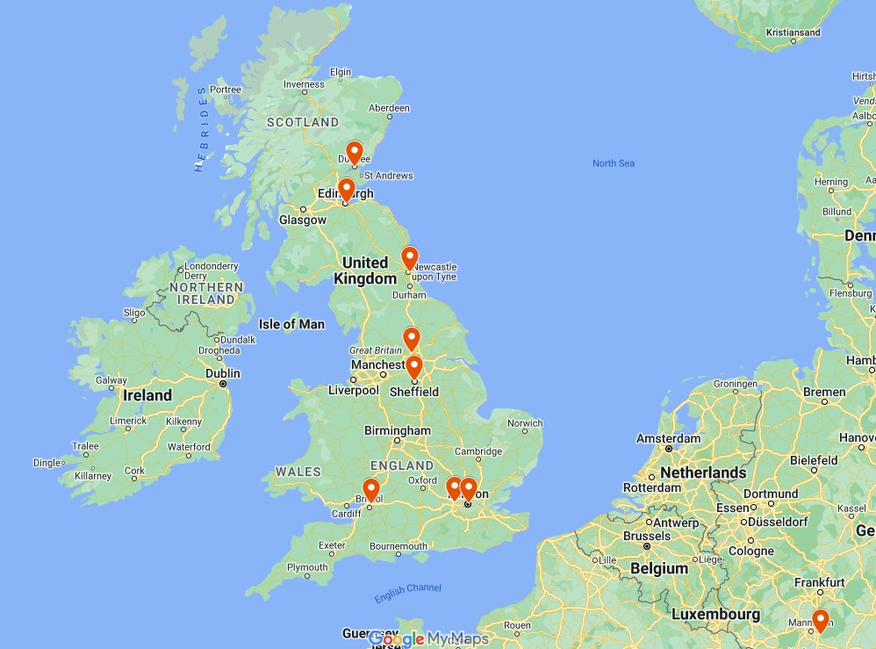
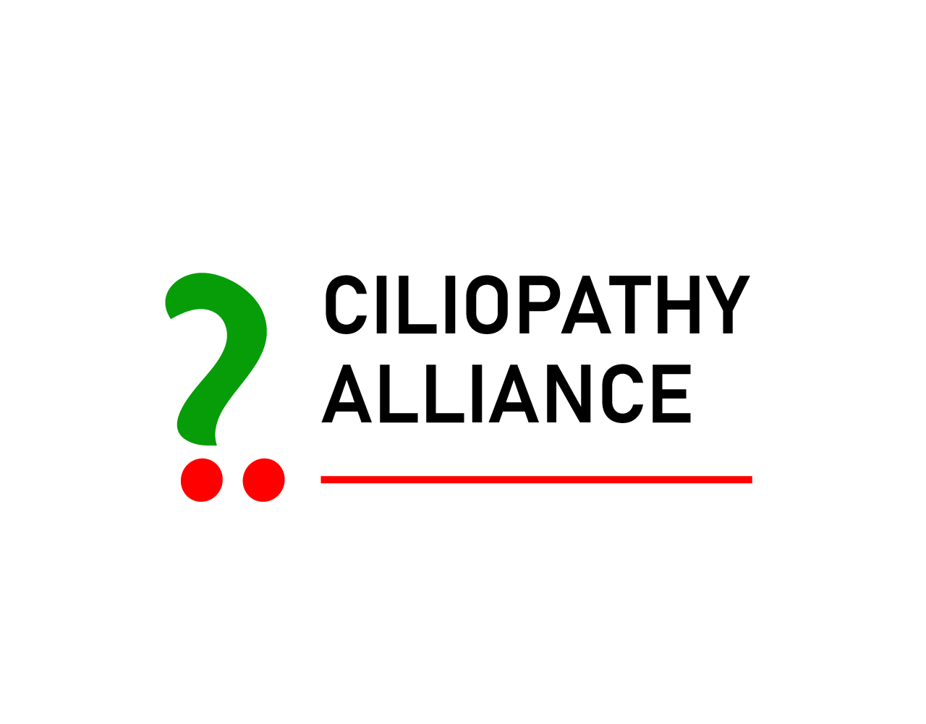
UK Renal Ciliopathies National Network (UKRCNN)
Research Platform – 5-year programme
Centres & Patient Partners
UKRI/MRC funded
Polycystic Kidney Disease, Nephronophthisis, Joubert, Bardet-Biedl
Goals:
Improve renal ciliopathy patient care nationwide.
Develop infrastructure for stratified patient cohorts that are 'trial-ready’.
Build partnerships with academics and industry to accelerate development of much- needed translational therapies.

Slide 3
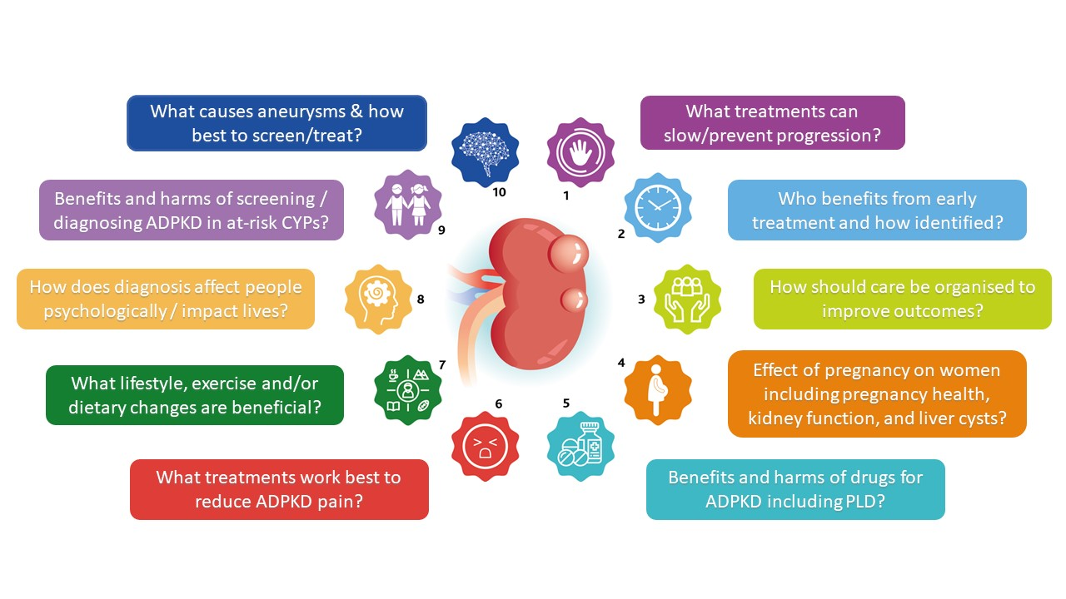
Working with ADPKD Clinical Study Group to identify research priorities

