Slide 1
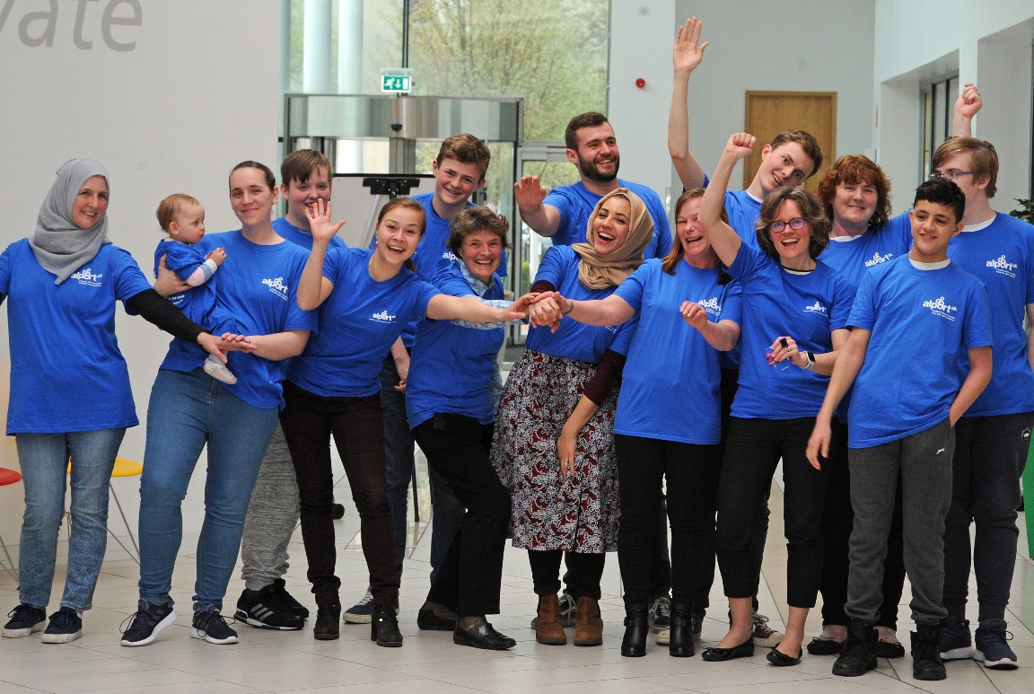

A brighter future for people living with
Alport Syndrome
Running a (patient-led)
research (meeting)
workshop
Prepared for RaDaR workshop
28 April 2023
Susie Gear, Chief Executive, Alport UK
Notes:
…is an inherited condition that can cause kidney failure, deafness and eye abnormalities.
Those that inherit it will probably require a kidney transplant when they are young adults. It can impact a large number of people in a family. It is the second most common form of inherited kidney disease.
1 in 800 according to Professor Moumita Barua’s 2021 research looking at UK Biobank data
1 in 10,000 in any population quoted in most publications to date
As research progresses, more people are diagnosed, prevalence increases
For research, patient numbers in each country alone are not enough. International collaboration is vital eg with USA and China: alport uk supported and encouraged development of the China patient organisation that now supports tens of thousands of patients across China

Slide 2

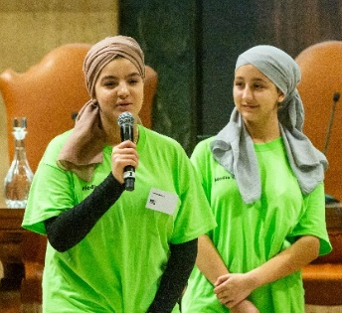

Alport UK works in partnership with individuals, families, researchers, clinicians, pharma/biotech
Support
Information
Research
Collaboration
Underpinned by fundraising
Notes:
Our Mission is to work in partnership with individuals, families and the scientific community to:
• Facilitate a support network for patients and families
• Be a conduit for high quality, accessible information
• Raise the profile of Alport Syndrome in the scientific
community
• Contribute to the international research agenda
• Collaborate on the development of a UK patient registry
and alliance of international patient registries.
Things we are proud of delivering for our patients:
Note divide these things in to the 5 areas.
Our positive and collaborative approach focused on a brighter future – for patients, families, clinicians, researchers, industry
Our daily support of patients connecting them with experts and the wider Alport community to reduce the feeling of isolation
The vibrant and healthy research community emerging and potential for an international clinical trials network
Four International workshops (in person) on Alport Syndrome: Italy 2019, Scotland 2017, Germany 2015, England 2013 bringing patients, clinicians, researchers and industry together and helping to accelerate the delivery of research celebrated in the video our young patients created: https://youtu.be/QH8mDTmKaVU
A series of 20+ international Alport online workshops during the pandemic featuring the latest Alport research on YouTube: https://tinyurl.com/y9cuhgby
Four international publications setting international clinical guidelines
The fun we have trying new techniques, using illustration, film and social media to connect our community with the latest information
The long-lasting friendships emerging across the community

Slide 3
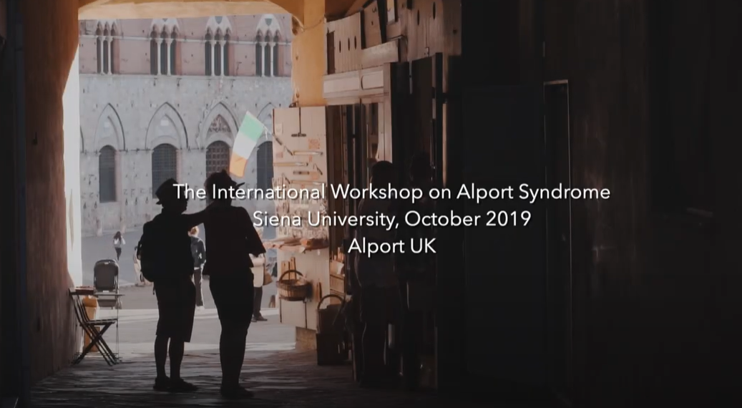
Click video below: https://youtu.be/QH8mDTmKaVU
Notes:
Our Mission is to work in partnership with individuals, families and the scientific community to:
• Facilitate a support network for patients and families
• Be a conduit for high quality, accessible information
• Raise the profile of Alport Syndrome in the scientific
community
• Contribute to the international research agenda
• Collaborate on the development of a UK patient registry
and alliance of international patient registries.
Things we are proud of delivering for our patients:
Note divide these things in to the 5 areas.
Our positive and collaborative approach focused on a brighter future – for patients, families, clinicians, researchers, industry
Our daily support of patients connecting them with experts and the wider Alport community to reduce the feeling of isolation
The vibrant and healthy research community emerging and potential for an international clinical trials network
Four International workshops (in person) on Alport Syndrome: Italy 2019, Scotland 2017, Germany 2015, England 2013 bringing patients, clinicians, researchers and industry together and helping to accelerate the delivery of research celebrated in the video our young patients created: https://youtu.be/QH8mDTmKaVU
A series of 20+ international Alport online workshops during the pandemic featuring the latest Alport research on YouTube: https://tinyurl.com/y9cuhgby
Four international publications setting international clinical guidelines
The fun we have trying new techniques, using illustration, film and social media to connect our community with the latest information
The long-lasting friendships emerging across the community

Slide 4

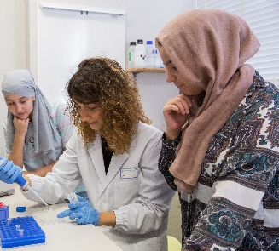
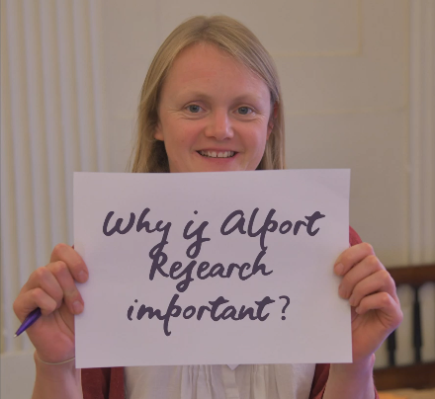
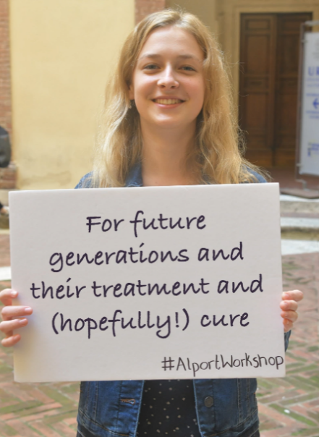
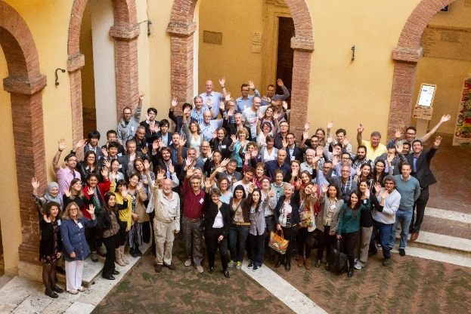
Research
ACE inhibitors and Flozins
Three drugs in clinical trials
6 International workshops and
26 online workshops
£2.5m funding for Alport research hub and seed funding for new ideas
Vibrant international research community
Patient registries
Notes:
Raise the profile of Alport Syndrome in the research community
Alport Warriors
Innovative patient/researcher/clinician collaboration
ACE inhibitors help young adults get through critical teenage years
Two drugs in clinical trials, more in development
Vibrant international research community of 250+ researchers, 50 new projects and 12+ industry partners developing drug and gene therapy options
Patient registries vital to collect data for Natural history studies

Slide 5














Support
Information
Research
Collaboration
Facilitated by patients – where to start
Scientific community
Across the UK
International partners
Genetics
Industry partners
Nierpatiënten
Vereniging
Nederland (NVN)
Ears
Kidneys
Alport Foundation of Australia
Eyes
Notes:
Collaboration drawing on different strengths
Patient numbers are more relevant for research if you look internationally For example:
USA
China
Australia
Rest of Europe
Lots of great organisations interested in research – charities wanting to fund it, organising it etc. but a huge lack of people interested in Alport Syndrome and doing research generally.
There was no shopping list of research to fund.
So we did a web search and put together the names of people who seemed to have a lot of interest

Slide 6

Transformational results - a brighter future
The trick is how you do things, not what you do…

Slide 7
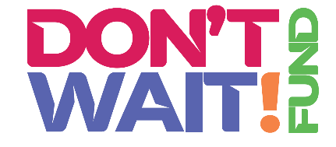
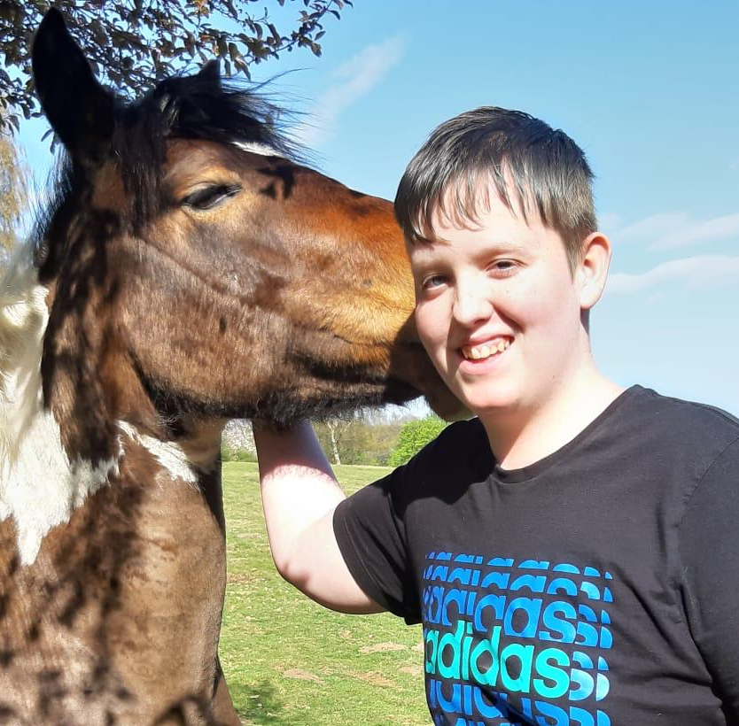
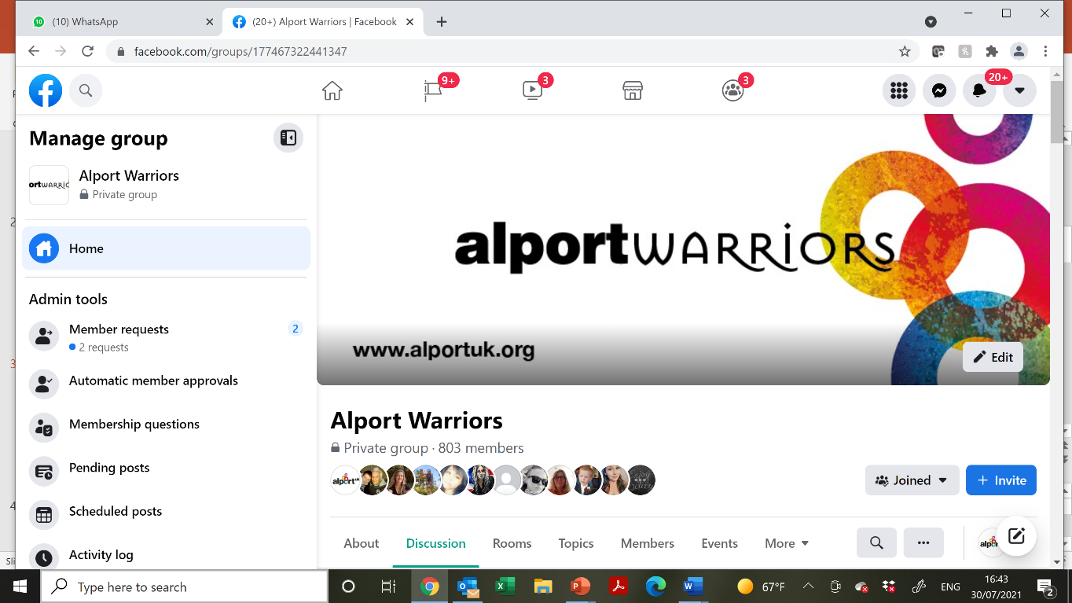
Support
Alport Warriors Facebook page
Expert advice from
Scientific advisors
Alport Avengers
Don’t Wait Fund
Fundraising and volunteering
Collaboration – eg Kidney Care UK
Notes:
Our main acitivity is to facilitate a support network for patients and families
6 Pillars of Wellbeing are our inspiration for:
Don’t Wait Fund – Sam Clarke was the inspiration to get out and try a new form of exercise.
Alport Warriors Facebook – local networks and online community support each other
Expert advice provided by our Scientific advisors to answer questions
Alport Avengers – 18-35 year old community connect to reduce the feeling of isolation at the most critical stage in their journey

Slide 8
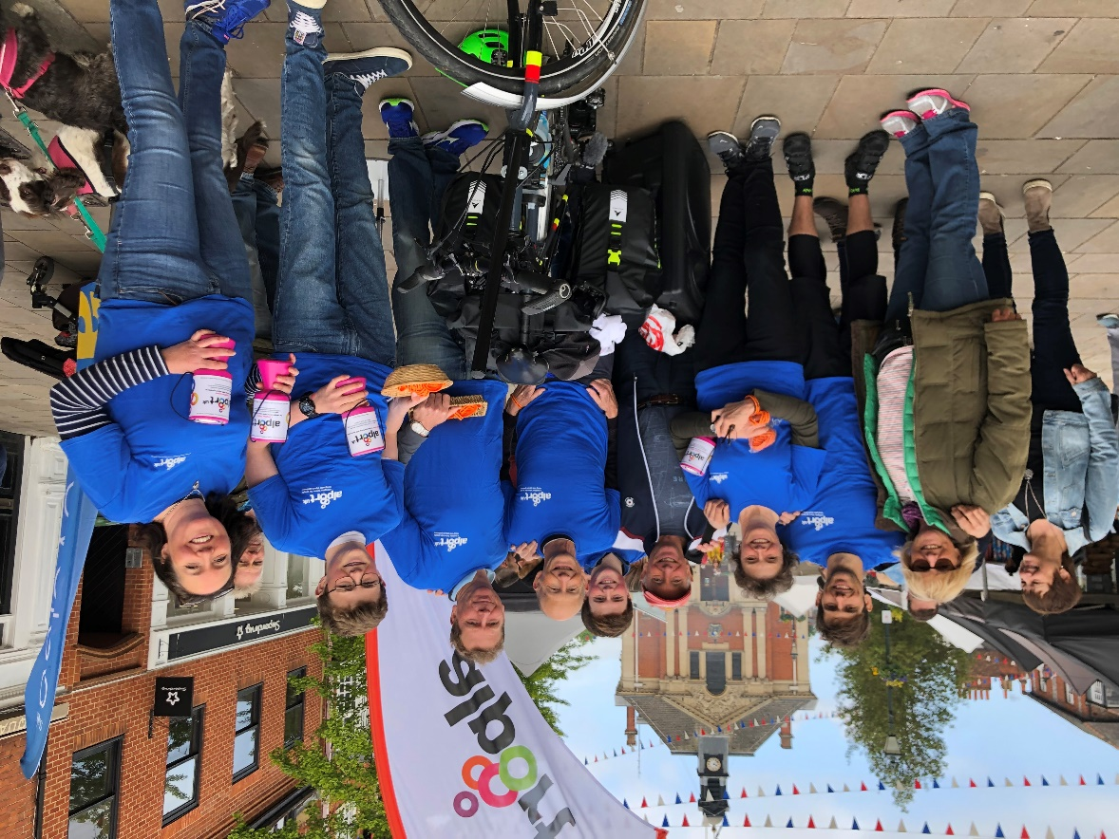
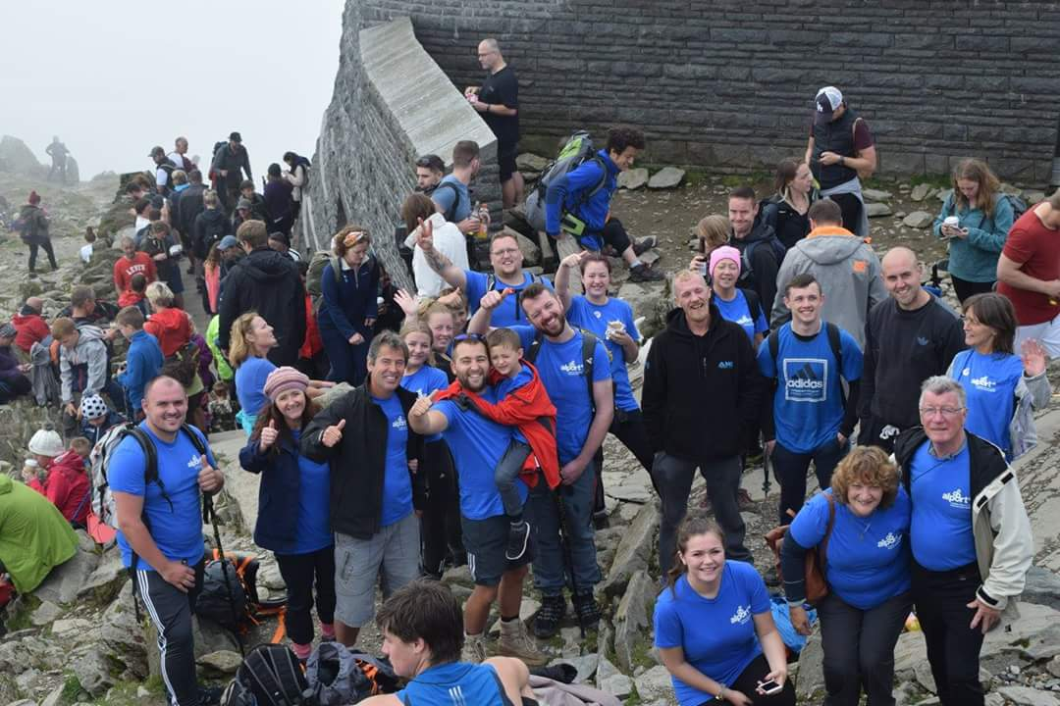
Fundraising for Alport UK – helps patients
Meaningful activity
Social connections
Notes:
Two of the six pillars of wellbeing are
meaningful activity – sam clarke
Social connection – Humphries family climbing Snowden in Wales
As Sam Clarke has shown us with his cycle ride – good for your mental health .

