Slide 1

How Does RaDaR work?

Slide 2
Patient / Data Pathway
Consent by clinician/ research staff at kidney centre
New opportunity to consent electronically – ‘Docusign’
Details are registered by research staff on RaDaR website
Local RaDaR teams trained to collect cohort-specific data
Automated data feed from local hospital site – including historical
(Blood/urine/genetic tests, biopsy reports, clinic letters)

Slide 3
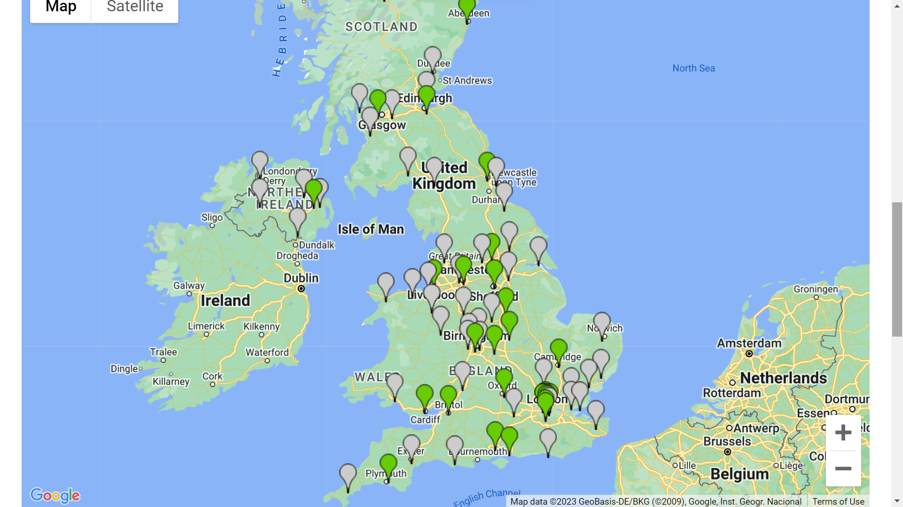
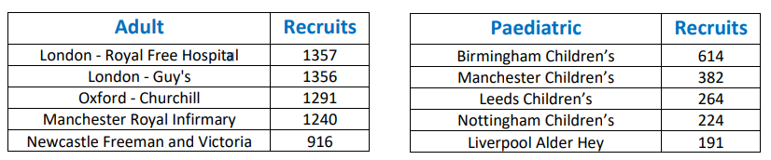
1st April 2023: 30,520 participants from 108 sites

Slide 4
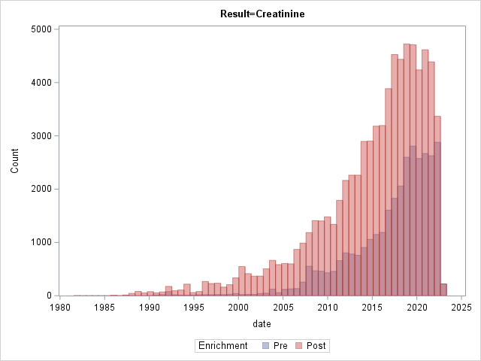
Data Enrichment
5 genomic lab centres, 2 datasets
Dialysis/transplant
Pathology – analysis to extract data from unstructured text
Lab results - significant back-data 300K
Research
Academic and industry
RaDaR cross sectional/descriptive paper
Molecular Genetics analysis
Natural history analysis

Slide 5
Benefits of registration and data link
Large numbers of participants with rare renal diseases
Unique opportunity to gain essential information to help improve care and treatment
Platform for research teams to contact participants directly about new studies e.g. questionnaires, drug trials
Patient groups to drive and steer the most important research for their disease
Notes:
Research, e.g. IgA Nephropathy study
Patient contact - worked really well with recent Alport study

Slide 6


Exciting times ahead!!

