Slide 1





BioPTiC:
Bio markers for Paediatric Transplantation in Children
Professor Stephen Marks
Consultant Paediatric Nephrologist
Great Ormond Street Hospital for Children NHS Foundation Trust
and UCL GOS Institute of Child Health, London, UK
UK Paediatric Kidney Conference 2026, Solihull, UK
Friday 30 January 2026

Slide 2
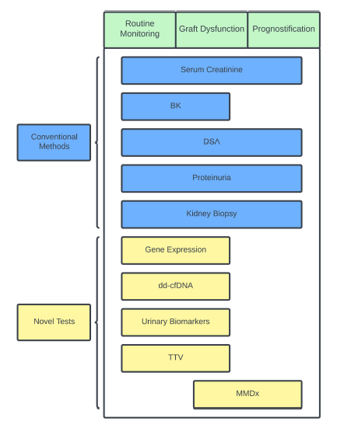
Research biomarkers
TruGraf®,AlloMap® kSORT®
Allosure®,Prospera® TRAC®
Urinary mRNA profiling
Urinary chemokines
LYMPHOCYTE FUNCTION
ImmunKnow® / Pleximark® / ELISpot
ddcfDNA +
gene expression

Slide 3
Immune / viral monitoring
HLA
Humoral Immuno-surveillance
NON- HLA
ELISpot IGRA
Cellular Immuno-surveillance
FLOW CYTOMETRY
TORQUE TENO VIRUS
Molecular diagnostic
GENE EXPRESSSION PROFILING
CELL FREE DNA
Advanced infection surveillance
Viral monitoring: EBV / CMV / BKV
Pathogen specific monitoring
(CMV-specific T-cell immunity assays) (QuantiFERON-CMV or ELISPOT)

Slide 4
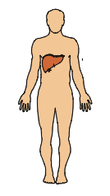
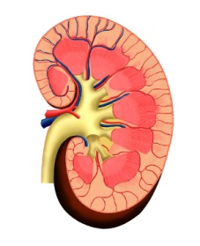
Timepoints for biomarkers
PRE-TRANSPLANT
POST-TRANSPLANT
PERI-TRANSPLANT
Humoral sensitization
Drug toxicity
Recurrent primary disease
Rejection
Pharmacological immunosuppression
Heterologous immunity
1 year
Cellular alloimmunity
Ischemia reperfusion
Surgical damage
Immune system
Graft response to injury
Drug toxicity
Systemic effects of organ damage
Rejection
Pharmacological immunosuppression
Patient compliance
Tolerance

Slide 5
Proposal
National protocol for biobanking of samples for paediatric kidney transplant to look for ddcfDNA
Ethical approval obtained for all 13 paediatric nephrology sites (and additional sites for other solid organ transplantation) at least 15 times
  pre-transplantation
  post-transplantation: D0, D1, D2, D5, D7, D14
  post-transplantation: M1, M3, M6, M9, M12 M15, M18, M24 and when rejection is suspected

Slide 6
Contact
Are you interested in joining BioPTiC ?
Please contact the following:
  Stephen Marks stephen.marks@gosh.nhs.uk
  Barian Mohidin barian.mohidin.23@ucl.ac.uk
  Kyle Lin yingkit.lin@ gosh.nhs.uk

Slide 7

Any questions ?

