Slide 1

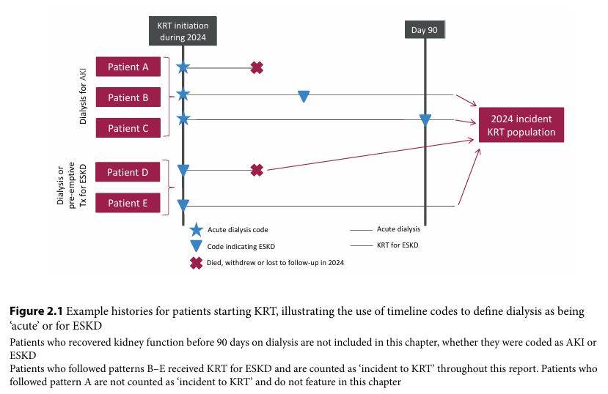
UK Renal Registry 28th Annual Report
Data to 31/12/2024

Slide 2
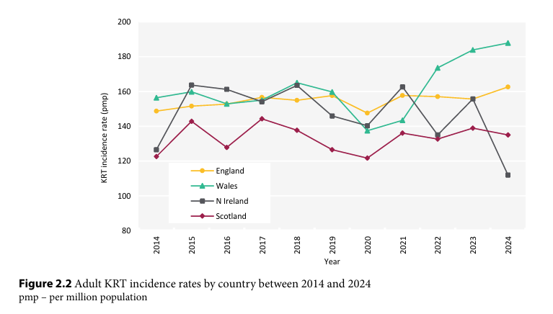
UK Renal Registry 28th Annual Report
Data to 31/12/2024

Slide 3
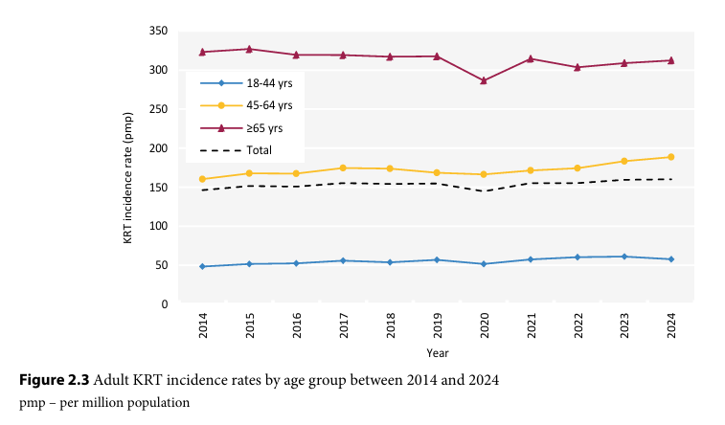
UK Renal Registry 28th Annual Report
Data to 31/12/2024

Slide 4
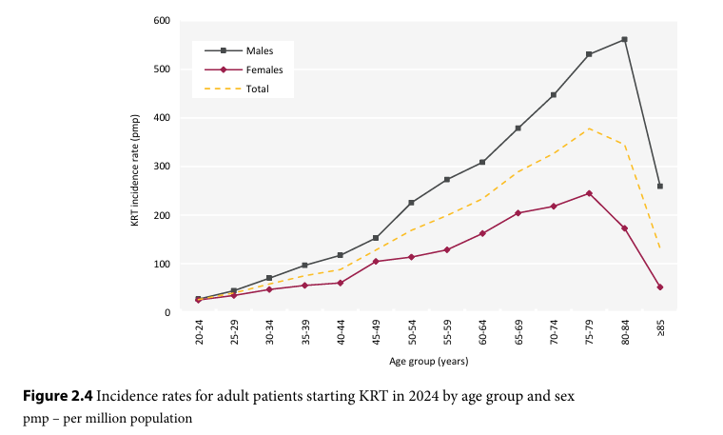
UK Renal Registry 28th Annual Report
Data to 31/12/2024

Slide 5
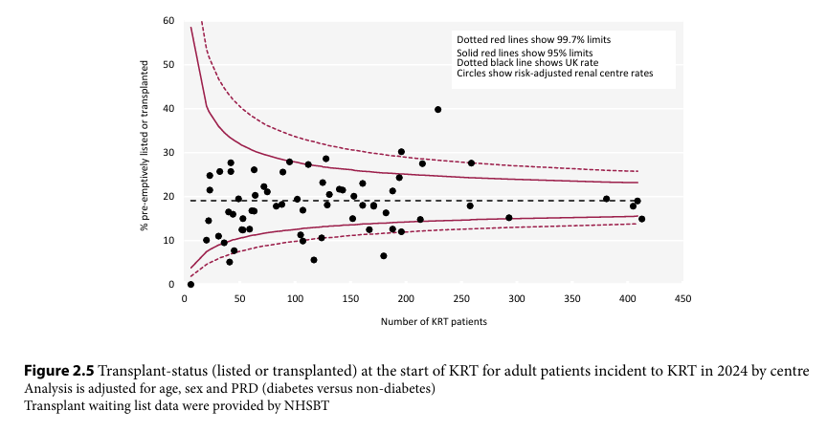
UK Renal Registry 28th Annual Report
Data to 31/12/2024

Slide 6
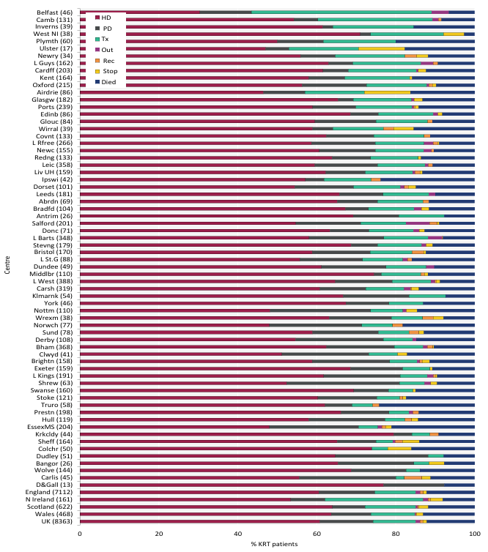
UK Renal Registry 28th Annual
Report
Data to 31/12/2024
Figure 2.6 KRT modality at 1 year for adult patients incident to KRT in 2023 by centre
Number of patients in a centre in brackets
Out – moved out of a centre but did not reappear in another centre;
Rec – recovered kidney function;
Stop – treatment withdrawal
Centres are ordered by decreasing use of Tx at 1 year

Slide 7
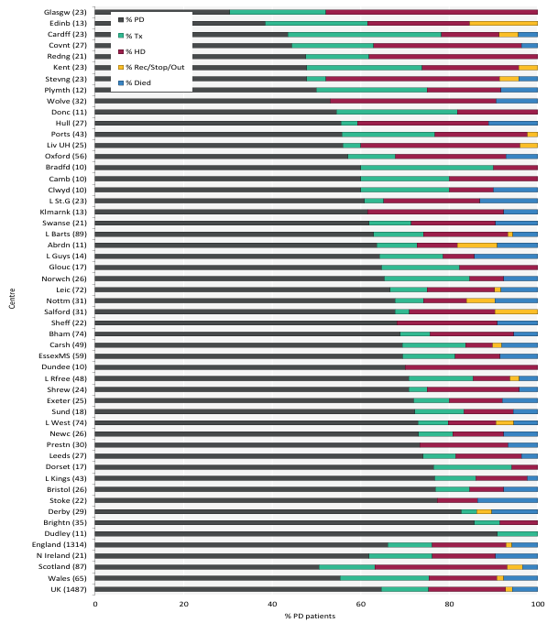
UK Renal Registry 28th Annual Report
Data to 31/12/2024
Figure 2.7 KRT modality at 1 year for adult patients incident to PD in 2023 by centre
Number of patients in a centre in brackets
Out – moved out of a centre but did not reappear in another centre;
Rec – recovered kidney function;
Stop – treatment withdrawal
Centres are ordered by increasing use of PD at 1 year

Slide 8
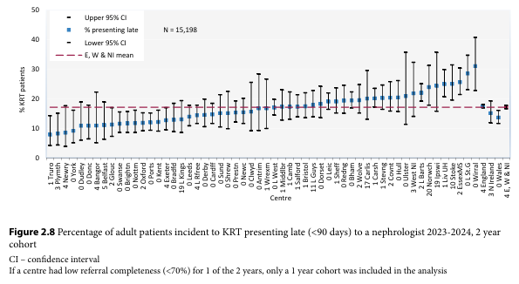
UK Renal Registry 28th Annual Report
Data to 31/12/2024

Slide 9
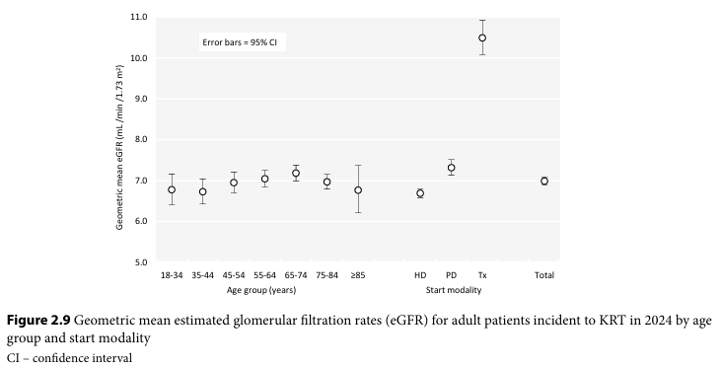
UK Renal Registry 28th Annual Report
Data to 31/12/2024

Slide 10
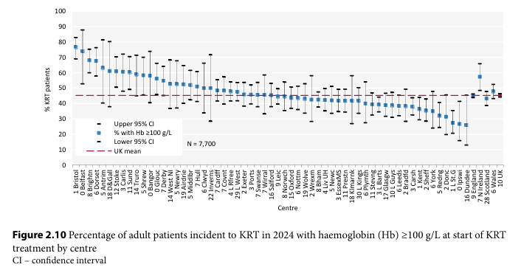
UK Renal Registry 28th Annual Report
Data to 31/12/2024

Slide 11
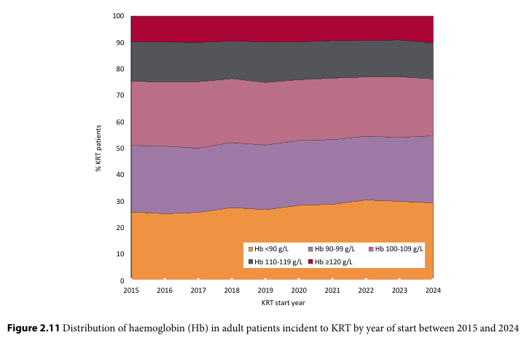
UK Renal Registry 28th Annual Report
Data to 31/12/2024

Slide 12
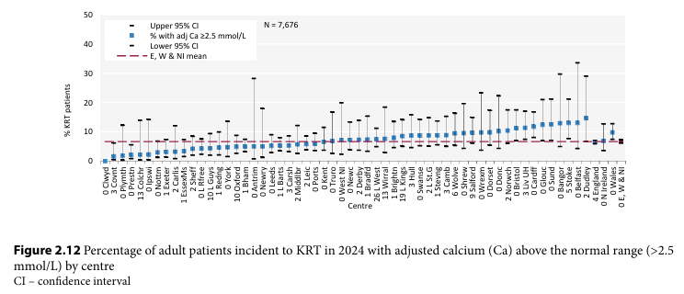
UK Renal Registry 28th Annual Report
Data to 31/12/2024

Slide 13
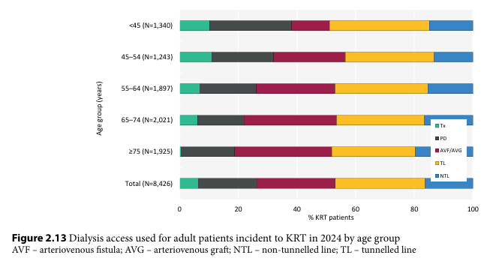
UK Renal Registry 28th Annual Report
Data to 31/12/2024

Slide 14
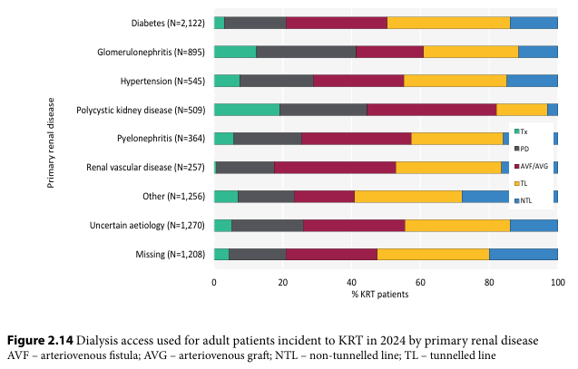
UK Renal Registry 28th Annual Report
Data to 31/12/2024

Slide 15
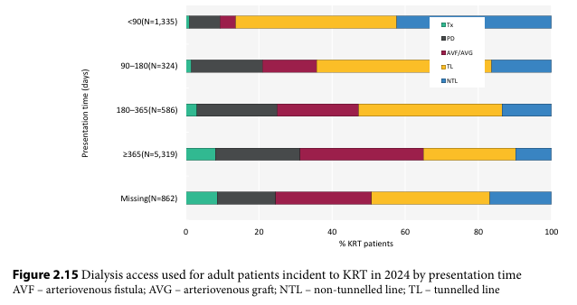
UK Renal Registry 28th Annual Report
Data to 31/12/2024

Slide 16
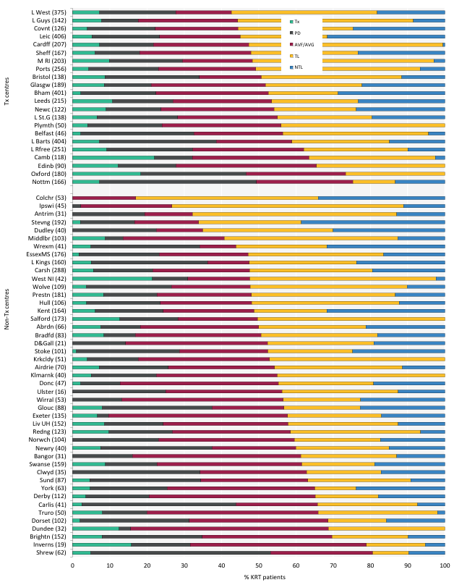
UK Renal Registry 28th Annual Report
Data to 31/12/2024
Figure 2.16 First dialysis access used for adult patients incident to KRT in 2024 by centre
Number of incident patients on KRT in a centre in brackets
Centres are ordered by decreasing use of lines
The percentage of pre-emptive transplants is underestimated for Antrim, Belfast and Ulster (see Appendix A section 2.2)
AVF – arteriovenous fistula; AVG – arteriovenous graft; NTL – non-tunnelled line; TL – tunnelled line

Slide 17
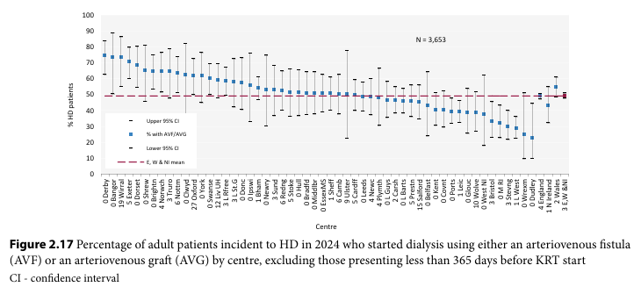
UK Renal Registry 28th Annual Report
Data to 31/12/2024

Slide 18
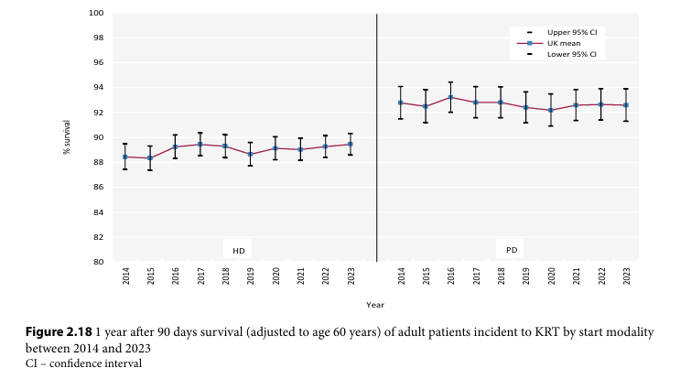
UK Renal Registry 28th Annual Report
Data to 31/12/2024

Slide 19
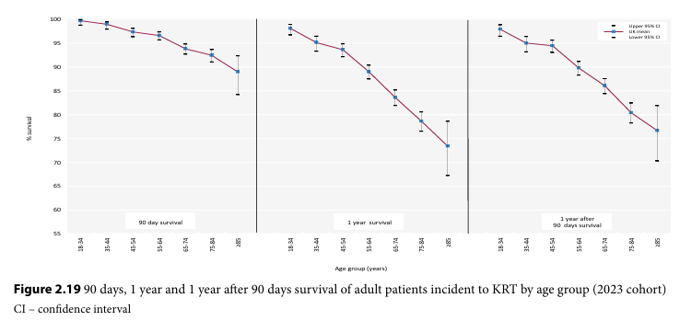
UK Renal Registry 28th Annual Report
Data to 31/12/2024

Slide 20
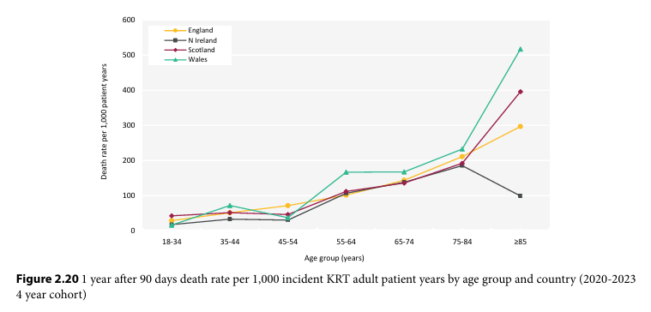
UK Renal Registry 28th Annual Report
Data to 31/12/2024

Slide 21
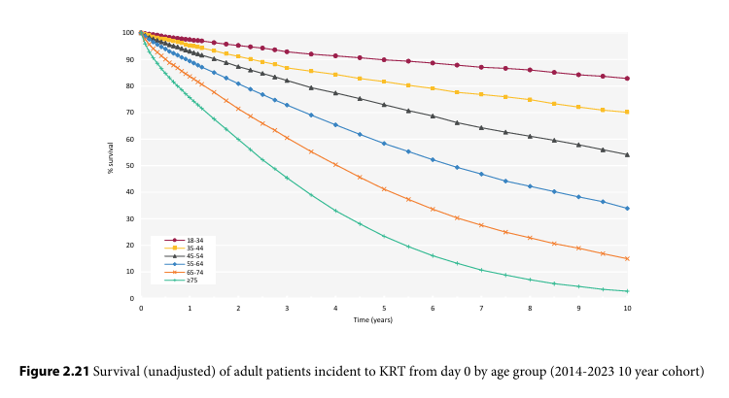
UK Renal Registry 28th Annual Report
Data to 31/12/2024

Slide 22
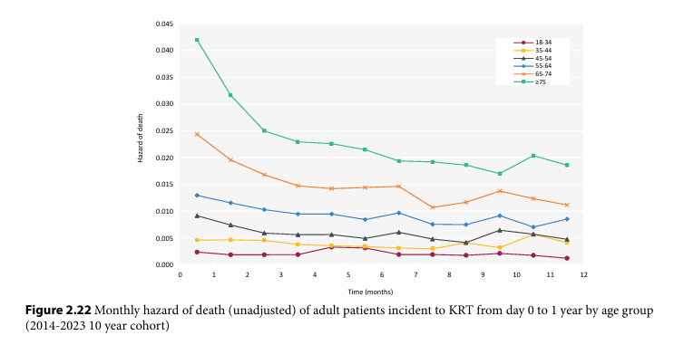
UK Renal Registry 28th Annual Report
Data to 31/12/2024

Slide 23
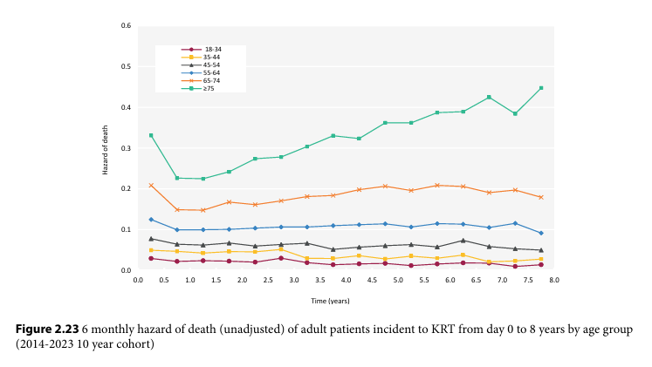
UK Renal Registry 28th Annual Report
Data to 31/12/2024

Slide 24
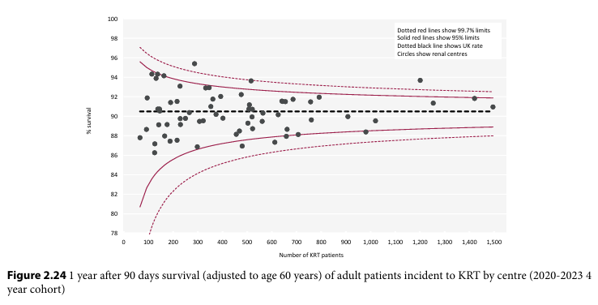
UK Renal Registry 28th Annual Report
Data to 31/12/2024

Slide 25
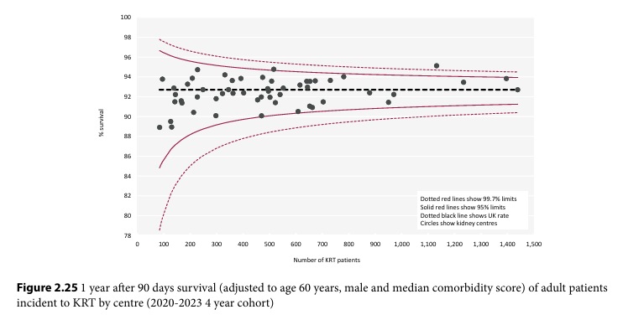
UK Renal Registry 28th Annual Report
Data to 31/12/2024

