Slide 1

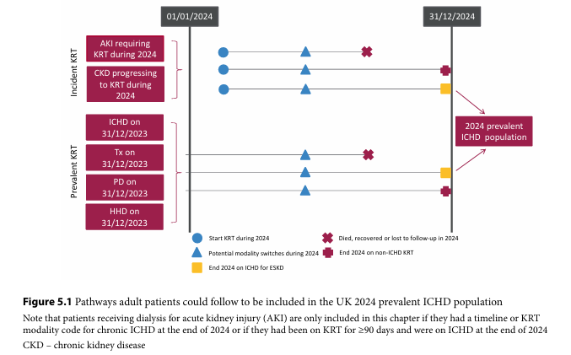
UK Renal Registry 28th Annual Report
Data to 31/12/2024

Slide 2
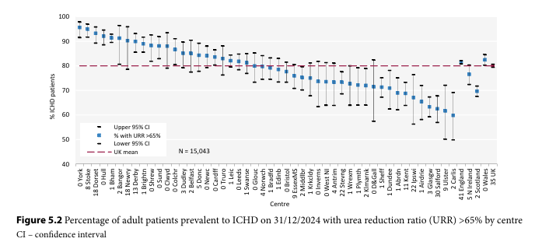
UK Renal Registry 28th Annual Report
Data to 31/12/2024

Slide 3
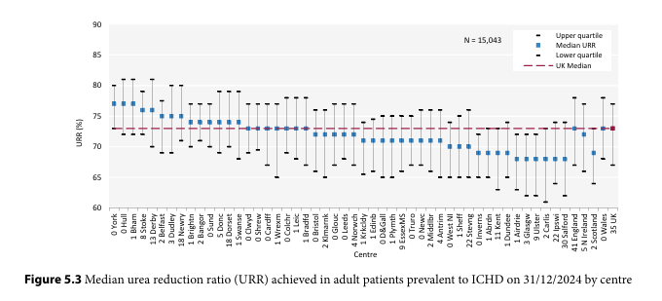
UK Renal Registry 28th Annual Report
Data to 31/12/2024

Slide 4
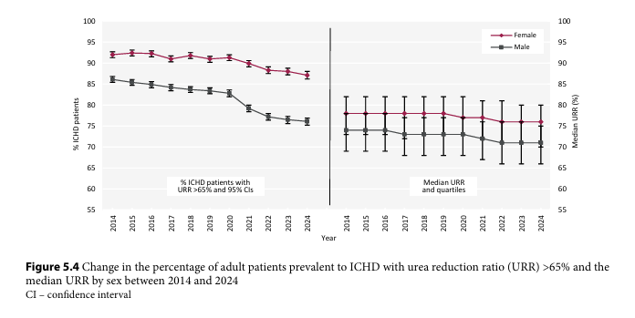
UK Renal Registry 28th Annual Report
Data to 31/12/2024

Slide 5
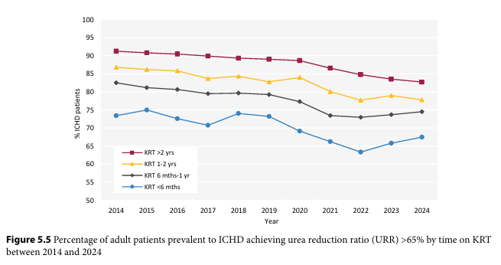
UK Renal Registry 28th Annual Report
Data to 31/12/2024

Slide 6
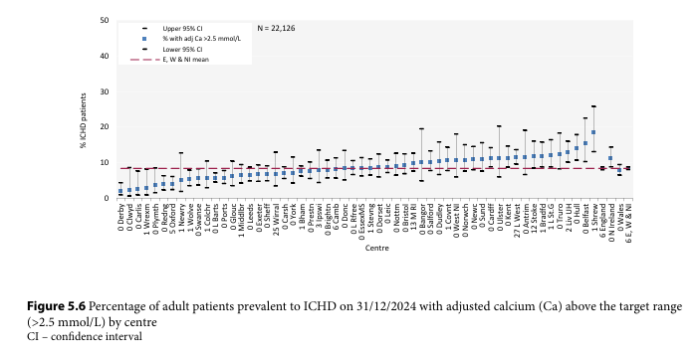
UK Renal Registry 28th Annual Report
Data to 31/12/2024

Slide 7
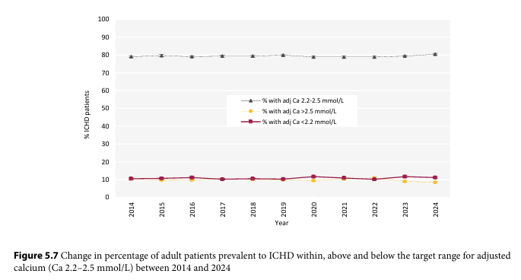
UK Renal Registry 28th Annual Report
Data to 31/12/2024

Slide 8
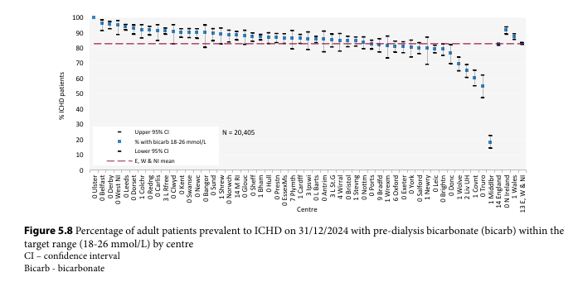
UK Renal Registry 28th Annual Report
Data to 31/12/2024

Slide 9
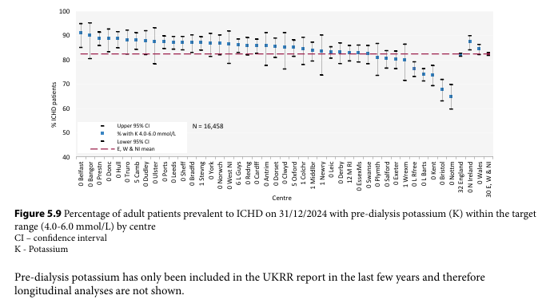
UK Renal Registry 28th Annual Report
Data to 31/12/2024

Slide 10
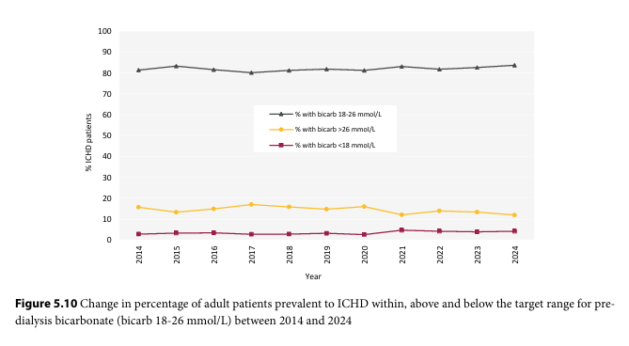
UK Renal Registry 28th Annual Report
Data to 31/12/2024

Slide 11
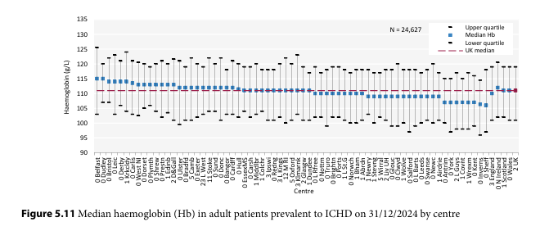
UK Renal Registry 28th Annual Report
Data to 31/12/2024

Slide 12
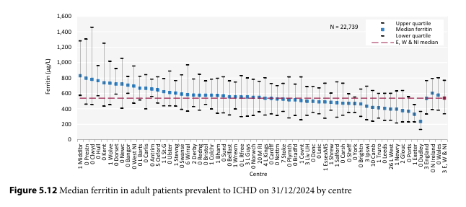
UK Renal Registry 28th Annual Report
Data to 31/12/2024

Slide 13
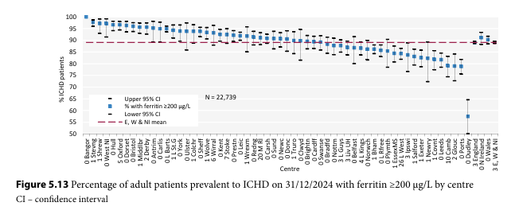
UK Renal Registry 28th Annual Report
Data to 31/12/2024

Slide 14
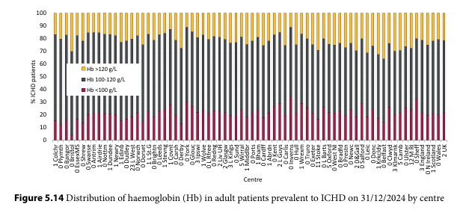
UK Renal Registry 28th Annual Report
Data to 31/12/2024

Slide 15
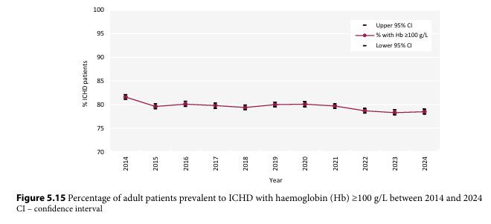
UK Renal Registry 28th Annual Report
Data to 31/12/2024

Slide 16
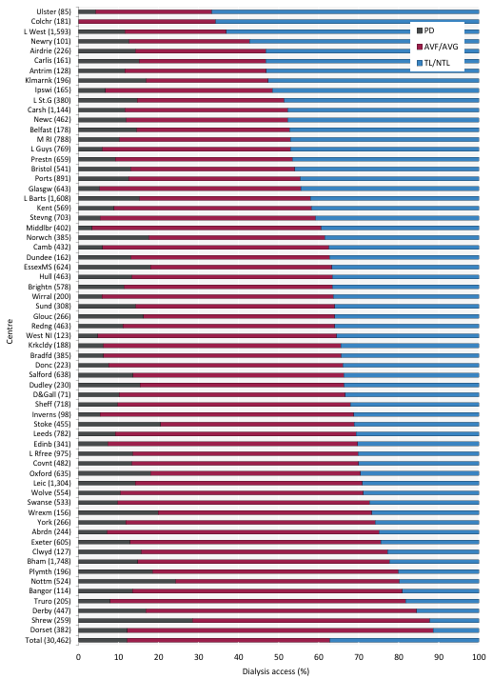
UK Renal Registry 28th Annual Report
Data to 31/12/2024
Figure 5.16 Dialysis access in adult patients prevalent to dialysis on 31/12/2024 by centre
Number of patients on dialysis in a centre in brackets (centres with <70% access data for the prevalent dialysis population were excluded).
AVF – arteriovenous fistula; AVG – arteriovenous graft; NTL – non-tunnelled line; TL – tunnelled line

Slide 17
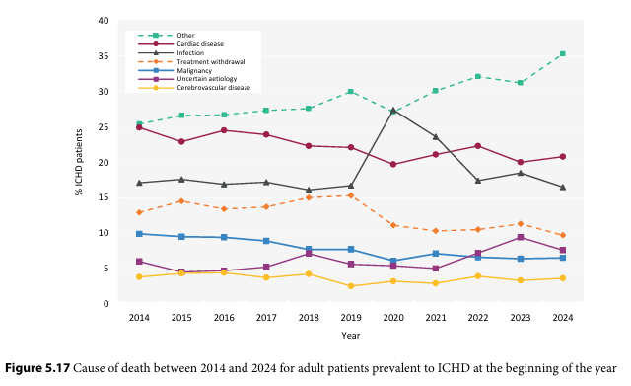
UK Renal Registry 28th Annual Report
Data to 31/12/2024

