Slide 1
The Renal Association Short Life Clinical Affairs Working Party
Preliminary report to the
Renal Association
7th October 2003
Renal Association Clinical Affairs Working Party 2003

Slide 2
The Remit
“The remit of the Working Party is to consider the future role of the Renal Association in the development of clinical standards for renal units, in promoting the conditions needed to attain them, and auditing the success with which this is done. The Working Party will make specific recommendations to the Executive within the overall context of the changing Health Service.”
Renal Association Clinical Affairs Working Party 2003

Slide 3
Terms of Reference
Consider current and future roles of these Subcommittees
Standards and Audit
Service and Provision
Registry
Take account of NHS developments
NICE
NSF
CHI
NHS IT
Consultation with the MDT and Patients
Renal Association Clinical Affairs Working Party 2003

Slide 4
Invited opinions from:
Executive and members of the Renal Association
BRS
BTS
BAPN
DoH
ERG of the Renal NSF
National Kidney Research Fund
Renal Association Clinical Affairs Working Party 2003

Slide 5
Members of the Working Party
Prof John Feehally
Prof Terry Feest
Prof Alison McCleod
Dr Donal O’Donoghue
Prof Steve Powis
Dr Stewart Rodger
Dr Kate Verrier-Jones
Dr Es Will
Dr Christopher Winearls (Chairman)
Renal Association Clinical Affairs Working Party 2003

Slide 6
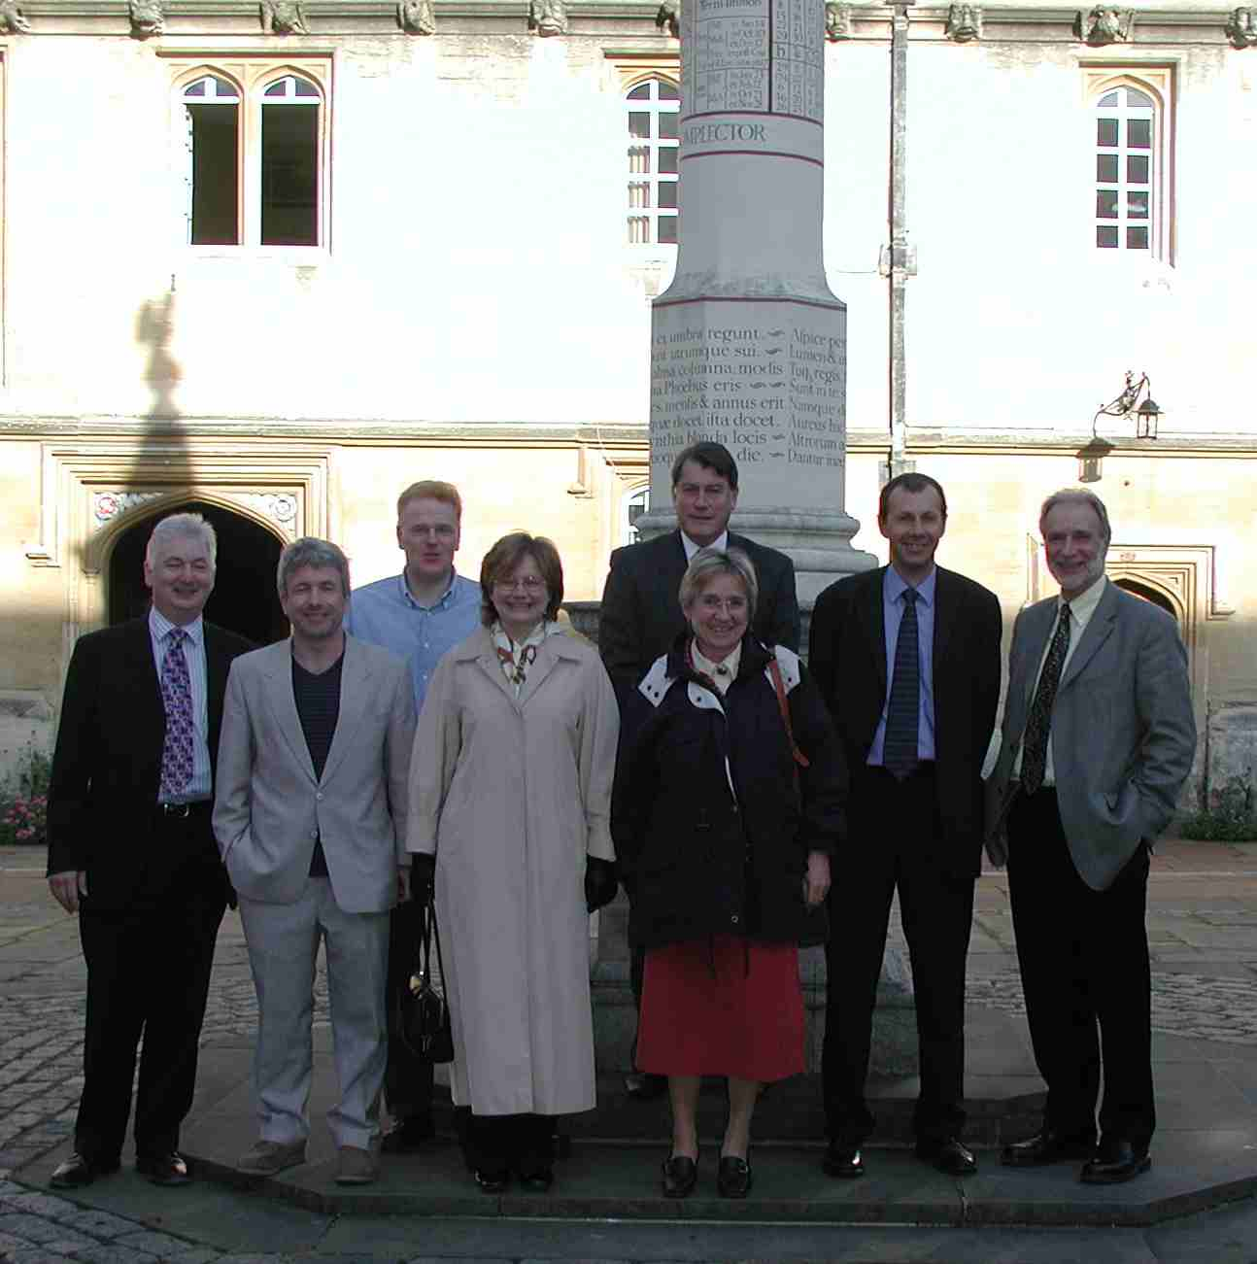
Renal Association Clinical Affairs Working Party 2003

Slide 7
Five agenda items
Standards and Audit
Registry
Service Provision and Delivery
Re-organising the Committee structure
Relations with external bodies involved in renal care
Renal Association Clinical Affairs Working Party 2003

Slide 8
Clinical & Service issues: principles
The RA has an inescapable leadership role
Collaboration with other organisations is essential
Paediatric input
Avoid duplication of effort
Consult widely
Renal Association Clinical Affairs Working Party 2003

Slide 9
1. Standards and Audit should :
Continue to produce standards policies for the UK
Modular by multidisciplinary expert groups
(ratified by the subcommittee)
Produce a shared renal transplant policy with BTS
Publish electronically and in print
Extend scope beyond ESRF
Concentrate on basic and NSF standards
Identify areas of uncertainty for research
Renal Association Clinical Affairs Working Party 2003

Slide 10
1. Standards and Audit should not:
Attempt exhaustive reviews
Be bound by DOQI or EBPG
Take responsibility for unit peer review
or undertake invited visits
(but should assist with both)
Provide guidelines on management of common conditions
Renal Association Clinical Affairs Working Party 2003

Slide 11
2. The Renal Registry
Outstanding success
Independent
Funded
Innovative
Expanding UK coverage
Unique resource internationally
Potential setter and driver of standards
Renal Association Clinical Affairs Working Party 2003

Slide 12
2. Renal Registry: some problems & issues
Data quality
Need for management structure
Non-numerical data
Succession planning
Siting
Overlap with UKTS
Lack of feedback and analysis
Clinical Governance responsibilities
Renal Association Clinical Affairs Working Party 2003

Slide 13
2. Renal Registry: some ideas
Create 2 session funded Clinical Director but retain Hon Chairman
Place the Registry in a University Dept
Encourage use of the data set
Forum for feedback, analysis, synthesis
Drive establishment of informatics support for units
Renal Association Clinical Affairs Working Party 2003

Slide 14
3. Service, Provision and Delivery
Organise the Clinical Director Forum
Collaborate with agencies involved in provision
Identify inequalities and assess adequacy of provision
Recommend best practice for commissioning and delivery
Renal Association Clinical Affairs Working Party 2003

Slide 15
3. Service, Provision and Delivery: Priorities
Monitor dialysis provision
Medical and other workforce planning
Encourage uniform and rational commissioning of renal services
Renal Association Clinical Affairs Working Party 2003

Slide 16
4. Reorganisation of Committee structure
Establish a Clinical Affairs Board
reporting to President and EC
oversees and co-ordinates the subcommittees
Appoint/elect a Clinical Vice President to chair
Members: Chairs of Subcommittees
2 elected members EC
DGH EC representative
Review terms of reference of the subcommittees
allocate elected members of EC to them
(Consider creating parallel Academic Affairs Board)
Renal Association Clinical Affairs Working Party 2003

Slide 17
5. External Relationships
Equip the RA to takes its place alongside BTS, BRS, BAPN, NKF,NFKPA
to influence policy and planning
Seek bi- and multi-lateral arrangements
Foster contacts between Chairs & Presidents of these bodies
Support this function of the Kidney Alliance
Formal collaboration with international bodies framing standards of renal care.
Renal Association Clinical Affairs Working Party 2003

Slide 18
Next steps:
Invite comments from the members
Present preliminary findings to Executive Committee in November 2003
Working Party meets to:
Resolve contentious issues
Discuss responses from EC and RA
Finalise report & recommendations
Deliver to EC before Spring meeting 2004
Renal Association Clinical Affairs Working Party 2003

