Slide 1
Transform AKC-
For the best patient experience
Pilot QI Project Pack
Pilot site unit name: Royal Free

Slide 2
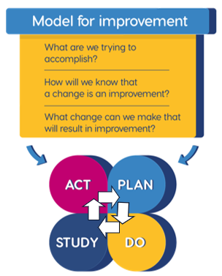
10 steps in QI
KQIP Methodology
Agree an area for improvement using data
Prepare to lead a QI team
Understand your system and problem
Define project aim and scope
Identify and engage stakeholders
Define drivers and develop change ideas
Agree measures including baseline data
Test change ideas using PDSA cycles
Display data over time to understand impact
Sustain and share improvements
IHI Model for Improvement

Slide 3
Step 1: Area for improvement (Jan 2025)
Area for improvement : Health Literacy
How do we document and measure health literacy levels within AKC population with aim to adapting patient education?

Slide 4
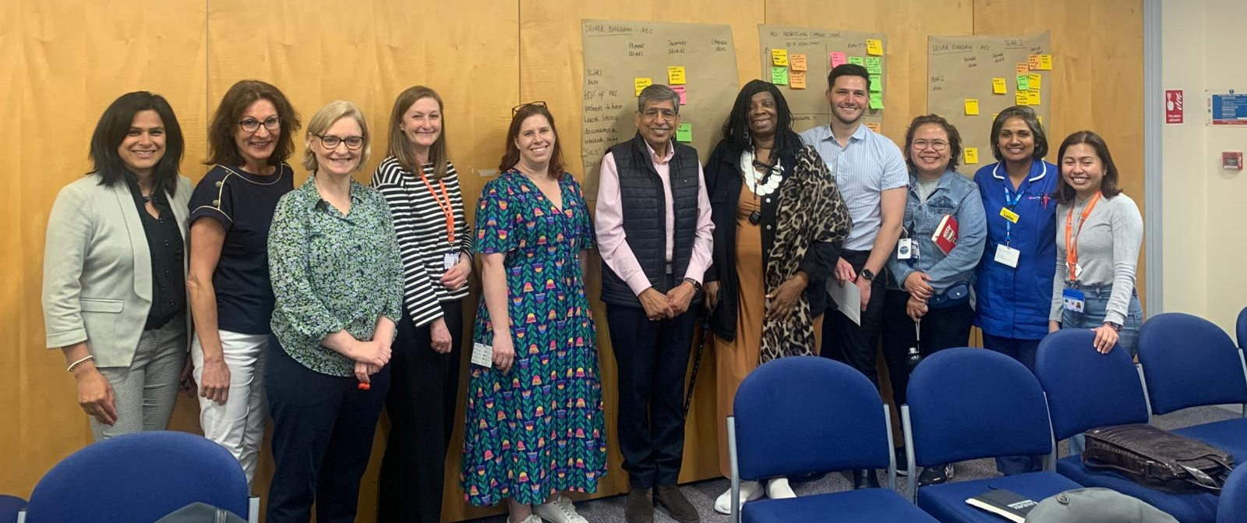
Step 2: Prepare to lead a QI team

Slide 5
Step 3: Understanding the system and problem
Process Map, Fishbone, Pareto

Slide 6
Step 3: Understanding the system (11 Feb 2025)
Royal Free Ideal Process Map
Adapting what matters to you
Adapt make every contact count
Add in comments box into SILS
5 -Always
STEPS
Form for sharing case studies
Difficult conversations booklet
Script/prompt as natural as possible
New AKC pt (100%)
PROBLEM
Staff education understand why etc
Check staff confidence
Explain and ask the SILS question to pt
Document answer on Vital Data
Be ready to respond-act on answer
AKC follow up
POTENTIAL CHANGE IDEA
Staff education & what to do with your answer
Pre & post confidence level
survey
How people interpret the Question
NEED MORE INFO
Easy read education
Notes:
6

Slide 7
Step 3 Fishbone– understanding low attendance of the patient education sessions – staff perspective (Dec 2025)
STAFF
PATIENT FACTORS
COMMUNICATIONS
Don’t advertise dates with other staff
No interest in attending
No information on the purpose / importance of attending these sessions
Symptom burden
Limited preparation
Work/ carers commitments
Language barriers
Cognition issues
PROBLEM
Low patient attendance at the patient education sessions
Patient in denial about disease/ condition
Attending other appointments at same time/ day
Limited reminders – PES are excluded from the trust text messaging service
Location
Timings
Transport/ car parking
Not having the right staff attend
Digital exclusion/ literacy
ENVIRONMENT
PROCESSES
TECHNOLOGY

Slide 8
Step 3: Pareto Chart Reasons for not attending PES at Royal Free, patient perspective (Dec 2025)

Slide 9
Step 3: Pareto Chart Reasons for not attending PES at Tottenham Hale, patient perspective (Dec 2025)

Slide 10
Step 4: Define project aim and scope

Slide 11
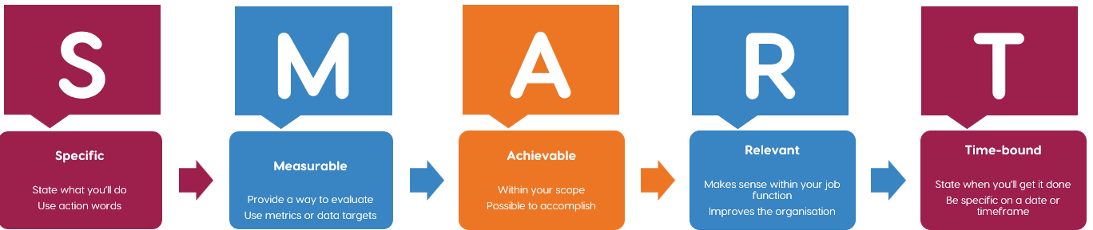
Step 4: Project Aim
Measure health literacy
Use validated tool (SILS)
Put tool on vitaldata first
Use health literacy to shape care and education
31/12/25
Aim statement (draft)
Year 1
60% of AKC patients to have health literacy documented on Vitaldata using “Single Item Literacy Screen” tool by 31/12/25
Year 2 – how to use to shape care?

Slide 12
Step 4: Project scope
What is not in the project (yet)
? Involve earlier CKD patients later
What is in the project
All of patients in AKC service
Patricia (patient) idea
? Factsheet on info about what to expect about PD / Home HD / hospital HD

Slide 13
Step 4: Project Aim for 2026 (Dec 2025)
To deliver person-centred kidney care which is tailored to Royal Free patients meeting their health literary needs ensuring right decision and kidney treatment is made in a timely manner by Nov 2026

Slide 14
Step 5: Identify and engage stakeholders

Slide 15
Step 5: Identify & Engage -Stakeholder Map (Feb 2025)
More power in the project | Satisfy Opinion formers. Keep them satisfied with what is happening and review your analysis of their position regularly | Manage (key stakeholders) Key stakeholders should be fully engaged through full communication and consultation
Less power in the project | Monitor This group may be ignored if time and resources are stretched | Inform Patients often fall into this category. It may be helpful to take steps to increase their influence by organising them into groups or taking active consultative work
 | Less impact | More impact
Administrative staff
Triumvirate Renal management
RFH comms team
Macius
KCUK
AKC consultant
Csilla/Jo
Other pilot sites
Frailty Team & OT/PT
North central London
Renal IT
RFH AKC staff/ nurses/AHPs
Community MDT
KPA
KQIP – Transform AKC team
AKC/LCC patients
Renal IT
Phlebotomy
LKN
DALS – trust language service provider
Local orgs working with patients
NKF
Patients
Royal Free charity
Renal staff
Kidney Research
Patients' relatives/carers
Dementia specialists
Population health team
Learning disability acute liaison nurses

Slide 16
Step 5 – Understanding stakeholders (Feb 2025)
Stakeholder | Who are they? Specify their roles but also consider their status, connections, whether they are supporters, peers, influencers, saboteurs, funders, delivery partners… | What do they know? About you, the subject, the language, the history, the context, the people | What do they fear? Costs, time, boredom, requests they can't meet, missing something, letting people down, more work, bad publicity | What do they want? To make a difference, save money hit targets, promotion, fame, a cause, their lunch….
AKC consultants | Sarah Hildebrand, Aine Burns, Cate Goodlad, Sai Duraisingham, Dakshina Jayasena, Colley Crawford, David Wheeler, Dorothea Nitsch | Supporters, influencers | More work, unaware of tool, what we do with it, not being able to meet communication needs, | To make a difference and improve experience
KPAs
Csilla/Jo
Frailty team OT & PT
KCUK
IT

Slide 17
Step 5 – Engaging with stakeholders (Feb 2025)
Using this 30/60/90-day template to plan how you will engage and communicate with your key stakeholders
 | Action(s) | Who will ensure this is completed
30 days (13 Mar) | Present to AKC team meeting 12.02.25-rolling agenda Meet with KCUK Clair re patient information sheet Send photos of waiting areas Script for asking questions Develop training for staff Escalate VD build Hot topics Planning for Birmingham | Jan/Csilla Macius Macius, Jo, core team Sarah
60 days (12 Apr) | AKC summit – present project Deliver training staff KPA newsletter item- update KPA team SILS tool live on VD Service line meeting and divisional board update. | Jo Henry
90 days (12 May) | Start SILS screening for new patients to AKC clinic Top tips to guide post SILS where to get help/advice Monitor number of SILS completed

Slide 18
Step 6: Define drivers & developing change ideas
Driver diagrams, Priority matrix

Slide 19
Step 6: Define Drivers & Developing change ideas 1 – (April 2025)
Aim
60% of AKC patients to have health literacy documented on Vitaldata using “Single Item Literacy Screen” tool by 31/12/25
Staff survey results end of June (Janette)
Staff awareness
Staff education
Roll out education by end ofJuly (Jo)
Have MDT fill in SILS question (Lisa)
Chunk and check, teach back (Jo)
Vital data changes (Dave) add a field to Pt vital data to reflect offered
Measurement
Tools on Vital Data
Run reports monthly (Dave)
Missed appointments data (Sarah)

Slide 20
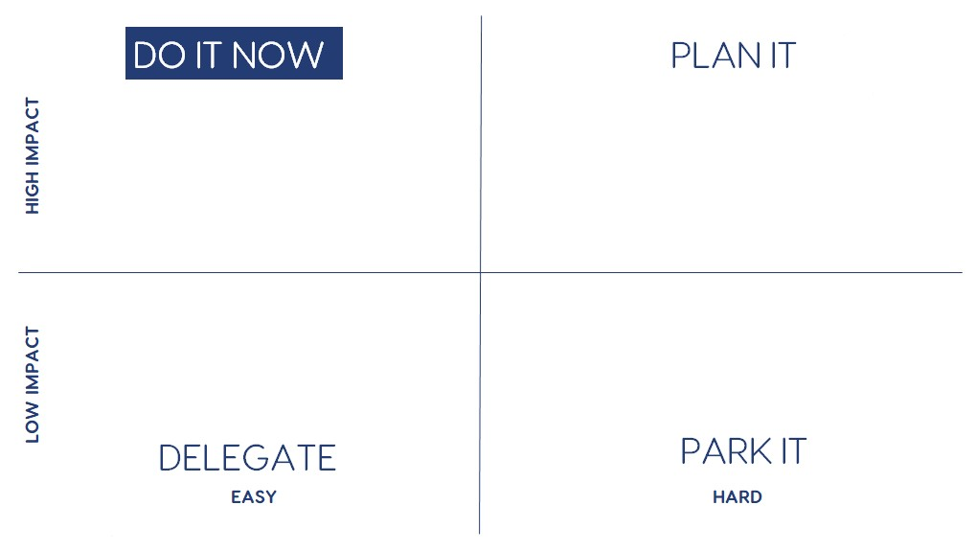
Prioritising change ideas-Year 1 (April 2025)
30 Days
Roll out education by end ofJuly (Jo)
60/90 Days
X3 sessions yearly
Run reports monthly (Dave)
Someone from team to attend KPA meeting
Jo/Jan & Patricia
Missed appointments data (Sarah)
Vital data changes (Dave) add a field to Pt vital data to reflect offered
Staff survey results end of June (Janette)
Add in awareness of question into session Jo
Why do people not attend education session? Audit and call pts (Princess & Zara). Start with St Pancreas, Edgware, Tottenham and Royal Free
Look at questions in session evaluation (Juan)
Have MDT fill in SILS question (Lisa)
Invite pts by nurses, requirements for reimbursing pts, accessing sessions, advertising sessions, incentivise pts to attend
(Juan, Princess, Lalini, Magda) by Sept

Slide 21
Step 6: Define Drivers & Developing change ideas (April 2025) Developing change ideas 2
Patients know best
Why do people not attend education session? Audit and call pts (Princess & Zara). Start with St Pancreas, Edgware, Tottenham and Royal Free
Someone from team to attend KPA meeting
Jo/Jan & Patricia
Add in awareness of question into session Jo
Aim
The impact of recording the SILS score
So what?
Patient information session
RCA into reasons why pts don’t attend
Patient education
Tailor sessions to findings
Look at questions in session evaluation (Juan)
X3 sessions yearly
Delivery method of sessions
Invite pts by nurses, requirements for reimbursing pts, accessing sessions, advertising sessions, incentivise pts to attend
(Juan, Princess, Lalini, Magda) by Sept
Communication
Platforms asking what you would like
Text reminder for appointment
Asking advice about how to ask questions
Record language
Personalise communication
Letters to patients (appropriate language)
Missed appointments
Assessing level of education
Create visual tools
Digital Literacy
Using education questions
Add level of education to electronic system
Deprivations scores
Modality-
treatment options
Audit sample patients – is there a correlation between SILS score and treatment

Slide 22
Step 6: Developing change ideas 2 Dec 2025
The impact of recording the SILS score….So what?
With new TAKC patient information folder does SILS score influence information. eg easy read vs standard versions
Patient information
Assessing level of education?
How do we use our patient feedback better? Pareto? Fishbone?
Patient education
Patient information session
How could Harsh encourage patients to engage?
Use of Accurx for invite and reminders – calendar/poster
Aim
To deliver person-centred kidney care which is tailored to Royal Free patients meeting their health literary needs ensuring right decision and kidney treatment is made in a timely manner by Nov 2026
Delivery method of sessions
PES sessions being streamed - Arrange a teaching session on how to live stream
Understanding Digital literacy barriers
Trust goals
Review stake holder list. Sustainability Model tool
How does our project line up with Trust strategy
Sustainability Model tool
Renal Dept Goals
Departmental improvement plan
Refresher session on HL tool kit – with sharing tips session
Staff education
Review staff survey.
Look at 10 pts that scores 5 how has this changed our communication. Consider looking at range of scores from 1-5.
Communication
Record language
Letter audit comparing language used in letters 12 months ago to now. Using Hemingway app. (have we eliminated acronyms in our letters.
Contact point for comms with patient
Shared Decision Making - ask Ranjit and how do we collate in a different system? In particular map question % of those that feel PES session has help them make a decision? From each session.
Shared Decision Making
Modality-
treatment options
How do we map who has attended PES, date stamp, PRE ESRF, Preferred dialysis, accessing Tx w/up, pre-emptively listed, SILS score, language, Interpreter.

Slide 23
Priorities for the next 3 months (Dec 2025)
Use of Accurx for invite and reminders – calendar/poster
How can Harsh encourage other patients to attend patient education sessions
How does this project fit into trust goals – complete the sustainability tool - Jo
Recirculate staff survey and compare to pre-education results - Janette
Review 10 patients who have a SILS=5 – how do we communicate with them – No name
Stakeholder review - Jo
Review patient education session posters/ flyers/ invite - Janette
Arrange a teaching session on how to live stream - Juan
Easy to do/ High impact – DO IT NOW (end Jan)
Hard to do/ High impact – PLAN IT (end Feb)
Hard to do/ Low impact – DELEGATE
Hard to do/ Low impact – PARK IT

Slide 24
Driver diagram – Patient education session Dec 2025
Tracking patient attendance
Measurement
For 100% attendance of patients at the Royal Free patient education session by Nov 2026
Give patients the option of attending virtually, in person of at their local unit
Patients
Send reminders
Review invite and posters – Janette and Juan
Staff
Ensure calendar of the sessions in visible in the clinic rooms
Group appointments
Need a template on the system for group appointments
Same slide set is used for each session/ site

Slide 25
Step 7: Agree measures including baseline data

Slide 26
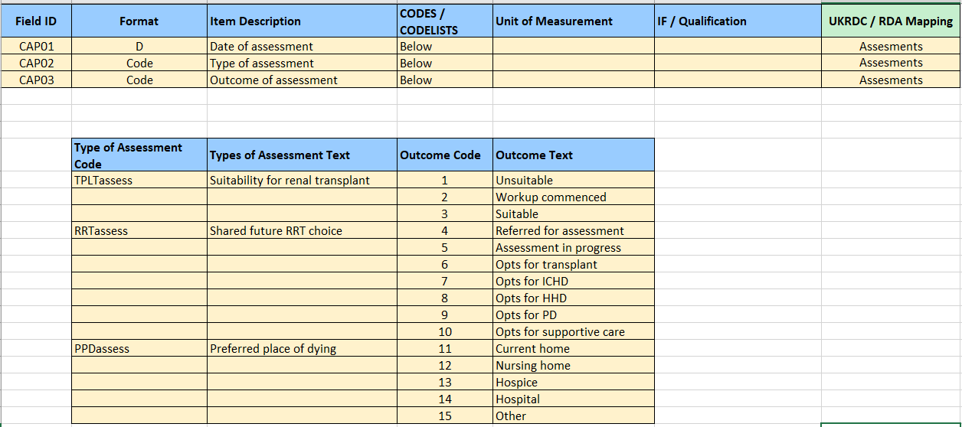
Step 7: National Measurement Strategy
Renal Registry Dataset v5 – Care planning
For data experts!
Transplant suitability & workup
Shared decision making
(transplant / dialysis / MCM)
Don’t worry about “preferred place of death” data unless you are focusing on conservative management

Slide 27

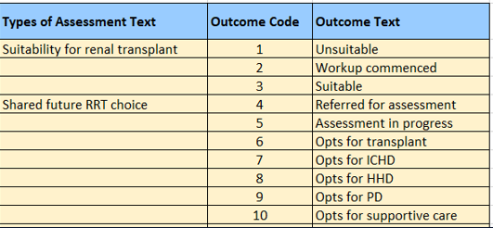
Step 7: National Measurement Strategy
How will pilot sites measure project impact?
Pilot sites – please try to pull off an initial “care planning” dataset for your AKC patients by 31/1/25:
Renal registry data (or similar)
  Identify AKC patients – are some missing?
  Patient demographics
  Date of entry into AKC clinic / service
  Care planning data fields
    Shared decision making for future treatment options
    Transplant workup
    Future dialysis treatment choice
  You may want to include more detail if it helps you

Slide 28
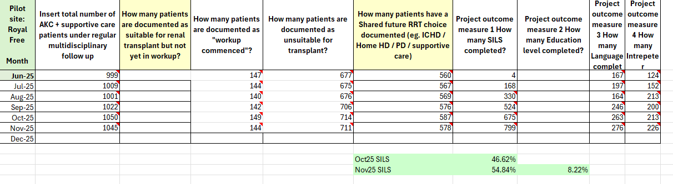
Step 7: Royal Free AKC/Project dataset - Jun 25-Dec 25

Slide 29
Step 7 – Local project measurement strategy
Define measures – year 1 Aim
Measure | Number or % Define numerator and denominator | Electronic or paper | Who is best person to collect the data | Sample size | How often (weekly/ monthly/ quarterly
No of patients with a SILS score (outcome measure) | % 60% of 1400 Total AKC pop | Electronic Vital data | Dave |  | monthly
Staff experience Pre/post staff survey 3-4 questions (30 staff) (process measure) | number | Electronic via teams' form | Janette | 30 | July (pre)

Slide 30
Step 7 – Local project measurement strategy
Define measures – year 1
Measure | Number or % Define numerator and denominator | Electronic or paper | Who is best person to collect the data | Sample size | How often (weekly/ monthly/ quarterly
Been invited to patient education session | numbers | Electronic spreadsheet | AKC team |  | 3x year
Attended a patient education session | numbers | Electronic Vital data | Dave |  | 3x year
Understanding why patients do not attend the education session |  |  | AKC team

Slide 31
Step 7 – Local project measurement strategy
Define measures – year 1
Measure | Number or % Define numerator and denominator | Electronic or paper | Who is best person to collect the data | Sample size | How often (weekly/ monthly/ quarterly
Attendance to clinic appointments (DNAs) 2 reporting methods
Treatment options
Language Level of education Interpreter | Numbers language field completed | Electronic Vital data | Dave |  | monthly

Slide 32
Step 8: Test change ideas using PDSA cycles

Slide 33
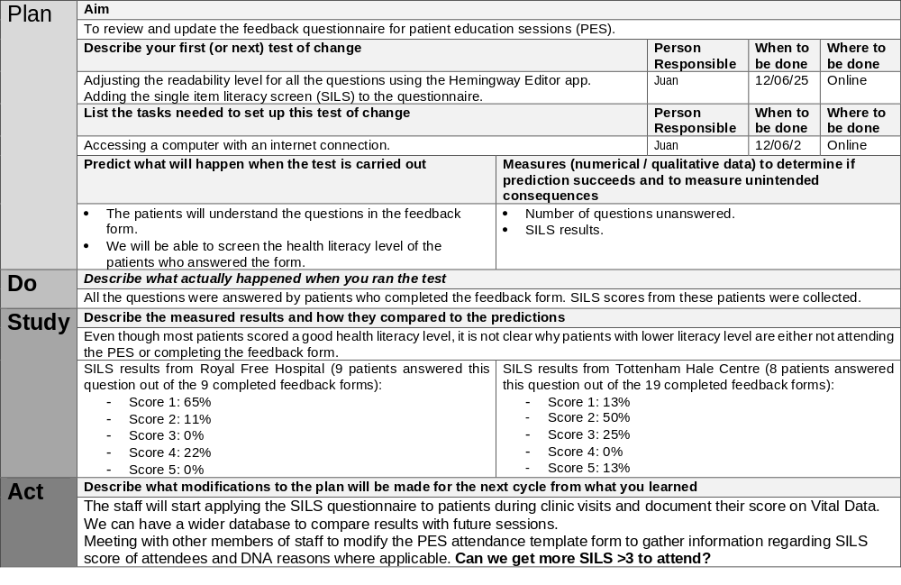
Step 8: Test change ideas using PDSA cycles
To review and update the feedback questionnaire for PES

Slide 34
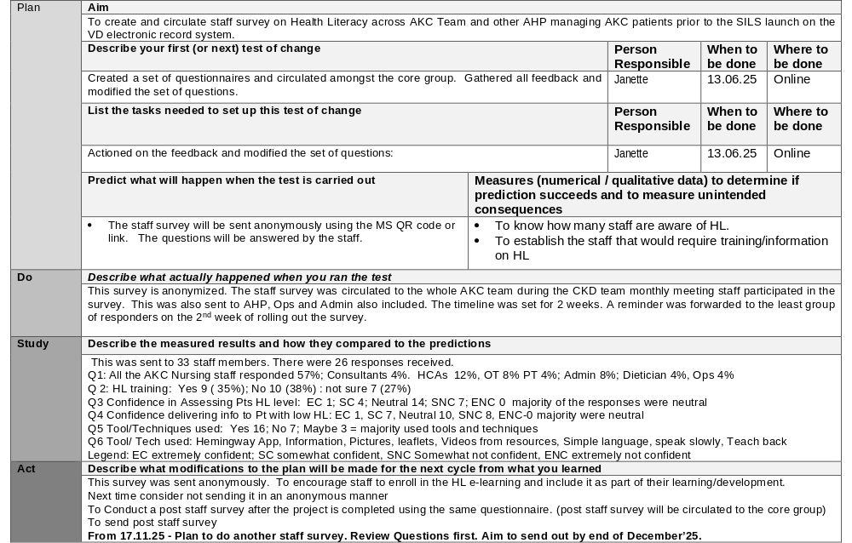
Step 8: Test change ideas using PDSA cycles – staff survey

Slide 35
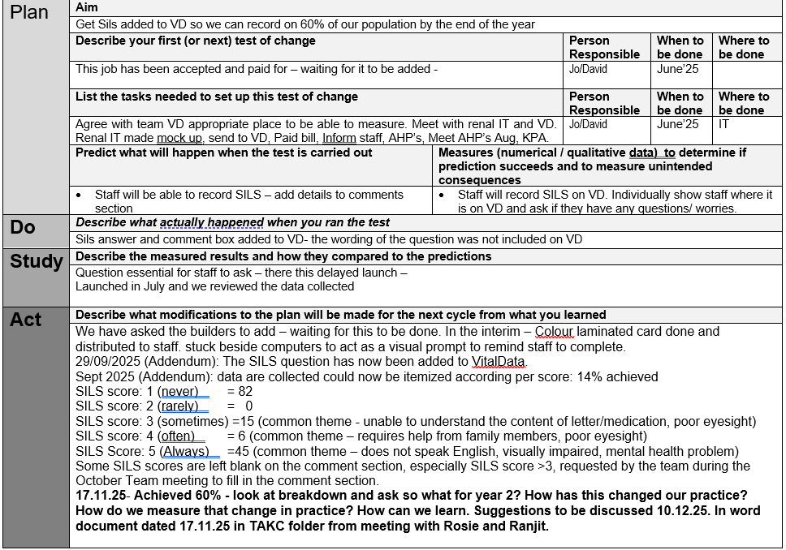
Step 8: Test change ideas using PDSA cycles – add SILS to Vital Data

Slide 36
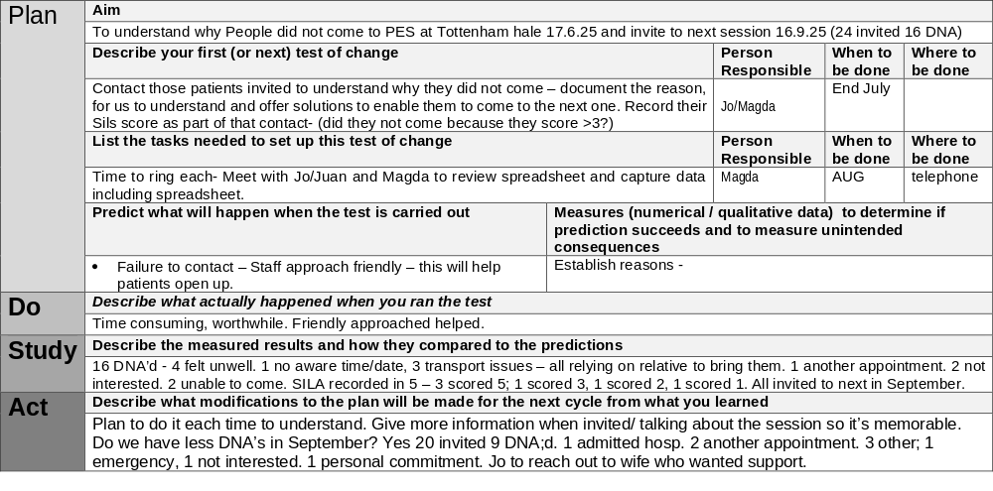
Step 8: Test change ideas using PDSA cycles
Understand why people did not attend PES at TH

Slide 37
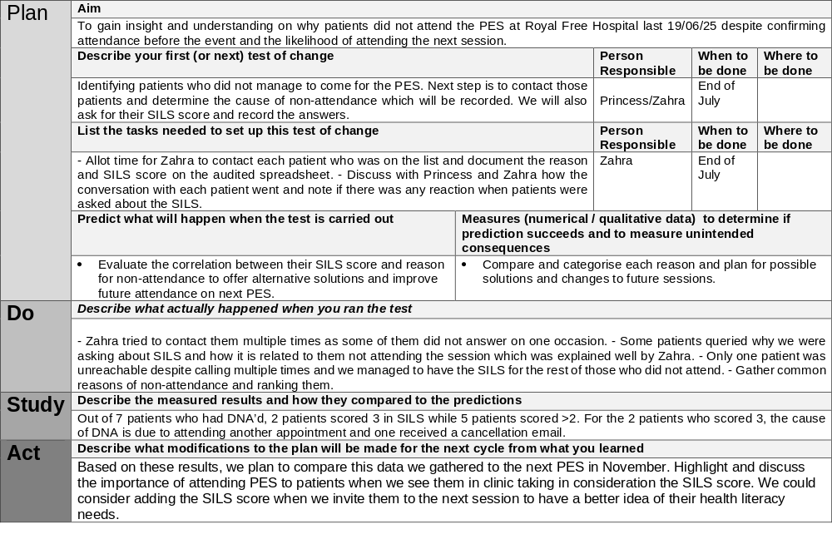
Step 8: Test change ideas using PDSA cycles why not attend PES at RF

Slide 38
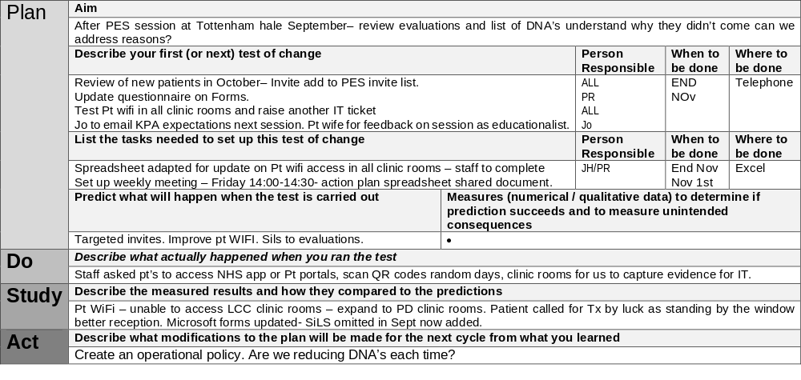
Step 8: Test change ideas using PDSA cycles
Review evaluations at TH

Slide 39
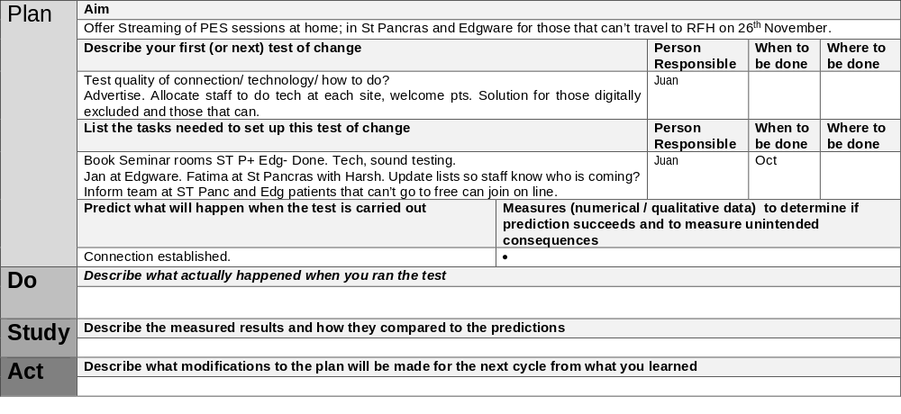
Step 8: Test change ideas using PDSA cycles
Offering live streaming of PES

Slide 40
Step 8: Patient education session PDSA’s Dec 2025
PDSA title | Date | Discussion | Next steps | Comments
Sending patient reminders | Dec 2025 | Although it’s takes time, staff are using the phone and via email. Also sending text messages | Continue but need to understand if this is working to increasing attendance | On going
Giving patients options for attending in person, local units or virtually | Dec 2025 | Plan A is to have patients attend in person. Plan B is patients attend on -line | Add into the invite email ‘in case you are unable to attend in person, please attend virtually either at home of in your local unit – here is the link:’ | On going
Review invite email and posters | Dec 2025 | Janette and Juan agreed to lead this PDSA. | Once final content version has been agreed with the team, to send to comms team and a few patients for comments | On going

Slide 41
Step 9: Display data over time to understand impact

Slide 42
SILS July to September report on VD (Target 10% monthly)
Step 9: Display data over time to understand impact

Slide 43
Data
PES Feedback
All attendees were satisfied or very satisfied.
64.7% had high health literacy, while 17.6% had good, and 17.6% had poor skills.
Reason for non-attendance:
- Mainly attributed to “distance related issues” (52.9%).
- Followed by “feeling unwell” and “forgetfulness” (23.55% respectively).
Quality of Information:
- 80% felt they were spoken to in a way they could understand
- 100% found the information helpful, specially hearing from other patients, observing dialysis equipment, dietary advice, and learning about conservative management.
Need for Improvement
The least helpful were low sound volume and bright lighting affecting screen visibility.

Slide 44
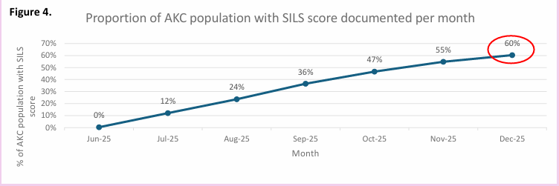
Step 9: Display date over time Jan 2026 presented at UKKW

Slide 45
Step 10: Sustain and share improvements

Slide 46
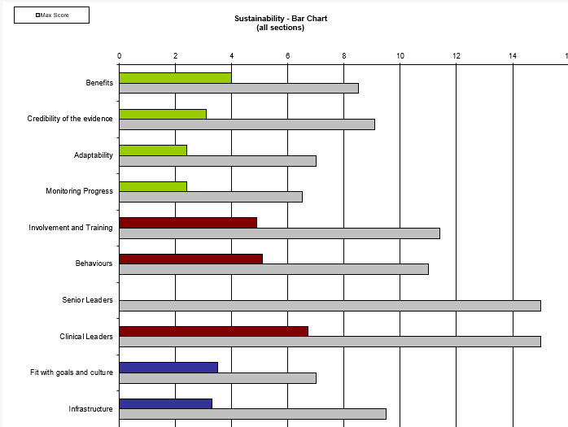
Step 10: Sustain and share improvements
Sustainability Model March 2026

Slide 47
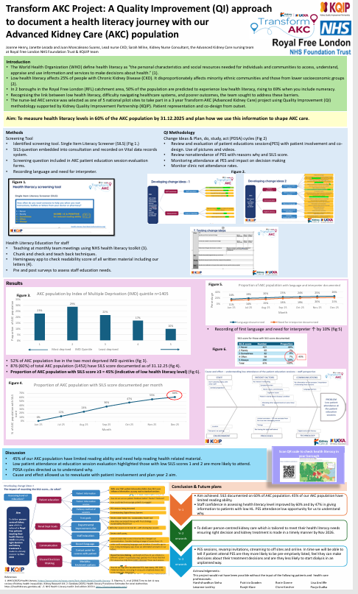
Step 10: Sustain and share improvements

Slide 48
Archive

Slide 49
Measurement checklist
Measure name – e.g. Shared future RRT choice
Why is it important? Understand whether progressing along care plan– if not why not? Target patients for action to improve care. If blank, why no data – try to fill in gaps Compare chosen and actual dialysis modality – root cause analysis (provide justification and links to organisation strategy) national targets, trust initiatives on frailty
Who owns the measure? eGFR>20 – CKD cohort; eGFR <20 AKC team – nurses complete page on Vitaldata (person responsible for making it happen)
Measure definition | What is the definition? eGFR<20 + rapidly progressing (spell it very clearly in words)
 | What data items do you need? See registry list for care planning items Date of encounter – clinic / education session
 | What is the calculation? words
 | Which patient groups are to be covered? Do you need to stratify? (clinic location – all 4 AKC clinic locations)
Goal setting | What is the numeric goal you are trying to achieve? 90% of eGFR <15 to have commenced shared decision making
 | Who is responsible for setting the goal? AKC team – Joanne, Sarah etc.
 | When will it be achieved by?

Slide 50
Measurement - Process
Measure name - e.g. Shared future RRT choice
Collect | Is the data available? yes
 | Who is responsible for the data collection? AKC nurses + doctors enter data
 | What is the process for collecting the data – monthly RAG report – may need separate report
Analyse calculate measure & present results | What is the process for presenting data? Jan creates charts and presents to team quarterly report + longer annual report (Run chart, excel bar chart)
 | Who is responsible for the analysis? AKC team
 | How often is the analysis completed? Monthly (some) – quarterly - annually
Review | Where will the decisions be made based on results?
 | Who is responsible for acting on results?

Slide 51
Royal Free
Patient education
& health literacy
Action plan should be agreed with your improvement team
List achievable actions and set dates for completion.
Once 90 days over – restart with 30/60/90 planning.
Use at every improvement team meeting asking are we on track? Anything else we need to do? Are the dates still achievable?
Within | We want to achieve … (actions) | We want to complete this by … (insert date)
30 days | Meet Kerry Lee (PhD student) about health literacy project Find out where we document language – what is it Who interprets for the patients – how do we identify whether they need it NHS tracker – will tell you the reading age (NHS readability checker) Confirm SILS as health literacy screening tool with AKC staff Work with David (data manager) to get SILS onto Vitaldata | 15/2/25
60 days | Test use of SILS tool in AKC (PDSA cycle – review what worked well and limitations – ? adjust / different tool) Team training around use of tool Raise awareness more widely in renal team / NHS trust Look at pre clinic leaflet – is it being sent out? Did they get it? Very dense/lots to do/ format to make action clearer/2nd part of letter Did they read it? You are welcome to bring someone with you Ask patients for feedback on preclinic letter | 15/3/25
90 days | Get SILS onto vitaldata ? Redesign preclinic leaflet | 15/3/25

